Slide 1

Data Science for Good: Combating Sexual Violence in NYC
Varsha Garla
Metis | Business Fundamentals | August 2021

Slide 2

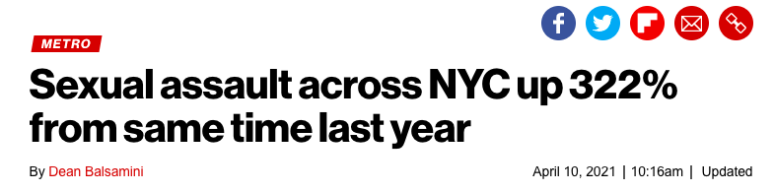
The Problem
Sexual violence has a devastating impact on victims’ mental and physical health
Reports of sexual violence were on the rise in NYC from 2013 to 2018
NY Post

Slide 3


Opportunity
Develop a data-driven approach to
Prevent cases of sexual violence
1
Allocate support/resources to victims
2

Slide 4

Solution
Build an interpretable linear regression model that will identify factors that increase the risk of sexual violence cases.

Slide 5



Methodology
Data
Cleaning/EDA
Visualization
NYPD Crime Complaint Data Historic
2010-2019
Rape and sex crime offenses

Slide 6
Insights: Who?

Slide 7
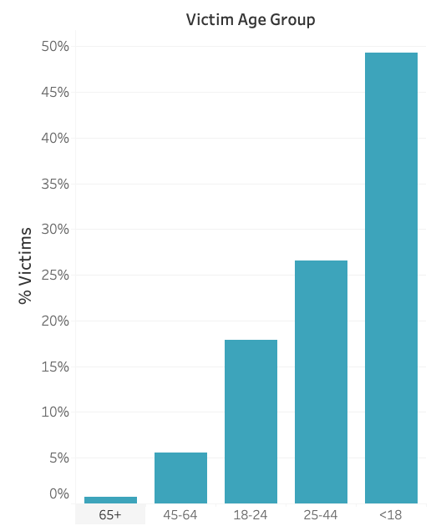
Most victims are minors or between 25 and 44 years old
*4.4% victims’ age Unknown

Slide 8
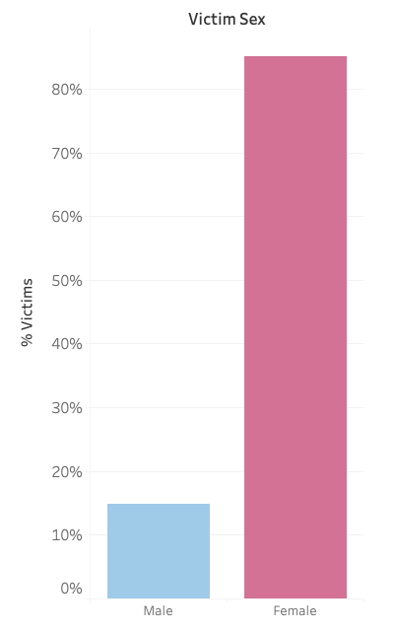

85% of all victims are female…

Slide 9
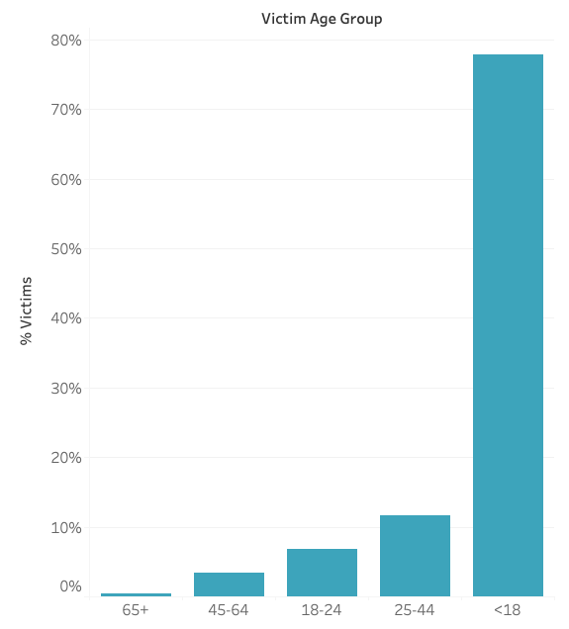

…but across all males, ~80% are minors
*8.7% male victims’ age Unknown

Slide 10
Insights: When?

Slide 11
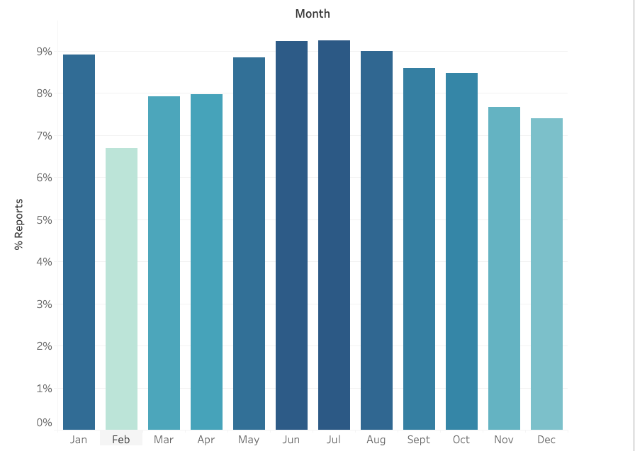

Most reports are from the summer

Slide 12
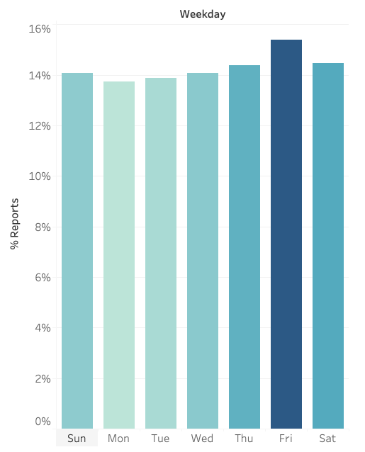

Cases occurred most on Friday

Slide 13
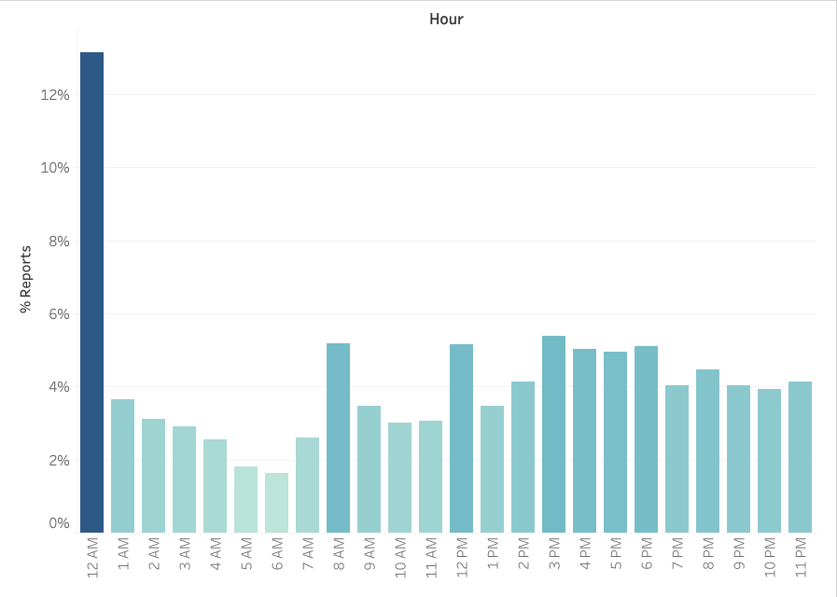

…cases occur most between midnight & 1am

Slide 14


Conclusions
Potential predictors of higher risk
Recommendations
Increase NYPD patrolling at identified times
Train counselors at Safe Horizon to support victims of different sex and age

Slide 15

Future Work
Use recent report data in addition to historic data to find more patterns
Build interpretable linear regression model

Slide 16
Thank you
Questions?

