Slide 1

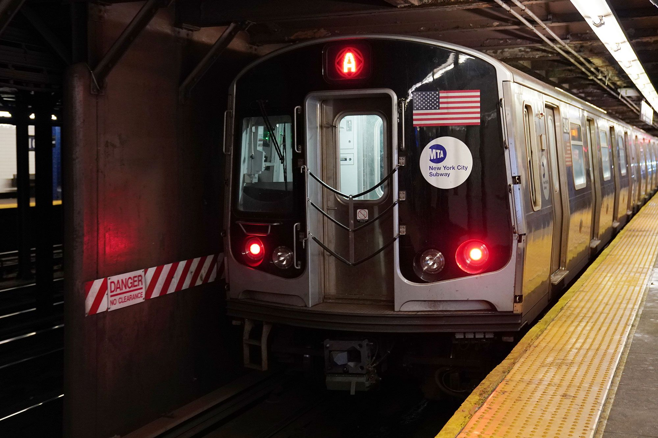

Socioeconomic Status and MTA Ridership Decline during pandemic
Varsha Garla
Metis project 1
July 23, 2021

Slide 2
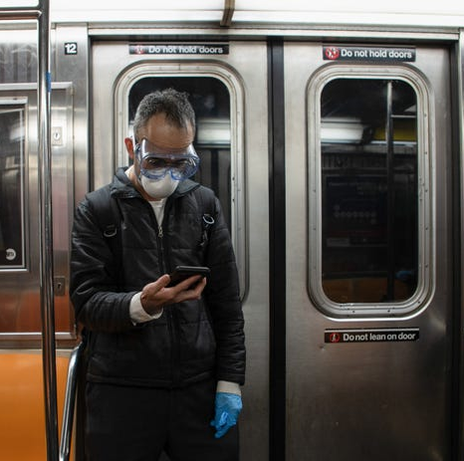
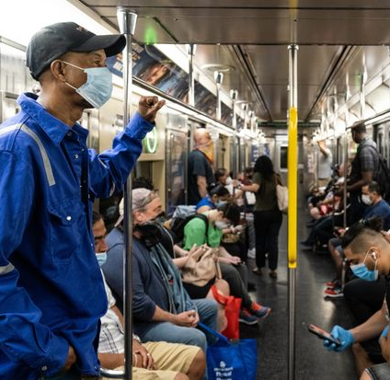
Did socioeconomic status affect subway ridership decline?
March 7th: State of emergency
March 14th: first covid-19 deaths in NY
March 20th: NY Pause
1-3 million riders in February → 10% in march 2020

Slide 3

methodology

Slide 4


data
Metrics
Percent change subway usage
MTA turnstile data for March, April, May 2020
Median Household Income (2006-2010) by zip code

Slide 5







Tools

Slide 6
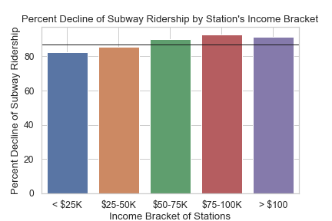
Results
87%
85%
90%
93%
91%
83%

Slide 7
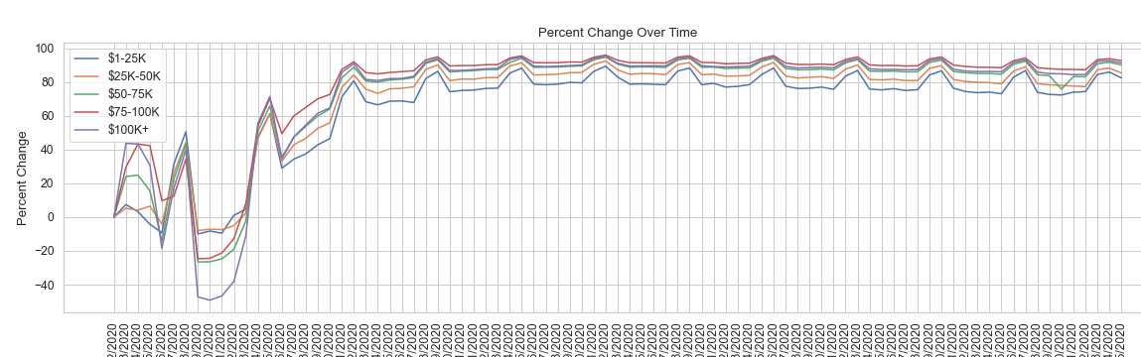
Results

Slide 8
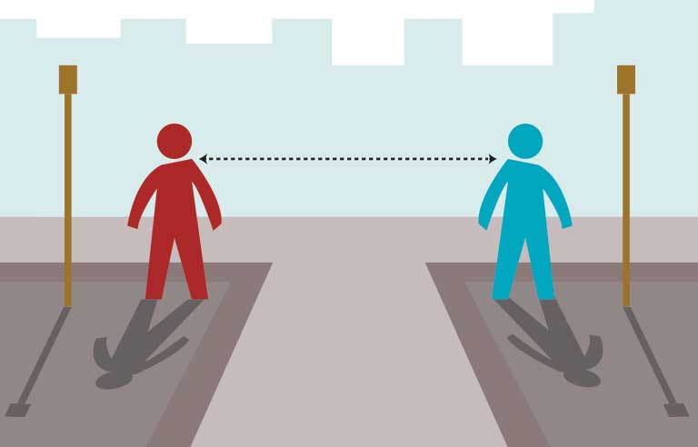
Conclusion
lower-income zip codes in New York City did not experience as large of a decrease in ridership as higher-income zip codes
more crowded subways, and easier spread of COVID-19

Slide 9

Future Work
Statistical significance
Recent income data

Slide 10
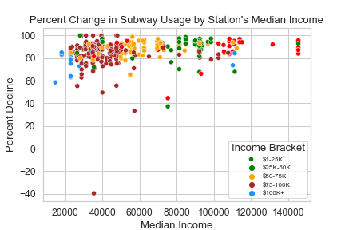
Appendix

Slide 11
credit
Collaborated with Metis Peer, Sam Reiff, on compiling zip codes of stations in data set
https://github.com/reiffs
MTA turnstile data
http://web.mta.info/developers/turnstile.html
Median income data (2006-2010) by zipcode
https://www.psc.isr.umich.edu/dis/census/Features/tract2zip/
University of Michigan Population Studies Center

