Slide 1

Scientific Paper Recommender
Varsha Garla
Metis | September 2021 | NLP & Unsupervised ML

Slide 2
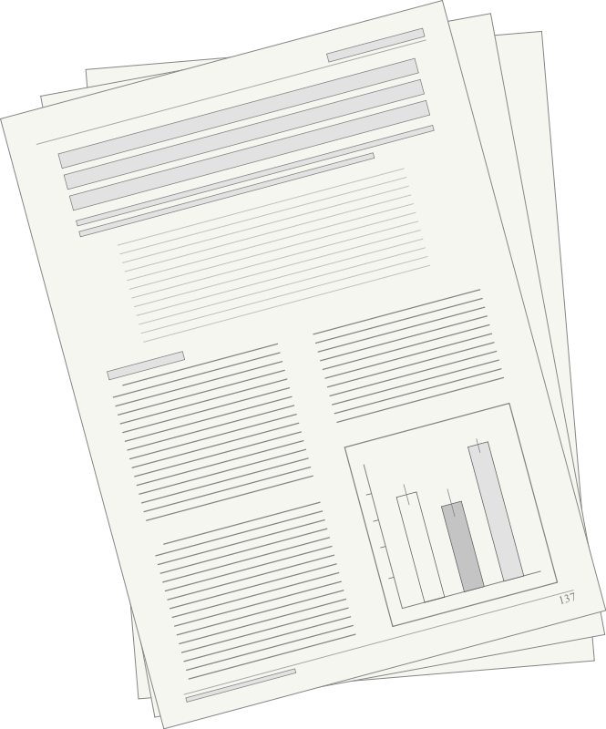
Motivation
Researchers constantly need relevant literature
Tag-based search results
Citations
Another advantage:
newer articles get discovered
Keyword tag
References
CITE
CITE
Other Articles
Other Articles
Notes:
CITE → other articles
Other articles → CITE

Slide 3
Objective
Use unsupervised learning & NLP to optimize this!
Build recommendation system
Recommended
Notes:
CITE → other articles
Other articles → CITE

Slide 4
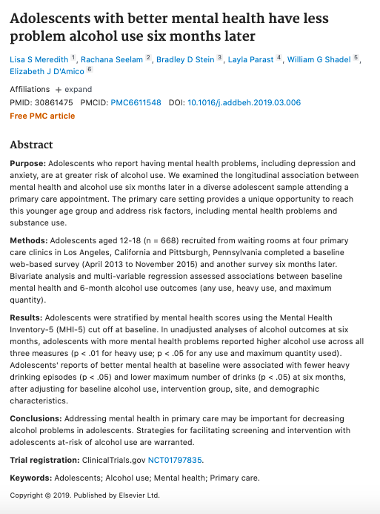

The Data
tobacco
alcohol
9, 719 abstracts from 2015 to 2019
Containing keywords: 726

Slide 5





Methodology
Clean and preprocess text
Tokenize
Lemmatize
Remove adverbs
Custom and English stopwords
Build topic model
Dimensionality Reduction
Content-based recommendation system
Cosine Similarity Function
Notes:
Final model

Slide 6
Topics
Depression | Diagnosis of Psychiatric Disorders | Alcohol/Smoking & BMI
Tobacco National Health | ADHD & Suicidal Ideation | Mental Health & Violence
Treatment/Intervention | ADHD & Drug Use | PTSD
Notes:
Animation with word clouds transitioning into topic names

Slide 7
Recommendation System
TF-IDF Vectorizer
Latent Semantic Analysis (LSA) Model
9 Topics
Unigrams and bigrams
Min doc frequency = 0.01 (~10 articles)
Max doc frequency = 0.9 (~650 articles)

Slide 8
Example of Recommendation
Parental violence and alcohol in adolescents
Depression: 0.05
Diagnosis of Psychiatric Disorders: -0.05
Alcohol/Smoking & BMI: -0.01
Tobacco National Health: -0.04
ADHD & Suicidal Ideation: 0.06
Mental Health & Violence: 0.06
Treatment/Intervention: -0.01
ADHD & Drug Use: -0.06
PTSD: 0

Slide 9
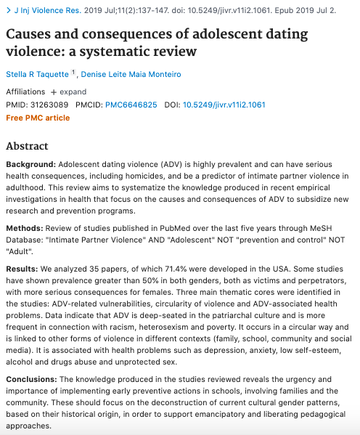
Example of Recommendation
Parental violence and alcohol in adolescents
Recommendation #1
Depression, anxiety, alcohol and drugs abuse

Slide 10
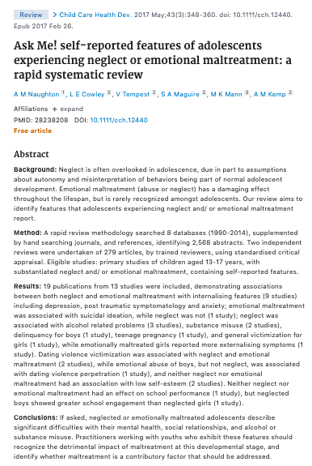
Example of Recommendation
Parental violence and alcohol in adolescents
Recommendation #2
Depression, post-traumatic, suicidal ideation, alcohol, substance misuse, dating violence

Slide 11
Future Work
Deploy recommendation system as an app
Create user profiles (collaborative-based)
Full-text articles
More data & research domains

Slide 12
Thanks!
Any questions?
You can find me at:
varsha.garla@gmail.com

