Slide 1
Digital portfolio
Student name:varsha.k
Register no and nmid :36424Uo9100al and astvu346m24381
Department :BCA
College :m.m.e.s women arts and science college/university: thiruvalluvar

Slide 2
Agenda Slide Problem Statement Project Overview End Users Tools and Technologies Portfolio Design and Layout Features and Functionality Results and Screenshots Conclusion GitHub Link

Slide 3
Project title: digital portfolio

Slide 4
Problem Statement Explain the issue or challenge that the digital portfolio aims to solve Example: Lack of a centralized place to showcase student projects and skills

Slide 5
4️⃣ Project Overview Summarize the purpose and objectives of the digital portfolio project Example: A web-based platform to present academic achievements, projects, and skills effectively

Slide 6
End Users List target users of the digital portfolio ➔ Students ➔ Employers ➔ Educational Institutions

Slide 7
Tools and Technologies Technologies used to develop the portfolio ➔ HTML, CSS, JavaScript ➔ GitHub for version control ➔ Any other tools (like Bootstrap, Node.js if applicable)

Slide 8
Portfolio Design and Layout Discuss the design approach ➔ Responsive Design ➔ Simple Navigation ➔ Clean User Interface (UI) ➔ Organized Sections: About Me, Projects, Skills, Contact

Slide 9
Features and Functionality Key features of the digital portfolio: ✅ Responsive Layout (mobile & desktop) ✅ Project Showcase with images and descriptions ✅ Contact Form ✅ Downloadable Resume ✅ Links to GitHub & LinkedIn profiles

Slide 10
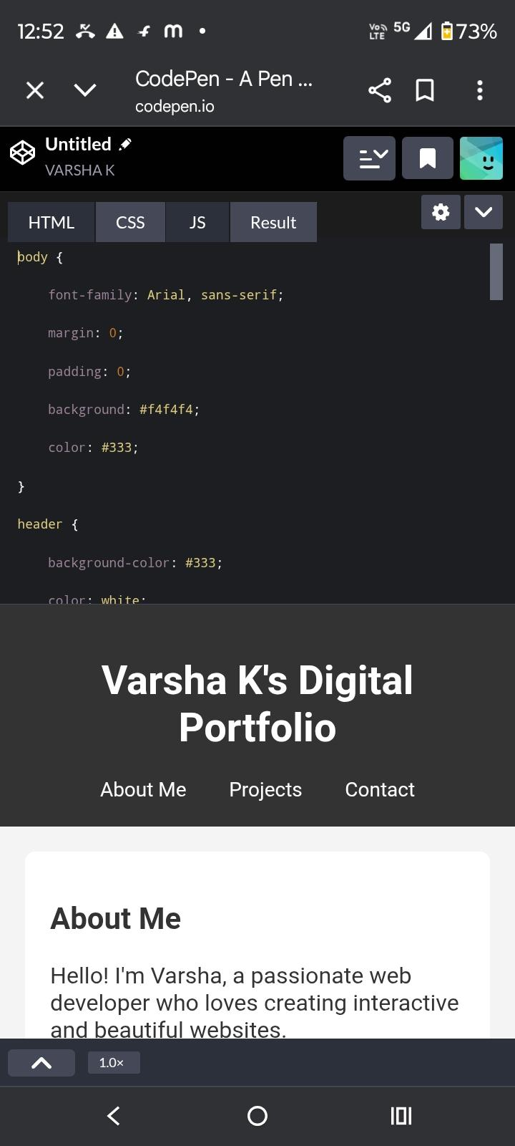
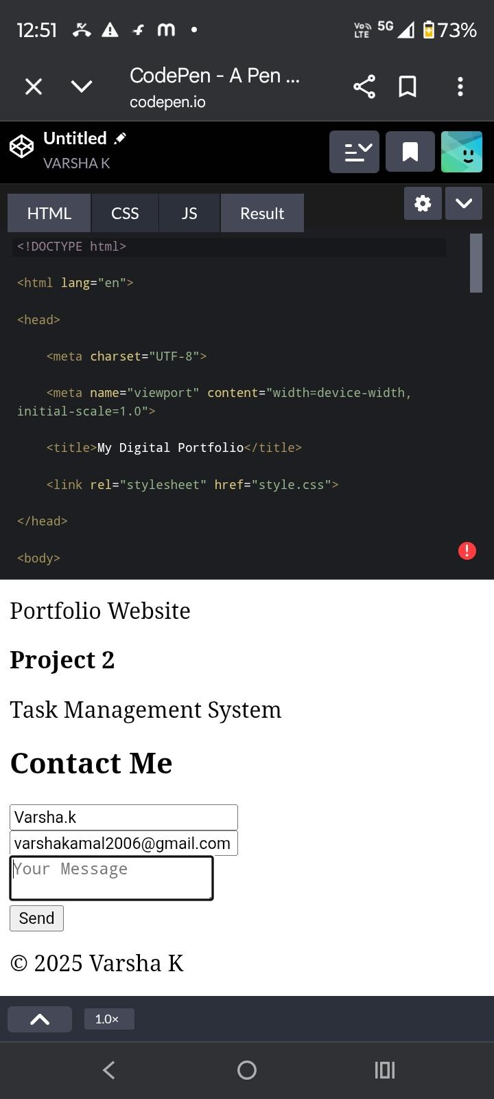
Results and Screenshots

Slide 11
🔟 Conclusion Summarize the project outcome ➔ A user-friendly platform to display skills and projects ➔ Improved digital presence for students ➔ Easier access for employers to assess candidates

Slide 12
GitHub:
https://varshakamal2006-lab.github.io/Digital-portfolio-/

