Slide 1
DG INTERNS HUB
WEEK 5 – VAPT PRACTICAL LEARNING
Nmap • Nikto • Burp Suite
Submitted By: Varsha Kammari
Department: Cybersecurity
DRK College of Engineering and Technology
Submission Date: 20 September 2026

Slide 2
PROJECT OVERVIEW
Objective
Targets
Tools
Learn basic VAPT by scanning an authorized vulnerable web application and interpreting results.
Nmap: testphp.vulnweb.com
Burp evidence: testasp.vulnweb.com
Nmap – network scanning
Nikto – web-server checks
Burp Suite – HTTP inspection
Testing was performed only on the internship-provided lab sites.
Evidence was collected from terminal output and Burp Suite.
Only findings supported by the evidence are reported.
2

Slide 3
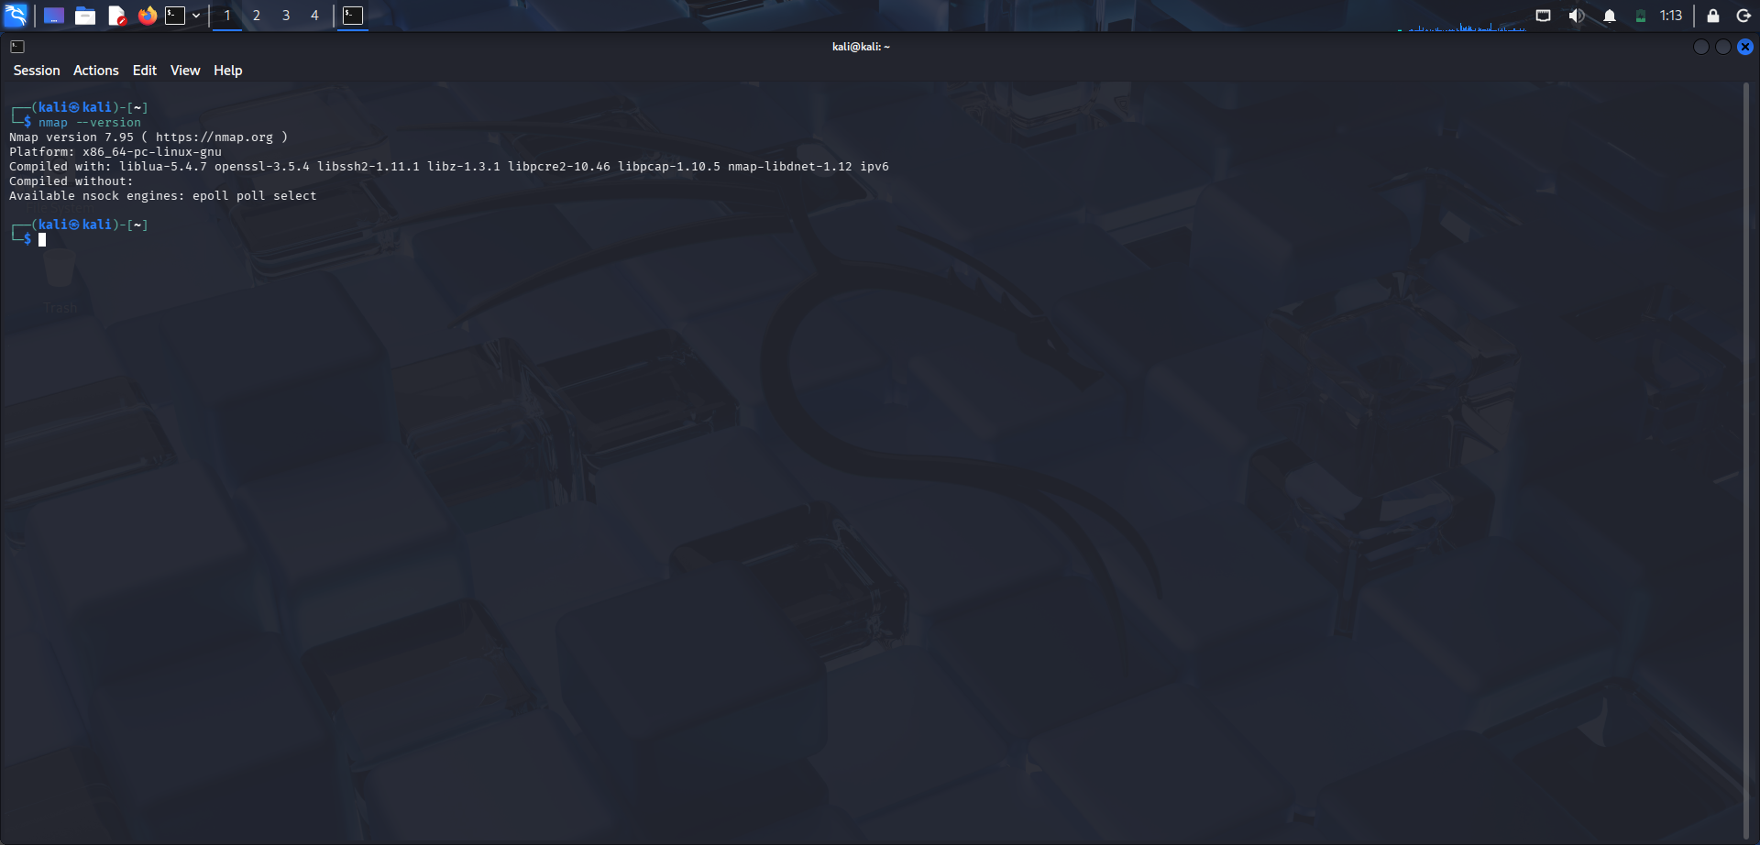
NMAP – NETWORK SCANNING
Nmap 7.95 was verified on Kali Linux.
SYN scan (-sS): host reachable; 1000 TCP ports filtered.
Service scan (-sV): no service/version identified.
Aggressive scan (-A): OS detection was unreliable.
Security Observation
No exposed open TCP service was confirmed in the default 1000-port scan.
3

Slide 4
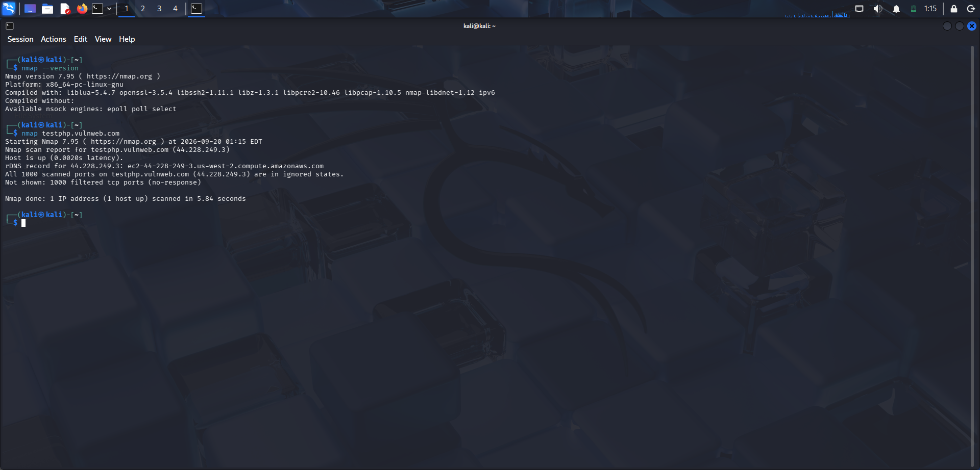
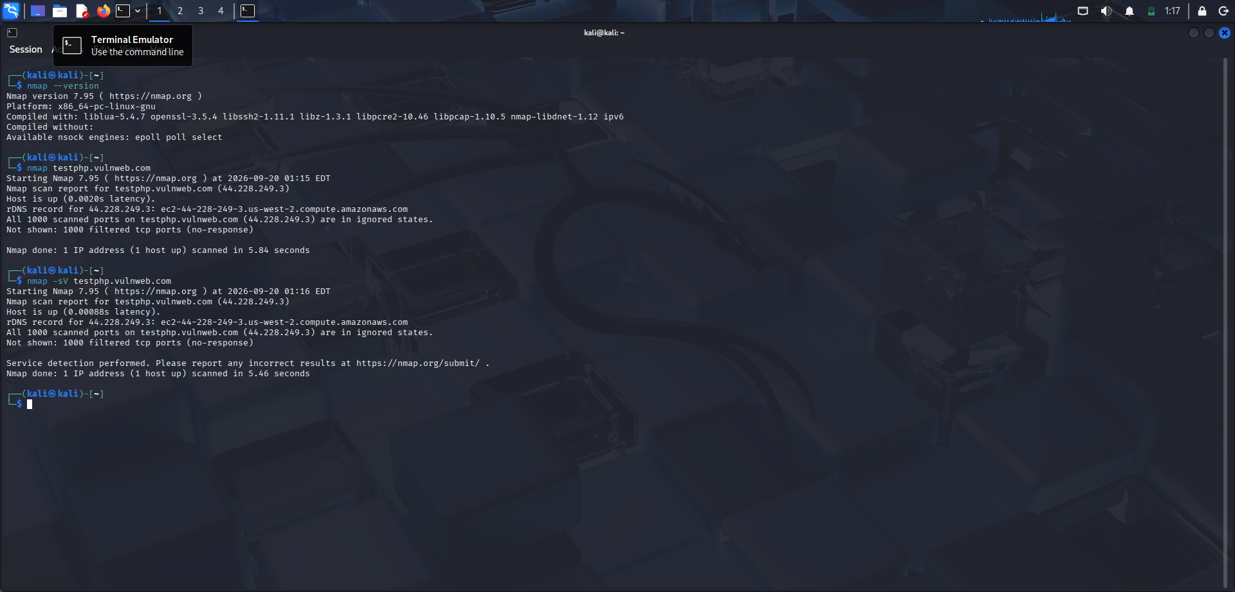
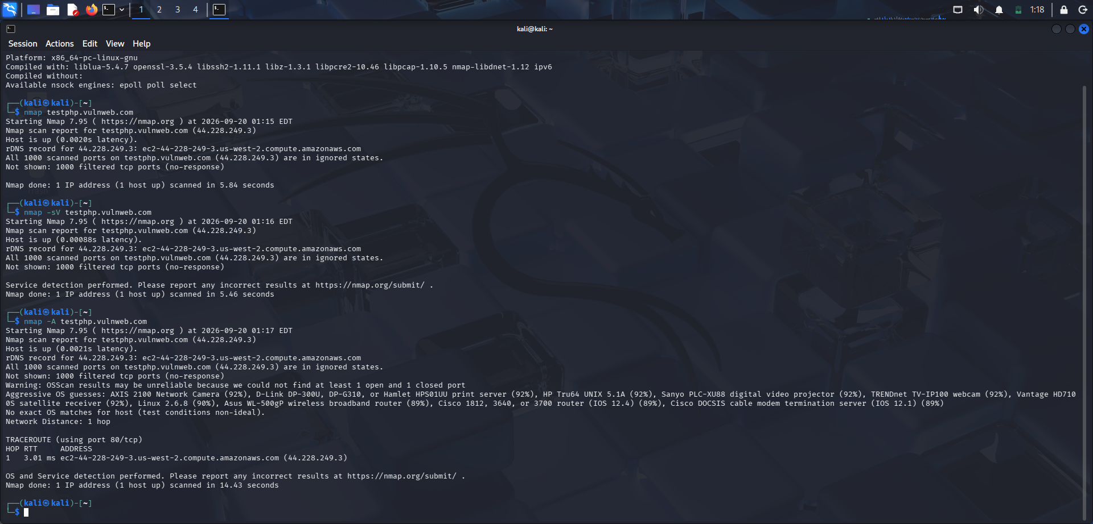
NMAP EVIDENCE
-sS SYN Scan
-sV Service Scan
-A Aggressive Scan
4

Slide 5
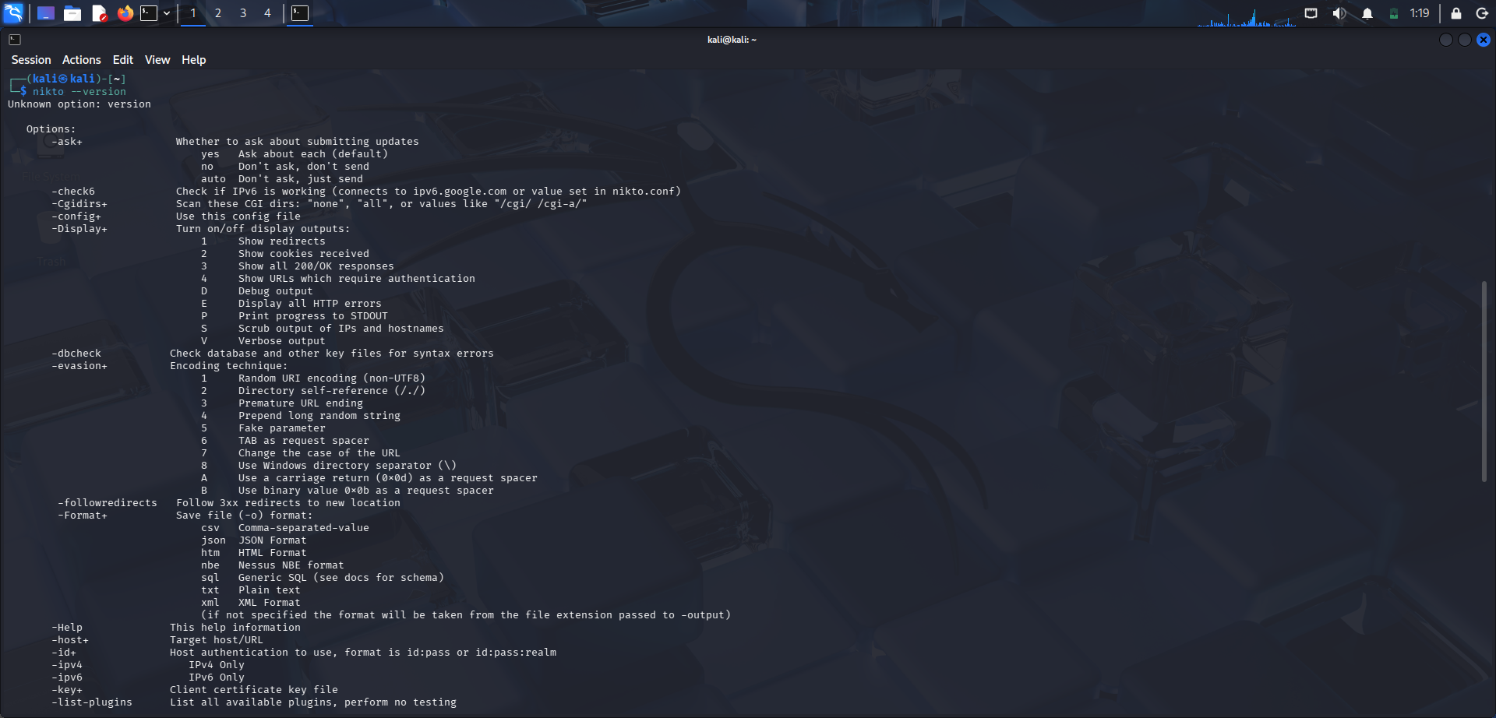
NIKTO – WEB VULNERABILITY SCAN
Nikto checks web servers for common security issues.
The supplied evidence shows the Nikto options/help screen, not a completed scan.
Therefore, no Nikto vulnerability is claimed as confirmed.
A valid scan should record target, command, timestamp and screenshot.
5

Slide 6
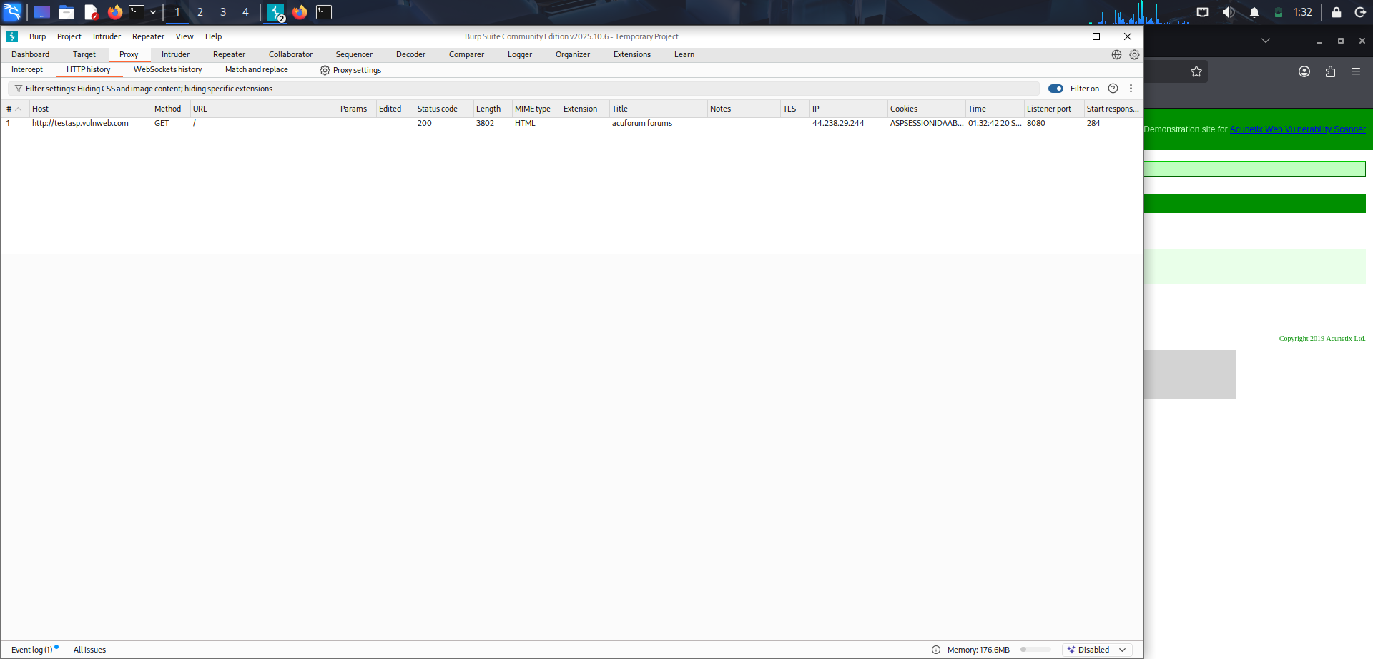
BURP SUITE – HTTP INTERCEPTION
Proxy listener configured on 127.0.0.1:8080.
Browser traffic was captured in HTTP history.
Captured request: GET / with HTTP 200 OK response.
Headers and session-cookie information were available for review.
6

Slide 7
FINDINGS & CONCLUSION
Finding 1 – HTTP
Finding 2 – Server Info
Finding 3 – Cookie Review
The captured request used HTTP, not HTTPS, in the supplied evidence.
The response exposed server/framework information such as Microsoft-IIS and ASP.NET.
A session cookie was observed; its security attributes should be reviewed.
Nmap confirmed the host was reachable but did not confirm an open TCP service.
Burp Suite showed practical HTTP request, response, header and cookie analysis.
The exercise demonstrated evidence-based VAPT reporting.
Nikto results should be added after completing a valid scan.
Conclusion: The practical improved understanding of basic VAPT workflow and security evidence.
7

