Slide 1
Dependancies
Lombok
Spring web
Spring security
jjwt
spring data JPA

Slide 2
Entity
User
Repository
UserRepo extends JPA
Controller
MyController
Service
UserService

Slide 3
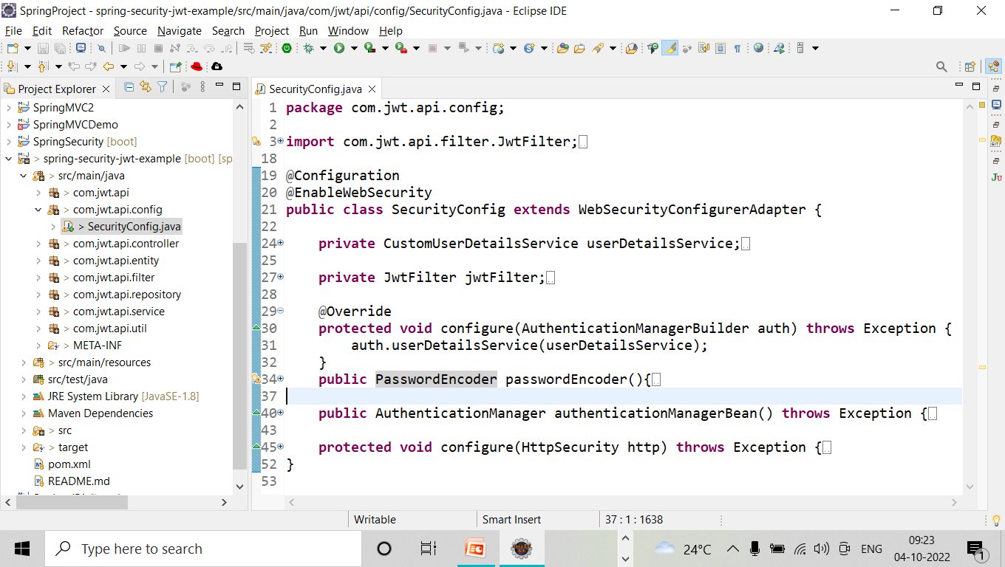
SecurityConfig class

Slide 4
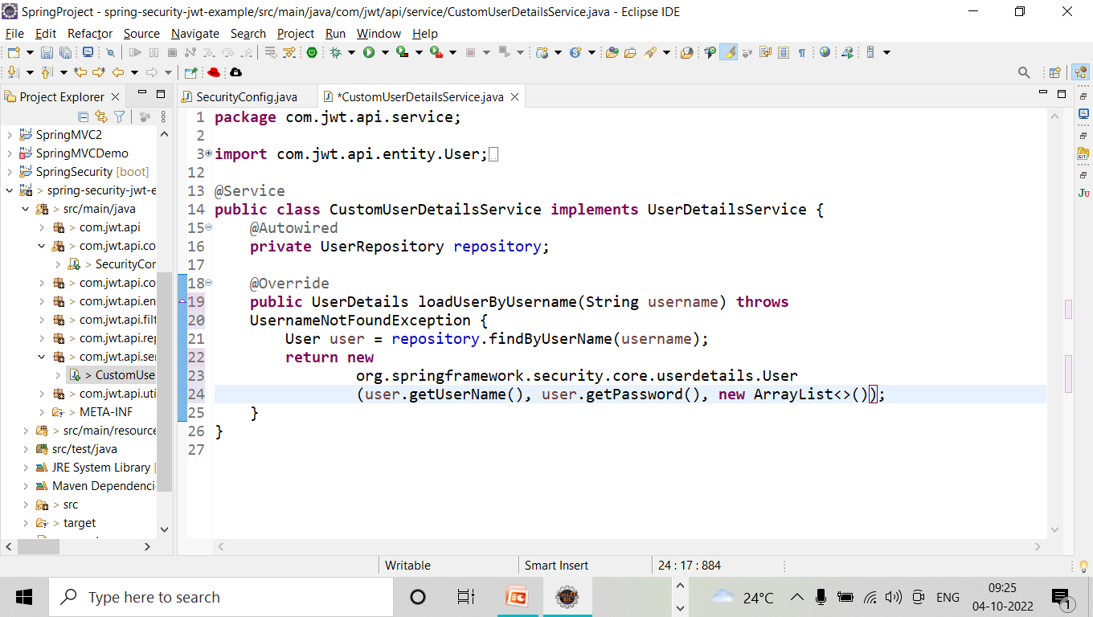
CustomUserDetailsService

Slide 5
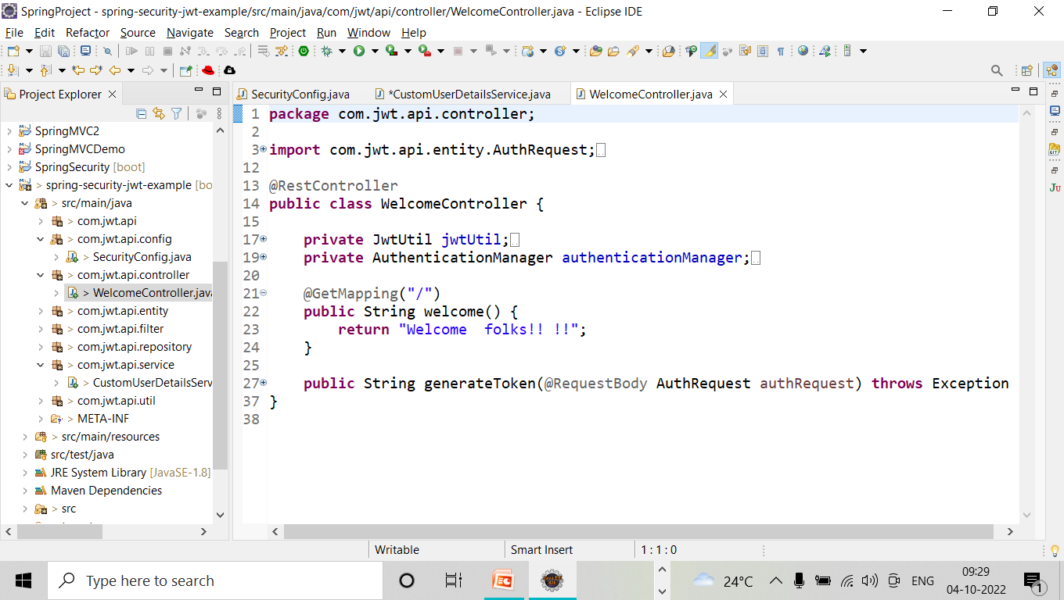
WelcomeController

Slide 6
SecurityConfig
@Bean
public PasswordEncoder passwordEncoder(){
return NoPasswordEncoder.getInstance()
}

Slide 7
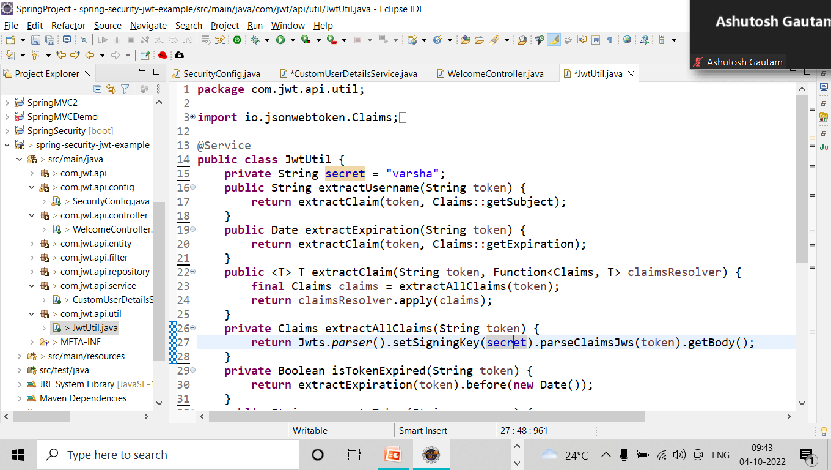
Create Token and Generate Token jwtutil class

Slide 8
Add post in Welcome Controller
@PostMapping("/authenticate")
public String generateToken(@RequestBody AuthRequest authRequest) throws Exception {
try {
authenticationManager.authenticate(
new UsernamePasswordAuthenticationToken(authRequest.getUserName(), authRequest.getPassword())
);
} catch (Exception ex) {
throw new Exception("inavalid username/password");
}
return jwtUtil.generateToken(authRequest.getUserName());
}

Slide 9
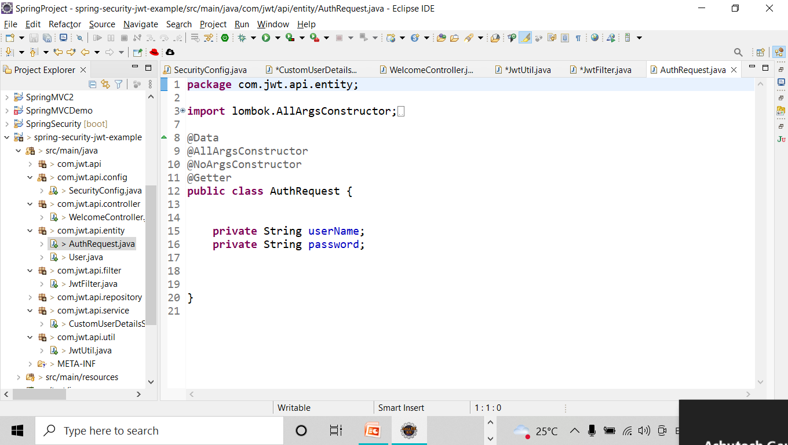
Pass values to post method

Slide 10
Security Config
@Override
protected void configure(HttpSecurity http) throws Exception {
http.csrf().disable().authorizeRequests().antMatchers("/authenticate")
.permitAll().anyRequest().authenticated()
.and().exceptionHandling().and().sessionManagement()
.sessionCreationPolicy(SessionCreationPolicy.STATELESS);
http.addFilterBefore(jwtFilter, UsernamePasswordAuthenticationFilter.class);;
}

Slide 11
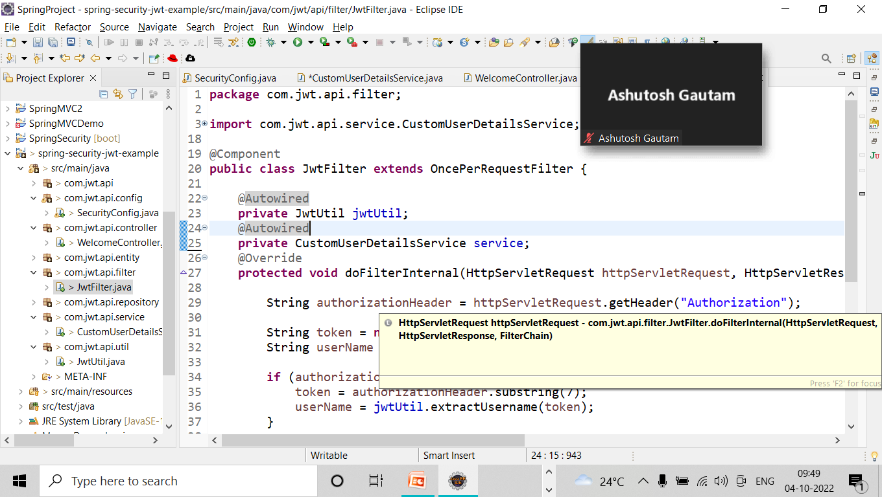
jwtFilter

