Slide 1
Education Over Censorship

Slide 2
Misinformation and Feed Manipulation
How do we stop fake news spreading?
News can be subjective. Who’s to say what’s fake?
Freedom of Speech. Is fake news a 1st amendment right?
how do we stop automated tools from artificially amplifying misinformation in ways that create false waves of public opinion?
Public opinions are created by humans not machines.
Educating the humans might be a better solution than censoring them

Slide 3
Add Information
Upstream:
Post #1: 2+2=6
Post #2: 2+2=4
Downstream: (scenario A)
Post #1 reposted = 2+2=6
Downstream: (scenario B)
Post #1 reposted = 2+2=6 or 2+2=4

Slide 4
Algorithm
2+2=6 is being reposted
Algorithm recognizes X + Y = Z
Searches for X + Y where X and Y are the same but Z is different
Finds 2+2=4
Adds the match to the repost
Creates Downstream: (scenario B)
Post #1 reposted = 2+2=6 or 2+2=4

Slide 5
Benefits
Free-flow of information. (no 1st Amendment violations)
Additional information added to let the humans know that there are conflicting opinions.
This can also inform experts
Decreases the chances that misinformation will be propagated out of ignorance.
Also helps with the bubble problem

Slide 6
Machine Learning Algorithms
There may be hundreds or even millions of assertions regarding the sum of 2+2.
Machine learning algorithms can apply ratings to the assertions based on numerous things…
Simple math: 100% certainty
Consensus: 1% to 100% certainty
A repost can add the 100% certainty or the next best.
A report can also add a link to a list of alternate assertions

Slide 7
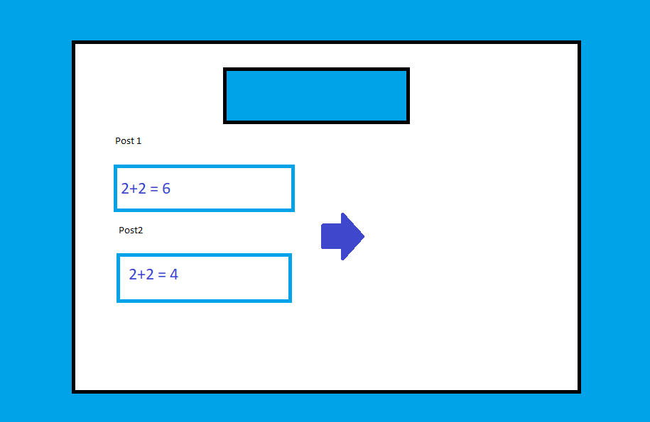



Slide 8
