Slide 1

FINDYOURSPACE (A real estate chatbot)
by :
1)Riddhi Pandya
2)Priyanka s
3)Rithin Nagaraj
4) Varsha KUSUMADHARA KODI
Future wannabe corporate slaves
Ai**

Slide 2
Problem Statement : Create a personalised Chatbot. ( a chatbot that preferably solves a real Life problem)
SOLUTION: We have aimed to create a personalized chatbot that helps customers find properties in Bangalore. Instead of visiting real estate agents time and again, they can use this chatbot to know available properties. Findyourspace generates output based on the user's specifications, such as the desired Location, specific BHK, amenities etc. The chatbot not only saves our time but also provides at least 3-4 available properties per locality. Overall, findyourspace is an affordable, easily accessible, user-friendly alternative to the conventional real estate practice.

Slide 3
The modules used :
1) OpenAIEmbeddings
2) LLMChain
3)OpenAI
5)PromptTemplate
6) ConversationBufferMemory

Slide 4
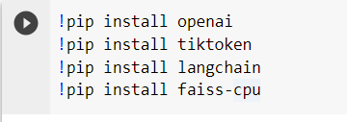
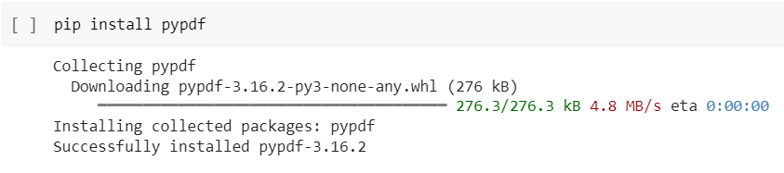
The flow of the code : the cool part

Slide 5
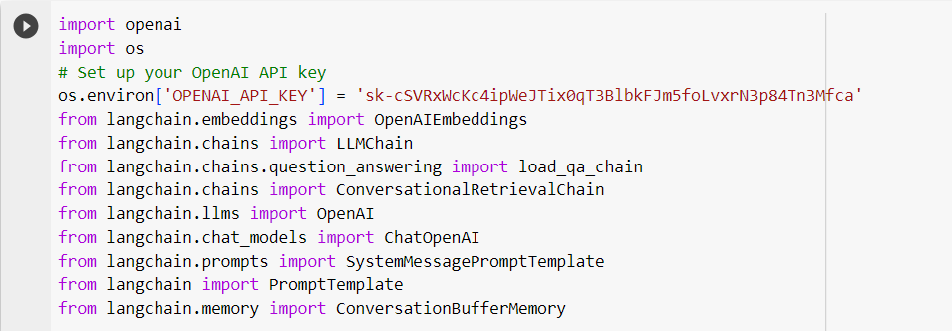
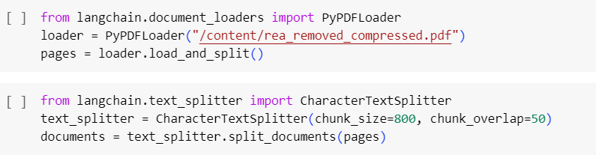
The flow of the code : the cool part

Slide 6
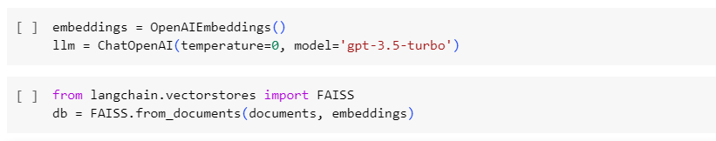
The flow of the code : the cool part

Slide 7
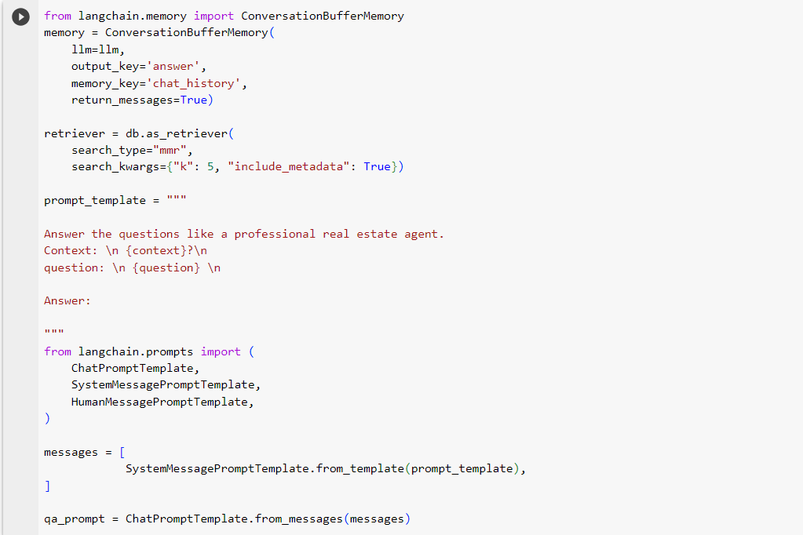
The flow of the code : the cool part

Slide 8
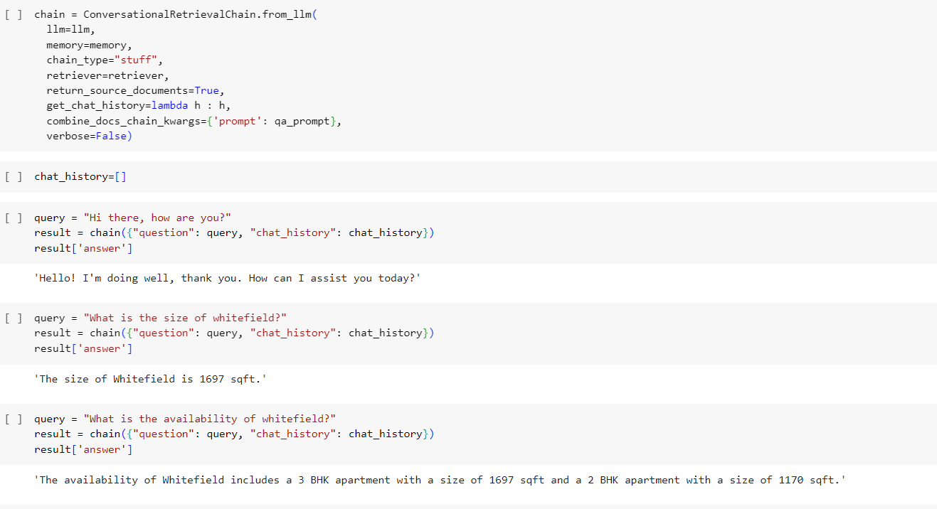
The flow of the code : the cool part

Slide 9

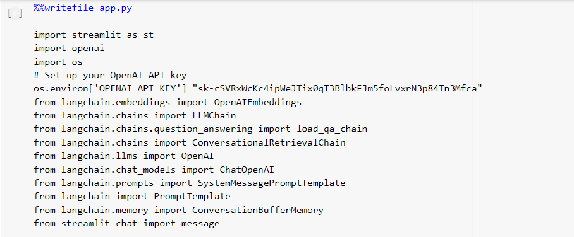
The flow of the code : the cool part

Slide 10
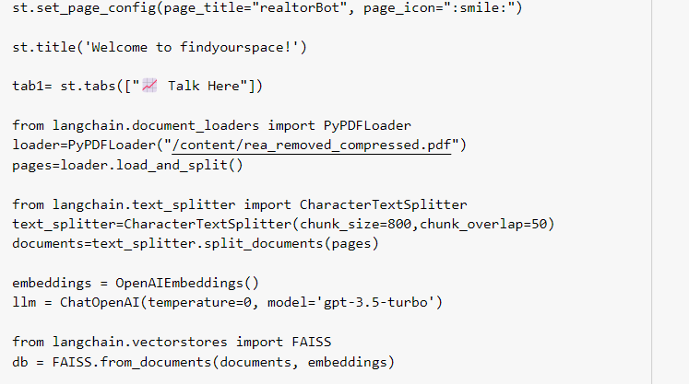
The flow of the code : the cool part

Slide 11
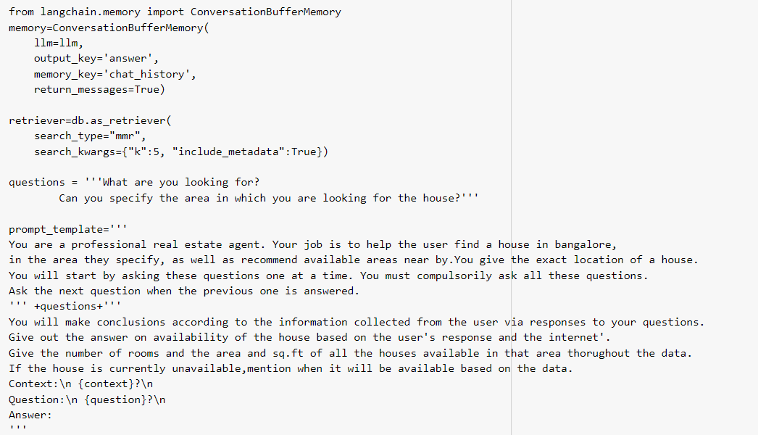
TEMPLATE

Slide 12
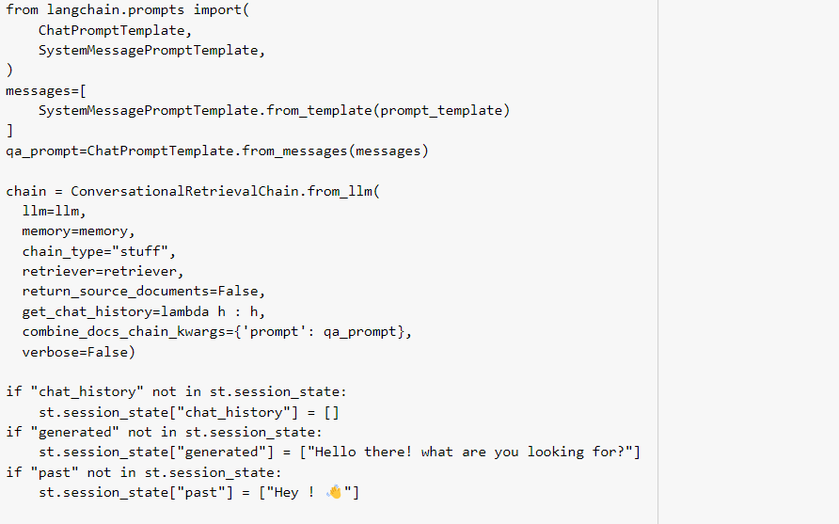
The flow of the code : the cool part

Slide 13
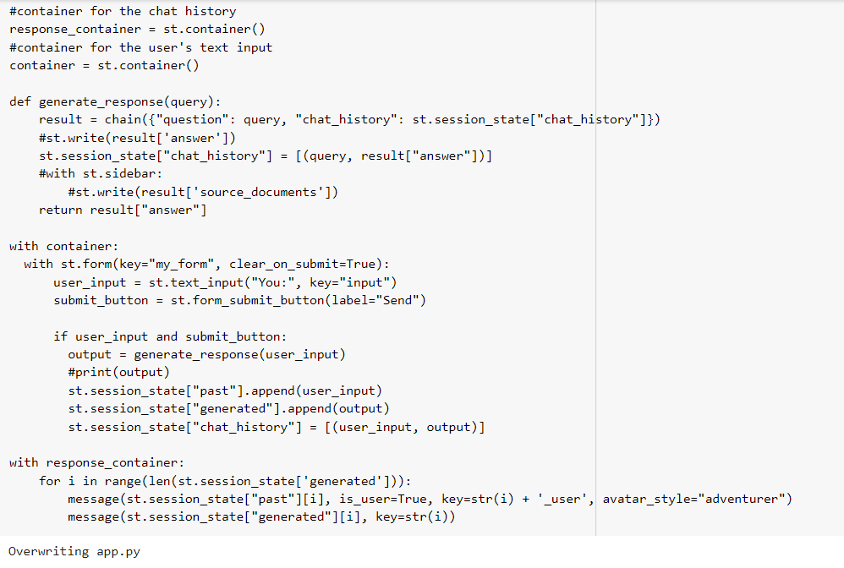
The flow of the code : the cool part

Slide 14
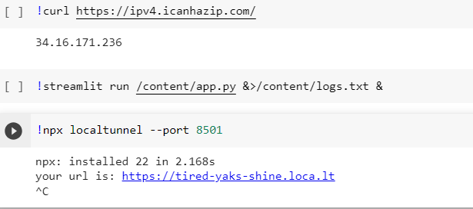
The flow of the code : the cool part

Slide 15
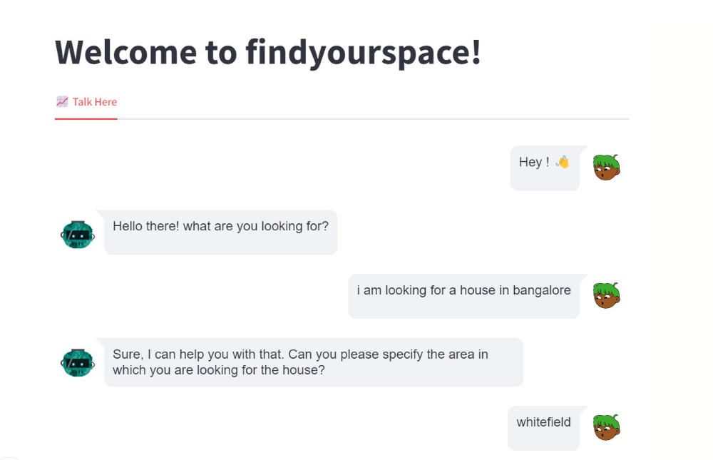
OUTPUT :

Slide 16
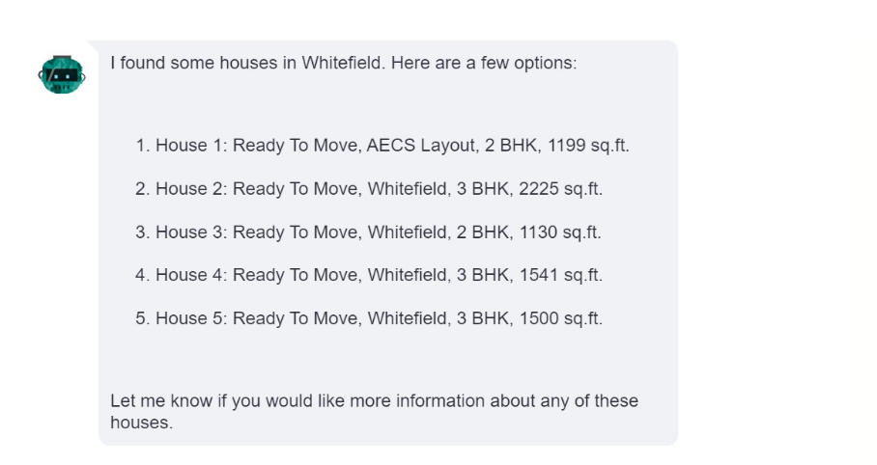
OUTPUT :

Slide 17
REFERENCES :
1) https://openai.com/
2)https://colab.research.google.com/drive/1eZN2B586yYLckuIdIv9Y2VvdoBapqxVM (Kumar Abhimanyu’s Colab Notebook)

Slide 18


