Slide 1


Slide 2
NETWORKING

Slide 3
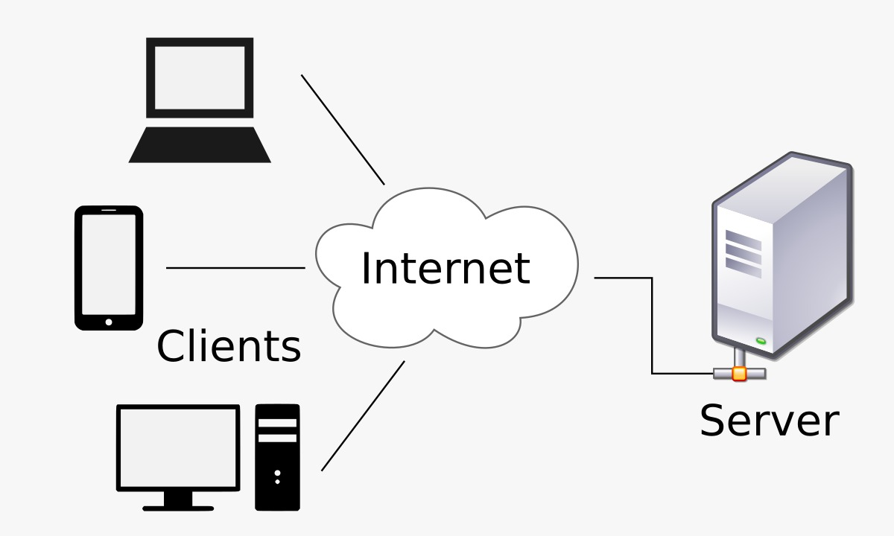
Networking:
Networking is the process of connecting two or more computers or devices to communicate and share data and resources.
To share data and information
To share resources(printers, files, internet)
To enable communication between devices.
Introduction
Types of Network
Network Topologies
Network Devices
Layers
Real-Life Uses
Summary

Slide 4
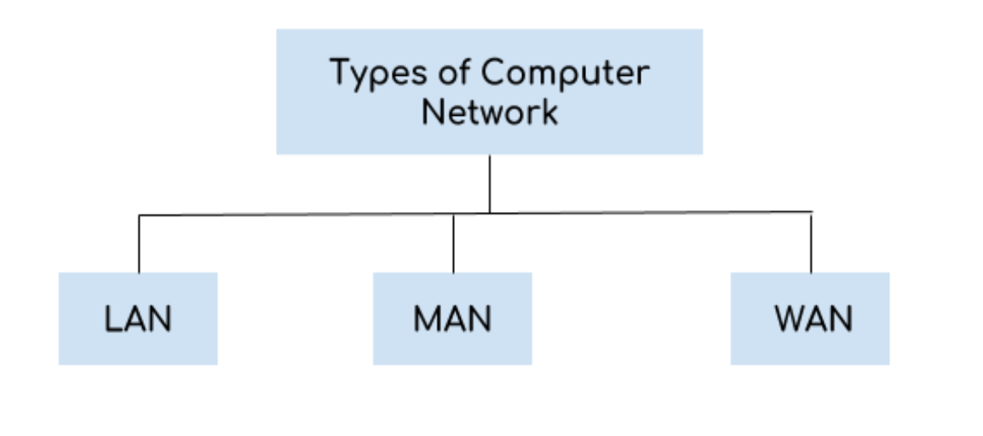
Types of Computer Networks:
Types of networking are primarily categorized by geographical area and purpose, with the most common being LAN (Local Area Network - office/home), MAN (Metropolitan Area Network - city-wide), and WAN (Wide Area Network - global/country-wide).
Introduction
Types of Network
Network Topologies
Network Devices
Layers
Real-Life Uses
Summary

Slide 5
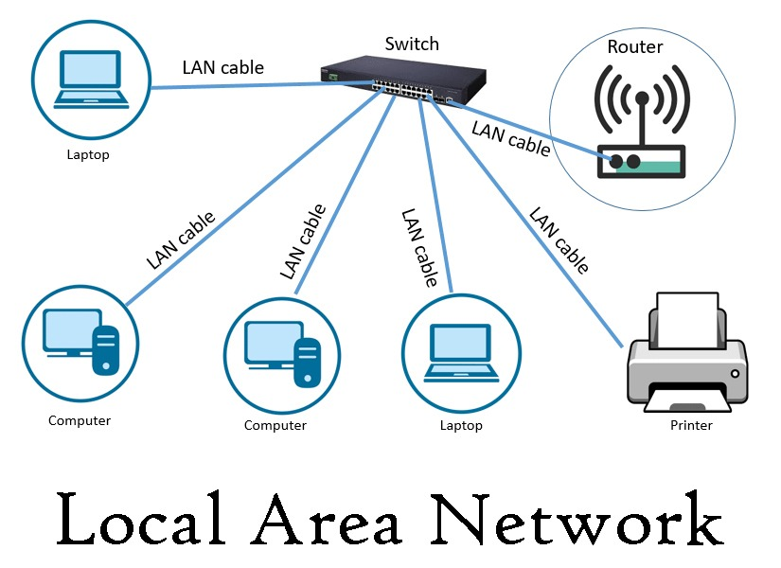
1)Local Area Network (LAN):
A Local Area Network (LAN) connects computers and devices within a small geographical area such as home, school, or office.
It provides high-speed data transfer and is low in cost because it covers a limited area.
Examples of LAN:
    Wi-Fi network in a home or school
    Wired network in an office or computer lab
Introduction
Types of Network
Network Topologies
Network Devices
Layers
Real-Life Uses
Summary

Slide 6
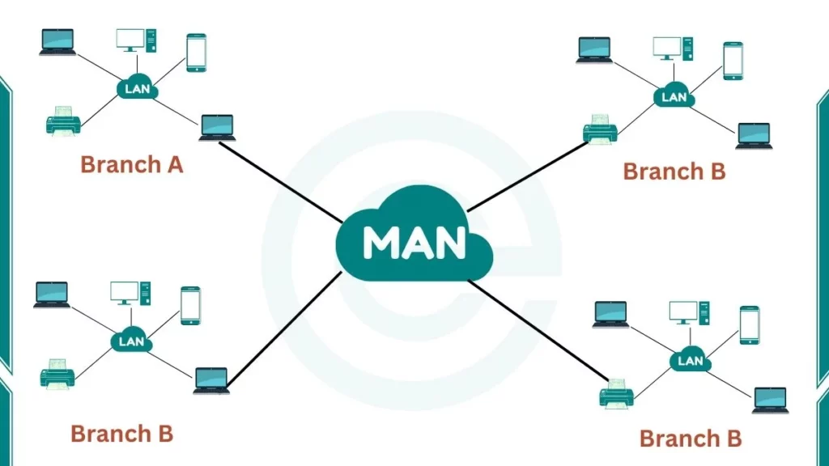
2)Metropolitan Area Network (MAN) :
A Metropolitan Area Network Connects computers and devices across a city or large town.
It covers a larger area than LAN but smaller than WAN.
Examples of MAN:
      City-wide internet network
      Cable TV network
      University campus network
Introduction
Types of Network
Network Topologies
Network Devices
Layers
Real-Life Uses
Summary

Slide 7
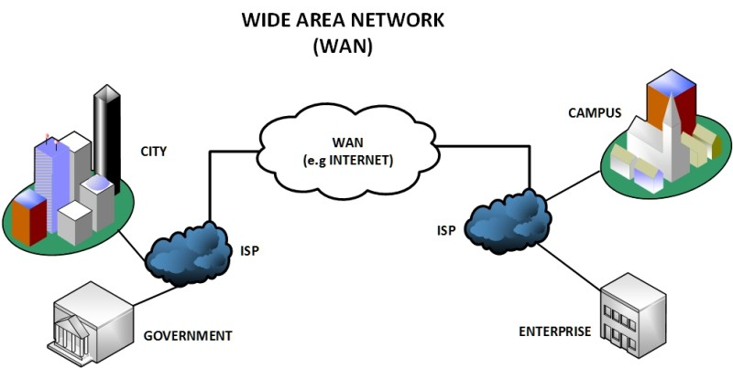
3)Wide Area Network (WAN):
A Wide Area Network connects computers and networks over a large geographical area, such as countries or continents.
It is used for long-distance communication and data sharing.
Examples of WAN:
      Internet
      Bank networks
      International company networks
Introduction
Types of Network
Network Topologies
Network Devices
Layers
Real-Life Uses
Summary

Slide 8
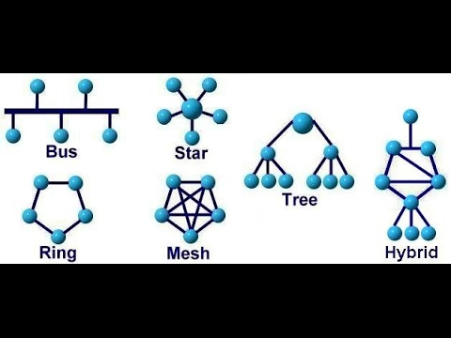
Network Topologies:
Network topology is the physical or logical layout of a network
It shows how devices are connected and how data flows
Choosing the right topology improves performance and reliability
Allows the network to grow easily by adding more devices without major changes.
Introduction
Types of Network
Network Topologies
Network Devices
Layers
Real-Life Uses
Summary

Slide 9
Star Topology:
All devices are connected to a central device (hub or switch)
Data passes through the central device
Easy to install and manage
Failure of one device does not affect others
Failure of central device stops the network
Introduction
Types of Network
Network Topologies
Network Devices
Layers
Real-Life Uses
Summary

Slide 10
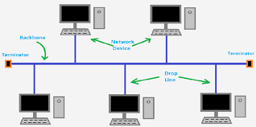
Bus Topology:
All devices are connected to a single main cable
Data travels along the main cable
Easy and low cost to install
Performance reduces as devices increase
Failure of main cable stops the network
Introduction
Types of Network
Network Topologies
Network Devices
Layers
Real-Life Uses
Summary

Slide 11
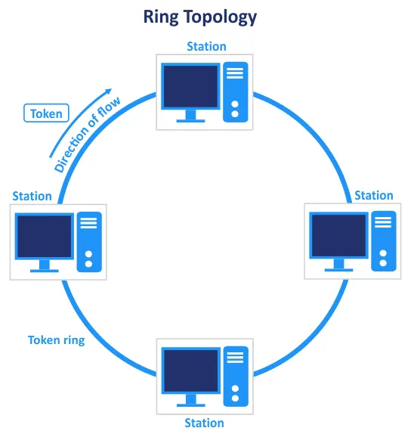
Ring Topology:
Devices are connected in a circular ring
Data moves in one direction
Each device passes data to the next
No central device required
Failure of one device affects the network
Introduction
Types of Network
Network Topologies
Network Devices
Layers
Real-Life Uses
Summary

Slide 12
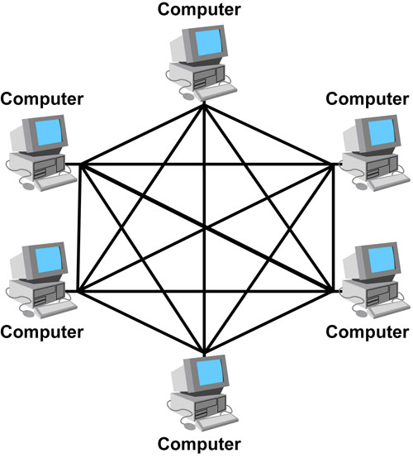
Mesh Topology:
Each device is connected to multiple devices
Multiple paths for data transmission
Very reliable and secure
Expensive and complex
Used in critical networks
Introduction
Types of Network
Network Topologies
Network Devices
Layers
Real-Life Uses
Summary

Slide 13
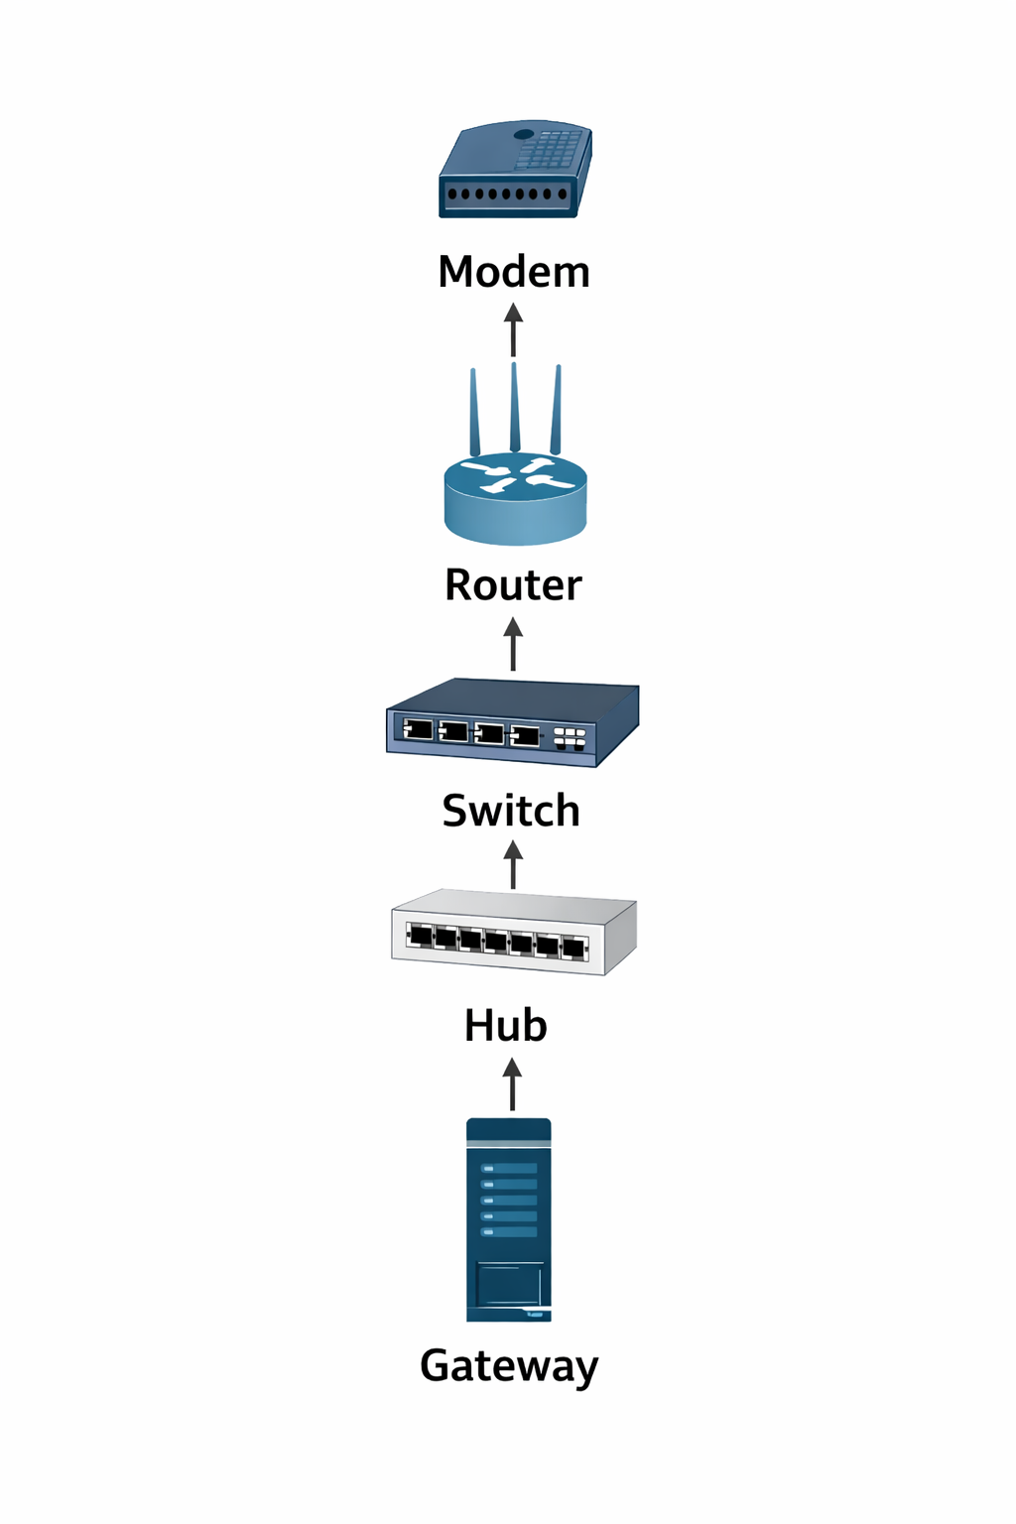
Networking Devices:
Modem
    Connects the network to the Internet
    Converts signals for communication
Router
    Connects different networks
    Directs data to the correct destination
Switch
    Connects devices within a LAN
    Improves network performance
Hub
    Basic device to connect computers
    Sends data to all devices
Gateway
    Connects two different types of networks.
    Translates data between different protocols.
Introduction
Types of Network
Network Topologies
Network Devices
Layers
Real-Life Uses
Summary

Slide 14
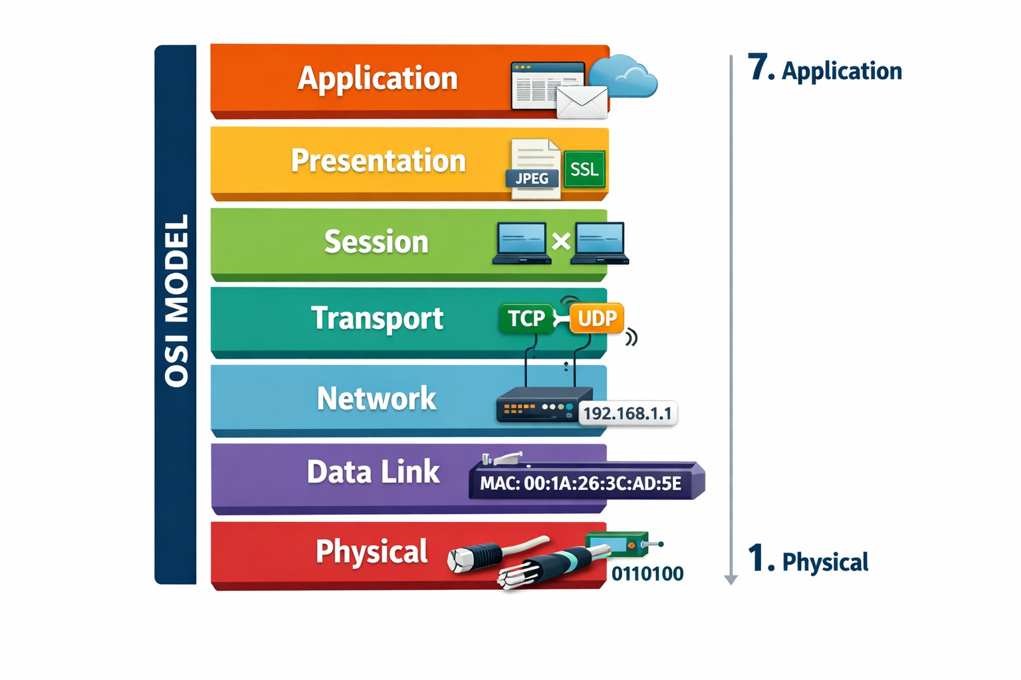
OSI Layer:
Introduction
The OSI (Open Systems Interconnection) Model is a set of rules that explains how different computer systems communicate over a network. OSI Model was developed by the International Organization for Standardization (ISO). The OSI Model consists of 7 layers and each layer has specific functions and responsibilities. This layered approach makes it easier for different devices and technologies to work together.
Types of Network
Network Topologies
Network Devices
Layers
Real-Life Uses
Summary

Slide 15
Layer 7 – Application:
  This is the layer users interact with directly
  Provides network services like web browsing, email, file transfer
  Example: Opening a website, sending an email
Layer 6 – Presentation:
  Makes data readable and secure
  Handles formatting, encryption, and compression
  Example: Encrypting data before sending
Layer 5 – Session:
  Controls communication sessions between devices
  Starts, manages, and ends connections
  Example: Keeping you logged in during a video call
Introduction
Types of Network
Network Topologies
Network Devices
Layers
Real-Life Uses
Summary

Slide 16
Layer 4 – Transport:
  Ensures complete and reliable data delivery
  Breaks data into segments and reassembles them
  Example: TCP, UDP
Layer 3 – Network:
  Decides the best path for data to travel
  Uses IP addresses
  Example: Routers
Layer 2 – Data Link:
  Transfers data between two directly connected devices
  Uses MAC addresses
  Example: Switches, Ethernet
Layer 1 – Physical:
  Sends data as signals (bits) through cables or wireless
  Includes hardware, wires, connectors
Introduction
Types of Network
Network Topologies
Network Devices
Layers
Real-Life Uses
Summary

Slide 17
Introduction
Introduction
Real-Life Uses of Networking:
Types of Network
Communication – Email, video calls, messaging apps
Internet Access – Browsing websites and online services
Education – Online classes, e-learning platforms
Business – File sharing, online meetings, cloud services
Banking & Finance – Online banking, ATM networks
Healthcare – Patient records, telemedicine
Entertainment – Online games, streaming (YouTube, Netflix)
Network Topologies
Network Devices
Layers
Real-Life Uses
Summary

Slide 18
Introduction
Types of Network
Introduction
Types of Network
Summary:
Network Topologies
Networking connects devices to share data and resources
Different types of networks are used for different purposes
Network topologies define how devices are arranged
Networking is used in daily life: communication, education, business
Proper networking improves speed, reliability, and security
Network Devices
Layers
Real-Life Uses
Summary
"Ultimately, effective networking isn't just about connecting devices; it's about connecting people and opportunities. By leveraging these digital pathways, we unlock greater productivity, faster innovation, and build stronger relationships, proving that in today's world, being connected isn't just an advantage—it's a necessity."

Slide 20
THANK YOU

