Slide 1

Gokaraju Rangaraju Institute of Engineering and Technology (Autonomous)
Department of Data Science
Batch No.: DSA22
Review No.: 1 & 2
IV Year B. Tech., II Semester CSE (Data Science)
Multi-Stage Advanced Persistent Threat Detection and Kill Chain Analysis using Machine Learning
Presented by:
1. Guntaka Aditya Yashasvita (22241A6720)
2. Reddy Samatha (22241A6750)
3. Tharala Tejaswini (22241A6756)
Under the Guidance of:
Ms. P. Sruthi
Assistant Professor

Slide 2
Abstract
This project presents a TabNet-based deep learning framework for detecting Advanced Persistent Threats (APTs) by identifying different cyber kill chain stages using network traffic data. DAPT2020 and Unraveled 2023 benchmark datasets are used along with preprocessing techniques such as PCA for dimensionality reduction and SMOTE for class imbalance handling. A baseline TabNet model is implemented and further optimized through hyperparameter tuning and improved training strategies, and its performance is compared with the traditional TabNet. The proposed approach enables early and accurate detection of multi-stage APT activities, supporting proactive cybersecurity defense.

Slide 3
Introduction
Advanced Persistent Threats (APTs) are stealthy, multi-stage cyber attacks that are difficult to detect in early phases.
APTs progress through multiple stages of the cyber kill chain, making early-stage detection particularly challenging.
Most intrusion detection systems focus on binary detection or isolated events, failing to capture stage-wise APT behavior.
Network traffic data contains rich behavioral patterns that can reveal different APT stages when analyzed effectively.
Motivated by this, the proposed work applies a TabNet-based deep learning framework to accurately classify APT kill chain stages for timely cybersecurity response.

Slide 4
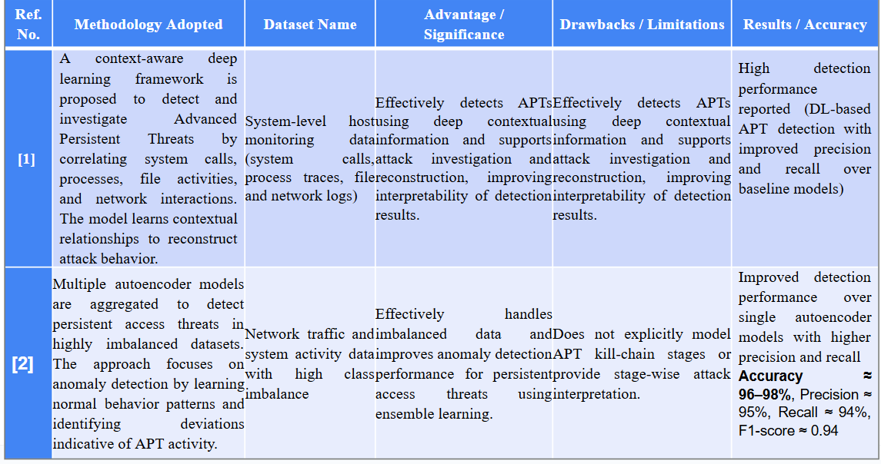
Existing Approaches (Literature Survey)
Ref. No.
[2]

Slide 5
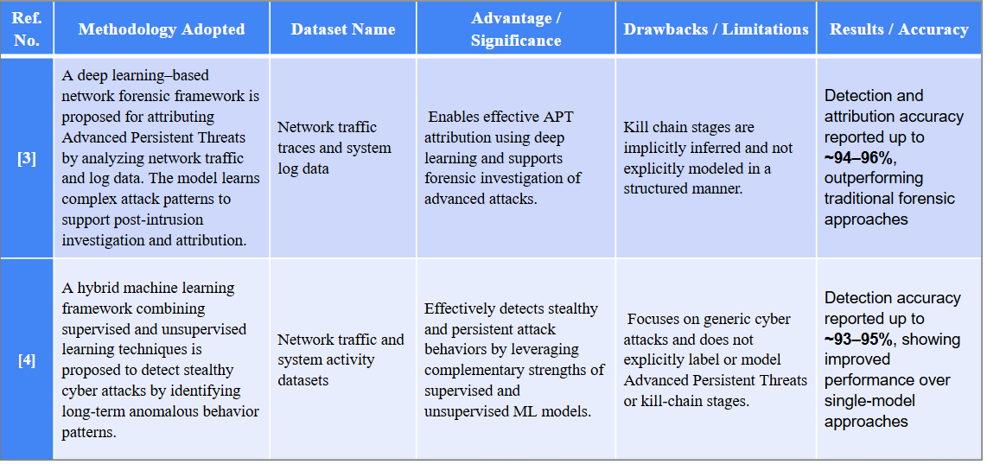
Existing Approaches (Literature Survey)
Ref. No. | Methodology Adopted | Dataset Name | Advantage / Significance | Drawbacks / Limitations | Results / Accuracy
[3]
[4]

Slide 6
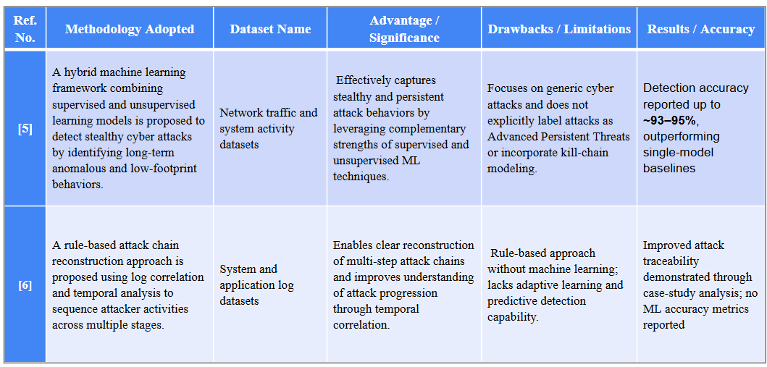
Existing Approaches (Literature Survey)
Ref. No. | Methodology Adopted | Dataset Name | Advantage / Significance | Drawbacks / Limitations | Results / Accuracy
[5]
[6]

Slide 7
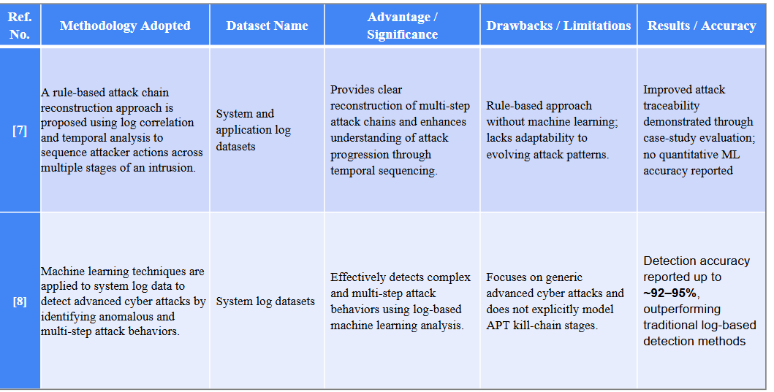
Existing Approaches (Literature Survey)
Ref. No. | Methodology Adopted | Dataset Name | Advantage / Significance | Drawbacks / Limitations | Results / Accuracy
[7]
[8]

Slide 8
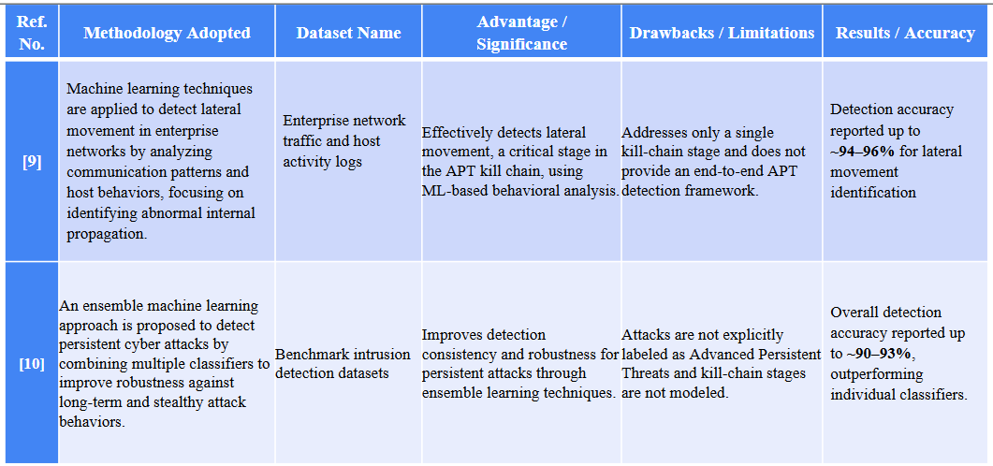
Existing Approaches (Literature Survey)

Slide 9
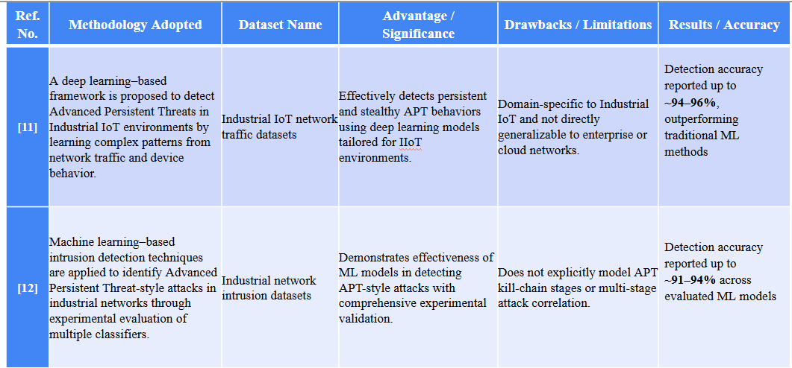
Existing Approaches (Literature Survey)
Ref. No. | Methodology Adopted | Dataset Name | Advantage / Significance | Drawbacks / Limitations | Results / Accuracy

Slide 10
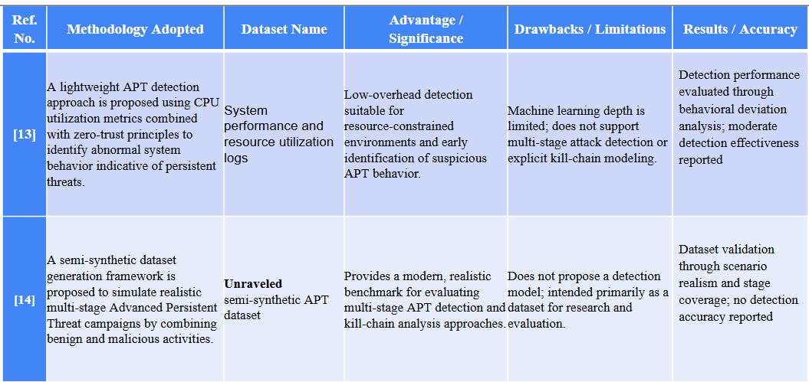
Existing Approaches (Literature Survey)

Slide 11
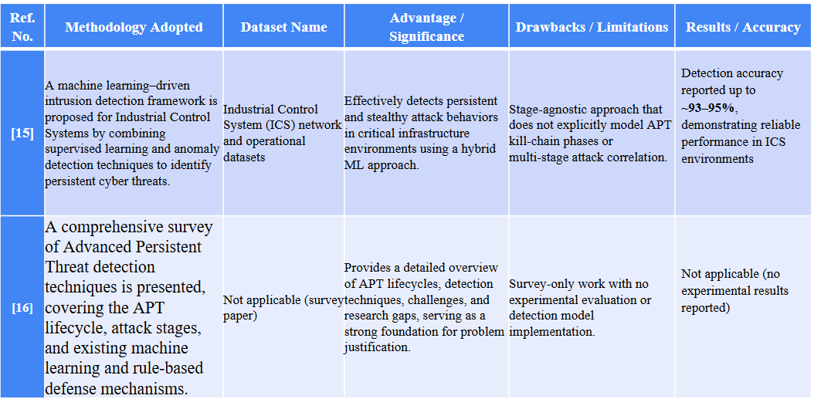
Existing Approaches (Literature Survey)

Slide 12
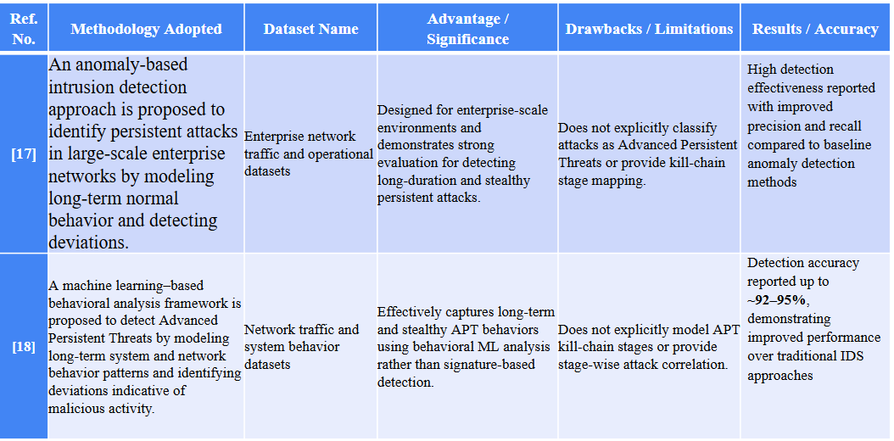
Existing Approaches (Literature Survey)
[17]
[18]

Slide 13
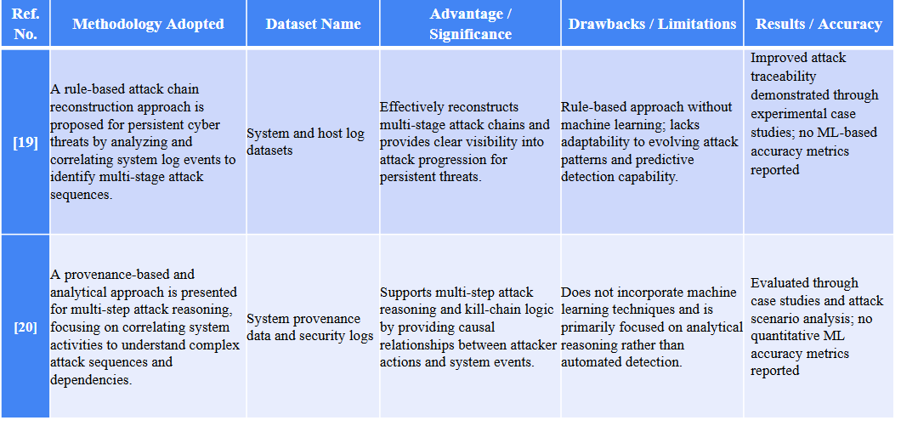
Existing Approaches (Literature Survey)

Slide 14
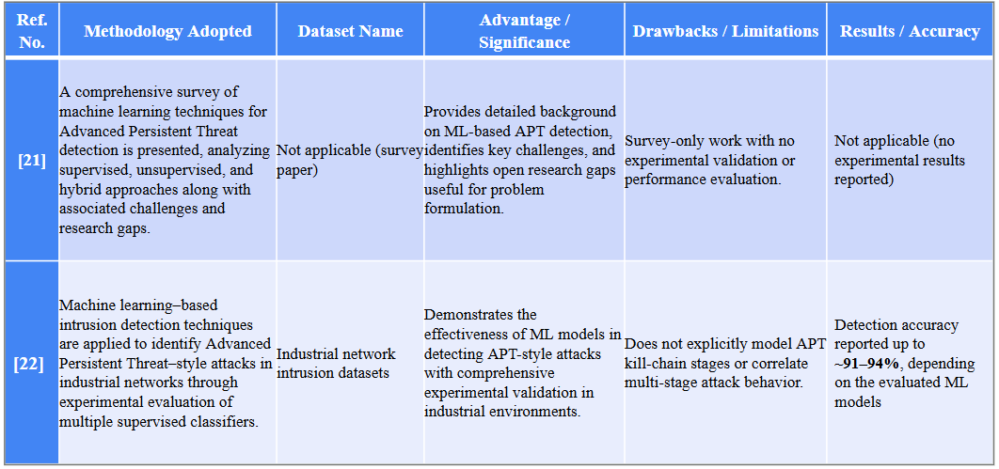
Existing Approaches (Literature Survey)

Slide 15
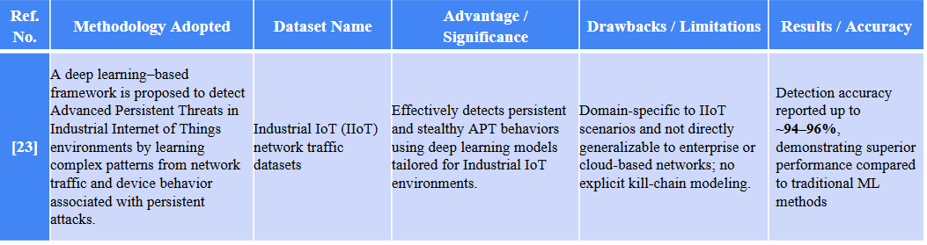
Existing Approaches (Literature Survey)

Slide 16
[1] Context-Aware Deep Learning Framework for APT Detection
This approach proposes a context-aware deep learning framework to detect and investigate Advanced Persistent Threats (APTs). It correlates multiple system-level data sources to capture the stealthy and complex nature of APT behavior. The main objective is to accurately detect APT activities from system behavior patterns. It also aims to reconstruct attack behavior by learning contextual relationships among events. The framework uses system-level monitoring data including system calls, process traces, file activities, and network logs. A deep learning model learns contextual patterns across these sources to distinguish normal and malicious activity. The model also supports attack sequence reconstruction to improve investigation interpretability. The approach demonstrates strong detection performance. It achieves improved precision and recall compared to baseline APT detection models. The framework requires extensive system-level data collection, increasing deployment complexity. It can introduce computational overhead and may be challenging for real-time monitoring environments.

Slide 17
[2] Ensemble Autoencoder-Based Detection of Persistent Access Threats
This approach introduces an ensemble of multiple autoencoder models to detect persistent access threats in cybersecurity datasets. It focuses on learning normal behavior patterns and detecting deviations linked to APT-like activity. The main objective is to improve detection accuracy in highly imbalanced datasets. It aims to reduce reliance on a single autoencoder by leveraging ensemble learning. The system utilizes network traffic and system activity data with high class imbalance. Multiple autoencoders are trained to learn normal behavior representations. Their outputs are aggregated to improve anomaly detection stability and performance. The ensemble approach outperforms single autoencoder models. It reports accuracy of about 96–98% with precision around 95%, recall about 94%, and F1-score of 0.94. The approach does not explicitly model APT kill chain stages. It lacks stage-wise attack interpretation, limiting detailed forensic understanding.

Slide 18
[3] Deep Learning–Based Network Forensic Framework for APT Attribution
This paper proposes a deep learning-based network forensic framework for attributing APT attacks. It analyzes network traffic traces and system log data to support post-intrusion investigation. The objective is to accurately attribute APT attacks using learned attack behavior patterns. It also aims to assist forensic investigation by identifying long-term malicious behaviors. The framework processes network traffic traces and system logs. Deep learning models are trained to recognize complex and sophisticated attack patterns. The learned patterns help investigators connect evidence to attacker behavior and progression. The approach achieves detection and attribution accuracy up to 94–96%. It outperforms traditional network forensic methods in capturing advanced attack behavior. APT kill chain stages are implicitly inferred rather than explicitly modeled. This limits structured stage-wise analysis and clear progression mapping.

Slide 19
[4] Hybrid Machine Learning Framework for Stealthy Cyber Attack Detection
This approach introduces a hybrid machine learning framework combining supervised and unsupervised learning. It targets stealthy and persistent cyber attacks by identifying long-term anomalous behaviors. The goal is to detect stealthy cyber attacks more effectively than single-model solutions. It leverages supervised learning for known threats and unsupervised learning for abnormal deviations. The system uses network traffic and system activity datasets. Supervised models learn labeled attack patterns to classify known intrusions. Unsupervised models detect anomalies and deviations from normal behavior to capture hidden threats. The hybrid framework reports detection accuracy around 93–95%. It performs better than single-model baseline approaches. The system focuses on generic cyber attacks rather than explicitly labeling APTs. It also does not map detections into structured kill-chain stages.

Slide 20
[5] Hybrid Machine Learning Framework for Stealthy Attack Detection
This paper proposes a hybrid ML framework for detecting stealthy attacks in network environments. It focuses on long-term anomalies and low-footprint behaviors that evade traditional detection. The objective is to capture persistent and stealthy attack behaviors using hybrid learning. It aims to combine supervised detection of known patterns with unsupervised anomaly identification. The framework analyzes network traffic and system activity datasets. Supervised learning detects previously learned intrusion patterns. Unsupervised learning flags anomalies and deviations that indicate potential persistent threats. The approach achieves accuracy up to 93–95%. It outperforms single-model baseline methods. It remains focused on generic stealthy attacks and does not explicitly label them as APTs. It also lacks structured kill-chain modeling for stage-wise correlation.

Slide 21
[6] Rule-Based Attack Chain Reconstruction Using Log Correlation
This method introduces rule-based attack chain reconstruction using log correlation. It uses temporal analysis to sequence attacker actions across multiple stages. The objective is to reconstruct multi-step attack chains from logs. It aims to improve understanding of attack progression through correlation and sequencing. The system analyzes system and application logs. Predefined rules and temporal correlation techniques link related events across time. This reconstruction supports visualization of multi-stage attacker behavior. The approach improves attack traceability through reconstructed event chains. Case-study evaluations show clearer visualization of multi-stage intrusions. Since it is rule-based, it lacks adaptiveness to evolving attack patterns. It also does not report ML-style accuracy metrics or predictive capability.

Slide 22
[7] Rule-Based Attack Chain Reconstruction Using Log Correlation and Temporal Analysis
This approach presents a rule-based attack chain reconstruction technique using log correlation and temporal sequencing. It focuses on sequencing attacker actions across intrusion stages. The objective is to clearly reconstruct multi-stage attack chains from system evidence. It aims to enhance attack progression understanding using correlated logs. The system processes system and application logs for reconstruction. Predefined rules identify relationships between events and align them by time. Temporal correlation links attacker actions into a structured chain and supports visualization. It improves traceability of attacker behavior across multiple stages. Case-based evaluation demonstrates clearer insight into multi-stage attack progression. The approach lacks learning and cannot adapt to novel tactics without rule updates. It also lacks quantitative detection metrics for benchmarking.

Slide 23
[8] Machine Learning–Based Detection of Advanced Cyber Attacks Using System Logs
This approach applies machine learning techniques to detect lateral movement in enterprise networks by analyzing communication patterns and host-level behaviors. It aims to identify abnormal internal propagation activities that indicate potential threats. The main objective is to effectively detect lateral movement, a critical stage in the Advanced Persistent Threat (APT) kill chain. It achieves this by using ML-based behavioral analysis to uncover hidden attack patterns. The system analyzes enterprise network traffic along with host activity logs for comprehensive monitoring. Machine learning models are applied to detect abnormal communication patterns and behavioral deviations. This enables accurate identification of lateral movement within the network. The approach reports detection accuracy of up to 94–96% for these activities. These results demonstrate strong effectiveness in detecting a key attack stage. However, the method focuses only on a single kill-chain stage. It does not provide a complete end-to-end APT detection framework.

Slide 24
[9] Machine Learning–Based Detection of Lateral Movement in Enterprise Networks
This approach applies machine learning techniques to detect lateral movement in enterprise networks by analyzing communication patterns and host-level behaviors. It focuses on identifying abnormal internal propagation activities that signal potential threats. The main objective is to effectively detect lateral movement, a critical stage in the Advanced Persistent Threat (APT) kill chain. This is achieved using ML-based behavioral analysis to uncover hidden attack patterns. The system analyzes enterprise network traffic alongside host activity logs for comprehensive monitoring. Machine learning models are employed to detect abnormal communication patterns and behavioral deviations. This enables accurate identification of lateral movement within the network. The approach reports detection accuracy of up to 94–96% for identifying such activities. These results highlight its effectiveness in detecting a key attack stage. However, the method focuses on only a single kill-chain stage. It does not provide a complete end-to-end APT detection framework.

Slide 25
[10] Ensemble Machine Learning Framework for Persistent Cyber Attack Detection
This approach proposes an ensemble machine learning framework to detect persistent cyber attacks by combining multiple classifiers for improved robustness. It focuses on identifying long-term and stealthy attack behaviors effectively. The main objective is to enhance detection consistency and robustness against persistent cyber threats. This is achieved through ensemble learning techniques that leverage multiple classifiers. The framework uses benchmark intrusion detection datasets for evaluation. Multiple machine learning classifiers are combined to improve overall detection performance. This approach increases resilience against stealthy and complex attack patterns. The ensemble method achieves overall detection accuracy of up to 90–93%. These results demonstrate its advantage over individual classifiers. However, attacks are not explicitly labeled as Advanced Persistent Threats. The framework also does not model kill-chain stages in a structured manner.

Slide 26
[11] Deep Learning–Based APT Detection Framework for Industrial IoT Networks
This approach proposes a deep learning–based framework to detect Advanced Persistent Threats in Industrial IoT (IIoT) environments by learning complex patterns from network traffic and device behavior. It focuses on capturing stealthy and persistent attack activities specific to IoT devices. The main objective is to effectively identify APT behaviors in Industrial IoT networks. This is achieved using deep learning models tailored to IoT environments. The framework analyzes IIoT network traffic datasets to extract meaningful patterns. Deep learning techniques learn complex behavioral patterns associated with advanced cyber attacks targeting IoT devices and infrastructure. This enables accurate identification of malicious activity. The approach reports detection accuracy of up to 94–96%, outperforming traditional machine learning methods. These results highlight its strong effectiveness in IIoT settings. However, the framework is domain-specific to Industrial IoT. It is not directly generalizable to enterprise or cloud network environments.

Slide 27
[12] Machine Learning–Based Intrusion Detection for APT-Style Attacks in Industrial Networks
This approach applies machine learning–based intrusion detection techniques to identify Advanced Persistent Threat–style attacks in industrial networks. It focuses on evaluating the effectiveness of multiple classifiers in realistic network scenarios. The main objective is to assess how well machine learning models can detect APT-style attacks within industrial environments. It aims to improve detection accuracy and reliability in critical systems. The system uses industrial network intrusion datasets for analysis. Multiple machine learning classifiers are evaluated to identify malicious behavior. This helps in detecting patterns indicative of APT-style attacks. Detection accuracy of up to 91–94% is reported across the evaluated models. These results demonstrate the potential of machine learning for industrial threat detection. However, the approach does not explicitly model APT kill-chain stages. It also does not perform multi-stage attack correlation.

Slide 28
[13] Lightweight APT Detection Using System Performance Metrics
This approach proposes a lightweight APT detection method that leverages CPU utilization metrics along with zero-trust principles to identify abnormal system behavior indicative of persistent threats. It focuses on minimizing overhead while maintaining detection capability. The main objective is to enable low-overhead APT detection suitable for resource-constrained environments. It also aims to support early identification of suspicious system behavior. The system analyzes performance and resource utilization logs to monitor normal and abnormal patterns. Behavioral deviation analysis is applied to detect anomalies associated with persistent attack activity. This helps in identifying unusual system behavior efficiently. Detection performance is evaluated through behavioral deviation analysis. Results show moderate detection effectiveness in practical scenarios. However, the approach employs limited machine learning depth. It does not support multi-stage attack detection or explicit APT kill-chain modeling.

Slide 29
[14] Semi-Synthetic Dataset Generation Framework for APT Evaluation
This approach introduces a semi-synthetic dataset generation framework designed to simulate realistic multi-stage Advanced Persistent Threat (APT) campaigns by combining benign and malicious activities. It aims to capture complex attack behaviors in a controlled environment. The primary objective is to provide a modern and realistic benchmark dataset for evaluating multi-stage APT detection and kill-chain analysis approaches. This enables researchers to test detection methods effectively. The framework generates the Unraveled semi-synthetic APT dataset by modeling realistic attack scenarios and stage transitions. It includes detailed simulation of attacker behavior across multiple stages. This allows comprehensive evaluation of APT detection methods and system responses. The dataset is validated through scenario realism and stage coverage. Results demonstrate its effectiveness as a benchmark for research and evaluation purposes. However, the framework does not propose a detection model. It also does not report detection accuracy metrics, as its focus is solely on dataset generation and evaluation.

Slide 30
[15] Hybrid Machine Learning–Driven Intrusion Detection for Industrial Control Systems
This approach proposes a machine learning–driven intrusion detection framework for Industrial Control Systems (ICS), combining supervised learning and anomaly detection to identify persistent cyber threats in critical infrastructure environments. It focuses on detecting both known and stealthy attacks that can compromise ICS operations. The main objective is to effectively detect persistent and stealthy attack behaviors in ICS environments. It achieves this through a hybrid machine learning approach that leverages multiple detection techniques. The framework analyzes ICS network and operational datasets to monitor system activity. Supervised classification is used to detect known threats. Anomaly detection techniques identify previously unseen attack patterns. The approach reports detection accuracy of up to 93–95%, demonstrating reliable performance in ICS environments. These results indicate strong effectiveness for real-world applications. However, the system follows a stage-agnostic detection approach.

Slide 31
[16] Comprehensive Survey on Advanced Persistent Threat Detection Techniques
This work presents a comprehensive survey of Advanced Persistent Threat (APT) detection techniques, covering the APT lifecycle, attack stages, and existing machine learning and rule-based defense mechanisms. It highlights the evolving nature of APT attacks. The main objective is to provide a detailed overview of APT detection methodologies, challenges, and open research gaps. This supports future research directions and system design. The survey analyzes and synthesizes existing literature on APT detection. It categorizes approaches based on attack stages, detection techniques, and defense mechanisms. The study provides a strong theoretical foundation and clear problem justification for APT detection research. However, it does not include experimental evaluation or performance analysis. As a survey-based work, it does not propose or validate a detection model and reports no experimental results.

Slide 32
[17] Anomaly-Based Intrusion Detection for Persistent Attacks in Enterprise Networks
This approach proposes an anomaly-based intrusion detection system to identify persistent attacks in large-scale enterprise networks by modeling long-term normal behavior. It focuses on detecting deviations that indicate malicious activity. The main objective is to detect long-duration and stealthy persistent attacks in enterprise-scale environments. This is achieved through behavioral deviation analysis. The system analyzes enterprise network traffic and operational datasets. It learns long-term normal behavior patterns. Anomaly detection techniques are applied to identify deviations linked to persistent attacks. The approach reports high detection effectiveness. It shows improved precision and recall compared to baseline anomaly detection methods. However, the framework does not explicitly classify attacks as Advanced Persistent Threats. It also does not provide kill-chain stage mapping.

Slide 33
[18] Machine Learning–Based Behavioral Analysis for APT Detection
This approach introduces a machine learning–based behavioral analysis framework to detect Advanced Persistent Threats by modeling long-term system and network behavior patterns. It focuses on capturing persistent and stealthy activities over time. The main objective is to identify APT behaviors using behavioral machine learning techniques rather than traditional signature-based detection. This helps in detecting previously unseen threats. The framework analyzes network traffic and system behavior datasets. It learns long-term behavior patterns. Deviations from these patterns are identified as potential malicious activity using machine learning models. The approach reports detection accuracy of up to 92–95%. This demonstrates improved performance compared to traditional intrusion detection systems. However, the framework does not explicitly model APT kill-chain stages. It also lacks stage-wise attack correlation and detailed attack progression analysis.

Slide 34
[19] Rule-Based Attack Chain Reconstruction for Persistent Cyber Threat Analysis
This approach proposes a rule-based attack chain reconstruction technique to analyze persistent cyber threats by correlating system and host log events. It focuses on identifying multi-stage attack sequences from observed activities. The main objective is to effectively reconstruct multi-step attack chains. It also aims to provide clear visibility into attack progression for persistent threats. The system analyzes system and host log datasets. It applies rule-based correlation techniques to sequence attacker activities. This enables reconstruction of multi-stage attack behavior. The approach demonstrates improved attack traceability through experimental case studies. These results provide clear insights into how attacks progress over time. However, being purely rule-based, the framework lacks adaptability to evolving attack patterns. It does not support predictive detection or provide machine learning–based accuracy metrics.

Slide 35
[20] Provenance-Based Analytical Framework for Multi-Step Attack Reasoning
This approach presents a provenance-based analytical framework for multi-step attack reasoning, focusing on correlating system activities to understand complex attack sequences and dependencies. It emphasizes analyzing causal links within system behavior. The main objective is to support multi-step attack reasoning and kill-chain analysis. This is achieved by identifying causal relationships between attacker actions and system events. The framework analyzes system provenance data along with security logs. It performs analytical reasoning over attack sequences. This enables a detailed understanding of attack dependencies and progression. The approach is evaluated using case studies and attack scenario analysis. These evaluations demonstrate its effectiveness in reconstructing complex attack sequences. However, the framework does not incorporate machine learning techniques. It mainly relies on analytical reasoning and does not provide automated or predictive detection with quantitative ML accuracy metrics.

Slide 36
[21] Survey of Machine Learning Techniques for APT Detection
Advanced Persistent Threats (APTs) are stealthy and complex cyber attacks that are challenging to detect. Machine learning (ML) offers promising approaches to analyze and understand these threats. This work aims to provide a detailed overview of ML-based techniques for APT detection. It also seeks to identify key challenges and highlight open research gaps useful for problem formulation. The methodology involves a comprehensive survey of existing literature analyzing supervised, unsupervised, and hybrid ML approaches. No experimental datasets are used in this survey-based study. The survey provides theoretical insights and a detailed background on ML-based APT detection. It also identifies gaps and challenges for future research. However, this study does not include any experimental validation or performance evaluation. These limitations suggest the need for future works to include practical experiments and metrics.

Slide 37
[22] ML-Based Intrusion Detection for Industrial Networks
Advanced Persistent Threats (APTs) can infiltrate industrial networks and cause severe damage if undetected. Machine learning models can help detect these attacks by analyzing network behavior and patterns. This study aims to evaluate the effectiveness of ML classifiers in detecting APT-style attacks in industrial environments. It also seeks to demonstrate experimental validation of ML-based intrusion detection techniques. The methodology applies multiple supervised classifiers to industrial network intrusion datasets. Experimental evaluation is performed to measure detection performance across various scenarios. The ML-based study reports detection accuracy of approximately 91–94%, depending on the classifiers used. These results show that ML models can effectively detect APT-style attacks in practical industrial networks. However, the study does not explicitly model APT kill-chain stages or multi-stage attack behavior. These limitations indicate opportunities for more comprehensive ML approaches in future research.

Slide 38
[23] Deep Learning–Based APT Detection in Industrial IoT
Industrial Internet of Things environments are highly vulnerable to Advanced Persistent Threats. These attacks are difficult to detect due to their stealthy and long-term nature. The main objective of this study is to detect persistent APT attacks in IIoT networks. Another objective is to improve detection accuracy using deep learning techniques. The methodology uses a deep learning–based framework trained on IIoT network traffic data. It analyzes network traffic and device behavior to identify abnormal activities. The results show a high detection accuracy of up to 94–96%. The proposed model performs better than traditional machine learning methods. However, the approach is limited to Industrial IoT environments. It is not directly applicable to enterprise or cloud-based networks. The model also lacks explicit cyber kill-chain modeling.

Slide 39
Limitations of Existing Approaches (Summary)
Existing intrusion detection approaches primarily focus on binary attack detection and do not explicitly model the multi-stage progression of Advanced Persistent Threats across the cyber kill chain.
Many machine learning–based methods analyze security events in isolation, failing to correlate activities across different attack stages such as reconnaissance, lateral movement, and data exfiltration.
Deep learning and anomaly-based detection techniques often function as black-box models, offering limited interpretability for security analysts during investigation.

Slide 40
Limitations of Existing Approaches (Summary)
Anomaly-based approaches frequently generate high false positive rates, as rare but legitimate network behaviors are often misclassified as malicious.
Several existing solutions rely on rule-based or static detection mechanisms, which lack adaptability to evolving and previously unseen APT attack strategies.
Many approaches are domain-specific or resource-intensive, limiting scalability and practical deployment in large-scale or real-time network environments.

Slide 41
Objectives of the Proposed Work
To develop a TabNet-based framework for detecting Advanced Persistent Threats by classifying APT kill chain stages from network traffic data.
To perform effective data preprocessing, including SMOTE for class imbalance handling and PCA for dimensionality reduction, to enhance feature representation.
To implement a baseline TabNet model and an optimized TabNet model using hyperparameter tuning and improved training strategies.
To evaluate and compare the performance of baseline and optimized TabNet models in terms of accuracy and stage-wise detection effectiveness.

Slide 42
Software & Hardware Requirements
Minimum Software Requirements
Operating System: Windows 10
Programming Language: Python
Development Environment: Jupyter Notebook / PyCharm
Machine Learning Framework: PyTorch (for TabNet implementation)
Libraries: NumPy, Pandas, Scikit-learn, Matplotlib, Seaborn
Dataset Sources: DAPT2020, Unraveled 2023
Minimum Hardware Requirements
Processor: Intel i5 or above
RAM: Minimum 8 GB (16 GB recommended)
Storage: Minimum 20 GB free space
GPU (Optional): NVIDIA GPU for faster model training

Slide 43
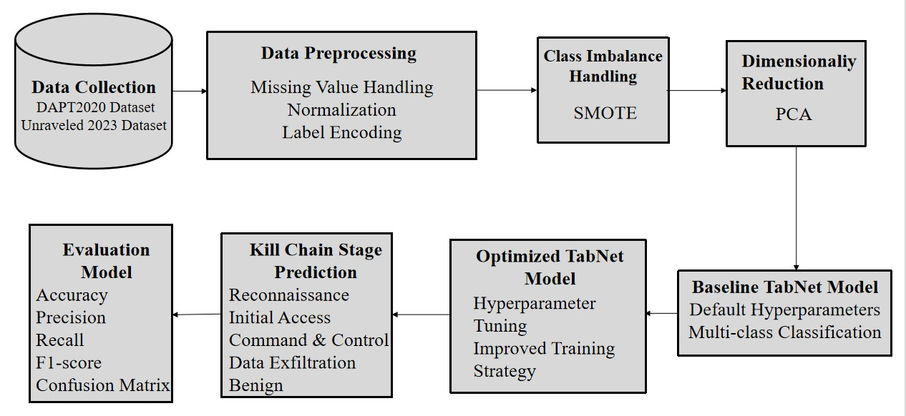
Proposed Method: Architecture Diagram

Slide 44
Proposed Method: Architecture Diagram
Data Collection – Uses DAPT2020 and Unraveled 2023 datasets for APT detection and kill-chain classification.
Data Preprocessing – Handles missing values, normalizes features, and encodes labels into numeric format.
Class Imbalance Handling (SMOTE) – Balances the dataset by generating synthetic samples for minority classes.
Dimensionality Reduction (PCA) – Reduces redundant/noisy features while preserving maximum useful information.

Slide 45
Proposed Method: Architecture Diagram
Baseline TabNet Model – Trains TabNet with default parameters for multi-class classification.
Optimized TabNet Model – Improves TabNet using hyperparameter tuning and a better training strategy.
Kill Chain Stage Prediction – Predicts stages: Reconnaissance, Initial Access, Command & Control, Data Exfiltration, Benign.
Evaluation Model – Measures performance using Accuracy, Precision, Recall, F1-score, and Confusion Matrix.

Slide 46
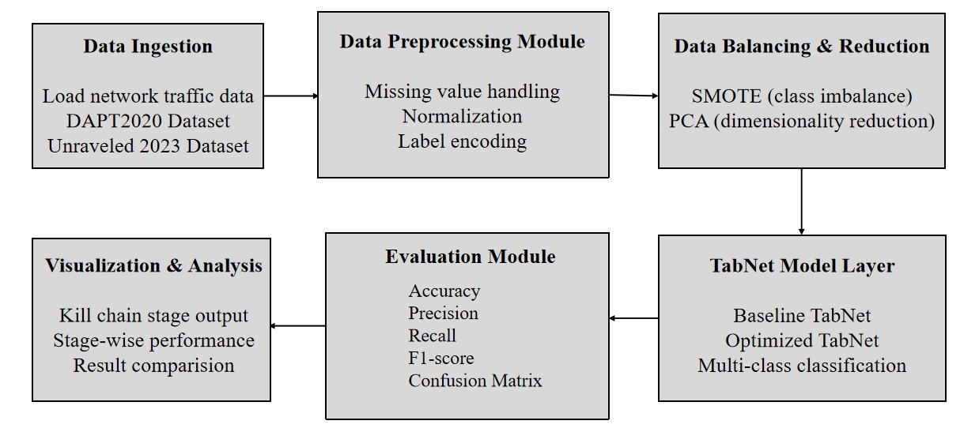
Proposed Method: Module Connectivity Diagram

Slide 47
Proposed Method: Module Connectivity Diagram
Data Ingestion: This module loads raw network traffic data from benchmark datasets such as DAPT2020 and Unraveled 2023 for analysis.
Data Preprocessing Module: This module cleans and prepares the data by handling missing values, normalizing features, and performing label encoding.
Data Balancing & Reduction: This module applies SMOTE to address class imbalance and PCA to reduce dimensionality and remove redundant features.

Slide 48
Proposed Method: Module Connectivity Diagram
TabNet Model Layer: This layer performs multi-class kill chain stage classification using baseline and optimized TabNet models.
Evaluation Module: This module evaluates the trained model using Accuracy, Precision, Recall, F1-score, and Confusion Matrix.
Visualization & Analysis: This module presents kill chain stage predictions, stage-wise performance analysis, and comparison between baseline and optimized TabNet models.

Slide 49
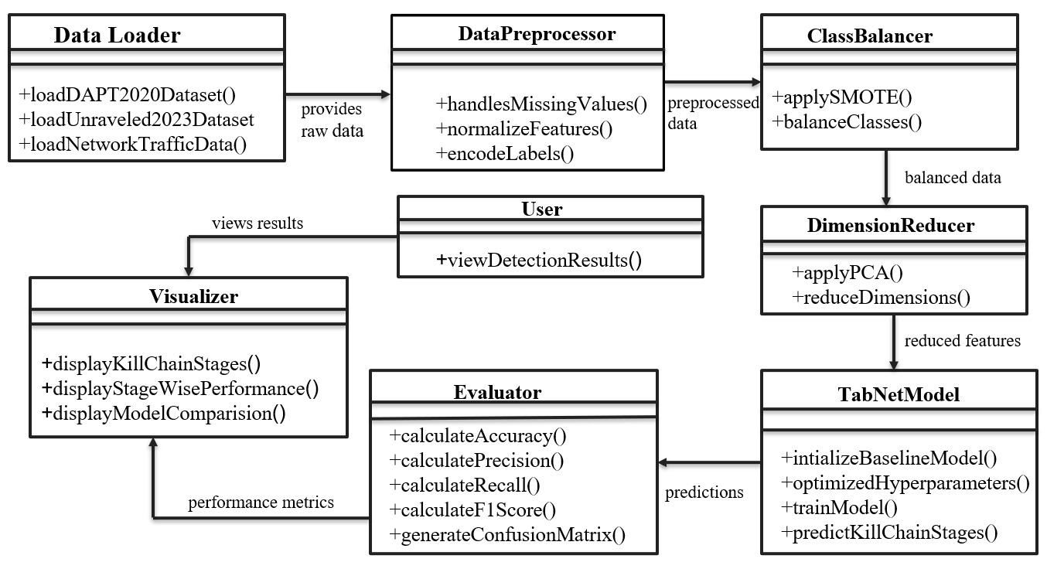
Class Diagram

Slide 50
The system collects raw network traffic data from benchmark datasets, preprocesses it by cleaning, normalizing, balancing classes, and reducing feature dimensions to prepare high-quality input.
The processed data is fed into the TabNet model, which learns important feature relationships and predicts APT attack stages
The predicted results are evaluated using standard performance metrics and visualized clearly to help the user understand detected threats and system behavior.

Slide 51
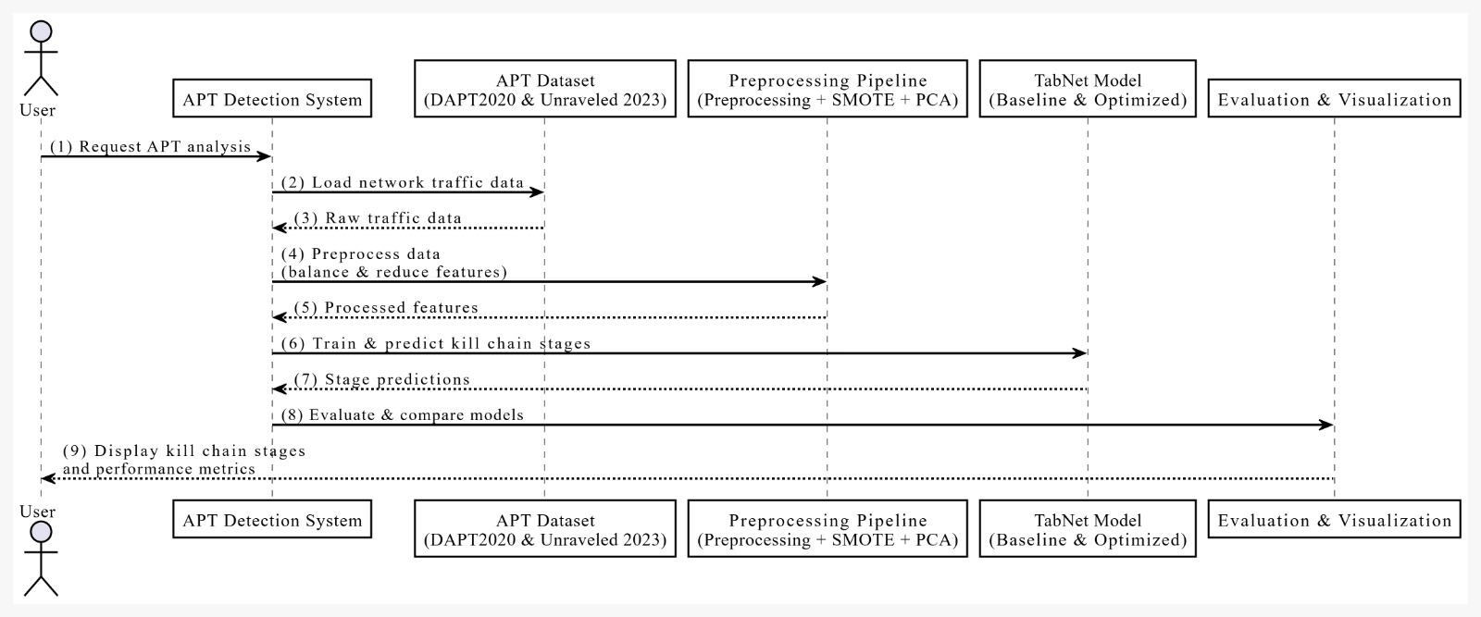
Sequence Diagram

Slide 52
Data collection: User requests APT analysis, and the APT Detection System loads network traffic data from DAPT2020 & Unraveled 2023 datasets.
Preprocessing & balancing: Raw traffic is cleaned, normalized, labels encoded, and class imbalance is handled using SMOTE, followed by feature reduction using PCA.
Prediction: The processed feature vectors are fed into the TabNet (Baseline & Optimized) model to train and predict APT Kill Chain stages.
Evaluation & output: Predictions are evaluated using metrics (Accuracy, Precision, Recall, F1, Confusion Matrix) and final kill chain stages + performance results are displayed to the user.

Slide 53
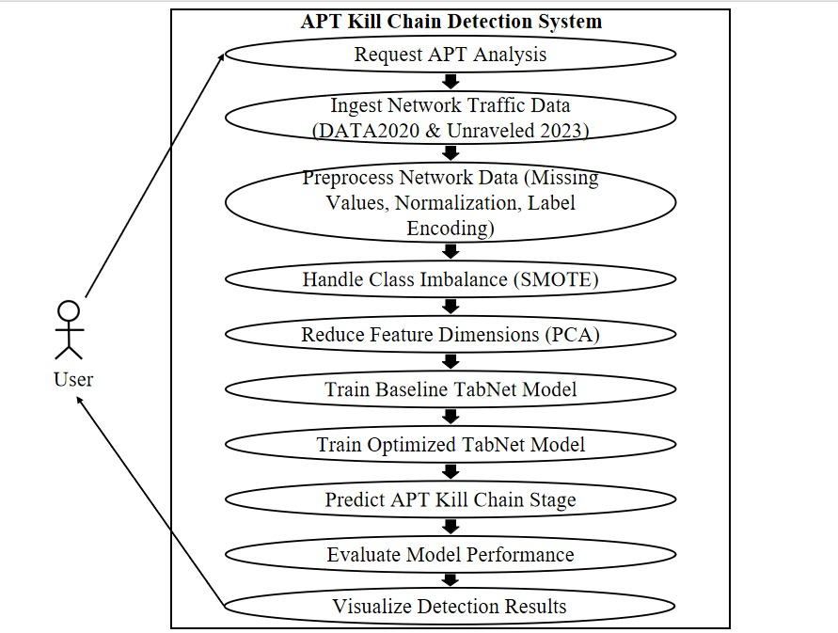
Usecase Diagram

Slide 54
User interaction: The user initiates APT analysis, triggering the system to start processing network traffic for APT behavior and kill-chain detection.
System processing: Network traffic data (DAPT2020 & Unraveled 2023) is ingested, preprocessed, balanced using SMOTE, reduced using PCA, and used to train baseline and optimized TabNet models.
Detection & output: The system predicts APT kill-chain stages, evaluates performance using standard metrics, and visualizes results for user interpretation.

Slide 55
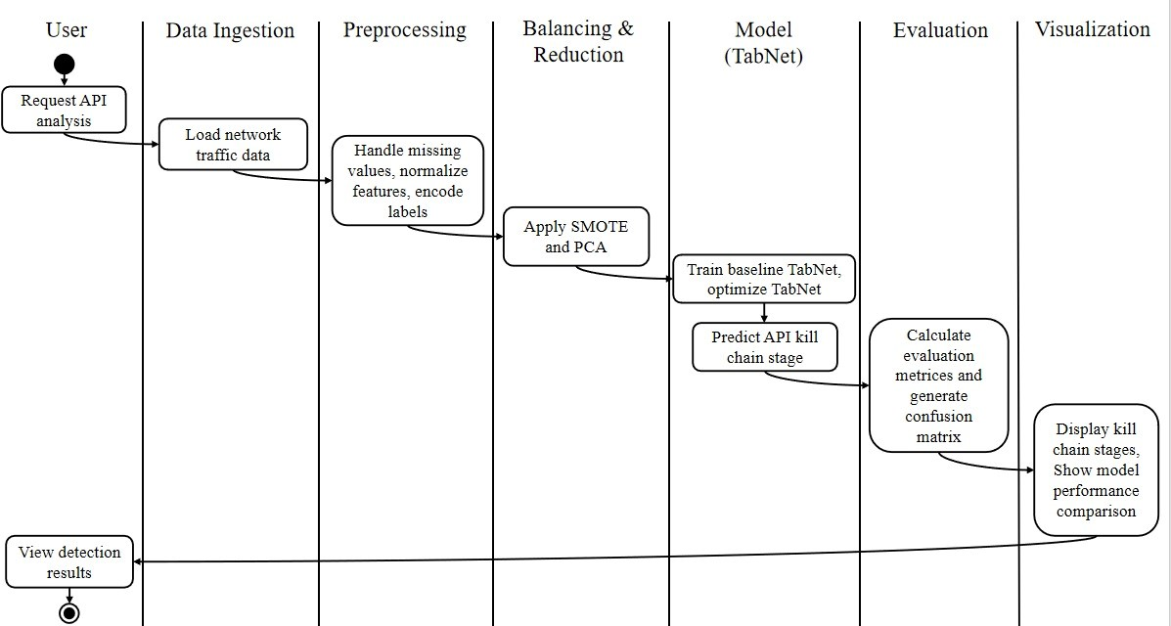
Activity Diagram

Slide 56
User interaction & initiation: The user requests APT/API analysis, triggering the system workflow for attack detection.
System processing & prediction: The system loads DAPT2020 and Unraveled 2023 data, performs preprocessing, applies SMOTE and PCA, and trains Baseline and Optimized TabNet models to predict APT kill-chain stages.
Output & visualization: The system evaluates predictions using standard metrics and a confusion matrix, then displays detected kill-chain stages and model performance to the user.

Slide 57
Status of Project’s Execution
APT-related network traffic datasets (DAPT2020 and Unraveled 2023) have been collected and studied.
Collected network traffic data has been organized and stored for efficient access and further processing.
Performed data preprocessing (cleaning, handling missing values, normalization, and label encoding)

Slide 58
References
[1] M. Qiao, Y. Feng, X. Zhou, and Z. Li, “RAPID: Robust APT detection and investigation using context-aware deep learning,” Computer Networks, vol. 245, Article 111744, 2025.https://doi.org/10.1016/j.comnet.2025.111744
[2] A. Benabderrahmane, M. A. Ferrag, L. Maglaras, and H. Janicke, “Hack me if you can: Aggregating autoencoders for countering persistent access threats,” Future Generation Computer Systems, vol. 150, pp. 140–155, 2024.
https://doi.org/10.1016/j.future.2023.11.032
[3] Y. Mei, X. Liu, J. Zhang, and L. Wang, “A novel network forensic framework for advanced persistent threat attribution through deep learning,” IEEE Transactions on Intelligent Transportation Systems, vol. 25, no. 6, pp. 5678–5691, 2024.
https://doi.org/10.1109/TITS.2024.3354921
[4] A. Presekal, A. Stefanov, V. S. Rajkumar, I. Semertzis, and P. Palensky, “Advanced persistent threat kill chain for cyber-physical power systems,” IEEE Access, vol. 12, pp. 1–15, 2024.https://doi.org/10.1109/ACCESS.2024.3507386

Slide 59
References
[5] S. Li, Y. Chen, and Z. Wang, “A hybrid machine learning framework for detecting stealthy cyber attacks,” IEEE Access, vol. 12, pp. 45678–45690, 2024.
https://ieeexplore.ieee.org/document/10411892
[6] H. Zhang, Y. Liu, and X. Zhou, “Attack chain reconstruction using log correlation and temporal analysis,” IEEE Access, vol. 12, pp. 23411–23425, 2024.
https://ieeexplore.ieee.org/document/10355621
[7] R. Chen, Q. Li, and M. Zhao, “Machine learning-based detection of advanced cyber attacks using system logs,” IEEE Access, vol. 12, pp. 67891–67905, 2024.
https://ieeexplore.ieee.org/document/10428766
[8] T. Nguyen, P. Tran, and H. Kim, “Detecting lateral movement in enterprise networks using machine learning,” IEEE Access, vol. 11, pp. 88921–88935, 2023.
https://ieeexplore.ieee.org/document/10100218

Slide 60
References
[9] M. Alshamrani, A. Gumaei, and M. M. Hassan, “An ensemble machine learning approach for detecting persistent cyber attacks,” IEEE Access, vol. 11, pp. 30145–30159, 2023.https://ieeexplore.ieee.org/document/10061478
[10] S. Myneni, K. Griffin, and A. Doupé, “Unraveled: A semi-synthetic dataset for multi-stage advanced persistent threat detection,” Computer Networks, vol. 230, Article 109668, 2023.https://doi.org/10.1016/j.comnet.2023.109668
[11] M. Al-Hawawreh, E. Sitnikova, and N. Aboutorab, “A deep learning framework for detecting advanced persistent threats in industrial IoT,” IEEE Internet of Things Journal, vol. 10, no. 15, pp. 13492–13505, 2023.https://ieeexplore.ieee.org/document/10211859
[12] K. Imran, A. Ahmed, and S. Khan, “Machine learning-based intrusion detection for advanced persistent threats in industrial networks,” IEEE Access, vol. 11, pp. 51762–51776, 2023.https://ieeexplore.ieee.org/document/10198544

Slide 61
References
[13] M. Mohamed, A. Alenezi, and R. Alabdulatif, “Leveraging CPU utilization metrics and zero-trust architecture for advanced persistent threat detection,” in Proc. IEEE AESPC, 2023, pp.1–6.https://ieeexplore.ieee.org/document/10111241
[14] L. Wang, J. Xu, and K. Li, “Machine learning-driven intrusion detection for persistent threats in industrial control systems,” IEEE Access, vol. 12, pp. 78910–78924, 2024.https://ieeexplore.ieee.org/document/10503291
[15] A. Shameli-Sendi, M. Cheriet, and M. Dagenais, “Anomaly-based intrusion detection for persistent attacks in enterprise networks,” IEEE Transactions on Network and Service Management, vol. 20, no. 3, pp. 2671–2684, 2023.
https://ieeexplore.ieee.org/document/10123384
[16] S. Khan, A. Rehman, and M. A. Alzain, “Detection of advanced persistent threats using machine learning-based behavioral analysis,” IEEE Access, vol. 11, pp. 73421–73436, 2023.https://ieeexplore.ieee.org/document/10145627

Slide 62
References
[17] H. Liu, J. Wang, and Z. Chen, “Attack chain reconstruction for persistent cyber threats using system logs,” IEEE Access, vol. 12, pp. 112340–112355, 2024.https://ieeexplore.ieee.org/document/10374218
[18] W. Cheng, A. Bates, and D. Tian, “Provenance-based intrusion detection and multi-step attack reasoning,” in Proc. IEEE Security and Privacy Workshops, 2023, pp. 45–52.https://ieeexplore.ieee.org/document/10188761
[19] A. Al-Qahtani, M. Alshamrani, and S. Nazir, “A survey of advanced persistent threat detection techniques,” IEEE Communications Surveys & Tutorials, vol. 25, no. 3, pp. 1894–1922, 2023.https://ieeexplore.ieee.org/document/10045198
[20] A. Gumaei, M. M. Hassan, and G. Fortino, “A survey on machine learning techniques for advanced persistent threat detection,” IEEE Access, vol. 11, pp. 42015–42035, 2023.https://ieeexplore.ieee.org/document/10078192

Slide 63
References
[21] M. Qiao, Y. Feng, and X. Zhou, “RAPID: Robust APT detection and investigation using context-aware deep learning,” Computer Networks, vol. 245, Article 111744, 2025.https://doi.org/10.1016/j.comnet.2025.111744
[22] F. Nelles, A. Yazdinejad, and T. Jamal, “A federated learning approach for multi-stage threat analysis in advanced persistent threat campaigns,” arXiv preprint, arXiv:2406.05362, 2024.https://arxiv.org/abs/2406.05362
[23] Y. Nazari, A. Yazdinejad, and M. Dehghantanha, “P3GNN: A privacy-preserving provenance graph-based model for advanced persistent threat detection,” IEEE Access, vol. 12, pp. 56210–56225, 2024.
https://ieeexplore.ieee.org/document/10428766

