Slide 1
AN ENHANCED SECURITY MECHANISM THROUGH BLOCKCHAIN FOR E-POLLING/COUNTING PROCESS
MAJOR PROJECT
VEDA NANDAN GANDI (16115085) PROJECT GUIDE
P VARSHANI REDDY (16115053) DR. PREETI CHANDRAKAR
CHANDRASHEKHAR GUPTA (16115081) ASST. PROFESSOR

Slide 2
OUTLINE
Problem Statement
Abstract
Introduction
Objective
Scope
Motivation
Literature Review
Flow Chart
Working
Parameters
Architecture
Results
Conclusion
Future work

Slide 3
Problem Statement
One of the biggest challenges in political mayhem is visible during the election process where no stone is kept unturned in order to gain power. Further, due to poll violence and waiting in the long queues to cast their votes, numbers of common citizens avoid the voting process completely in order to evade the chaos. In order to reduce these issues or to increase the voting rate, number of smart based voting applications have been projected by various authors. However, these devices can be easily compromised or hacked by the experts (intruders) in order to gain their own access. Therefore, to ensure an enhanced secure and transparent polling process, Blockchain plays a vital role in ensuring the legit votes and their counting without their manipulation in any way.

Slide 4
Abstract
In this project we present our idea in creating a fair e-voting application to ensure correct election results with Hyperledger Fabric and IBM Blockchain Platform.
We aim to build a web-app in which the voter can register with their voter ID, which is used to login to the app, and cast the vote.
The vote is tallied on the blockchain, and the web-app shows the current standings of the polls.
We use our voter ID to submit our vote, during which the application checks if this voter ID number has voted before and tells the user they have already submitted a vote if so.
If all goes well, the political party which the voter has chosen is given a vote, the and world state is updated.

Slide 5
Introduction
Objective
The main objective of this project is to build a security mechanism that ensures a reliable polling and counting process with the help of blockchain, as blockchain when applied in the process of voting along with smart devices further enhances the security among candidates and voters.
Here, the identities of all voters stored in a database that are further linked with Blockchain so that any single alteration in any phase of voting process can be easily traced and identifies by the authorities.

Slide 6
Introduction
Scope
Once every person has an application in their smartphones , it is not required to stand in long queues in the polling booths and fearing any kind of poll violence. It will provide a kind of transparency which will not let the results be questioned and will provide a new confidence to the voters.

Slide 7
Introduction
Motivation
The main motivation behind the project is to create a hassle-free interface for voting. There are many other technologies in the current world and Block chain provides a secure mechanism through which the duplicity of the votes is highly impossible because of the concept of immutable ledger.
There is a lot of chaos involved in the voting system where the people had to stand in queues for a longer time and many do not choose to give their opinion because of the chaos so the project provides an online mechanism where the voters need not go to the ballots to cast their votes and it provides an interface to give their opinion even when they are abroad or in a position unable to reach the ballot.

Slide 8
Literature Review(Table for the existing works)
S.no | Paper title | Authors | Year of publication | Parameters considered | Description
1 | Platform-Independent Secure Blockchain-Based Voting System [1] | Bin Yu et.al. | 2018 | Verifiability , encryption,proof-of-knowledge,linkable ring signature | Employ Hyperledger Fabric to deploy our voting system and analyse the performance of our deployed scheme numerically.
2 | Implementation of an E-Voting Scheme Using Hyperledger Fabric Permissioned Blockchain [2] | Denis Kirillov et.al. | 2019 | Traditional paper voting and e-voting | This approach allows carrying out combined voting of both traditional paper voting and e-voting. Described the architecture of our solution, discussed its implementation based on Hyperledger Fabric platform and demonstrated its functionality.
3 | Secure e-voting using ethereum blockchain [3] | Emre Yavuz , Ali Kaan | 2018 | Contracts, data privacy, electronic money, financial data processing, government data processing,mobile computing, Web services | Implemented and tested a sample e-voting application as a smart contract for the Ethereum network using the Ethereum wallets and the Solidity language. Android platform is also considered to allow voting for people who do not have an Ethereum wallet.
4 | Blockchain-Based E-Voting System [4] | Friðrik Þ. Hjálmarsso et.al. | 2018 | Contracts,Electronic voting, Peer-to-peer computing,Privacy,Electronic voting systems | Evaluated the potential of distributed ledger technologies through the description of a case study; namely, the process of an election, and the implementation of a blockchain-based application, which improves the security and decreases the cost of hosting a nationwide election
5 | Decentralized Voting Platform Based on Ethereum Blockchain [5] | David Khoury et.al. | 2018 | Authorisation,data integrity,data privacy,distributed databases,government data -processing,message-authentication,virtual machines | The main features of this system include ensuring data integrity and transparency, and enforcing one vote per mobile phone number for every poll with ensured privacy. To accomplish this, the Ethereum Virtual Machine (EVM) is used as the Blockchain runtime environment,

Slide 9
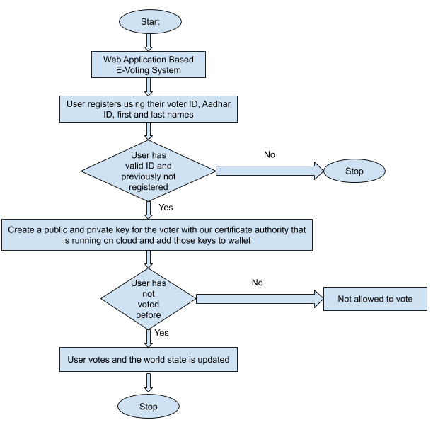
Flow chart

Slide 10
Working
User registers to vote by providing their voter ID, aadhar ID, first and last name. In this step, we can check to see if the Govt issued ID number is valid, and has not been registered previously.
If all goes well, we create a private and public key for the voter with our certificate authority that is running on the cloud, and add those keys to the wallet.
We use our voter ID to submit our vote, during which the application checks if this voter ID has voted before and tells the user they have already submitted a vote if so.
If all goes well, the political party which the voter has chosen is given a vote, and the world state is updated.
The application then updates our current standings of the election to show how many votes each political party currently has.
Since each transaction that is submitted to the ordering service must have a signature from a valid public-private key pair, we can trace back each transaction to a registered voter of the application, in the case of an audit.

Slide 11
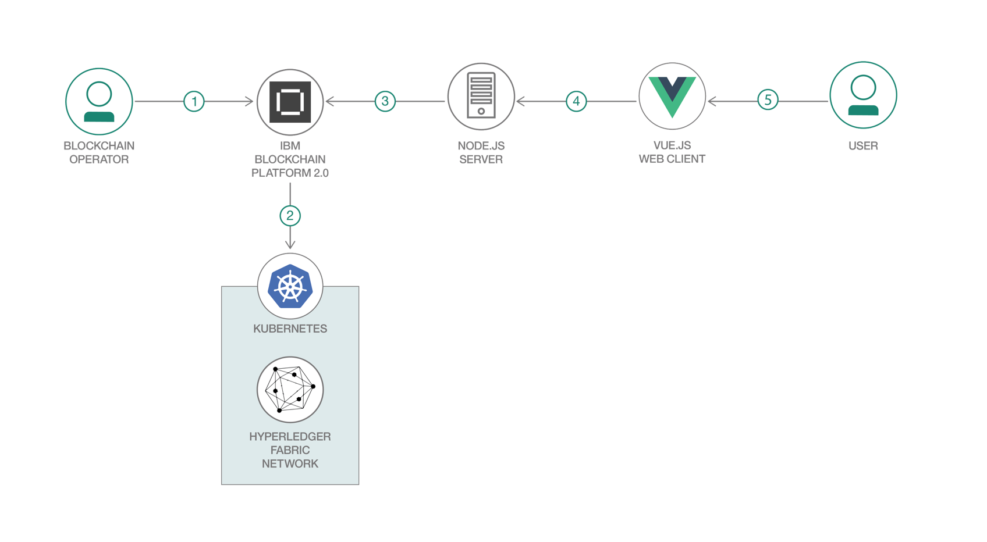
Architecture of the flow

Slide 12
Environmental setup and tools used
IBM Blockchain Platform
IBM Cloud Kubernetes Service
IBM Blockchain Platform Extension for Visual Studio Code
Hyperledger Fabric v1.4
Node.js
Vue.js 2.6.10

Slide 13
Prerequisites
Visual Studio Code version 1.38.0 or greater
IBM Blockchain Platform Extension for Visual Studio Code
Node v8.x or greater and npm v5.x or greater

Slide 14
RESULTS

Slide 15
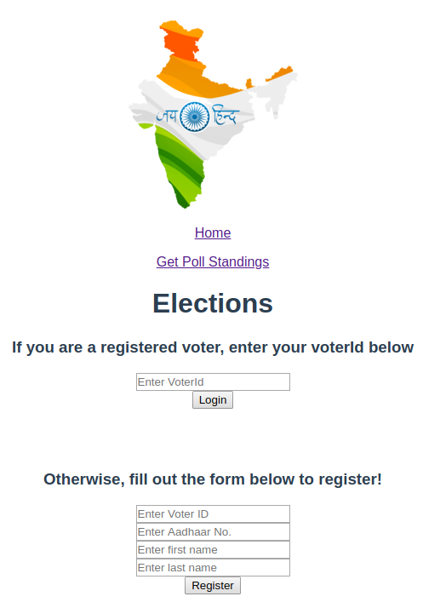
The home page of the web application is where the voter registers and login to cast their vote. Here the voters are asked to submit their Voter ID , aadhar number , first name and last name to register . If he or she is an authentic voter then they can login to cast their vote .

Slide 16
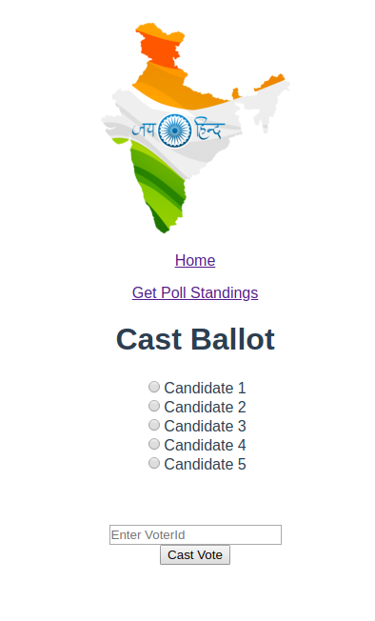
After logging-in into the web application they are directed to the ballot page . Here they are supposed to choose the party that they wanna support , then submit it entering the Voter ID.

Slide 17
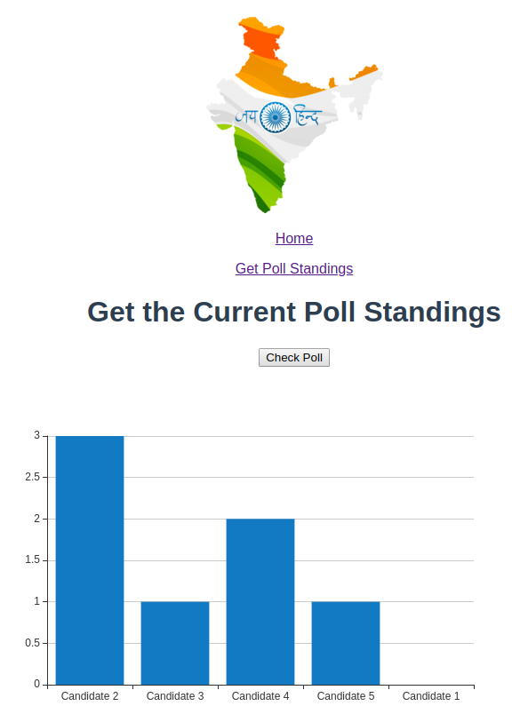
The web application provides an option to acknowledge the voters with the current statistics of the votes casted . This is where we get the results of the current polling in the form of a bar chart.

Slide 18
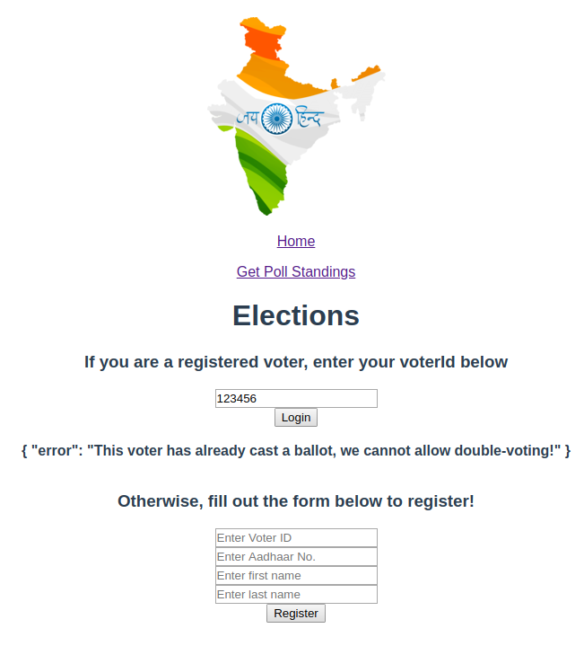
When a voter tries to login to vote for the second time we meet a terminating condition where the voter will not be allowed to vote again. Here is an example of such a situation.

Slide 19
Data used
ballotData.json :
This has the data regarding the Race titles that are involved like Presidential race ,etc. For each race it has data of its own description . Under each race , it has the data of each candidate participating and their respective agenda .
electionData.json :
This has all the data regarding the election that constitute the information regarding the Registrar of the election such as their name, organisation, locality, state, country etc and also has the data regarding the name of the election, the country where the elections are held and the year in which the election is conducted .
presElection.json :
This has all the data regarding the name and description of the candidates participating with their respective agendas.

Slide 20
Terminating conditions
When the voter registers himself to vote he will have to give several information about his name, place and government issued ID number . In case this data is not present in the data of the government DB, then the user cannot cast his vote as he is considered as an illegitimate voter .
When the registered voter casts his or her vote, then when they try to vote again for the second time then they will not be allowed to vote .

Slide 21
Hyperledger Fabric
Hyperledger Fabric is an open source framework implementation for private and permissioned business networks, where the member identities and roles are known to the other members. It’s designed as a foundation for developing solutions with a modular architecture. It allows components, such as ledger database, consensus mechanism, and membership services, to be plug-and-play. It leverages container technology and delivers enterprise-ready network security, scalability, and confidentiality.

Slide 22
Hyperledger fabric components
Assets
Shared ledger
Smart contract
Peer nodes
Channel
Organizations
Membership Services Provider (MSP)
Ordering service

Slide 23
Smart Contract
Smart contracts are trackable and irreversible applications that execute in a decentralized environment (e.g., blockchain). Once the smart contract has been deployed nobody can edit the code or change its execution behavior. Smart contract execution guarantees to bind parties together to an agreement as written. This creates a new powerful type of trust relationship that does not rely on a single party. Smart contracts enables better management for realizing and administering digital agreements because they are self-verifying and self-executing

Slide 24
Blockchain features
A blockchain is a distributed, immutable, incontrovertible, public ledger. This new technology works through four main features:
(i) The ledger exists in many different locations: No single point of failure in the maintenance of the distributed ledger.
(ii) There is distributed control over who can append new transactions to the ledger.
(iii) Any proposed “new block” to the ledger must reference the previous version of the ledger, creating an immutable chain from where the blockchain gets its name, and thus preventing tampering with the integrity of previous entries.
(iv) A majority of the network nodes must reach a consensus before a proposed new block of entries becomes a permanent part of the ledger.

Slide 25
Conclusion
The proposed framework ensures security by capturing and intimating each and every legal and illegal activity of the voters during the polling and counting process in E-voting.
As time and again, the literacy rate and education opportunities with competition is improving worldwide this method can be incorporated with a wide scope in upcoming years and decades.

Slide 26
Future work
The current project uses only the basic validation of the data using a government issued ID number such as voter ID or aadhar card number. In future this method can be made easy with the help of an optional fingerprint sensor available in almost all the devices in the current world of technology .

Slide 27
References
[1] Bin Yu ,Joseph K. Liu, Amin Skated , Surya Nepal ,Ron Steinfeld ,Paul Rimba, Man Ho Au Platform-Independent Secure Blockchain-Based Voting System(2018)
[2] Denis Kirillov ,Vladimir Korkhov ,Vadim Petrunin ,Mikhail Makarov ,Ildar M. Khamitov ,Victor Dostov Implementation of an E-Voting Scheme Using Hyperledger Fabric Permissioned Blockchain (2019)
[3] Emre Yavuz , Ali Kaan Secure e-voting using ethereum blockchain(2018)
[4] Hjalmarsson, F.P., Hreioarsson, G.K., Hamdaqa, M., & Hjalmtysson, G. (2018). Blockchain-based e-voting system. In IEEE 11th international conference on cloud computing (CLOUD) (pp. 983–986).
[5] David Khoury ,Elie F. Kfoury , Ali Kassem , Hamza Harb Decentralized Voting Platform Based on Ethereum Blockchain (2018)

Slide 28
THANK YOU

