Slide 1
Manifold learning of 3d objects
Varsha Pendyala
EE13B1022

Slide 2
Manifold learning
Most of the data that we encounter in any application is high-dimensional in its crude form.
Problems associated with high-D data:
Visualisation
Storage
Processing time
Curse of dimensionality

Slide 3
In that case, can we find the low dimensional basis for describing such data?
The answer is true in most of the cases.
Because any system that generates the data follows certain model. Hence, we can always get the data into such a representation where it is purely governed by the dof that the system generating it allows.
Or in other words, the data has intrinsic dimensionality that may be different from the ambient dimensionality (i.e the no. of dimensions of raw data representation).
In mathematical sense, some methods describe this intrinsic dimensionality as the topological dimension.
Topological dimension is the basis dimension of the local linear approximation of the hypersurface on which the data resides.

Slide 4
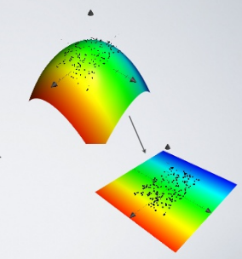
In this case, though we see the first surface has the 3D representation, we can find its equivalent 2D representation
by preserving the local neighbourhood.

Slide 5
Local Linear Embedding
Hence, one of the approaches called LLE uses this local linearity property to find the low dimensional representation to the data points.

Slide 6
How to find the intrinsic dimensionality?
Intrinsic dimensionality equals the dof of the system that is generating the data.
However, we may not have modelled the system in all the applications.
In that case we resort to certain mathematical approaches that estimates the intrinsic dimensionality from the data itself.
For example, in PCA we find the covariance matrix of the data and the number of dominant eigen values of that matrix gives the dimensionality of the data

Slide 7
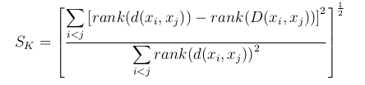
Several methods exist in case of non-linear data:
Local methods:
which perform tessellation of data space to do PCA locally
Using Topology representing networks to find the reference vectors that closely reflect the structure of input data distribution
Global methods:
PCA in linear case
Kernel PCA in non-linear case
MDS methods which tend to preserve, as much as possible the distances among the data
For example, one of the methods minimize following measure:

Slide 8
Inverse mapping
Now we have the high-D to low-D discrete mapping.
The other side of the problem is to find the inverse mapping from low-D to high-D.
The applications for such a problem include:
DE noising of the data: When we learn the low dimensional manifold, smoothing over the data is achieved. Hence, we get the de-noised high-D data when generated using its low-D counterpart.
Meaningful interpolation of temporal/spatial data: Learning the inverse mapping allows us to do all the modelling in low-D and give the high-D only for human consumption.
It gives more meaningful result, since curse of dimensionality do not allow for reliable interpolation in the high-dimensional space.

Slide 9
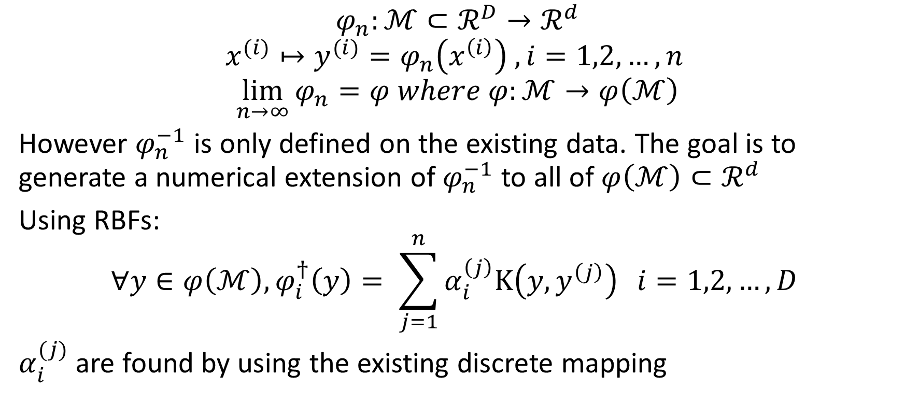
RBF interpolation for inverse mapping
$$φ_{n}:ℳ⊂ℛ^{D}→ℛ^{d}$$
$$x^{(i)}↦y^{(i)}=φ_{n}\left(x^{\left(i\right)}\right) , i=1,2,…,n$$
$$\lim_{n→∞}{φ_{n}}=φ where φ:ℳ→φ\left(ℳ\right)$$
However $φ_{n}^{−1}$ is only defined on the existing data. The goal is to generate a numerical extension of $φ_{n}^{−1}$ to all of $φ\left(ℳ\right)⊂ℛ^{d}$
Using RBFs:
$$∀y∈φ\left(ℳ\right), φ_{i}^{†}\left(y\right)= \sum_{j=1}^{n}{α_{i}^{\left(j\right)}Κ\left(y,y^{\left(j\right)}\right)} i=1,2,…,D$$
$α_{i}^{(j)}$are found by using the existing discrete mapping

Slide 10
Implementation

Slide 11


Intrinsic dimension estimation:
Grassberger-Procaccia (GP) algorithm is used to estimate the intrinsic dimension of the data:
D: correlation dimension, which is found to be close to intrinsic dimension of the data
However, it has been proved that in order to get an accurate estimate of the dimension D, the set cardinality N has to satisfy the following inequality: D < 2 log10 N
Hence, an empirical approach has been developed to work with small cardinality sets.

Slide 12
Consider the set Ω whose intrinsic dimension has to be estimated. The procedure has following steps:
Another set Ω’ with same cardinality N is generated from uniformly distributed data points from a d-dimensional hypercube. We assume ID of Ω’ to be d.
The correlation dimension(D) is measured by GP algorithm.
Previous steps are repeated for T different values of d, thus obtaining C={(Di,di) , i=1,2,...T}
The best fitting of points of C by non-linear functions is performed. (Thus we create a look up table for a particular N)
Finally the correlation dimension of Ω is computed, and by using the best-fit the intrinsic dimension of Ω is estimated.

Slide 13
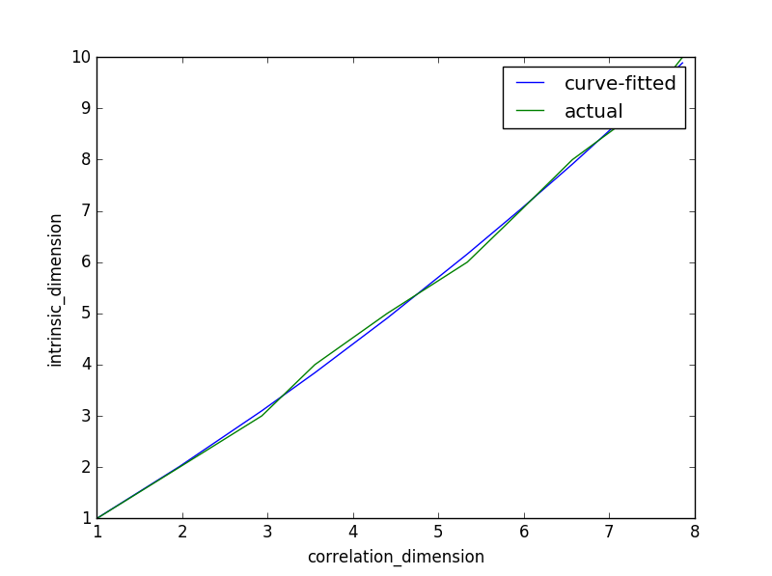
For N=1000, dmin=1, dmax=10 curve fitting is done with quadratic polynomial:

Slide 14
After finding this curve, it is tested with hypercube data of different dimensions. Hence, here ideally d=D.
Following are the results from GP algorithm:
D | Correlation_dimension | Intrinsic_dimension = d
11 | 8.67 | 11.21
13 | 9.8 | 13.16
15 | 10.68 | 14.7
17 | 11.5 | 16.2
19 | 12.79 | 18.7
23 | 14.48 | 22.29
26 | 15.5 | 24.6
28 | 16.17 | 26
30 | 16.3 | 26.4

Slide 15
DataSet
I have considered a 3d object in its nurbs representation
To learn the manifold of this object, we need to have various distorted versions of the same objects.
Nurbs have the property of affine invariance. It implies, we can perform affine transformation of the object by applying the same on its control points.
Thus each version of 3d object is given by an affine transformation over original control points.
Hence, we should be able to get the intrinsic dimension of this manifold of 3d object as nearly 9(since affine transformation allows 9 dof)

Slide 16
Inverse mapping
Once the lowd representation of nurbs object is obtained, inverse mapping is found through RBF interpolation
The efficiency of the RBF method can be found by leave-one-out reconstruction.

