Slide 1

Customer Behavior Dashboard Analysis
Transforming raw data into actionable customer insights for strategic decision-making

Slide 2

Dashboard Overview
A comprehensive analytical tool that captures customer purchasing patterns, demographic preferences, and transaction behaviors across multiple dimensions including age, gender, location, and payment methods.

Slide 3

Customer Behavior Dashboard Overview
This dashboard analyzes customer purchasing behavior across different demographics, payment methods, and product categories. It helps businesses understand revenue distribution, customer segments, and shopping preferences to support data-driven decisions.

Slide 4
Key Performance Indicators
251.51M
299K
Total Revenue
Quantity Sold
Overall sales generated across all customer segments and product categories
Total products purchased demonstrating strong market demand
These KPIs show strong business performance with high product demand and significant overall revenue generation.

Slide 5

Revenue by Age Group
56+ Age Group
Mid-Age Groups
Younger Customers
Generates 67.10M in revenue, indicating strongest purchasing power and higher spending capacity
Aged 36–45 and 46–55 also contribute significantly to overall revenue
Aged 18–25 generate lowest revenue, presenting growth opportunity

Slide 6

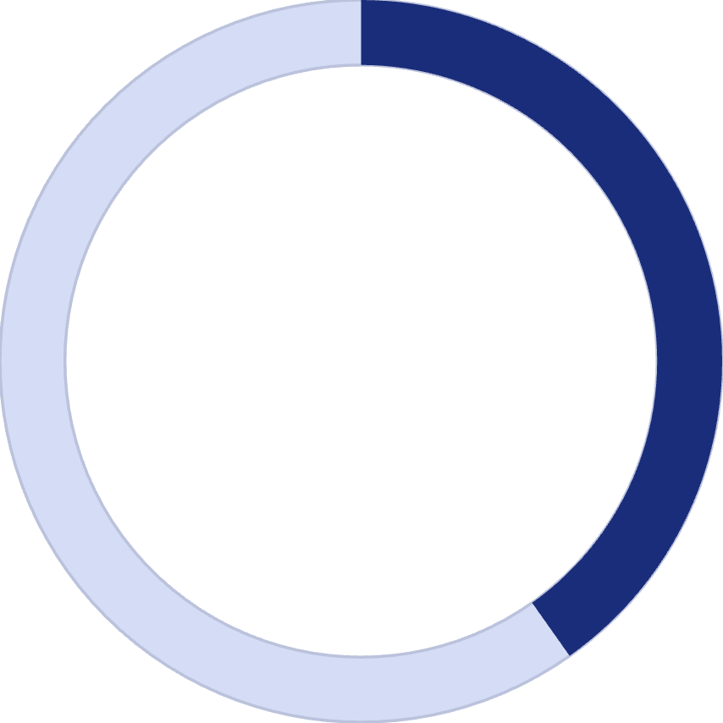
Revenue by Gender
59.8%
40.2%
Female Customers
Male Customers
Primary revenue contributors
Secondary revenue source
This indicates that female shoppers play a major role in overall sales.

Slide 7
Shopping Mall & Payment Method Analysis
1
2
3
Kanyon Mall Performance
Credit Card Dominance
Digital Payment Preference
Credit card payments lead all transaction methods, followed by debit cards and cash
Generates the highest revenue compared to other shopping locations, indicating strongest customer traffic and purchasing activity
Card-based transactions suggest customers value convenience and modern purchasing behavior

Slide 8

Category Distribution by Gender
Female Customer Dominance
Strategic Implication
This suggests stronger engagement of female customers in product purchasing behavior
Female customers dominate purchases across most product categories in the dataset

Slide 9
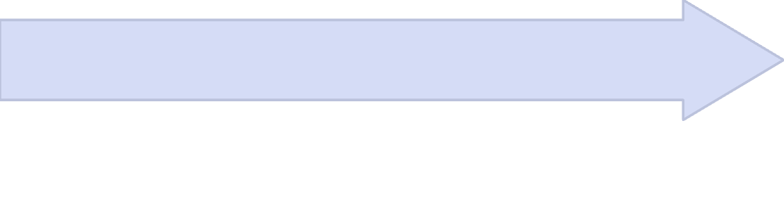

Age-Wise Quantity Sold
Key Insight
Gradual Decrease
Higher purchasing frequency among older customers suggests brand loyalty
56+ Age Group
Product demand decreases progressively with younger age groups
Purchase the highest quantity of products, demonstrating highest purchasing frequency

Slide 10




Business Insights
Target Marketing Campaigns
Strengthen Female Engagement
Focus promotional efforts on the 56+ age group with highest purchasing power
Develop strategies to maintain and grow female customer base
Promote Digital Payments
Engage Younger Demographics
Encourage digital transactions for smoother checkout experiences
Increase product promotions specifically for younger age groups

Slide 11
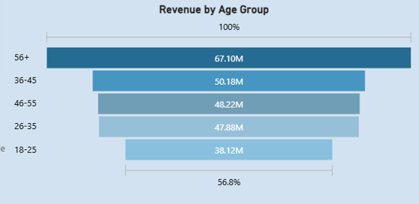
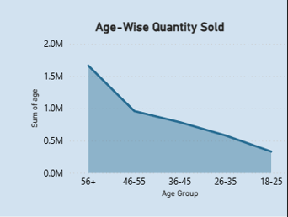
Customers aged 56+ generate the highest revenue (67.10M), showing the strongest purchasing power. The 36–45 and 46–55 age groups also contribute significantly to sales. In comparison, the 18–25 age group generates the lowest revenue (38.12M), indicating lower spending among younger customers.
The 56+ age group purchases the highest quantity of products, showing the strongest buying activity. Sales gradually decrease across younger age groups, with the 18–25 group purchasing the least. This indicates that older customers tend to buy products more frequently.

Slide 12
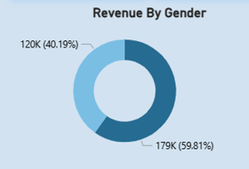
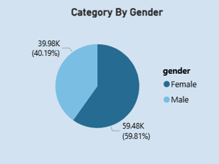
Female customers contribute the majority of revenue with 59.81% (179K), while male customers account for 40.19% (120K). This indicates that female shoppers play a more significant role in overall sales and purchasing activity.
Female customers account for the majority of purchases with 59.81% (59.48K), while male customers contribute 40.19% (39.98K). This shows that female shoppers are more active across product categories and drive a larger share of total purchases.

Slide 13
