Slide 1
LAPS N TABS TECNOLOGY PRIVATE LIMITED

Slide 2
Proud Indian homegrown brand in the IT Industry

Slide 3
Products
Desktop computers
All in ones
Monitors
Workstations
Keyboard & Mouse
Toner cartridges
CCTV Camera & Accessories

Slide 4
Our Products
Security
CCTV cameras
Cables – CAT6, 3+1 CCTV
SMPS
Accessories – POE switch, BNC connector, DC pin

Slide 5


























We are serving all major Central & State Govt. departments across 100 cities in India
CUSTOMERS

Slide 6











Certifications
Only Indian OEM brand recognized on the Intel website
We have all the necessary environment, quality and business certifications

Slide 7
Sales & Support
All our products are registered on GeM
We have a robust sales & service support system Pan India in more than 100 cities
Dedicated Toll free number for hassle free service experience

Slide 8
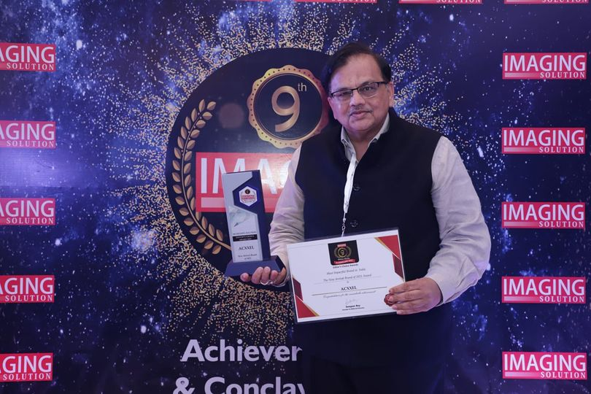
Most Promising IT Brand
Recognition & Reward

Slide 9
Thank You

