Slide 1
JSON
(javascript object notation)

Slide 2
Introduction to JSON
16 year web development professional
(Almost) entirely self taught
Has used various Ajax-esque data technologies since 2000, including XML, MS data islands and AMF for Flash
Develops JavaScript based web apps that rely on JSON for data workflow

Slide 3
overview
 What is JSON?
 Comparisons with XML
 Syntax
 Data Types
 Usage
 Live Examples

Slide 4

What is JSON?

Slide 5
JSON is….
1.A lightweight text based data-interchange format
2.Completely language independent
3.Based on a subset of the JavaScript Programming Language
4.Easy to understand, manipulate and generate

Slide 6
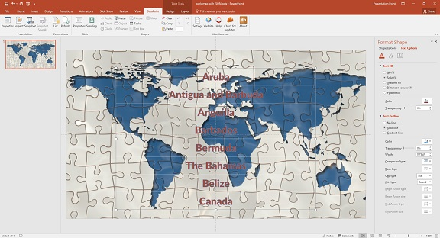
Usage of
Usage of JSON over the world

Slide 7

json is not…
Overly complex
A “document” format
A markup language
A programming language

Slide 8
Why to use json?
Straightforward syntax
Easy to create and manipulate
Can be natively parsed in JavaScript using eval()
Supported by all major JavaScript frameworks
Supported by most backend technologies

