Slide 1
Python Learning Session
Presented By
Ajeet Kumar Yadav

Slide 2
Agenda:Day1
Python Overvieww
Install Python
Example Python
Variables Python
Data Types Python
Literals Python
Operators Python
Comments Python

Slide 3
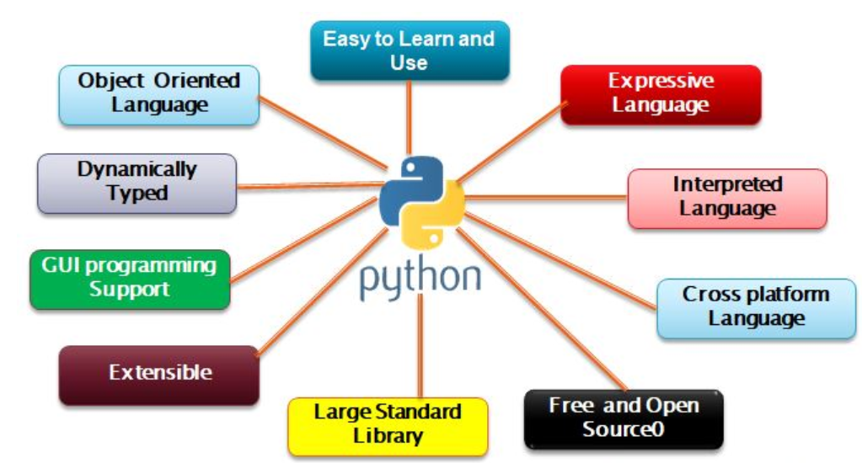
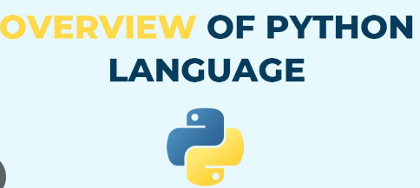
Python Overview

Slide 4
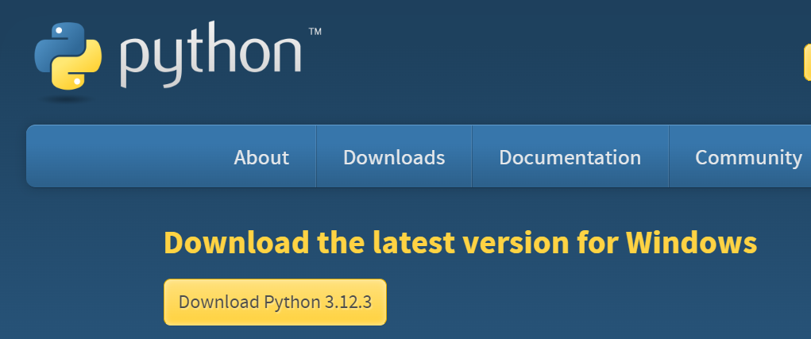

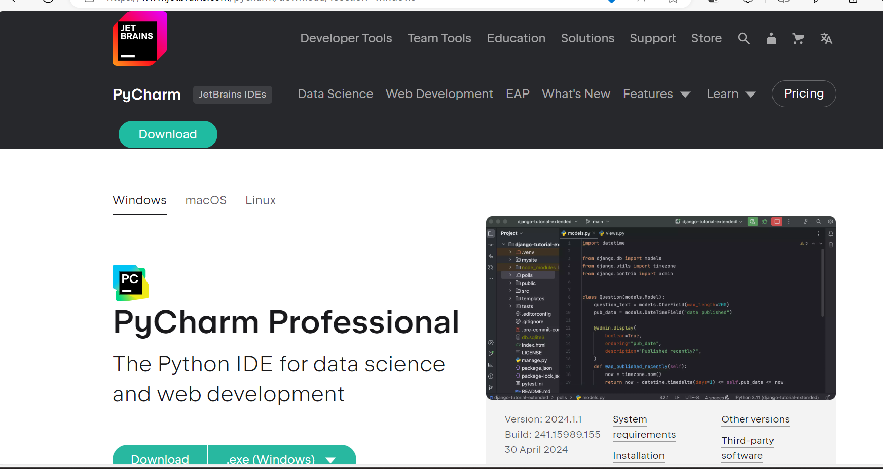
Installation & Configuration
Install Python
Set up Env variable
Verify in Command Prompt
Install PyCharm
Create project
Run First program using Python
Download Python | Python.org

Slide 5
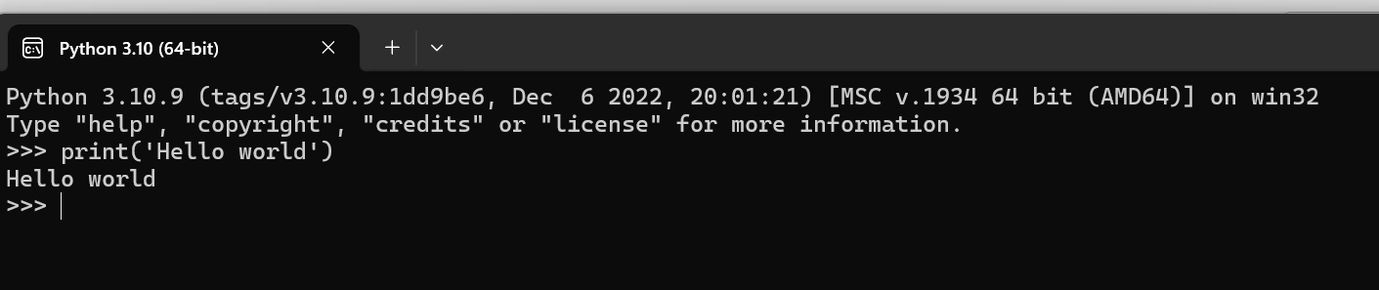
Example: Python Programming
Install Python
Set up Env variable
Verify in Command Prompt
Install PyCharm
Create project
Run First program using Python
Download Python | Python.org

Slide 6
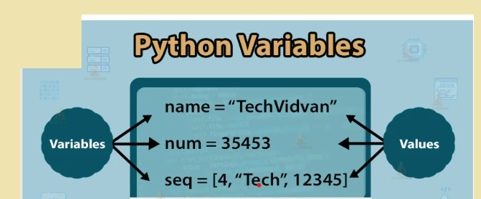
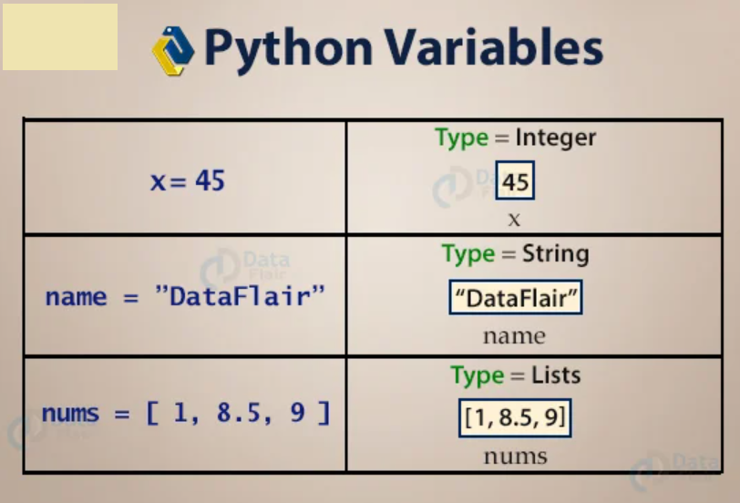
Variables Python
Variable names must begin with a letter or an underscore, but they can be a group of both letters and digits
The name of the variable should be written in lowercase. Both VARNAME and varname are distinct variables.

Slide 7
Variables Python
Assigning single value to multiple variables
Eg:
x=y=z=50
print(x)
print(y)
print(z)
Assigning multiple values to multiple variables:
Eg:
a,b,c=5,10,15
print a
print b
print c

Slide 8
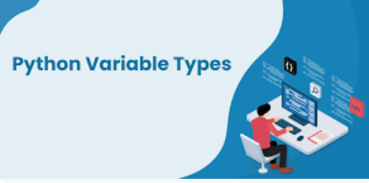
Variables Type Python
Python Variable Types
Local variable :
Declare locally-within block
Global variable
Global variables can be utilized all through the program,

Slide 9
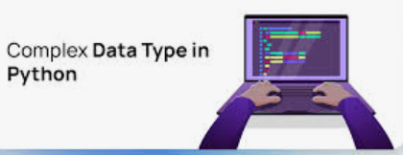
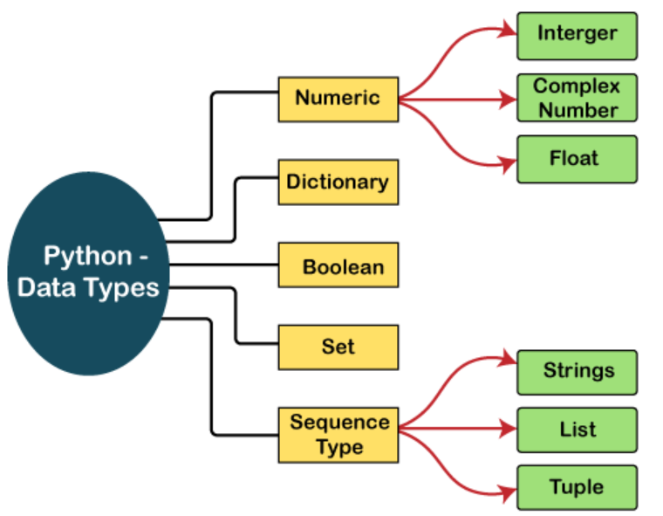
Data Type: Python

Slide 10
Data Type: Python
Numeric
Numeric values are stored in numbers.
The whole number, float, and complex qualities have a place with a Python Numbers datatype.
Python offers the type() function to determine a variable's data type.
Sequence Type
String
The sequence of characters in the quotation marks can be used to describe the string.
A string can be defined in Python using single, double, or triple quotes.

Slide 11
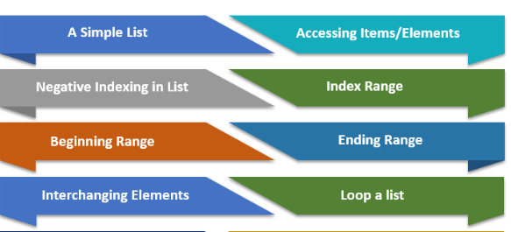
Data Type: Python
List
lists can contain data of different types
List elements are separated by comma (,) and encased inside square sections [].
Tuple
A parenthetical space () separates the tuple's components from one another.
Because we cannot alter the size or value of the items in a tuple, it is a read-only data structure.

Slide 12
Data Type: Python
Dictionary
A dictionary is a key-value pair set arranged in any order
The comma (,) and the curly braces are used to separate the items in the dictionary
Boolean
True and False are the two default values for the Boolean type
False can be represented by the 0 or the letter "F,"
True can be represented by any value that is not zero.

Slide 13
Data Type: Python
Set
The data type's unordered collection is Python Set.
It is iterable, mutable(can change after creation), and has remarkable components.
The elements of a set have no set order; It might return the element's altered sequence.
Either a sequence of elements is passed through the curly braces and separated by a comma to create the set or the built-in function set() is used to create the set.
It can contain different kinds of values.

Slide 14
Python Literals
Python Literals can be defined as data that is given in a variable or constant.
1. String literals:
String literals can be formed by enclosing a text in the quotes.
We can use both single as well as double quotes to create a string
a) Single-line String- Strings that are terminated within a single-line are known as Single line Strings.
b) Multi-line String - A piece of text that is written in multiple lines is known as multiple lines string.
1) Adding black slash at the end of each line.
2) Using triple quotation marks:-

Slide 15
Q & A

Slide 16
Thank You

Slide 17
Python Learning Session-2
Presented By
Ajeet Kumar Yadav

Slide 18
Agenda:Day2
If else Python
Loops Python
For Loop Python
While Loop Python
Break Python
Continue Python

Slide 19
Agenda:Day2
If else Python
Loops Python
For Loop Python
While Loop Python
Break Python
Continue Python

Slide 20
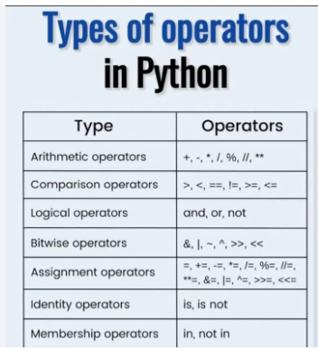
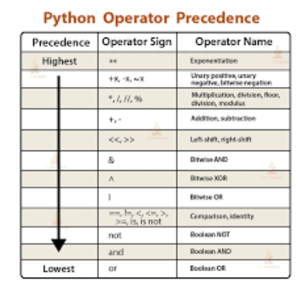
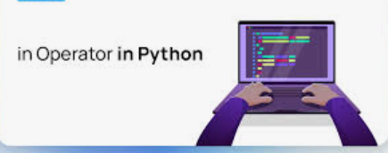
Python Operator

Slide 21
Comments in Python
A single-line comment of Python is the one that has a hashtag # at the beginning of it and continues until the finish of the line
# This code is to show an example of a single-line comment
print( 'This statement does not have a hashtag before it' )
Multi-Line Comments
Python does not provide the facility for multi-line comments. However, there are indeed many ways to create multi-line comments.
In Python, we may use hashtags (#) multiple times to construct multiple lines of comments. Every line with a (#) before it will be regarded as a single-line comment

Slide 22
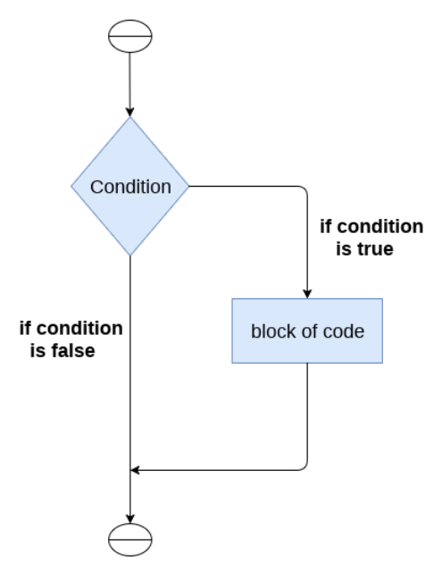
If Statement
The syntax of the if-statement is given below.
if expression:
statement

Slide 23
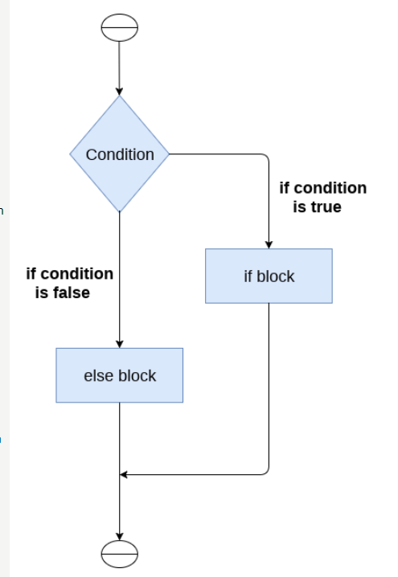
If-Else
The syntax of the if-else statement is given below.
if condition:
#block of statements
else:
#another block of statements (else-block)

Slide 24
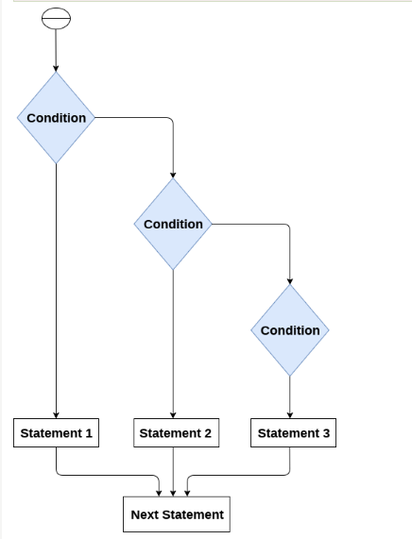
The elif statement
The elif statement enables us to check multiple conditions
if expression 1:
# block of statements
elif expression 2:
# block of statements
elif expression 3:
# block of statements
else:
# block of statements

Slide 25
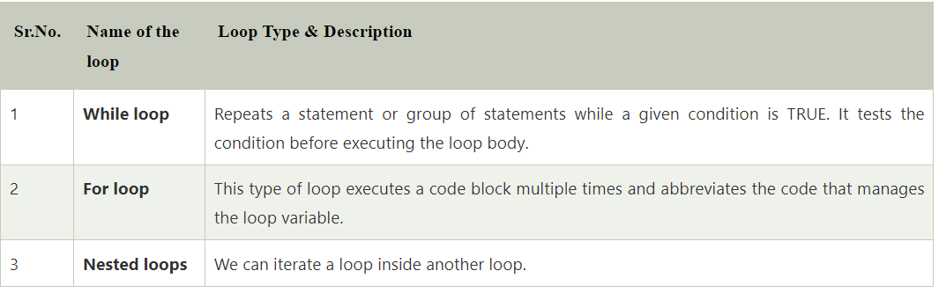
Loop: Python

Slide 26
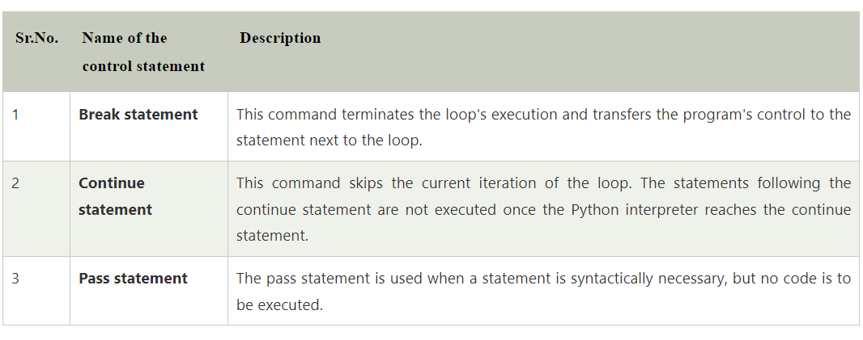
Loop Control Statements

Slide 27
The for Loop
Python's for loop is designed to repeatedly execute a code block while iterating through a list, tuple, dictionary, or other iterable objects of Python
for value in sequence:
{ code block }
The range() Function
With the help of the range() function, we may produce a series of numbers. range(10) will produce values between 0 and 9. (10 numbers).

Slide 28
While Loop
While loops are used in Python to iterate until a specified condition is met. However, the statement in the program that follows the while loop is executed once the condition changes to false.
Syntax of the while loop is:
while <condition>:
{ code block }

Slide 29
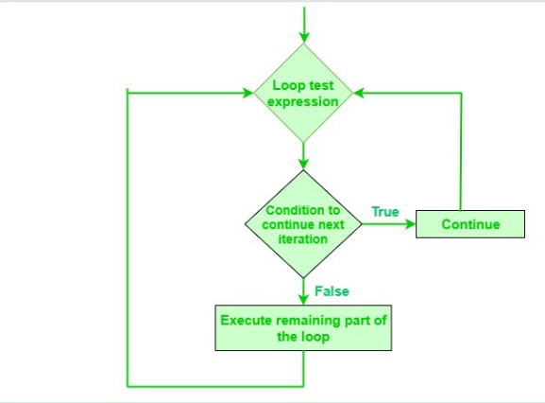
Continue Statement
It returns the control to the beginning of the loop.

Slide 30
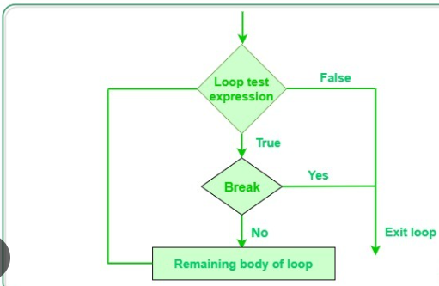
Break Statement:
In Python, the break statement is used to immediately exit a loop when a certain condition is met.
When working with nested loops, the break statement can be used to break out of both the inner and outer loops

Slide 31
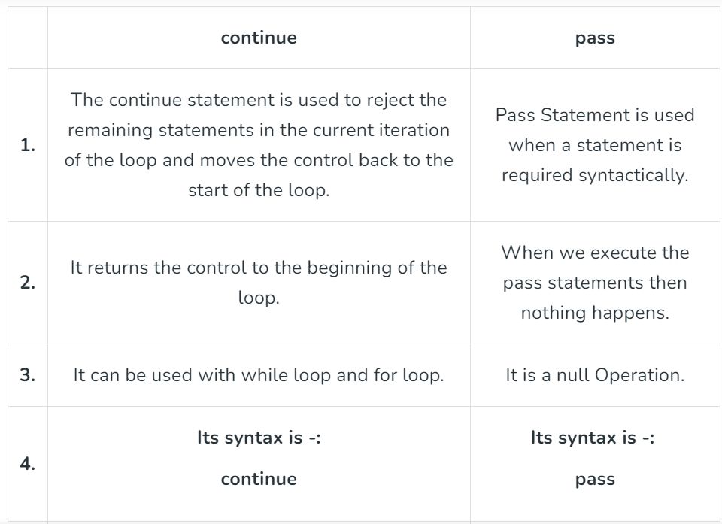
Pass Statement
The pass statement is used as a placeholder for future code.
When the pass statement is executed, nothing happens, but you avoid getting an error when empty code is not allowed.
Empty code is not allowed in loops, function definitions, class definitions, or in if statements

Slide 32
Q & A

Slide 33
Thank You

Slide 34
Python Learning Session-3
Presented By
Ajeet Kumar Yadav

Slide 35
Agenda:Day3
Python OOPs
Object
Inheritance Abstraction in Python
Constructors Python
Modules Python Exceptions

Slide 36
Python OOPs Concepts
Python is also an object-oriented language since its beginning. It allows us to develop applications using an Object-Oriented approach. In Python, we can easily create and use classes and objects.
Major principles of object-oriented programming system are given below.
Class
Object
Method
Inheritance
Polymorphism
Data Abstraction
Encapsulation

Slide 37
Class
The class can be defined as a collection of objects. It is a logical entity that has some specific attributes and methods
Syntax
class ClassName:
<statement-1>
.
.
<statement-N>

Slide 38
Object
The object is an entity that has state and behavior. It may be any real-world object like the mouse, keyboard, chair, table, pen, etc.
Syntax:
# Declare an object of a class
object_name = Class_Name(arguments)

Slide 39
The self-parameter
The self-parameter refers to the current instance of the class and accesses the class variables.
We can use anything instead of self, but it must be the first parameter of any function which belongs to the class.
Syntax
class ClassName:
#statement_suite
def __init__(self, name, age):
#statement_suite

Slide 40
_ _init_ _ method
In order to make an instance of a class in Python, a specific function called __init__ is called.
Although it is used to set the object's attributes, it is often referred to as a constructor.
The self-argument is the only one required by the __init__ method.
This argument refers to the newly generated instance of the class

Slide 41
Python Constructor
A constructor is a special type of method (function) which is used to initialize the instance members of the class.
In C++ or Java, the constructor has the same name as its class, but it treats constructor differently in Python. It is used to create an object.
Constructors can be of two types.
Parameterized Constructor
Non-parameterized Constructor

Slide 42
Python Constructor
Creating the constructor in python
In Python, the method the __init__() simulates the constructor of the class. This method is called when the class is instantiated. It accepts the self-keyword as a first argument which allows accessing the attributes or method of the class.
We can pass any number of arguments at the time of creating the class object, depending upon the __init__() definition. It is mostly used to initialize the class attributes. Every class must have a constructor, even if it simply relies on the default constructor.

Slide 43
Counting the number of objects of a class
The constructor is called automatically when we create the object of the class. Consider the following example.
class Student:
count = 0
def __init__(self):
Student.count = Student.count + 1
s1=Student()
s2=Student()
s3=Student()
print("The number of students:",Student.count)

Slide 44
Python Non-Parameterized Constructor
The non-parameterized constructor uses when we do not want to manipulate the value or the constructor that has only self as an argument. Consider the following example.
Example
class Student:
# Constructor - non parameterized
def __init__(self):
print("This is non parametrized constructor")
def show(self,name):
print("Hello",name)
student = Student()
student.show("John")

Slide 45
Python Parameterized Constructor
The parameterized constructor has multiple parameters along with the self. Consider the following example.
class Student:
# Constructor - parameterized
def __init__(self, name):
print("This is parametrized constructor")
self.name = name
def show(self):
print("Hello",self.name)
student = Student("John")
student.show()

Slide 46
Python Default Constructor
When we do not include the constructor in the class or forget to declare it, then that becomes the default constructor. It does not perform any task but initializes the objects. Consider the following example.
Example
class Student:
roll_num = 101
name = "Joseph"
def display(self):
print(self.roll_num,self.name)
st = Student()
st.display()

Slide 47
More than One Constructor in Single class
Let's have a look at another scenario, what happen if we declare the two same constructors in the class.
Example
class Student:
def __init__(self):
print("The First Constructor")
def __init__(self): print("The second contructor")
st = Student()

Slide 48
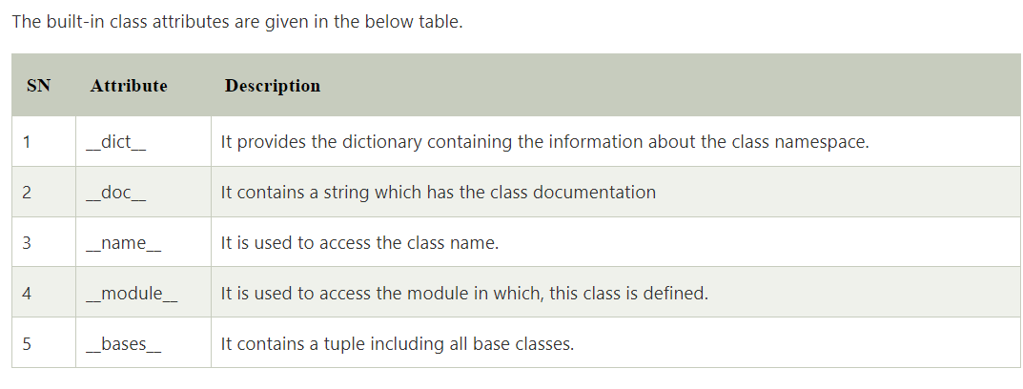
Built-in class attributes
Along with the other attributes, a Python class also contains some built-in class attributes which provide information about the class.

Slide 49
Q & A

Slide 50
Thank You

Slide 51
Python Learning Session
Presented By
Ajeet Kumar Yadav

Slide 52
Python Learning Session-4
Presented By
Ajeet Kumar Yadav

Slide 53
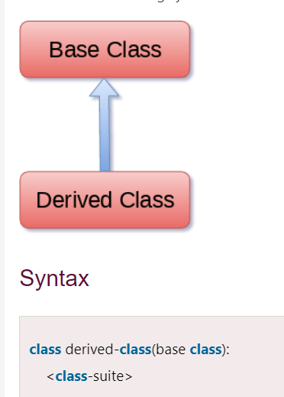
Python Inheritance
Inheritance is an important aspect of the object-oriented paradigm.
Inheritance provides code reusability to the program because we can use an existing class to create a new class instead of creating it from scratch.

Slide 54
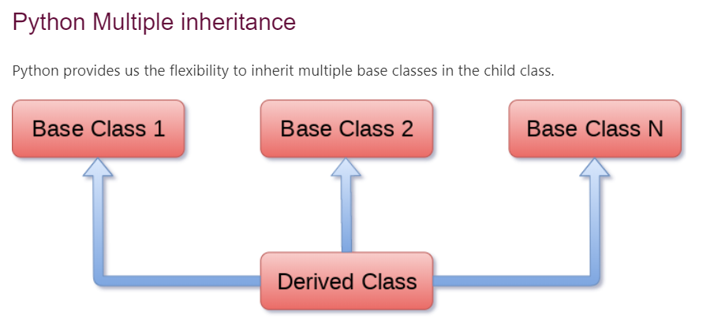
Python Inheritance
Syntax
class derive-class(<base class 1>, <base class 2>, ..... <base class n>):
<class - suite>

Slide 55
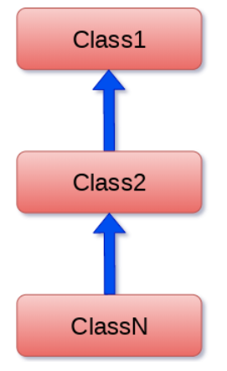
Python Multi-Level inheritance
Syntax
class class1:
<class-suite>
class class2(class1):
<class suite>
class class3(class2):
<class suite>

Slide 56
The issubclass(sub,sup) method
The issubclass(sub, sup) method is used to check the relationships between the specified classes.
It returns true if the first class is the subclass of the second class, and false otherwise.
class Calculation1:
def Summation(self,a,b):
return a+b;
class Calculation2:
def Multiplication(self,a,b):
return a*b;
class Derived(Calculation1,Calculation2):
def Divide(self,a,b):
return a/b;
d = Derived()
print(issubclass(Derived,Calculation2))
print(issubclass(Calculation1,Calculation2))

Slide 57
The isinstance (obj, class) method
The isinstance() method is used to check the relationship between the objects and classes.
It returns true if the first parameter, i.e., obj is the instance of the second parameter, i.e., class.
class Calculation1:
def Summation(self,a,b):
return a+b;
class Calculation2:
def Multiplication(self,a,b):
return a*b;
class Derived(Calculation1,Calculation2):
def Divide(self,a,b):
return a/b;
d = Derived()
print(isinstance(d,Derived)) /// True else false

Slide 58
Method Overriding
We can provide some specific implementation of the parent class method in our child class.
When the parent class method is defined in the child class with some specific implementation, then the concept is called method overriding.
class Animal:
def speak(self):
print("speaking")
class Dog(Animal):
def speak(self):
print("Barking")
d = Dog()
d.speak()

Slide 59
Real Life Example of method overriding
class Bank:
def getroi(self):
return 10;
class SBI(Bank):
def getroi(self):
return 7;
class ICICI(Bank):
def getroi(self):
return 8;
b1 = Bank()
b2 = SBI()
b3 = ICICI()
print("Bank Rate of interest:",b1.getroi());
print("SBI Rate of interest:",b2.getroi());
print("ICICI Rate of interest:",b3.getroi());

Slide 60
Abstraction in Python
Abstraction is used to hide the internal functionality of the function from the users.
The users only interact with the basic implementation of the function, but inner working is hidden.
Why Abstraction is Important?
In Python, an abstraction is used to hide the irrelevant data/class in order to reduce the complexity. It also enhances the application efficiency
An Abstract class can contain the both method normal and abstract method.
An Abstract cannot be instantiated; we cannot create objects for the abstract class.
Working of the Abstract Classes
Unlike the other high-level language, Python doesn't provide the abstract class itself. We need to import the abc module, which provides the base for defining Abstract Base classes (ABC). The ABC works by decorating methods of the base class as abstract. It registers concrete classes as the implementation of the abstract base. We use the @abstractmethod decorator to define an abstract method or if we don't provide the definition to the method, it automatically becomes the abstract method

Slide 61
Exceptions Handling
In Python, we catch exceptions and handle them using try and except code blocks. The try clause contains the code that can raise an exception, while the except clause contains the code lines that handle the exception.
# Python code to catch an exception and handle it using try and except code blocks
a = ["Python", "Exceptions", "try and except"]
try:
#looping through the elements of the array a, choosing a range that goes beyond the length of the array
for i in range( 4 ):
print( "The index and element from the array is", i, a[i] )
#if an error occurs in the try block, then except block will be executed by the Python interpreter
except:
print ("Index out of range")

Slide 62
How to Raise an Exception
#Python code to show how to raise an exception in Python
num = [3, 4, 5, 7]
if len(num) > 3:
raise Exception( f"Length of the given list must be less than or equal to 3 but is {len(num)}" )

Slide 63
Q & A

Slide 64
Thank You

