Slide 1
Intelligent I/O
Operating Systems Seminar

Slide 2
What is an I/O?
Input/output (I/O), in computing, is a communication process between a computer and the outside world.

Slide 3
The need of intelligence
Each operating system has its own unique I/O system and device interface. So hardware vendors faced the challenge of creating a different device driver for each operating system that they want their devices to support.
Thus the need of a standardized approach that complements existing drivers and offers a portable framework for the rapid development of a new generation of portable, I/O solutions.

Slide 4
What is an Intelligent I/O?
Intelligent I/O can be defined as a rule based model to perform I/O processing of the Operation system intelligently.
Intelligent I/O focus on a standard interface and permits complete implementation in user space applications that would normally require ad-hoc kernel modifications such as a Network File System.

Slide 5
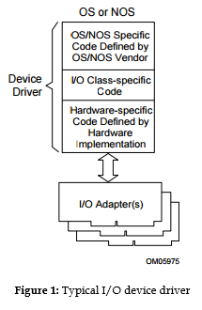
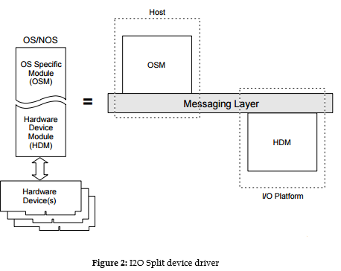
Typical Device Model vs Split Device Model

Slide 6
Benefits of I20
Standardization on intelligent platforms
Improved fault isolation and recovery
Handles real time requirements of I/O by exporting interrupts.

Slide 7
Thank you

