Slide 1
Web API
And
Web Services

Slide 2
Contents
Introduction to Asp. Net Web API
REST Protocol
Web API Routing
Security in Web API
What is a Web Service?
SOAP Based Web Service
HTTP Web Service
Examples of Web Services

Slide 3
Introduction to Web API
It is a framework for building HTTP services that can be consumed by range of clients like mobiles, iphones, tablets.
It makes it easy to create a set of web services that can respond to browser requests by using simple HTTP verbs GET, POST and DELETE.
It enables to build Representational State Tranfer(REST) enabled web services.
It facilitates two way communication between client system and server through task as:
instructing an application to perform certain task
reading data values
updating data values

Slide 4
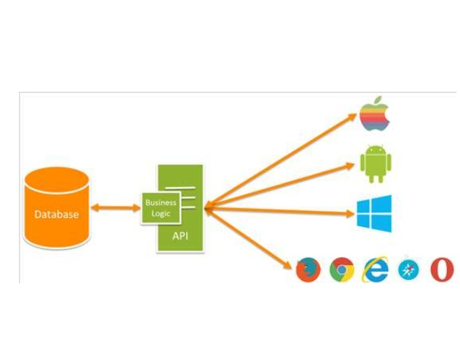

Slide 5
REST Protocol
It is a protocol used for exchanging data over a distributed environment.
For a remote resource all the CRUD operations should be possible using simple HTTP protocols.
Basic CRUD operations mapped to the HTTP protocols in the following manner:-
GET: R(Retrieve) the required data from the remote
resource.
PUT: U(Update) the current representation of the data on
the remote server.
POST: C(Create) the new entry for the current data that is
being sent to the server.
DELETE: D(Delete) the specified data from the remote
server.

Slide 6
Web API Routing
It helps to map HTTP requests to the Web API controllers and actions by using HTTP verbs and the request URL.
It supports two types of Routing
Web API Routing
Convention based
routing
Attribute Routing

Slide 7
Convention Based Routing
It is the default routing rule for every Web API application.
It uses the default route defined for the API which is
“api/{controller}/{id}”
Advantage:
Templates are defined in a single space and the routing rules are applied consistently across all controllers.

Slide 8
Attribute Routing
It use attributes to define routes.
It gives more control over the URIs in our Web API.
For ex: We can easily create URIs that describe hierarchies of resources.
In convention based routing it is hard to support certain URI patterns that are common in RESTfull APIs.

Slide 9
SECURITY IN WEB API
In ASP. NET Web API security can be implemented using Authentication and Authorization.
Authentication helps to authenticate a user against the application by verifying the identity of a user.
Authentication help to check whether a authenticated user is having rights or permission to perform specification.

Slide 10
WHAT IS A WEB SERVICE?
It is the communication platform between two different or same platform applications that allow to use their web method.
In context of .NET, it is a component that resides on a web server and provides information and services to other network application using standard web protocols such as HTTP and Simple Object Access Protocol(SOAP).
It is not designed to serve end users, as it is designed to provide services to other applications through a highly programmable Internet without having any user interface.

Slide 11
SOAP(SIMPLE OBJECT ACCESS PROTOCOL) BASED WEB SERVICE
It was designed to solve the problem of hybrid platform enterprises for communication.
It proposed the use of HTTP as the transport mechanism for sending and receiving XML.
It is a platform- and- language independent concept.
It can be used for broadcasting a message.

Slide 12
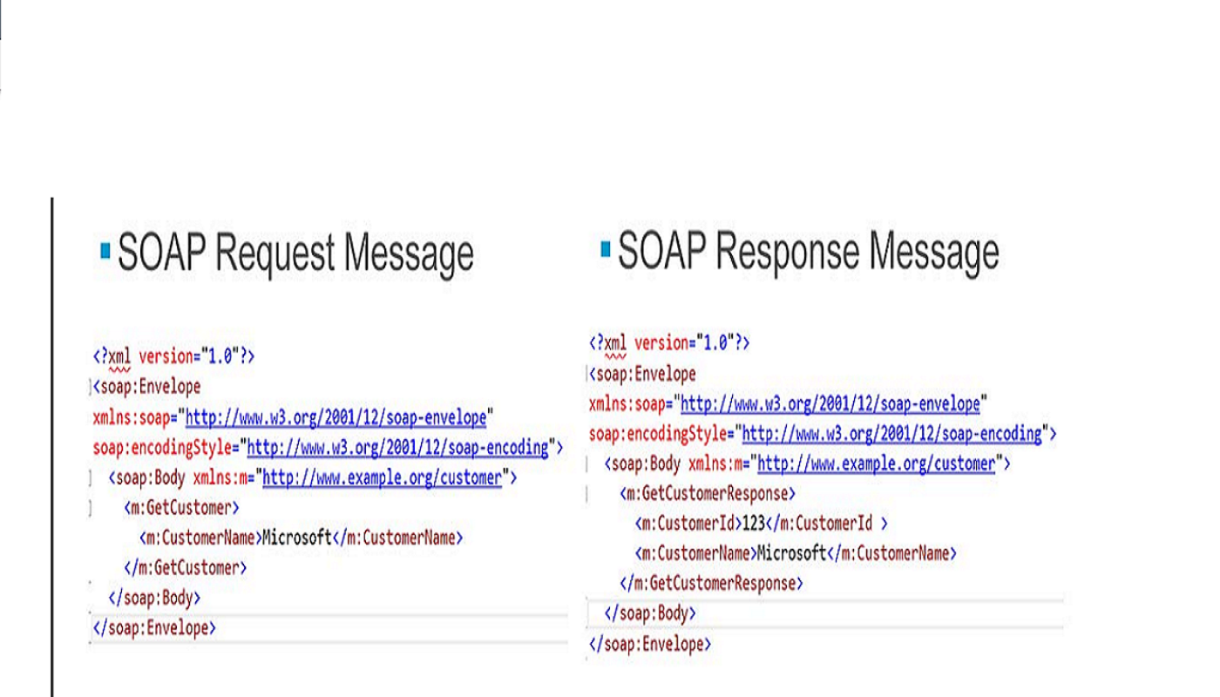

Slide 13
HTTP WEB SERVICE
HTTP is a flexible protocol used for communication where HTTP messages can be cached and travel through firewalls.
They’re lightweight which can be processed by processors on mobile devices.
They can be encrypted and the best of all every programming environment in the world offers some capability to send and receive HTTP messages.
SOAP based web services required a tool kit and more processing power whereas HTTP web service can be used anywhere.

Slide 14
WEB SERVICES EXAMPLE
Cloud Computing: “is location independent computing, whereby shared servers provide resources, software, and data to computers and other devices on demand”
In Cloud Computing, software is in the “cloud”. One of the main techniques for Cloud Computing is software as a service (SaaS), which is based on web services.
Google Apps/AppEngine: Google Cloud run our web applications on Google's infrastructure.

