Slide 1


Slide 2

Motivation
1 in 4 people die of heart diseases i.e. 1 in every 42 seconds
USA spends ~ $207 Billion every year
Key risk factors for heart disease – High blood pressure, high LDL cholesterol & smoking
Primary focus of
W-Heal will be cardiac arrest detection
W-Heal is a Software as a Service (SaaS)
aimed at bridging gap between
emergency dispatch and patients suffering from cardiac arrest

Slide 3
Social Impact
49% of the Americans have at least one of the 3 risk factors relating to heart condition
Life expectancy of an average American can be improved by early detection of possible risk.
We predict our product can influence 18% of the current population effected by heart diseases
This has an impressive cost benefit of $37.6 billion every fiscal year healthcare expenses
Above all, hundreds of lives might now have a change of being saved

Slide 4

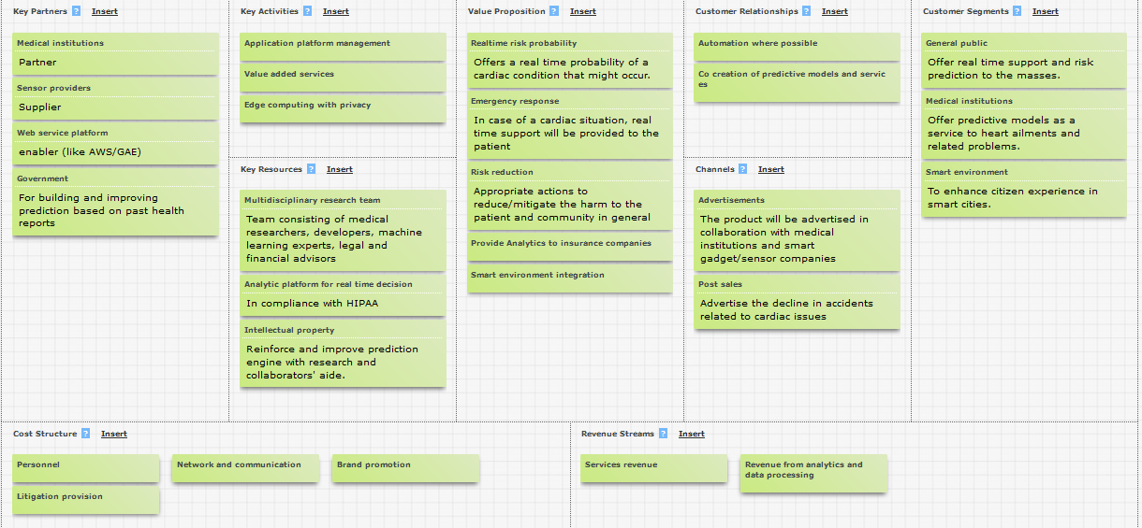
Business Model

Slide 5
Estimated Financial Figures
Approximate cost of development: $7000
Maintenance cost per year: $15000
Maintenance cost per customer per year: $1 .67(approx)
Cost of service per customer: 3 dollars(approx)
Net margin profit: $0.66(approx)

Slide 6
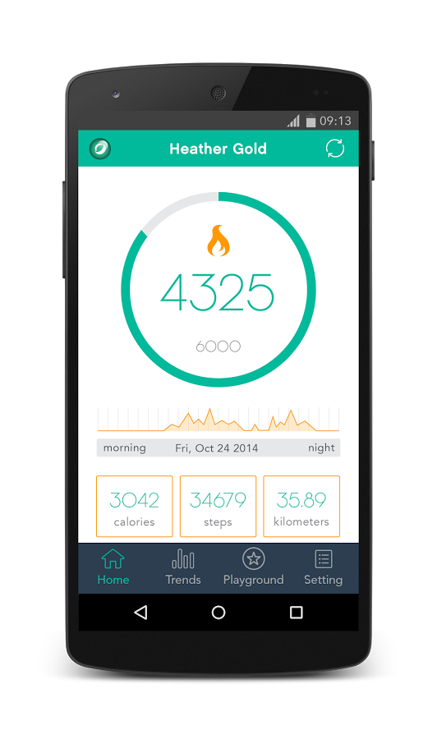
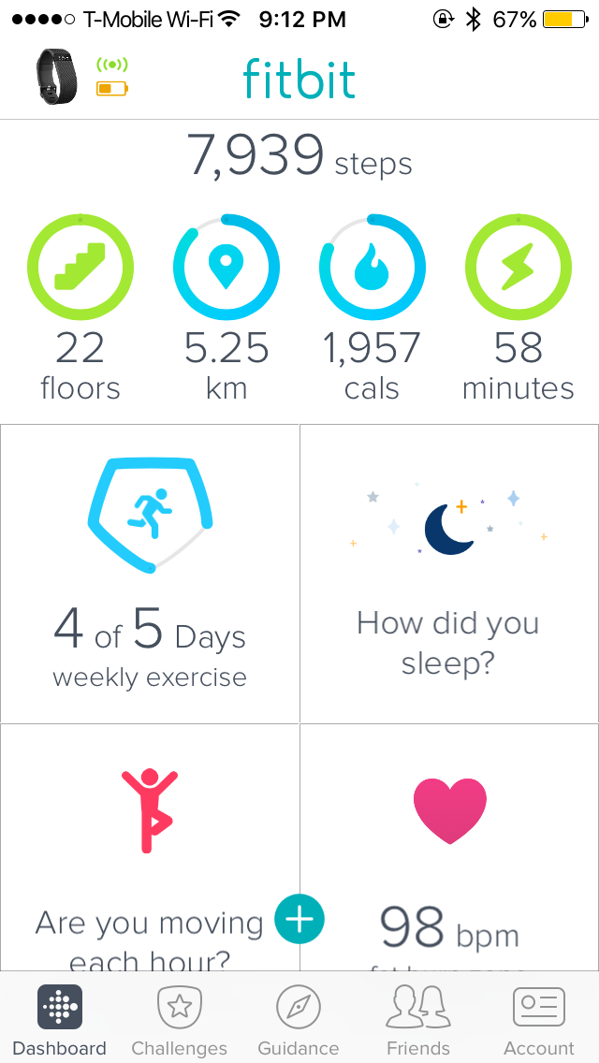

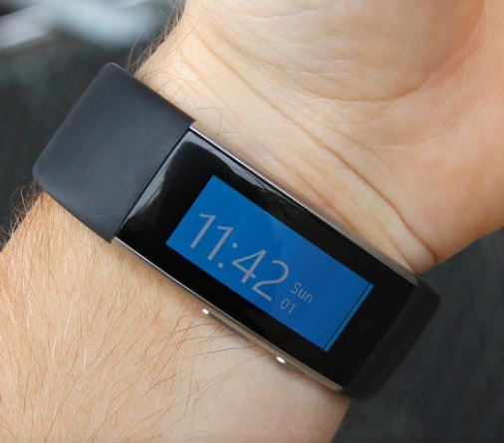
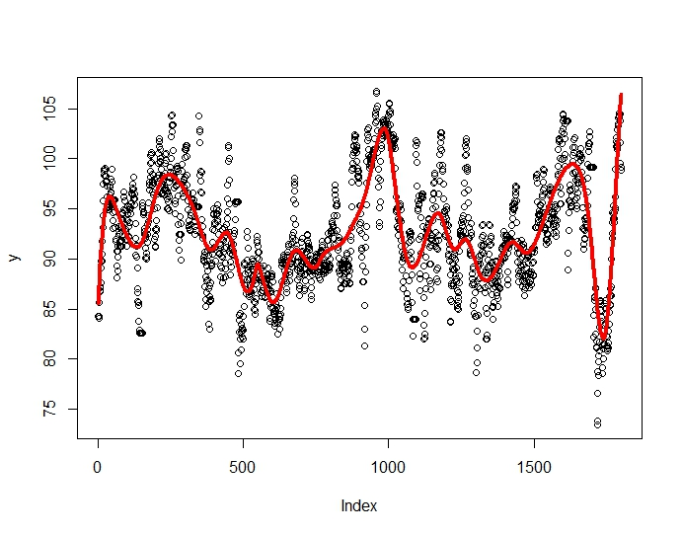

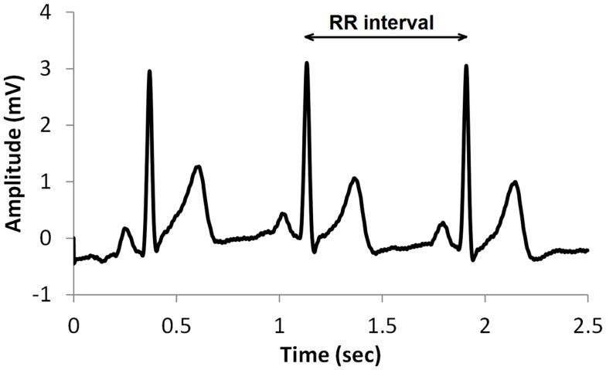
Overview
Vital Sign
Monitoring
Wearables
(Microsoft Band)
Emergency
Services
Heart Rate Monitoring
R-R Interval Assessment

Slide 7
Uniqueness
Doctors &
Medical Institutions
Research &
Acad.
Health Care Monitoring
W-Heal

Slide 8
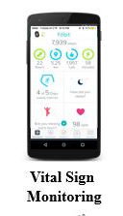
Cardiac Arrest - Factors to Consider
Personal Health Records
Real-Time Analysis
P(Cardiac Arrest)
Risk

Slide 9
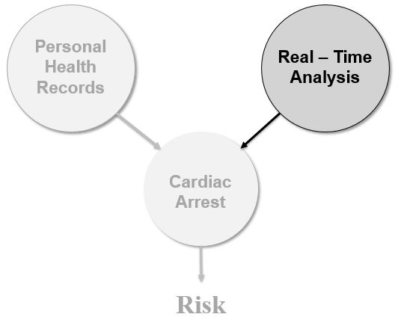
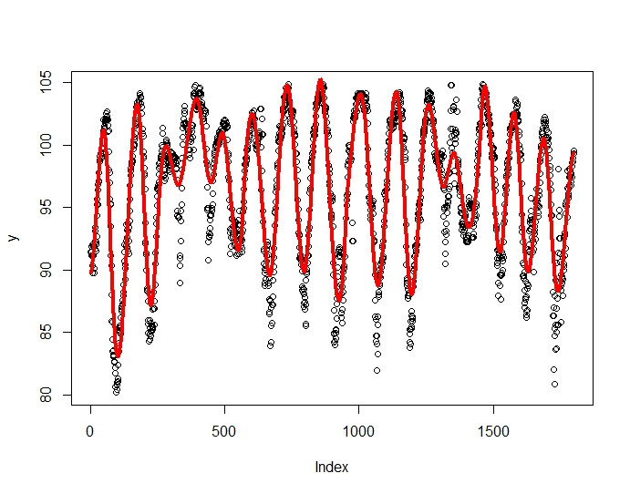
Periodicity - Metric for Real-Time Analysis
Healthy
Cardiac
Arrest
Health of a heart can be characterised by R-R Interval
Blood circulation is stochastic process and not strictly periodic
Periodic R-R implies cardiac arrest
Real-Time Analysis
R-R
R2
Microsoft Band

Slide 10
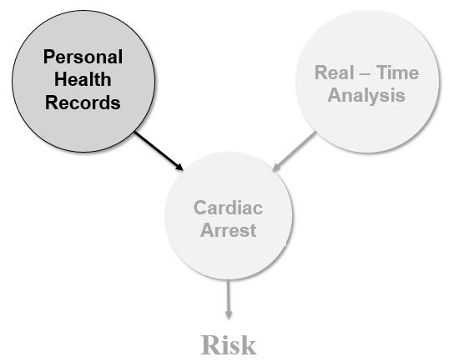

Stochastic Analysis in Diagnosis
Diagnosing heart-condition with patient history alone is time-consuming.
Adding stochastic analysis of heart and respiration can render efficient diagnosis.
This service package can help medical institutions.
Health Hist.
Doctor’s Expertise
Treatment
Hist.
Σ
R1
Stochastic Analysis
ECG Sensor

Slide 11
System Model for Risk Calculation
Neural
Net.
Health Hist.
Stochastic Analysis
+
Ensemble
Classifier
Treatment
Hist.
R1
×
ECG Sensor
Σ
w1
Risk
Real-Time Analysis
Wearable
R2
×
w2

Slide 12
Prototype - System Implementation
Over the last 36 hours, we demonstrated significance of stochastic analysis in determining risk
Decision
Making
De-trended functional
Analysis
α1
α2
MIT-BIH
Database
R-R Interval
Traditional
Studies
R2
Approximate Entropy
ApEn
Data – 24 hours R-R Intervals of two patients
R2 for healthy cardiac rhythm < 10%
R2 for un-healthy cardiac rhythm ~ 35%
We realize that this analysis is not substantial to prove validity of the system.
However, studies that were conducted over years can attest ability of these techniques

Slide 13
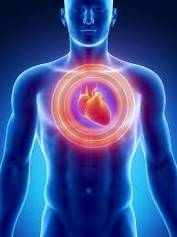


Emergency Response
During the event of Cardiac Arrest …
Suggesting
Appropriate
First-aid
Intimate
Emergency
Services
Notify
family
Probable sub-set of suggestions -
Specific body alignment/ movements
Off-the shelf medicine possibly available
Breathing regulation etc.
Information provided in real time -
GPS Location of the patient
Heart Rate
Pre-existing conditions

Slide 14
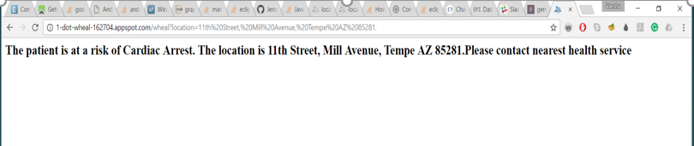

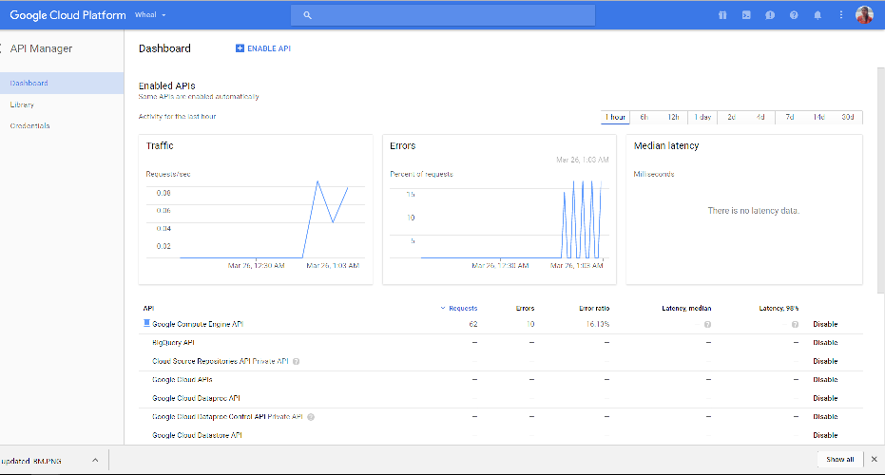
Prototype Modules - Location Extraction
We demonstrate a web application that
Extracts location information from a wearable
Is deployed on Google Cloud Platform.
On a Web-page
Dashboard
On an Android
Device

