Slide 1
Community-Driven Scam & Offer Verification Platform
“Helping students identify genuine opportunities through shared experiences”
Team Code Crafters

Slide 2
Problem Statement🧩
Internship and job offer scams are increasingly targeting students, especially freshers
Students often receive offers through unverified emails, messages, or informal platforms
There is no trusted, centralized system for students to verify the authenticity of these offers
Existing platforms lack community-backed validation and real student experiences
As a result, students face financial loss, wasted time, and loss of trust in career opportunities
Core Issue: Students are forced to make important career decisions without reliable or verified information.

Slide 3
Proposed Solution🧠
Our Solution: Community Scam Detector
A college-restricted web platform where only verified students can participate
Students can submit internship or job offer details and share real experiences
AI assists in analyzing offer content and summarizing community feedback
Each student is allowed only one review per offer, ensuring fairness and credibility
The platform presents a clear, community-driven verdict to help students decide safely
Outcome: A trusted ecosystem where students protect each other from scams using collective intelligence and AI support

Slide 4
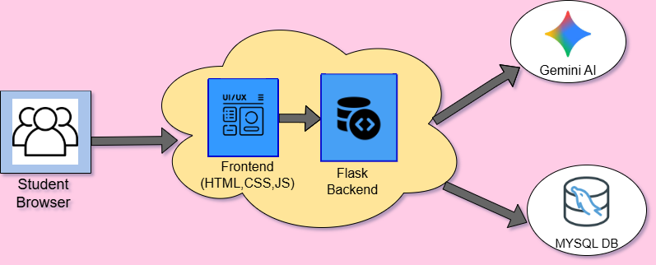
Tech Stack

Slide 5
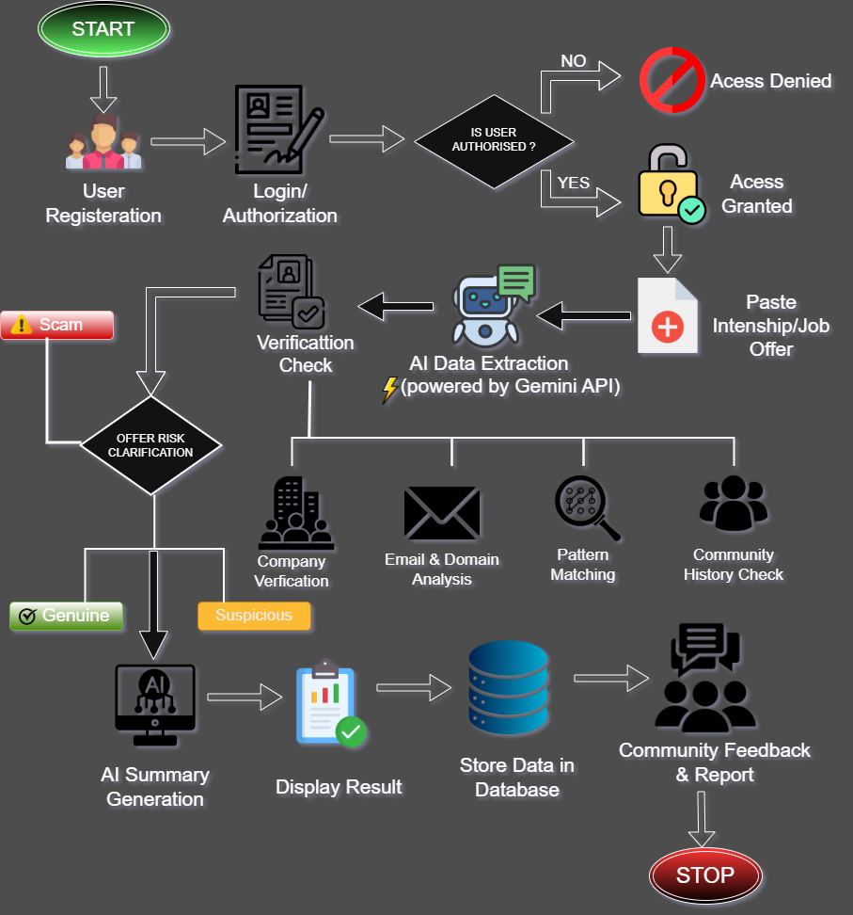
Work Flow

Slide 6


Benefits and Impact
BENEFITS
IMPACT
Community-verified internship and job offer information.
AI-assisted scam detection and review summarization
Secure, college-restricted platform ensures data reliability
One student–one review system improves trust and fairness
Reduces internship and job-related scams among students
Prevents financial and emotional losses
Encourages informed and safer career decisions
Builds a culture of peer awareness and accountability

Slide 7
Innovation
AI-based scam detection
Community verification system
One student–one review policy
College-restricted trusted platform
VERIFICATION LOGIC
The votes are collected and categorized ( scam, genuine& doubtful ).
With some decisive rules such as:
≥60% same vote → Final verdict
No clear majority → Doubtful
Low vote count → Under Review ,decisions are made.

Slide 8
Future Scope
Expand the platform to multiple colleges and universities
Implement real-time AI-based scam detection
Develop a mobile app for instant offer verification
Use blockchain for secure and tamper-proof reviews
THANK YOU

