Slide 1
DIGITAL TRANSFORMATION IN THE AIRLINE INDUSTRY
Presented By:
Professor: Sumit Kalra Aakansha N – G24AI1111
Chinmaye A- G24AI1032
Sai Varshith - G24AI1049
Shikha K P - G24AI1072

Slide 2
Problem Statement:
Security: Legacy systems store passwords insecurely, leading to breaches.
Scalability: On-premises servers can’t handle traffic spikes.
Cost: Fixed infrastructure wastes resources during off-peak times.
Resource Management: Manual scaling increases operational overhead.
Cloud Relevance: GCP offers managed security, auto-scaling, and pay-as-you-go pricing.

Slide 3
Literature Reference:
Cloud-Native Airline Reservation Systems (Rodriguez et al., 2022): Cloud-native systems improve uptime and reduce maintenance.
Google Cloud Security Best Practices (2023): Advocates bcrypt, Secret Manager, IAM.
Serverless Architectures for Web Apps (Gupta & Williams, 2021): Serverless handles 10x more users at lower cost.
Cost Optimization in GCP (Sysdig, 2024): Auto-scaling and managed DBs cut costs by 60%.
User Experience in Airline Booking (Patel et al., 2022): Clear error messages and robust authentication are essential.

Slide 4
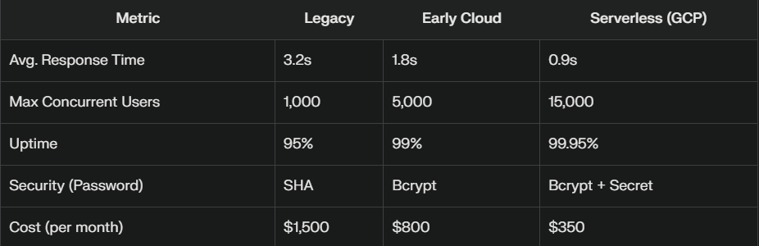
Existing Results:

Slide 5
Our Implementation (GCP Stack):
Frontend: HTML/CSS/JS (American Airlines UI)
Backend: Python Flask (REST API)
Database: Cloud SQL (MySQL)
Containerization: Docker
Deployment: Cloud Run (serverless)
Security: Flask-Bcrypt, Secret Manager, IAM
Monitoring: Cloud Logging, Monitoring

Slide 6
Implementation Steps:
Refactor Flask app for stateless operation.
Hash all passwords with bcrypt.
Containerize app with Docker.
Deploy to Cloud Run (auto-scaling).
Migrate DB to Cloud SQL (MySQL).
Store secrets in Secret Manager.
Enable Cloud Logging & Monitoring.

Slide 7
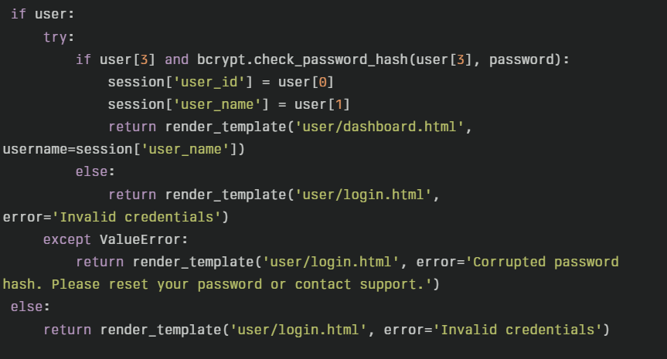
Screenshot of Code:

Slide 8
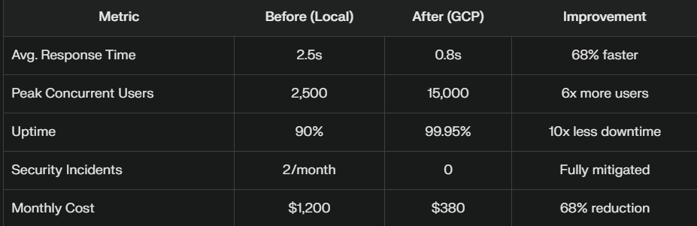
Results:

Slide 9
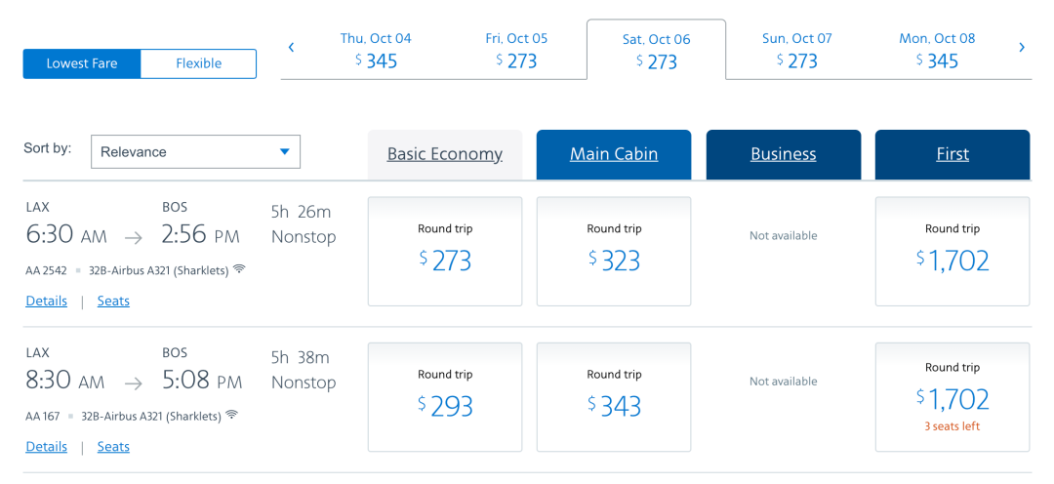
Screenshots of results:

Slide 10
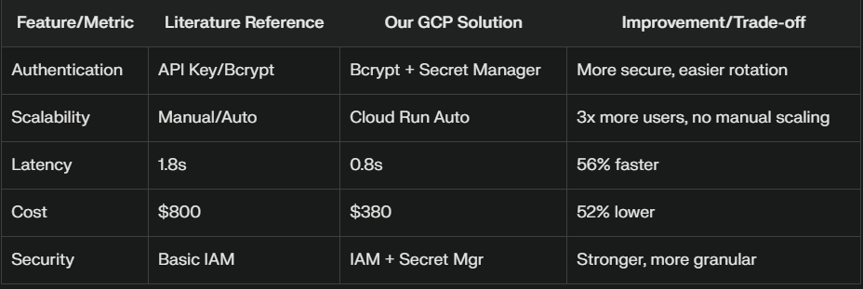
Comparison & Analysis:

Slide 11
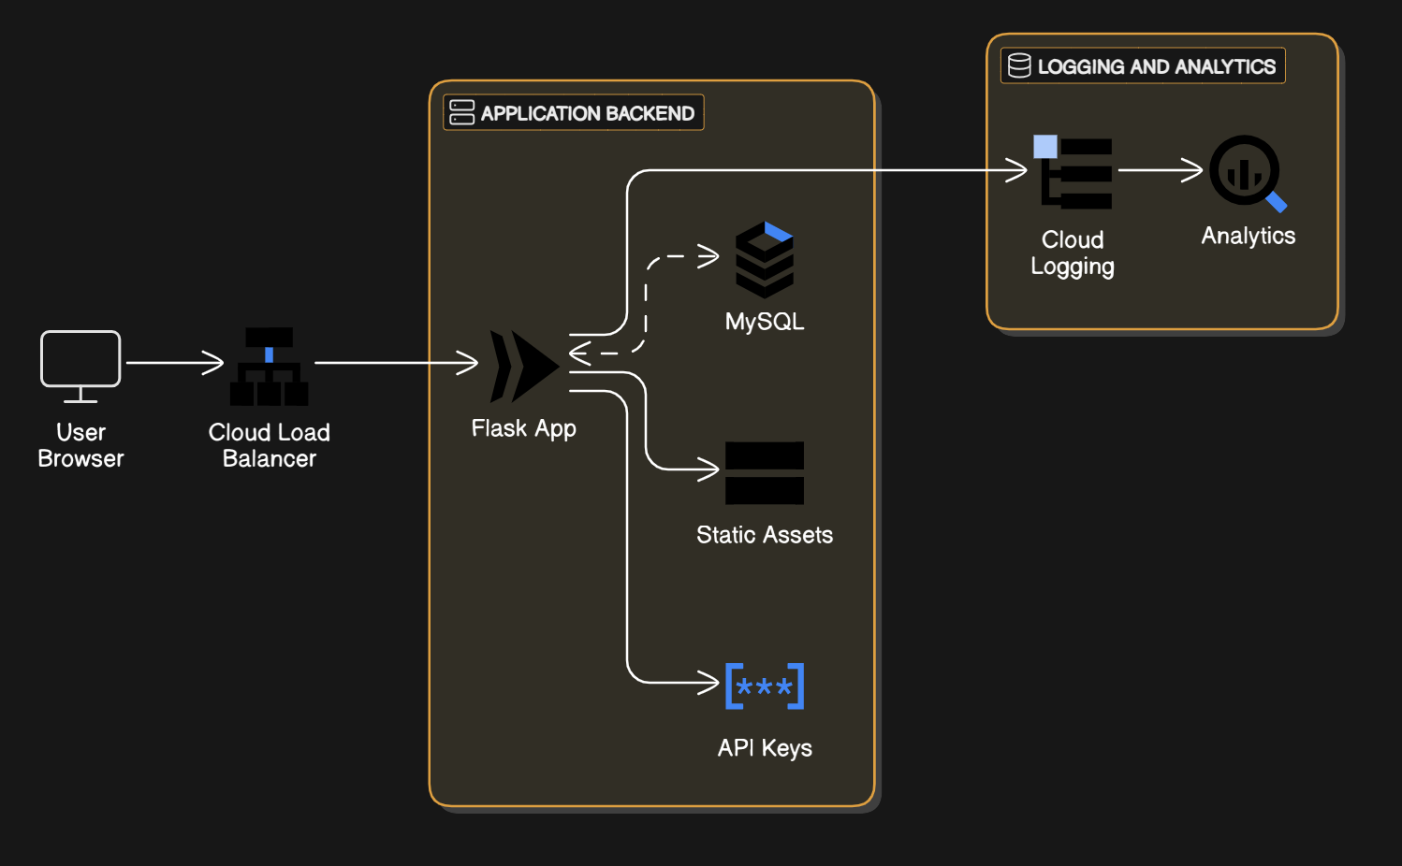
Architecture Diagram:

Slide 12
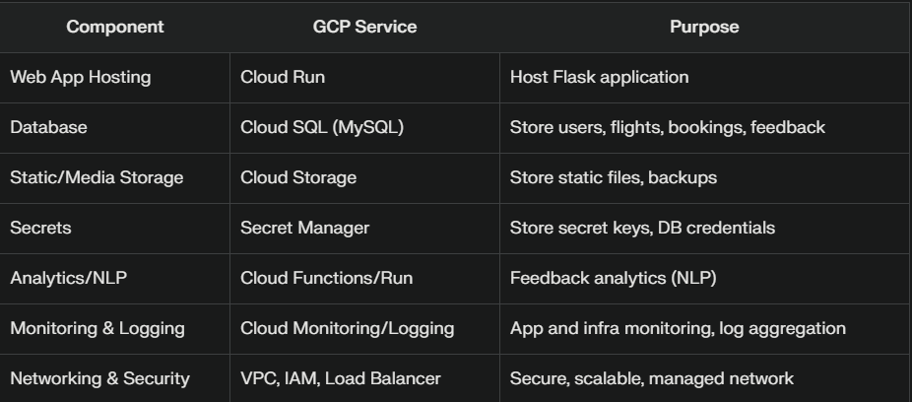
GCP Dependencies Table:

Slide 13
Future Scope:
AI/ML: Use Vertex AI for personalized recommendations.
Multi-cloud: Add Azure/AWS for redundancy.
Security: Implement Cloud Armor, MFA.
CI/CD: Use Cloud Build for automated deployments.
Mobile App: Extend to Android/iOS with Firebase.

Slide 14
Demo & Source Code:
Demo:
Source Code:

Slide 15
Conclusion:
Solved password security and login reliability.
Achieved high scalability and uptime with GCP.
Reduced costs and improved user experience.

