Slide 1
DEPARTMENT ELECTIVE PROJECT · FINAL PRESENTATION
HEADLINE RESULTS
Aspect-Based Sentiment Analysis of Product Reviews
79.9
macro-F1 on SemEval Laptops
(RoBERTa-large v2)
85.1
What we built, what the numbers say, and how a second training round (v2) improved on the first (v1).
macro-F1 on MAMS
(RoBERTa-large v2)
TF-IDF · BERT · RoBERTa-base · RoBERTa-large · SemEval-2014 Laptops · MAMS
84.6
Mrigank · 230150018
Varshith · 230150023
Jeswanth · 230150011
aspect-extraction span F1
on Laptops (RoBERTa-base v2)
Notes:
Introduce the team and the goal: compare a traditional TF-IDF approach with fine-tuned Transformers for aspect-based sentiment analysis, in-domain and across datasets, then show how a second training round improved results.

Slide 2
RECAP
One sentence, several opinions
ABSA splits the problem into two sub-tasks, and we evaluate every model in four train/test configurations.
“The laptop has an excellent display, but the battery life is disappointing.”
SUB-TASK 1
Aspect Term Extraction
• Token-level BIO tagging
• the/O battery/B life/I is/O ...
• Scored by exact-match span precision, recall, F1
SUB-TASK 2
Aspect Sentiment Classification
• Input: sentence + one target aspect
• Output: positive / negative / neutral
• Scored by accuracy and macro-F1 (class imbalance)
PROTOCOL
Four configurations
• Train Laptop → test Laptop
• Train MAMS → test MAMS
• Train Laptop → test MAMS
• Train MAMS → test Laptop
• Plus an end-to-end run: extract, then classify
Aspect-Based Sentiment Analysis · Final Presentation
2
Notes:
Quick reminder of the problem framing from the proposal. Sub-task 1 finds the aspects, sub-task 2 assigns a polarity to each. Two configurations are in-domain, two test generalisation to the other corpus.

Slide 3
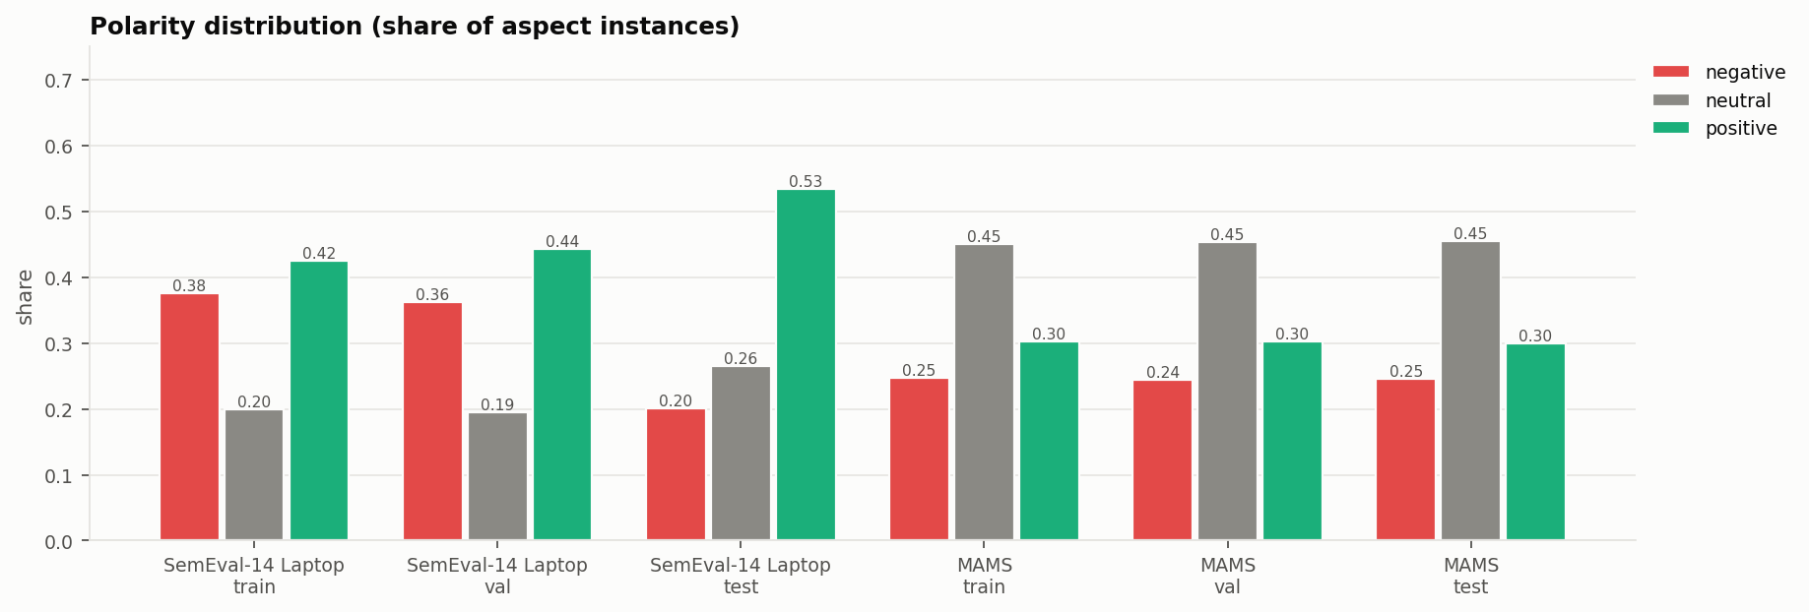
DATA
Two corpora with very different shapes
SemEval-2014 Laptops (product reviews) and MAMS (restaurant reviews, built so every sentence mixes polarities).
Dataset | Split | Sentences | Aspects | Pos | Neg | Neu
SemEval Laptop | train | 2,741 | 2,092 | 889 | 786 | 417
SemEval Laptop | val | 304 | 221 | 98 | 80 | 43
SemEval Laptop | test | 800 | 638 | 341 | 128 | 169
MAMS | train | 4,297 | 11,186 | 3,380 | 2,764 | 5,042
MAMS | val | 500 | 1,332 | 403 | 325 | 604
MAMS | test | 500 | 1,336 | 400 | 329 | 607
11% / 100%
2.6 vs 1.6
0.008
sentences with mixed polarities
(Laptop / MAMS)
aspects per sentence
(MAMS vs Laptop)
Jaccard overlap of aspect
vocabularies (train)
Aspect-Based Sentiment Analysis · Final Presentation
3
Notes:
SemEval has no validation split, so we hold out 10 percent of training sentences. The 45 'conflict' labels are dropped so both datasets share three classes. MAMS is neutral-heavy, Laptops is positive-heavy, and the aspect vocabularies barely overlap, which matters for the cross-dataset results.

Slide 4
WHAT WE BUILT
A reproducible pipeline, end to end
One command runs everything: python run_all.py (v1) and python run_v2.py (v2). Runs are cached and resumable.
Raw data
SemEval XML
MAMS auto-download
Preprocess
16-process pool:
parse, tokenise, BIO
Two views
token BIO tags
sentence–aspect pairs
Models
TF-IDF + LR / SVM
BERT, RoBERTa
Evaluate
4 configurations
end-to-end pairs
Analyse
curves, confusion,
error phenomena
ENGINEERING
Fast on a laptop GPU (RTX 4060, 8 GB)
• Whole tokenised dataset kept on the GPU, batches trimmed to their longest sentence
• bf16 mixed precision, TF32 matmuls, fused AdamW
• Preprocessing in ~8 s and cached; full v1 study in ~17 min
TRACKING
Every run leaves a trail
• Train and validation loss + metrics several times per epoch
• Early stopping on validation F1, best checkpoint restored
• Per-run curves, LR schedule, confusion matrices, live history.csv
Aspect-Based Sentiment Analysis · Final Presentation
4
Notes:
Walk through the pipeline left to right. Emphasise that every number in this talk is produced by the scripts and that the Jupyter notebook reproduces them with execution instructions.

Slide 5
ROUND 1 (V1)
Models compared under identical conditions
BASELINE
TF-IDF + LR / SVM
• Sentence 1–2-gram TF-IDF
• Context window: 6 words left/right of the aspect, side-tagged
• Aspect term TF-IDF
• C tuned on validation, grid run in parallel
• ATE: logistic-regression BIO tagger on word-window features
TRANSFORMERS
BERT-base & RoBERTa-base
• ASC input: [CLS] sentence [SEP] aspect [SEP]
• Classifier on the [CLS] vector
• ATE: token classifier, label on first sub-word
• AdamW, linear warm-up/decay, LR 2e-5 (ASC) / 5e-5 (ATE)
• 6 (ASC) / 8 (ATE) epochs, batch 32
EVALUATION
Same splits, same metrics
• ASC: accuracy, macro-P/R/F1, per-class F1
• ATE: exact-match span P/R/F1
• End-to-end: aspect span and polarity both right
• Checkpoint chosen on validation only; test touched once
Aspect-Based Sentiment Analysis · Final Presentation
5
Notes:
The baseline has no positional link between opinion words and the target, so we gave it a context window feature to make it a fair comparison. The Transformers read the sentence and the aspect together.

Slide 6
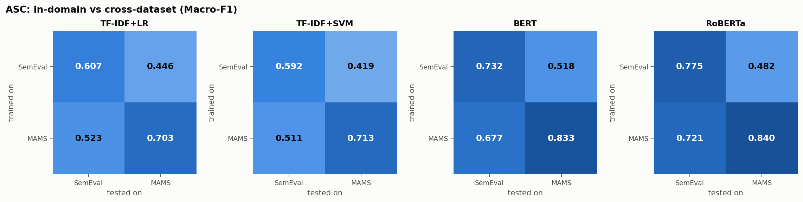
ROUND 1 RESULTS
Transformers beat TF-IDF everywhere, but transfer is lopsided
Aspect sentiment classification, macro-F1 (%) on the test sets.
Model | Laptop → Laptop | MAMS → MAMS | Laptop → MAMS | MAMS → Laptop
TF-IDF+LR | 60.7 | 70.3 | 44.6 | 52.3
TF-IDF+SVM | 59.2 | 71.3 | 41.9 | 51.1
BERT-base v1 | 73.2 | 83.3 | 51.8 | 67.7
RoBERTa-base v1 | 77.5 | 84.0 | 48.2 | 72.1
READING THE TABLE
Three observations
• Contextual models add 17 macro-F1 points over TF-IDF on Laptops
• MAMS → Laptop keeps 72 F1, Laptop → MAMS only 48
• A model trained on mostly single-polarity sentences never learns to separate aspects that disagree
• On Laptops, neutral is the weakest class for every model
Aspect-Based Sentiment Analysis · Final Presentation
6
Notes:
Highlight the asymmetry: training on MAMS transfers to laptops reasonably well, the reverse does not.

Slide 7
ROUND 1 RESULTS
Aspect extraction is domain-bound
Span F1 (%) for aspect term extraction and for the full extract-then-classify pipeline.
Aspect term extraction (span F1)
WHY
What limits extraction
• In-domain RoBERTa reaches the mid-80s on Laptops
• Laptop → MAMS: precision 76% but recall 31% — restaurant aspects are simply unseen
• End-to-end scores sit well below ASC alone: every missed aspect is also a missed sentiment
Model | Laptop → Laptop | MAMS → MAMS | Laptop → MAMS | MAMS → Laptop
TF-IDF+LR | 57.8 | 68.6 | 19.6 | 11.1
BERT-base v1 | 81.4 | 75.0 | 24.2 | 31.6
RoBERTa-base v1 | 85.9 | 76.2 | 44.0 | 39.5
End-to-end (aspect and polarity both correct)
Model | Laptop → Laptop | MAMS → MAMS | Laptop → MAMS | MAMS → Laptop
TF-IDF+LR | 41.4 | 52.1 | 10.8 | 6.5
BERT-base v1 | 63.5 | 64.2 | 14.2 | 24.6
RoBERTa-base v1 | 69.1 | 65.5 | 27.6 | 29.9
Aspect-Based Sentiment Analysis · Final Presentation
7
Notes:
Extraction depends on domain vocabulary; the model is precise but misses most restaurant aspects when trained on laptops.

Slide 8
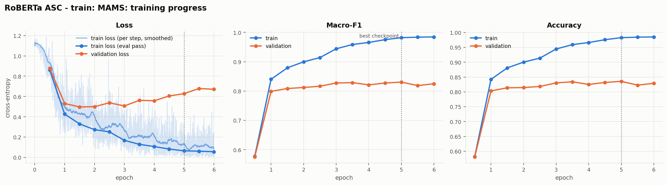
DIAGNOSIS
Why were the v1 numbers limited?
Reading the training curves and per-class scores pointed to four causes rather than one bug.
v1 RoBERTa-base, trained on MAMS
Blue = train, orange = validation. The gap opens after the first epoch and keeps widening.
1
Over-fitting
train macro-F1 reaches 98 while validation stalls near 83; validation loss rises after ~1.5 epochs
2
Aspect localisation
the [CLS] head is never told where the aspect sits — a problem when MAMS sentences carry 2–3 aspects with different labels
3
Neutral class
neutral F1 only 68 on Laptops; most errors are neutral ↔ positive/negative
4
Noisy selection
SemEval validation has 221 aspects, so validation F1 jumps ±3 points between checks
Aspect-Based Sentiment Analysis · Final Presentation
8
Notes:
This slide motivates every change in v2. Point at the widening gap between train and validation curves.

Slide 9
ROUND 2 (V2)
Each change answers one diagnosis
v1 problem | v2 change | Task
Over-fitting | Label smoothing 0.1 · FGM adversarial training on embeddings (ε = 0.5) · layer-wise LR decay | ASC + ATE
Aspect localisation | Aspect wrapped in the sentence: “… the # battery life # is …”; head reads [CLS] ⊕ mean of aspect tokens | ASC
Noisy selection | 4 validation checks per epoch, batch 16, patience counted in epochs | ASC + ATE
Invalid BIO output | Viterbi decoding that forbids O → I transitions | ATE
Model capacity | RoBERTa-large (355M params) with gradient checkpointing to fit 8 GB | ASC + ATE
Controlled comparison: RoBERTa-base v2 uses the same backbone as v1, so its gain is due to the recipe alone. RoBERTa-large v2 adds model capacity on top.
Unchanged: data splits, metrics, test sets and the four configurations.
Aspect-Based Sentiment Analysis · Final Presentation
9
Notes:
Go row by row: problem, then the change. Mention that markers follow Zhou and Chen's typed-marker idea and FGM is from Miyato et al.

Slide 10
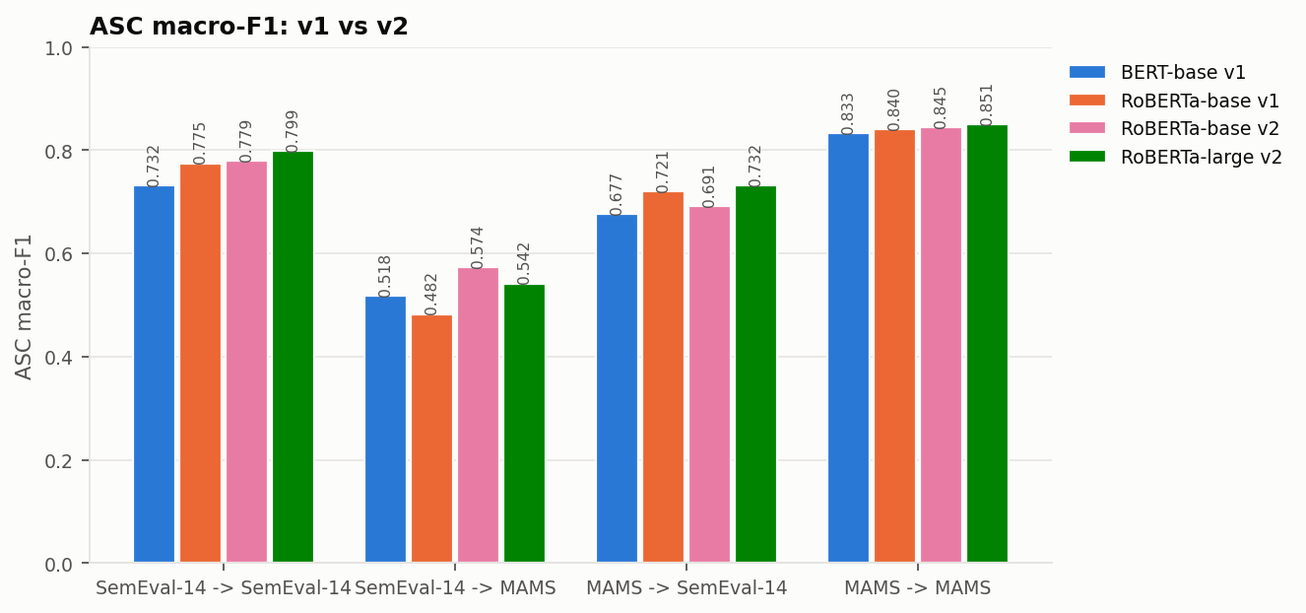
V1 → V2
Aspect sentiment: where the second round helped
Macro-F1 (%) and change versus the best v1 model (RoBERTa-base v1).
Configuration | v1 base | v2 base | Δ | v2 large | Δ
Laptop → Laptop | 77.5 | 77.9 | +0.4 | 79.9 | +2.4
MAMS → MAMS | 84.0 | 84.5 | +0.5 | 85.1 | +1.0
Laptop → MAMS | 48.2 | 57.4 | +9.2 | 54.2 | +5.9
MAMS → Laptop | 72.1 | 69.1 | -3.0 | 73.2 | +1.1
Accuracy (%)
Configuration | v1 base | v2 large | Δ
Laptop → Laptop | 80.4 | 83.2 | +2.8
MAMS → MAMS | 84.5 | 85.6 | +1.1
Laptop → MAMS | 48.7 | 55.6 | +6.9
MAMS → Laptop | 75.4 | 76.2 | +0.8
Aspect-Based Sentiment Analysis · Final Presentation
10
Notes:
Read the deltas: green is an improvement over the best v1 model. Comment separately on in-domain and cross-dataset rows.

Slide 11
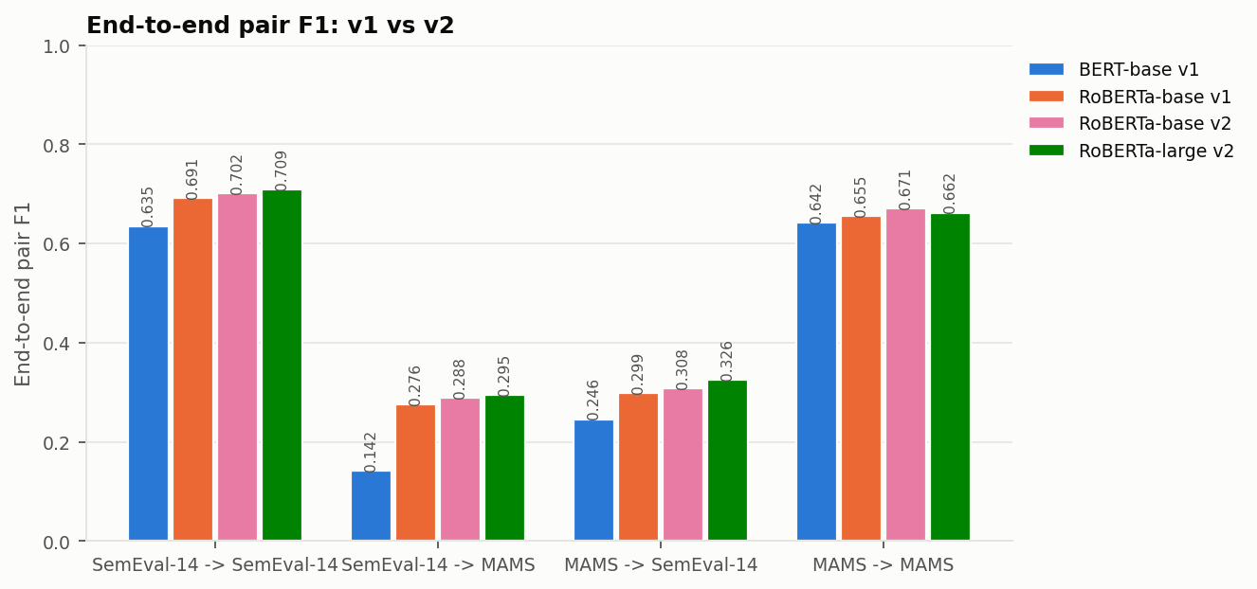
V1 → V2
Extraction and the full pipeline
Span F1 (%) — change versus RoBERTa-base v1.
Aspect term extraction
Configuration | v1 base | v2 base | Δ | v2 large | Δ
Laptop → Laptop | 85.9 | 84.6 | -1.4 | 86.1 | +0.2
MAMS → MAMS | 76.2 | 78.0 | +1.8 | 76.8 | +0.6
Laptop → MAMS | 44.0 | 38.3 | -5.7 | 38.1 | -5.9
MAMS → Laptop | 39.5 | 41.5 | +2.0 | 40.3 | +0.8
End-to-end pair F1
Configuration | v1 base | v2 base | Δ | v2 large | Δ
Laptop → Laptop | 69.1 | 70.2 | +1.0 | 70.9 | +1.8
MAMS → MAMS | 65.5 | 67.1 | +1.6 | 66.2 | +0.7
Laptop → MAMS | 27.6 | 28.8 | +1.3 | 29.5 | +1.9
MAMS → Laptop | 29.9 | 30.8 | +0.9 | 32.6 | +2.7
Aspect-Based Sentiment Analysis · Final Presentation
11
Notes:
Constrained decoding and regularisation change extraction; the end-to-end score inherits gains from both stages.

Slide 12
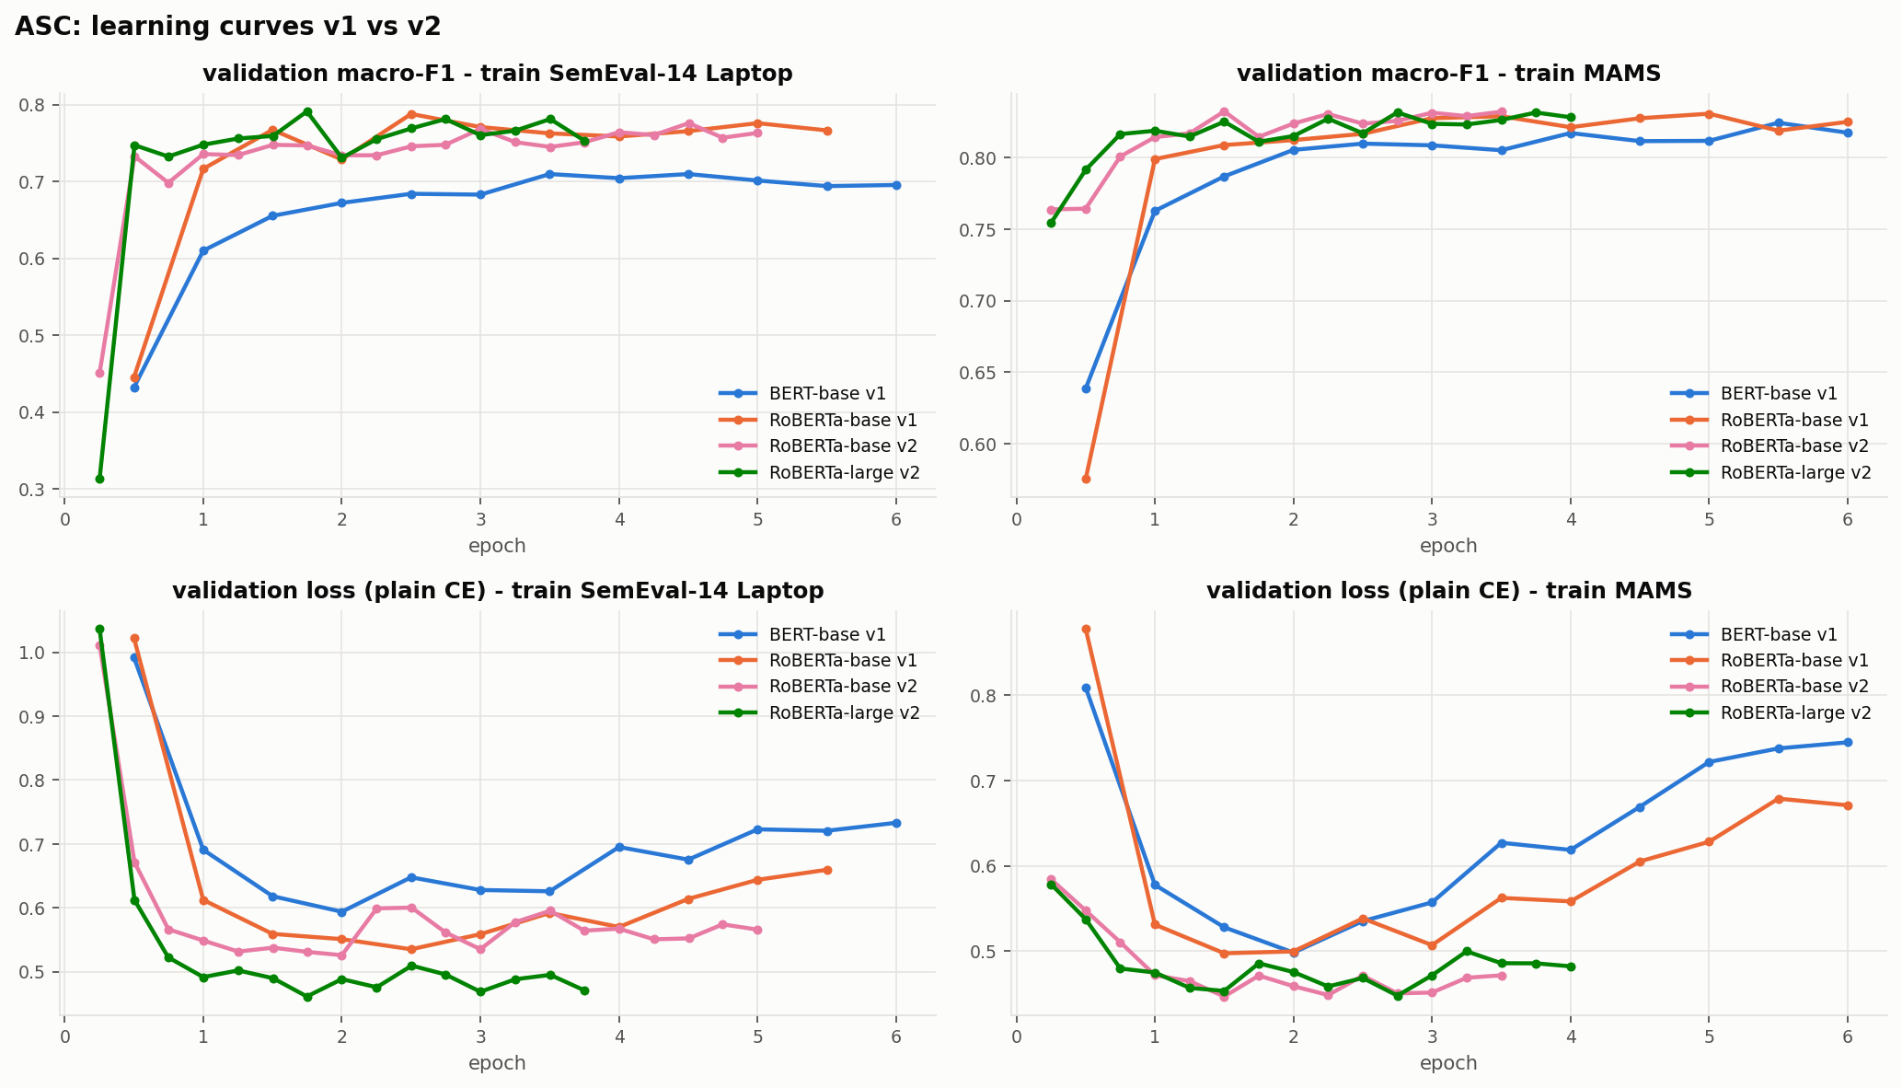
V1 → V2
Learning dynamics: less over-fitting on MAMS, noisy on Laptops
Validation macro-F1 and validation loss per epoch (top: metric, bottom: plain cross-entropy).
Gap at the selected checkpoint (ASC)
Model | Train | Train F1 | Val F1 | Gap
BERT-base v1 | MAMS | 98.8 | 82.4 | 16.3
RoBERTa-base v1 | MAMS | 98.2 | 83.1 | 15.2
RoBERTa-base v2 | MAMS | 91.0 | 83.2 | 7.8
RoBERTa-large v2 | MAMS | 96.0 | 83.1 | 12.9
BERT-base v1 | Laptop | 89.3 | 71.0 | 18.3
RoBERTa-base v1 | Laptop | 83.7 | 78.8 | 5.0
RoBERTa-base v2 | Laptop | 99.4 | 77.6 | 21.9
RoBERTa-large v2 | Laptop | 91.9 | 79.1 | 12.8
Aspect-Based Sentiment Analysis · Final Presentation
12
Notes:
On MAMS the train-validation gap roughly halves and the best epoch comes earlier. On Laptops the v1 checkpoint happened to be picked early, so its gap looks small; with only 221 validation aspects the selected epoch is noisy.

Slide 13
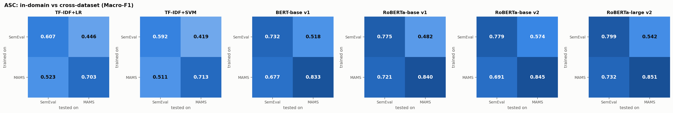
GENERALISATION
Cross-dataset transfer, all models
Rows: training corpus. Columns: test corpus. Macro-F1 for aspect sentiment classification.
TAKEAWAY
Transfer is asymmetric for every model family
• Best Laptop → MAMS: RoBERTa-base v2, 57.4 macro-F1
• Best MAMS → Laptop: RoBERTa-large v2, 73.2 macro-F1
• Training on multi-polarity text (MAMS) produces a model that also works on laptops; the reverse needs data, not tricks
Aspect-Based Sentiment Analysis · Final Presentation
13
Notes:
Every row of heatmaps shows the same pattern, from TF-IDF to RoBERTa-large: training data shape matters more than architecture for transfer.

Slide 14
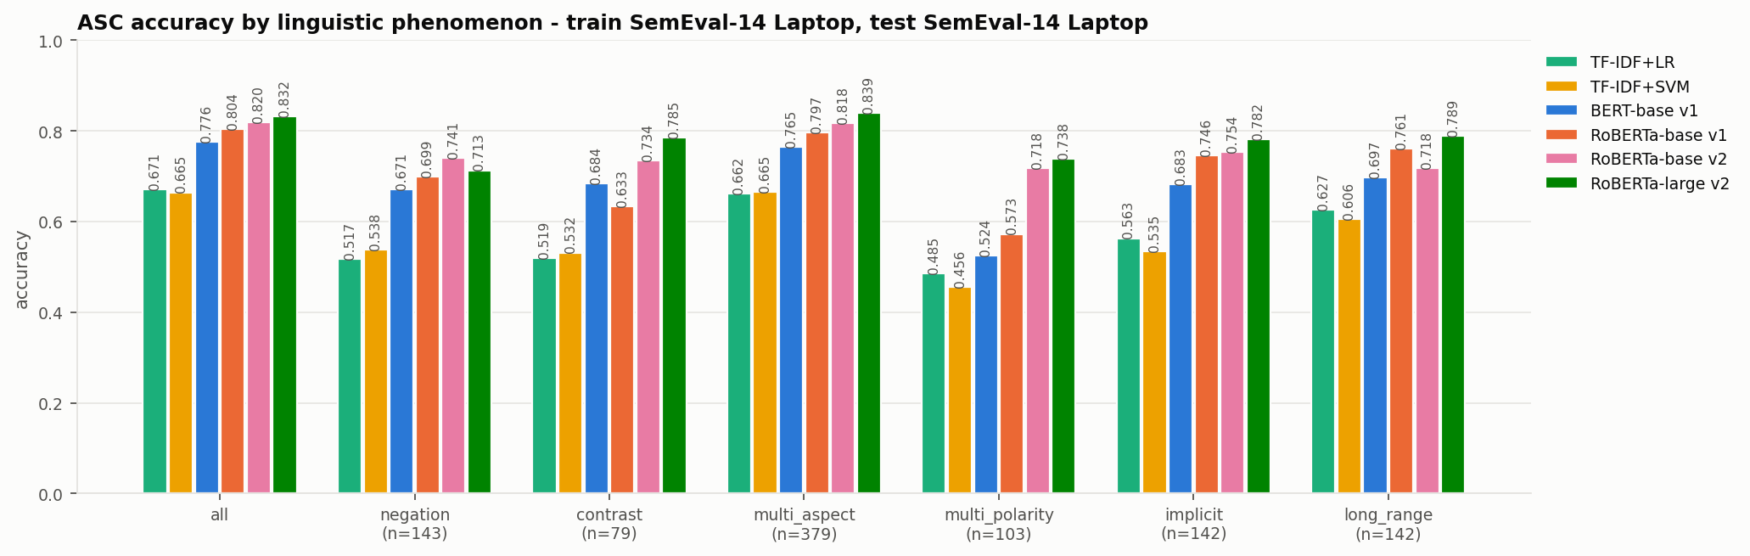
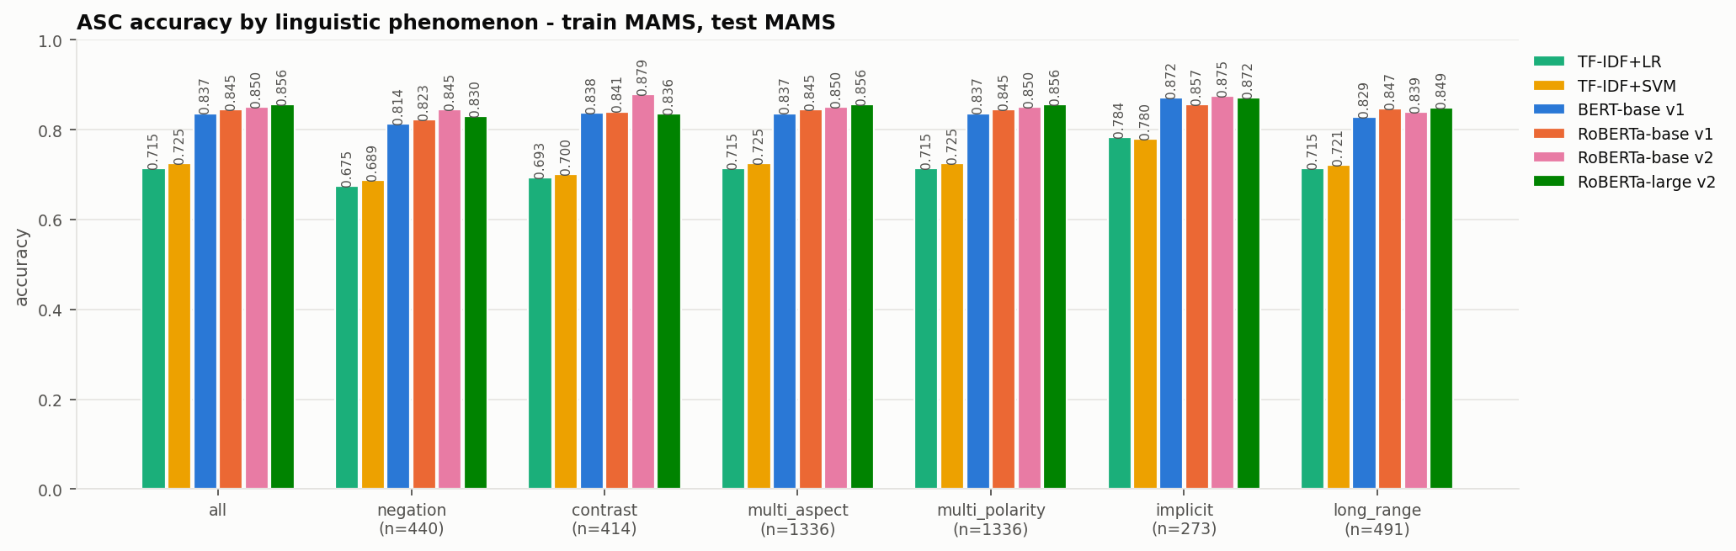
ERROR ANALYSIS
Which sentences are still hard?
Accuracy of aspect sentiment by linguistic phenomenon, in-domain test sets.
BEST MODEL: ROBERTA-LARGE V2
What changed, what remains
• Mixed-polarity Laptop sentences: 57% (v1) → 74% (v2), the largest gain of any group
• Laptop: hardest = negation (71% vs 83% overall)
• MAMS: hardest = negation (83% vs 86% overall)
• Tags are rule-based: negators, contrast words, Liu's opinion lexicon, distance to nearest opinion word
• Misclassified examples per model are saved for inspection
Aspect-Based Sentiment Analysis · Final Presentation
14
Notes:
Read the hardest category per dataset and give one concrete misclassified example from the error CSVs.

Slide 15
DEMO
From raw text to aspect-level opinions
RoBERTa-base v2 extractor + classifier trained on Laptops, run on new sentences (notebook section 9).
Sentence | Aspect | Polarity | Conf.
The laptop has an excellent display, but the battery life is disappointing. | display | positive | 0.95
The laptop has an excellent display, but the battery life is disappointing. | battery life | negative | 0.93
The battery life is excellent but the keyboard is uncomfortable. | battery life | positive | 0.94
The battery life is excellent but the keyboard is uncomfortable. | keyboard | negative | 0.94
Customer support never answered my emails, although the screen is gorgeous. | Customer support | negative | 0.94
Customer support never answered my emails, although the screen is gorgeous. | screen | positive | 0.94
It boots up fast and the trackpad works fine, but the speakers are tinny. | boots up | positive | 0.95
It boots up fast and the trackpad works fine, but the speakers are tinny. | trackpad | positive | 0.94
It boots up fast and the trackpad works fine, but the speakers are tinny. | speakers | negative | 0.95
I use it mostly for browsing and the price was okay. | price | positive | 0.95
Aspect-Based Sentiment Analysis · Final Presentation
15
Notes:
Show the live notebook demo in the video. The proposal's motivating example is the first row.

Slide 16
CONCLUSIONS
What we learned
FINDINGS
Results
• Fine-tuned Transformers beat TF-IDF by 14–17 macro-F1 points in-domain
• Best in-domain macro-F1: 79.9 (Laptop), 85.1 (MAMS)
• RoBERTa-large v2 beats the best v1 model in all 4 sentiment configurations; v2 improves end-to-end F1 everywhere
• Biggest v2 gain: mixed-polarity Laptop sentences, 57% → 74%
• Transfer depends on the shape of the training data more than on the model
• Aspect extraction does not survive a domain change
LIMITATIONS & NEXT STEPS
Honest caveats
• One random seed per run: differences of 1–2 points may not be significant
• v2 hurt Laptop → MAMS extraction (-5.7 pts) and base-v2 MAMS → Laptop sentiment (-3.0 pts)
• Small Laptop validation set (221 aspects) makes checkpoint choice noisy; the train–val gap grew there
• Phenomenon tags are heuristic, not hand-annotated
• Next: multi-seed averages, domain-adaptive pre-training on unlabeled reviews, joint ATE+ASC model, training on both corpora together
Aspect-Based Sentiment Analysis · Final Presentation
16
Notes:
Summarise in three sentences, then state limitations clearly.

Slide 17
Thank you
Questions welcome
REPRODUCE
pip install -r requirements.txt
python run_all.py # v1 study
python run_v2.py # v2 study
ABSA_Notebook.ipynb # results, figures and live demo
Mrigank · Varshith · Jeswanth

