Slide 1

Project Deliverable 2
Team 04 - The Masked Code Avengers
Saatwika Karra Malachy Swonger
Varshik Chebrolu Morgan VanderRiet
Jess Cobb
Joshua Keene

Slide 2



Agenda
User Stories and Tasks
Kanban board
CRC cards and class diagram
Outputs of scrum ceremonies

Slide 3
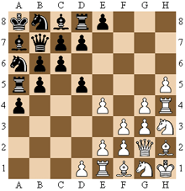
Legan Chess
Initial position differs from normal chess.
Pawns move forward diagonally and capture piece horizontally and vertically.
Pawns are promoted when they reach the opposite side.

Slide 4


User Stories

Slide 5
As a User, I would like to …..
As a User I would like to Register an account on the game platform.
As a User I would like to login into my registered account.
As a user, I would like to be able to instantiate/start a game or join an existing game.
As a user, I would like the game to enforce the ruleset for the given game.
As a user, I would like the game to keep track of each player’s turn and notify both when a game is ended.
As a user, I can save my game and pick up where I left off later.
As a User, I would like to see a list of potential opponents that I can Invite to play a game.
As a user, I would like to be able to invite other players or accept/reject invitations sent to me.
As a user, I would like to be able to see a history of the games I have played.

Slide 6
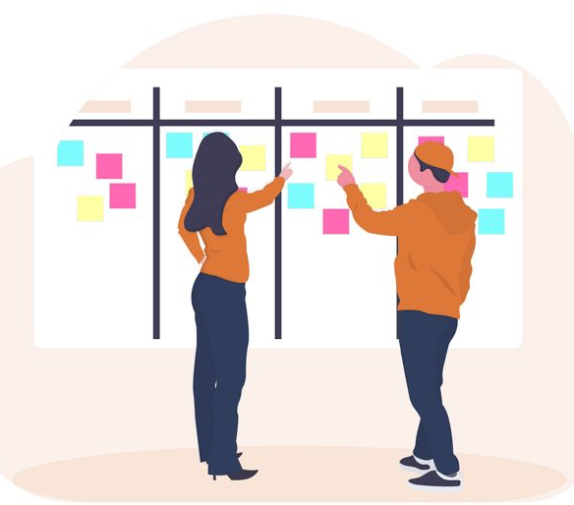
Kanban Board

Slide 7
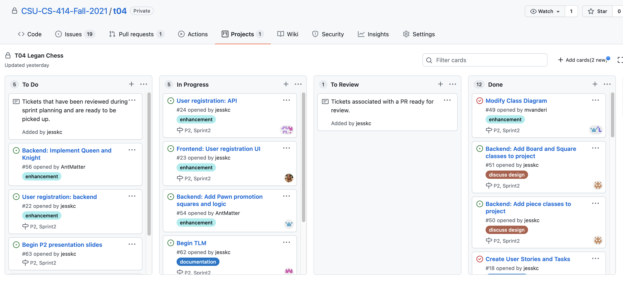
Sprint 2 board

Slide 8
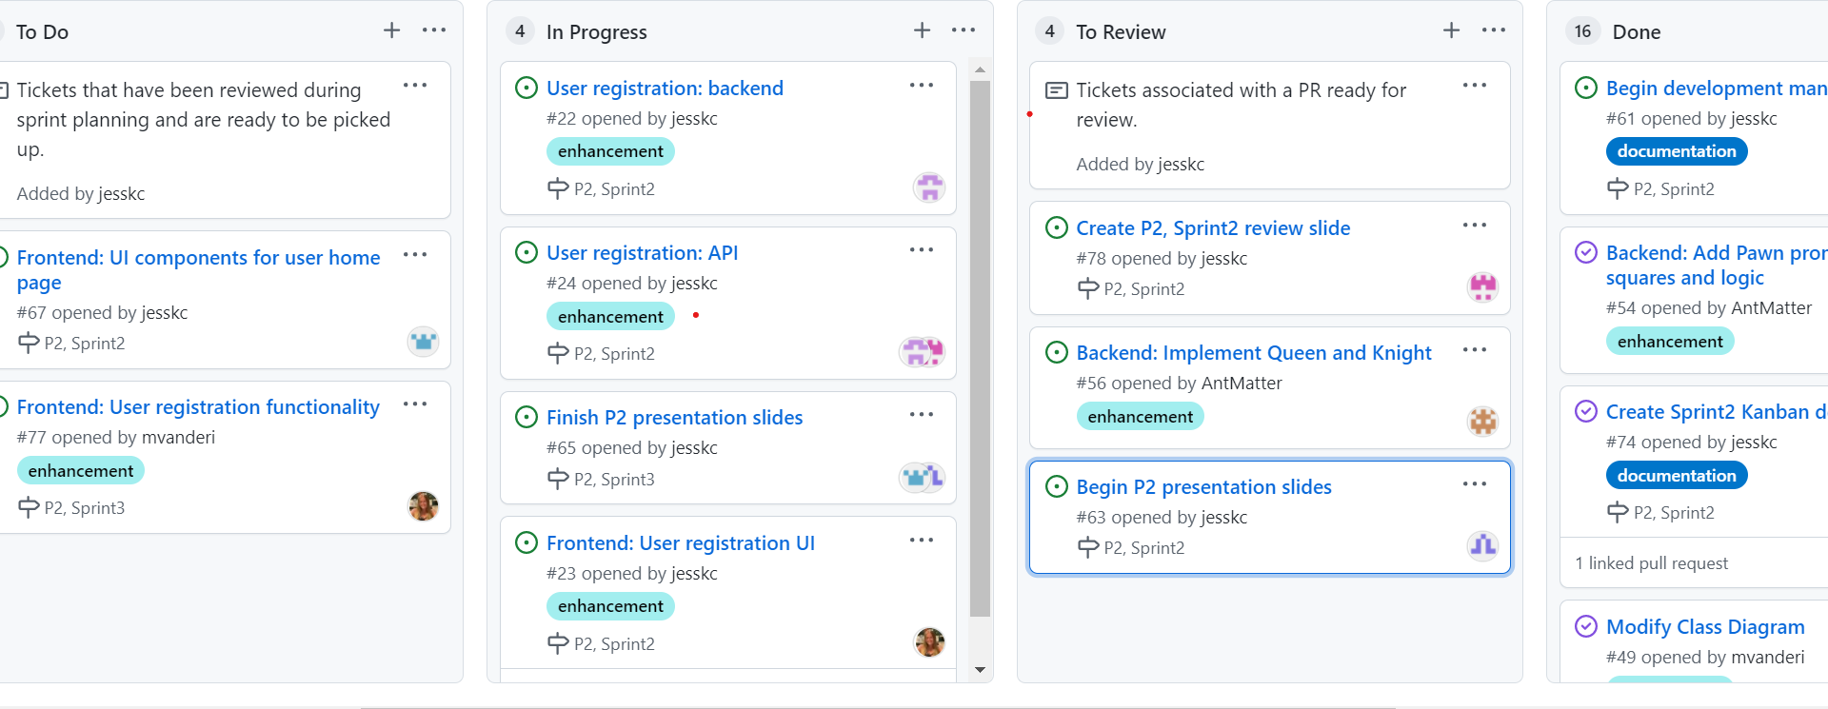
Sprint 3 board

Slide 9

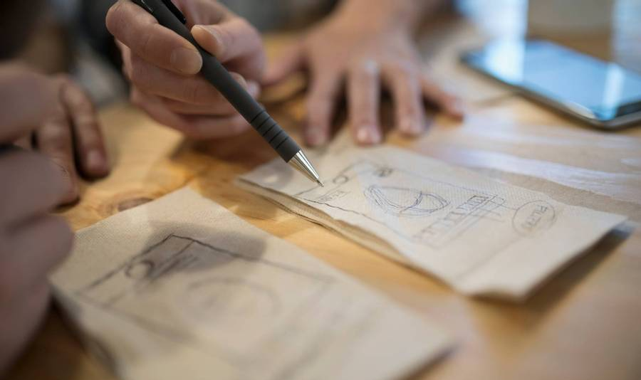
Design Artifacts

Slide 10
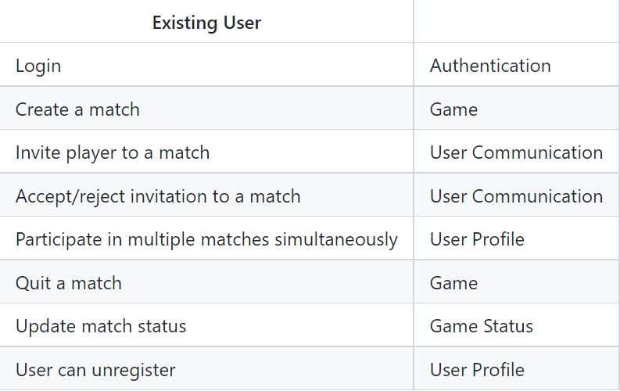
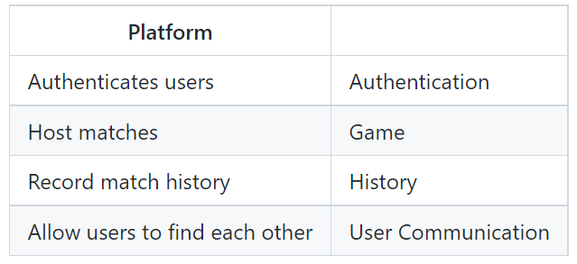
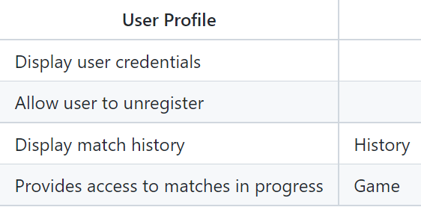
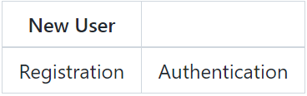
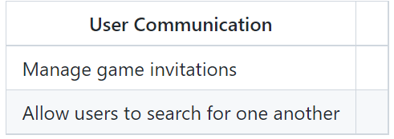
CRC cards

Slide 11
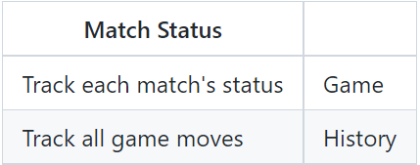
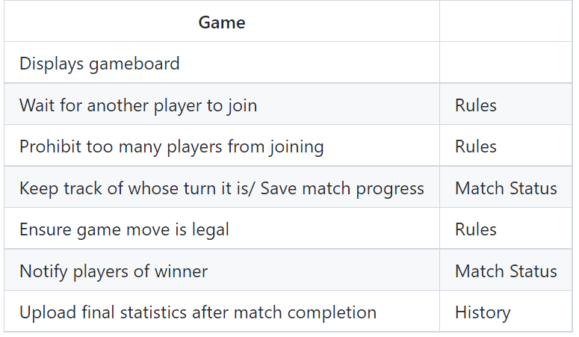
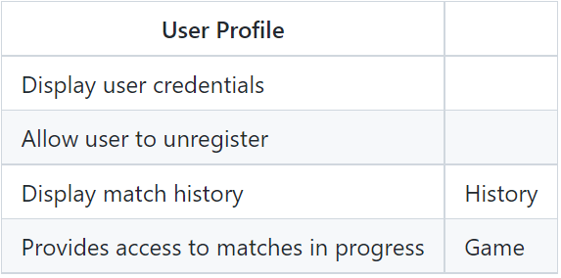
CRC Cards Cont.

Slide 12
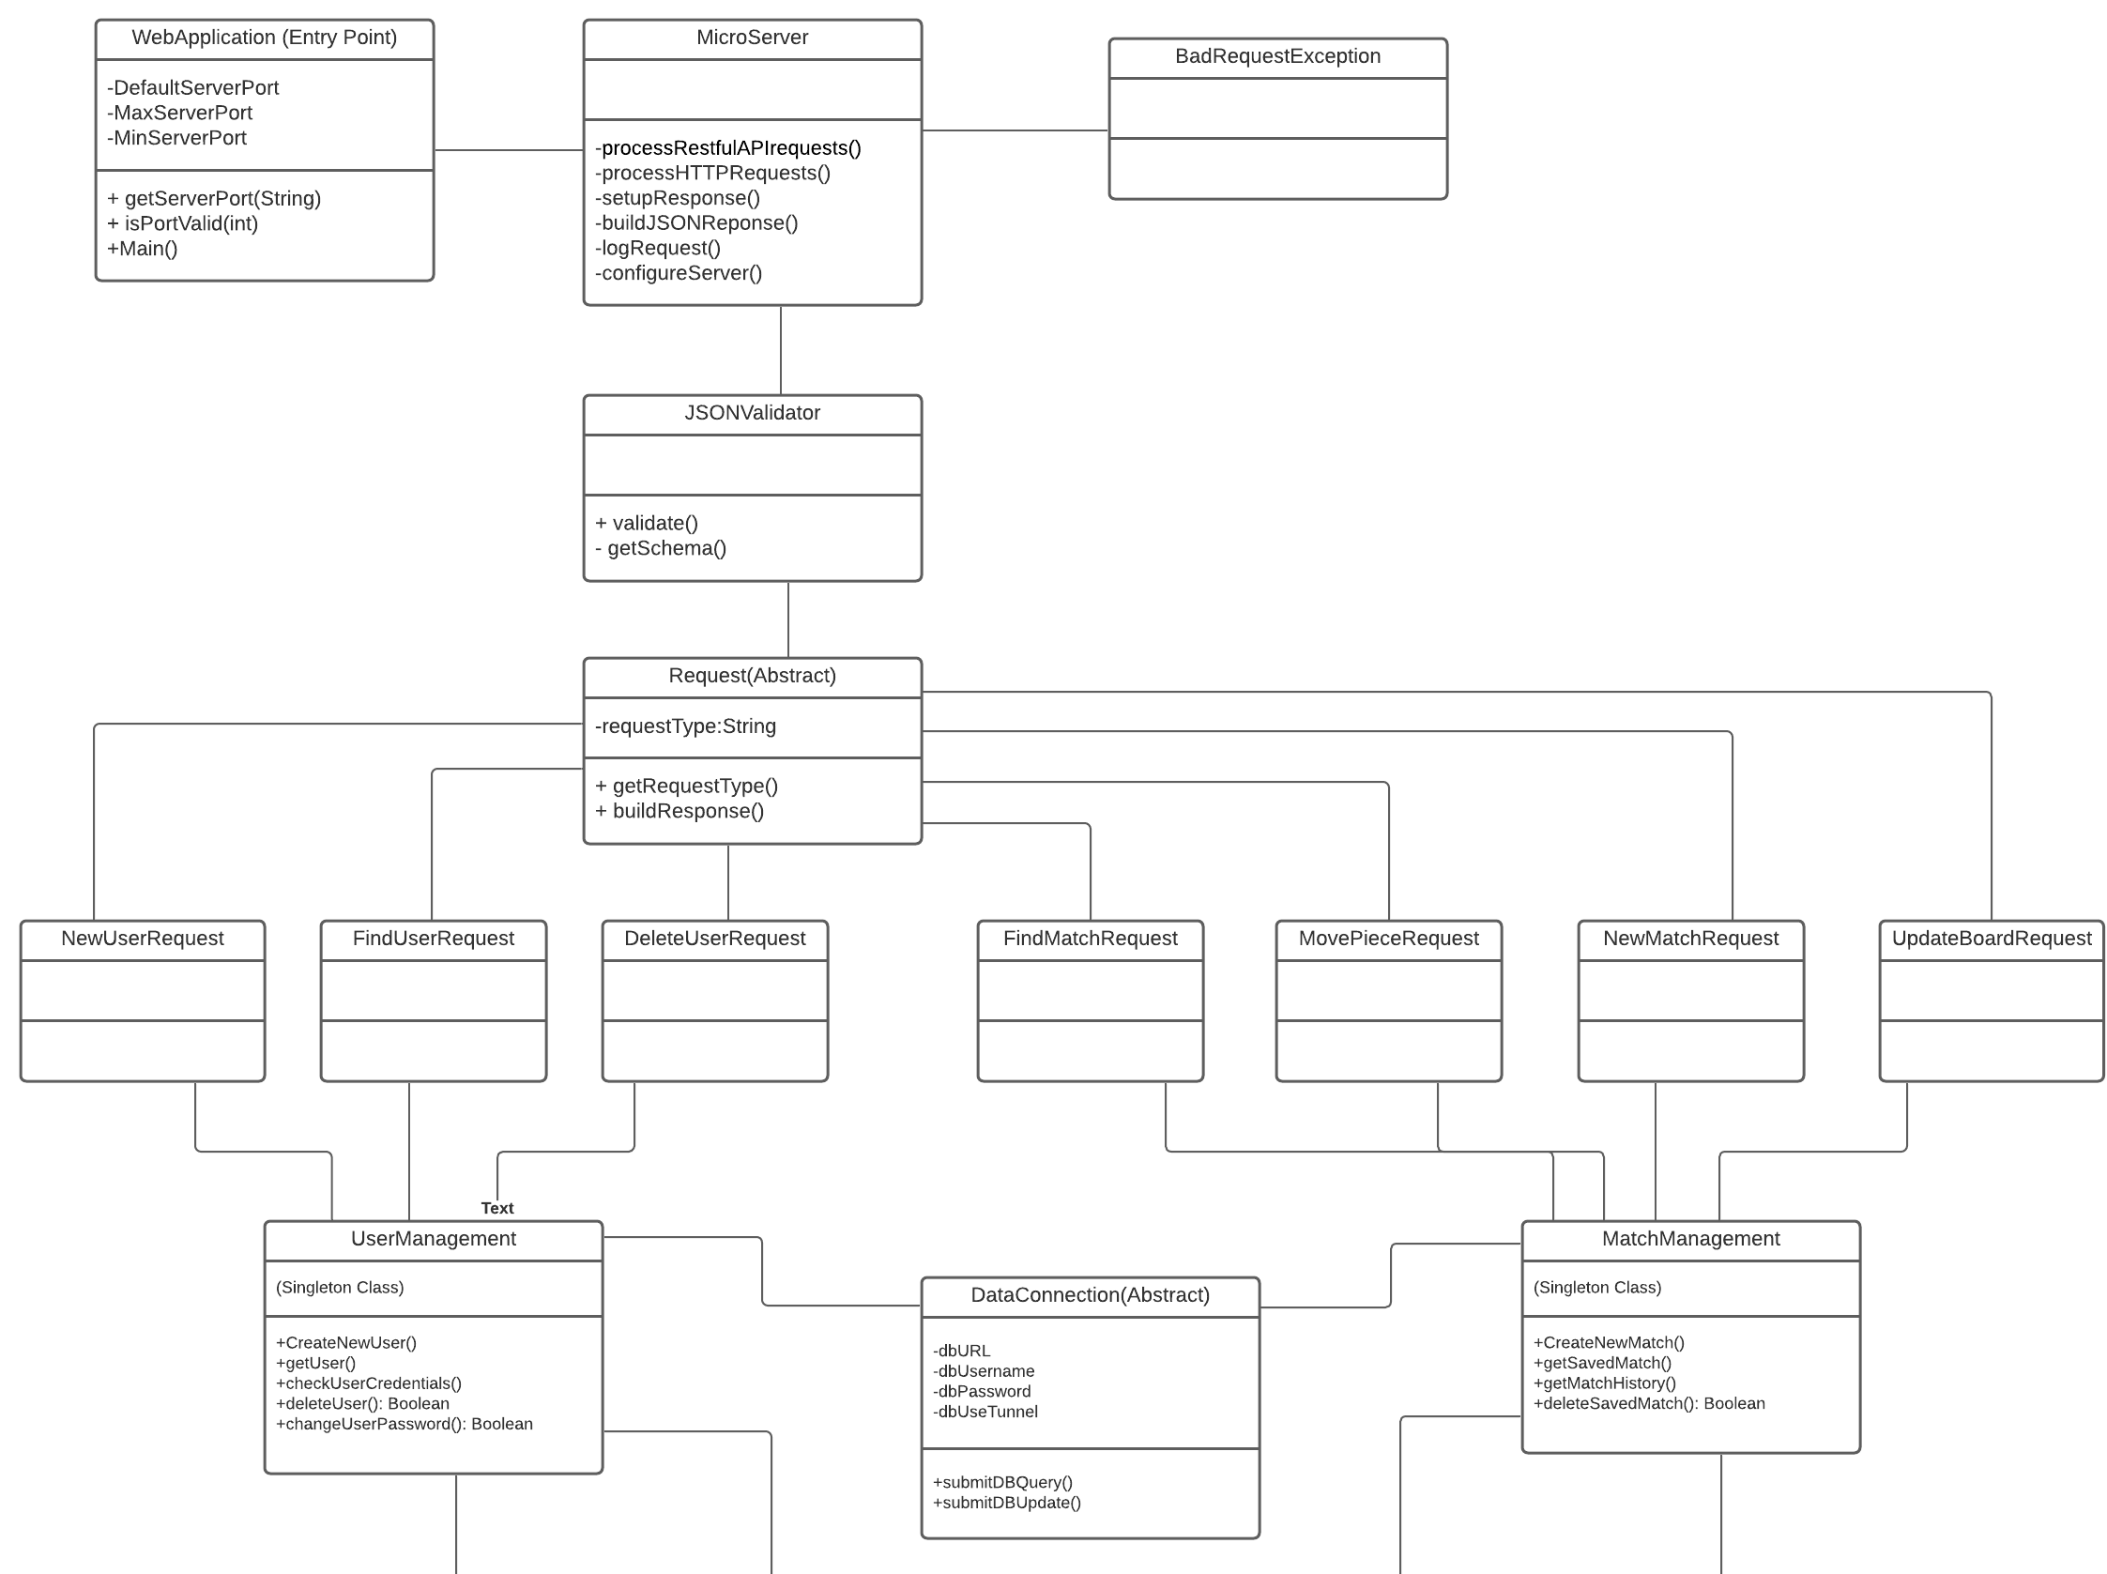
UML Diagram

Slide 13
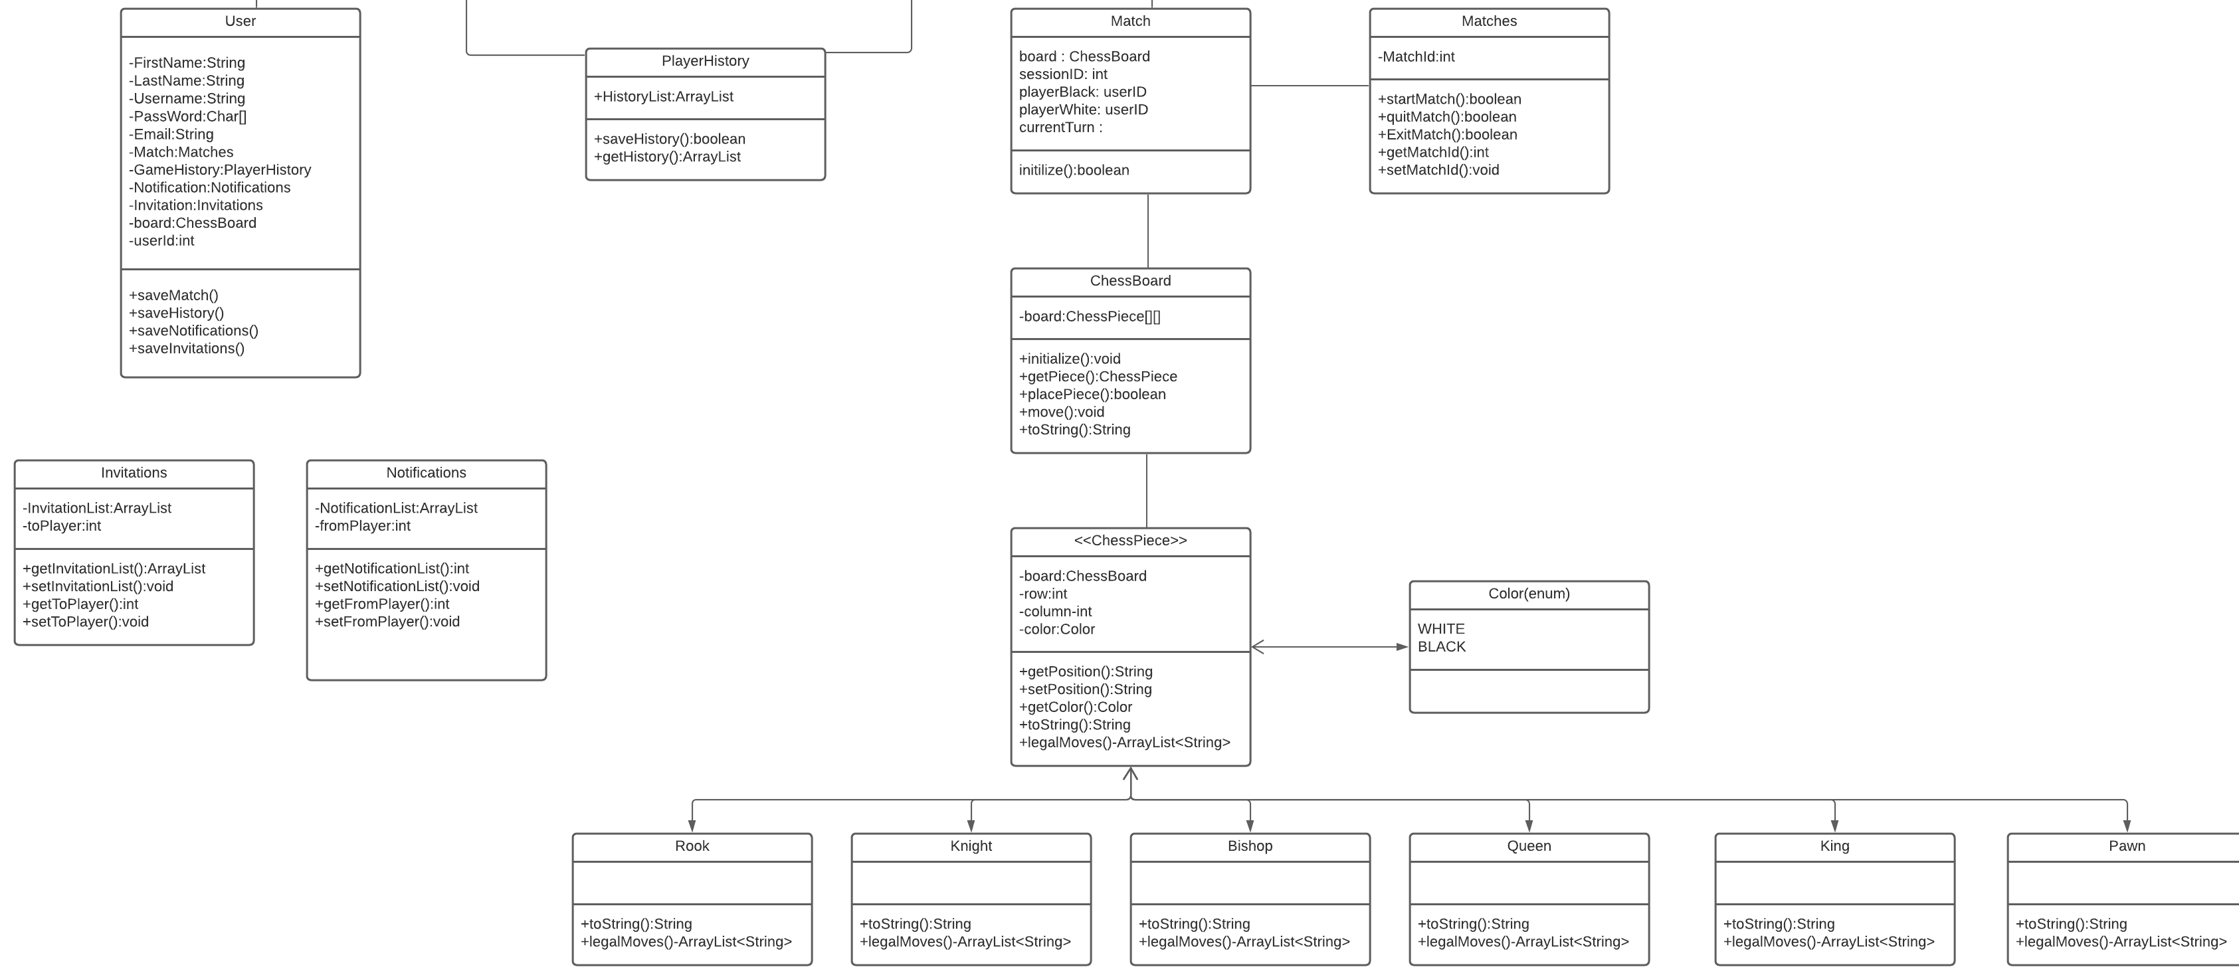
UML diagram cont.

Slide 14


Slide 15
Sprint 2 and 3 Review
Successfully completed tasks:
Updated the user stories, tasks and focused on the primary requirements.
Actively updated the Kanban board with the to-do things from the product backlog.
Added the backend logic for all the chess pieces with the legan rules.
Designed the UI for login page and started development for registration and Home page.
Participation in scrum meetings and noting minutes of meeting regularly.
Future tasks:
To Add the backend logic for rest of the classes and integrate them with UI and APIs.
To develop the UI for registration and game page.
To write queries for storing the data of the users and integrate DB with the java classes.

Slide 16
Sprint 2 and 3 Retrospective
Went Well!
Added complete logic for all the chess pieces
Updated class diagrams
Backend development
Decent team communication
Decent progress/movement on Kanban board
Collaboration and communication
Scrum call attendance
Learned
While fixing IDE issues learned how to deal with different versions and procedures.
Learned to develop abstraction for the classes.
Action Items:
Figure out IDE issues
More progress on front-end tasks
Making visible progress on working application
To improve quality of code
Integration of logic
To improve time-management
Longed For:
Fewer application components

Slide 17
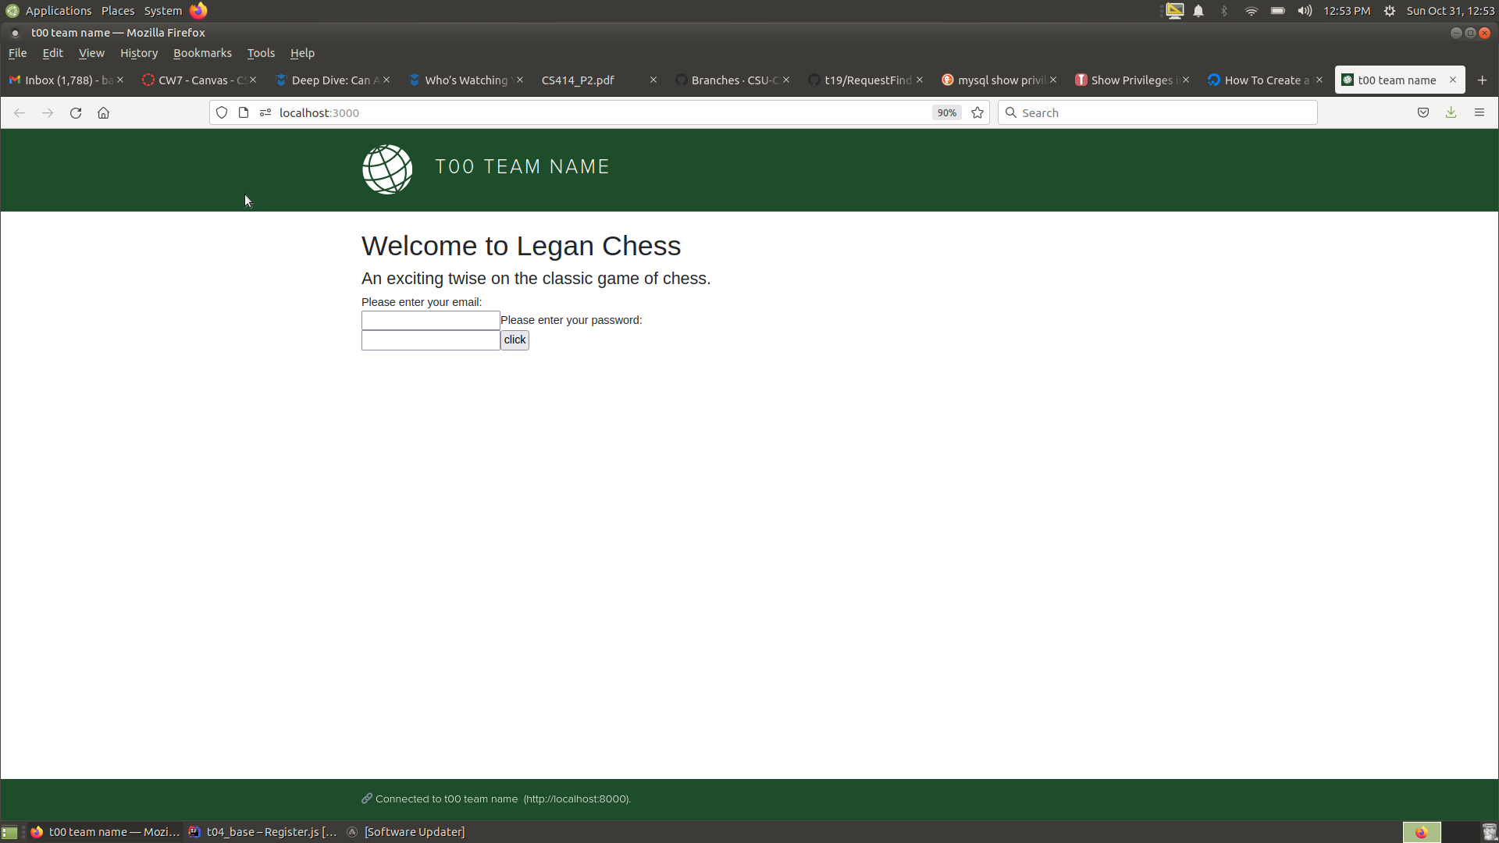

Slide 18

Thank You Any Questions?

