Slide 1
Project Deliverable 3 Presentation
Team 04 - The Masked Code Avengers

Slide 2

Team 04 - The Masked Code Avengers
Varshik Chebrolu, Jess Cobb
Saatwika Karra, Malachy Swonger
Joshua Keene, Morgan VanderRiet
Communication
Hard Work
Clean Code

Slide 3
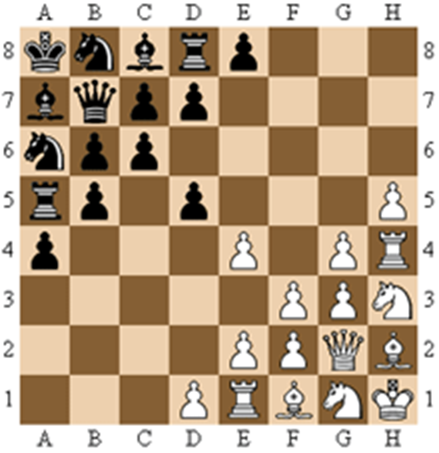
What is Legan Chess?
•Initial position differs from normal chess.
•Pawns move forward diagonally and capture piece horizontally and vertically.
•Pawns are promoted when they reach the opposite side.

Slide 4
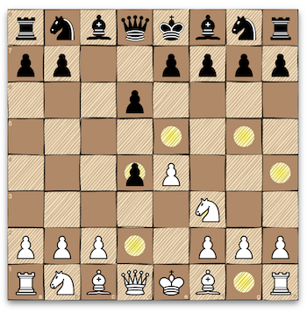
Process, Practices and Tools
Test Driven Development
Clean Code
React-Bootstrap
Chessboard.jsx

Slide 5
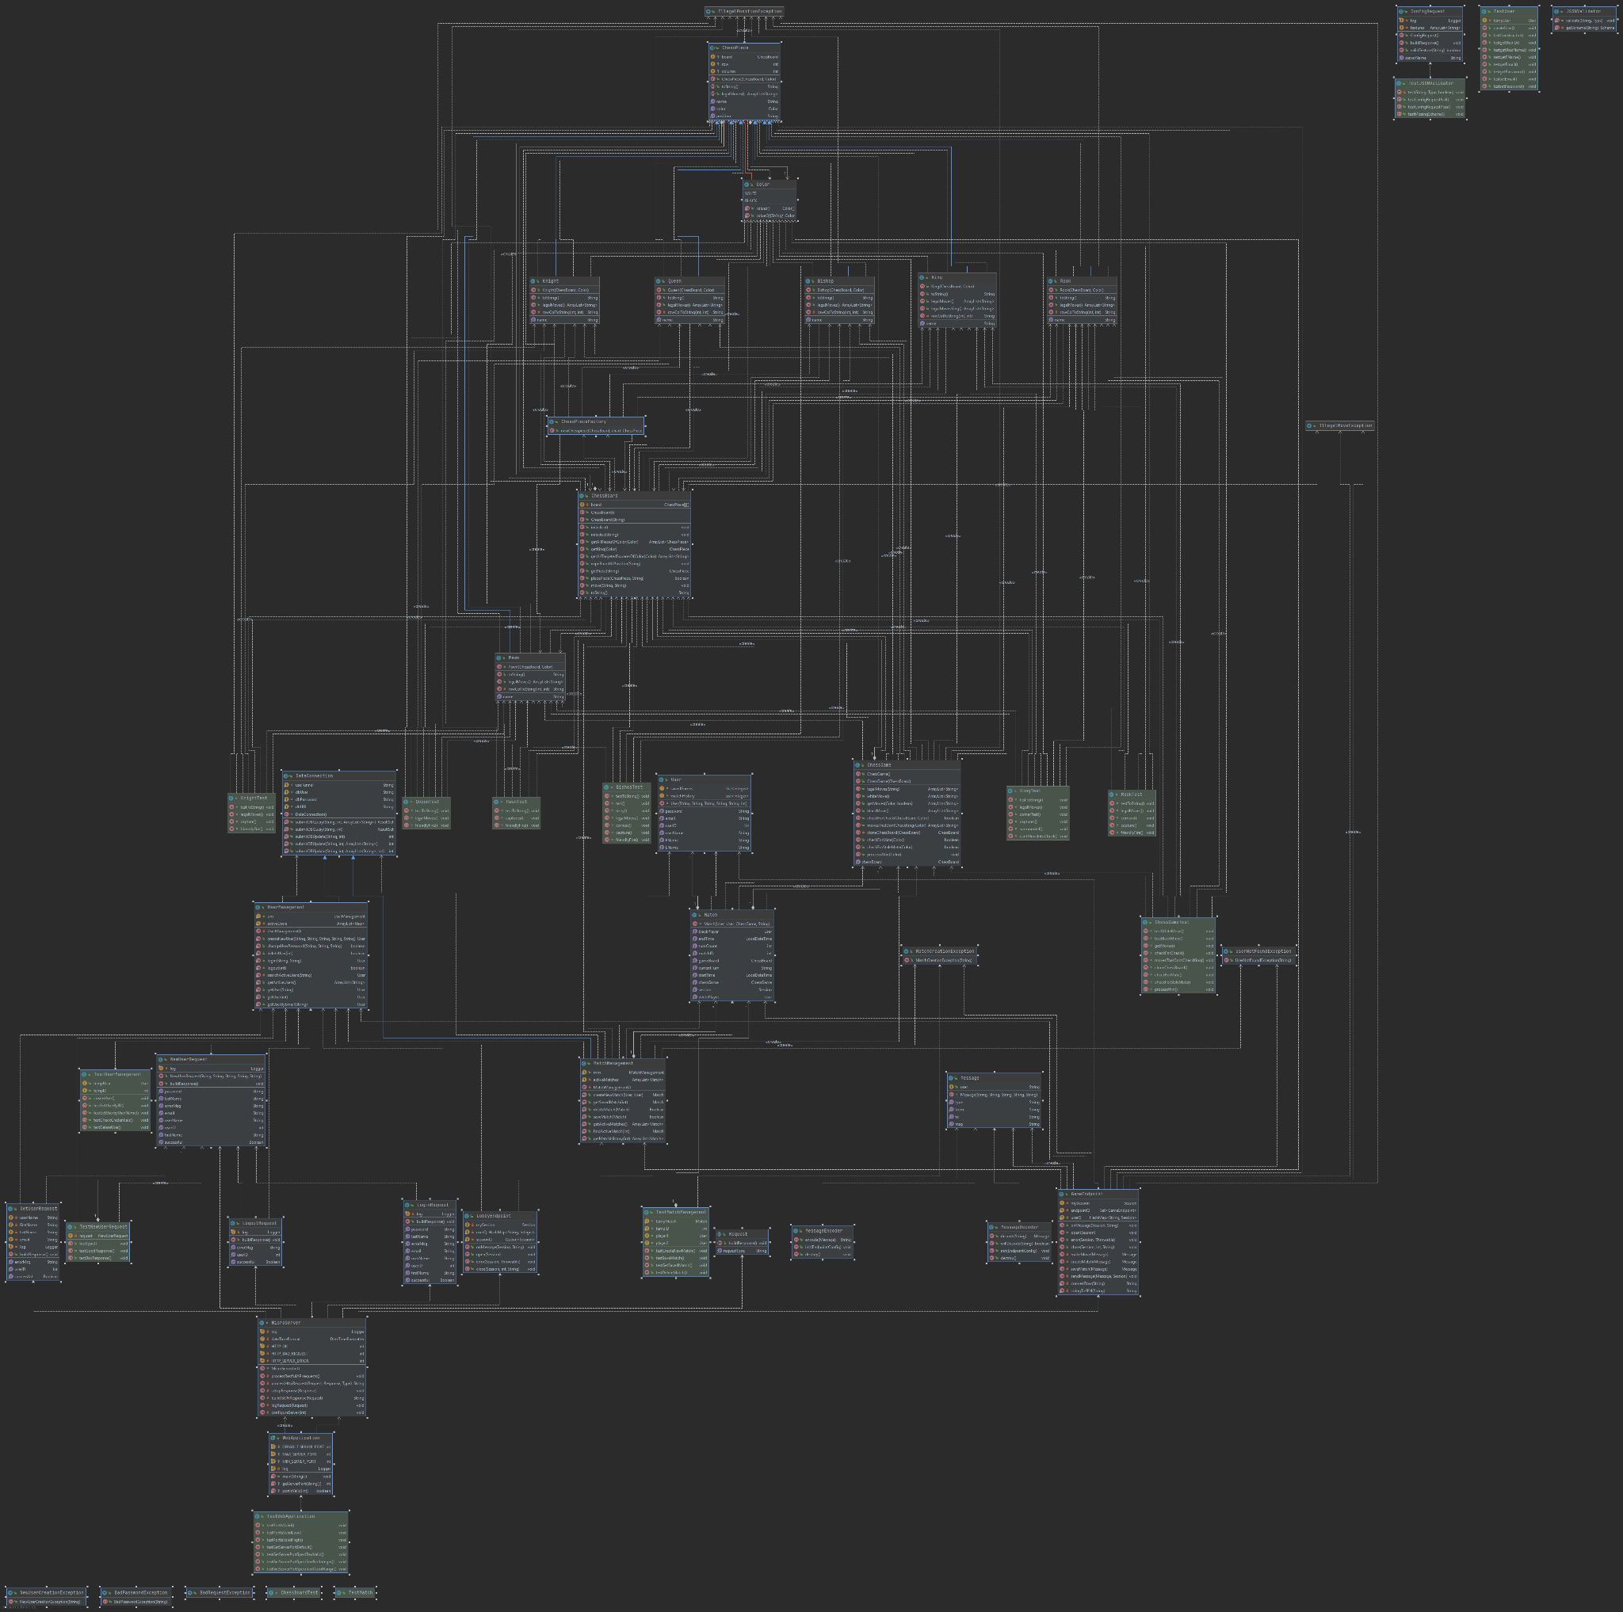
Class Diagram
Full Scale Image

Slide 6
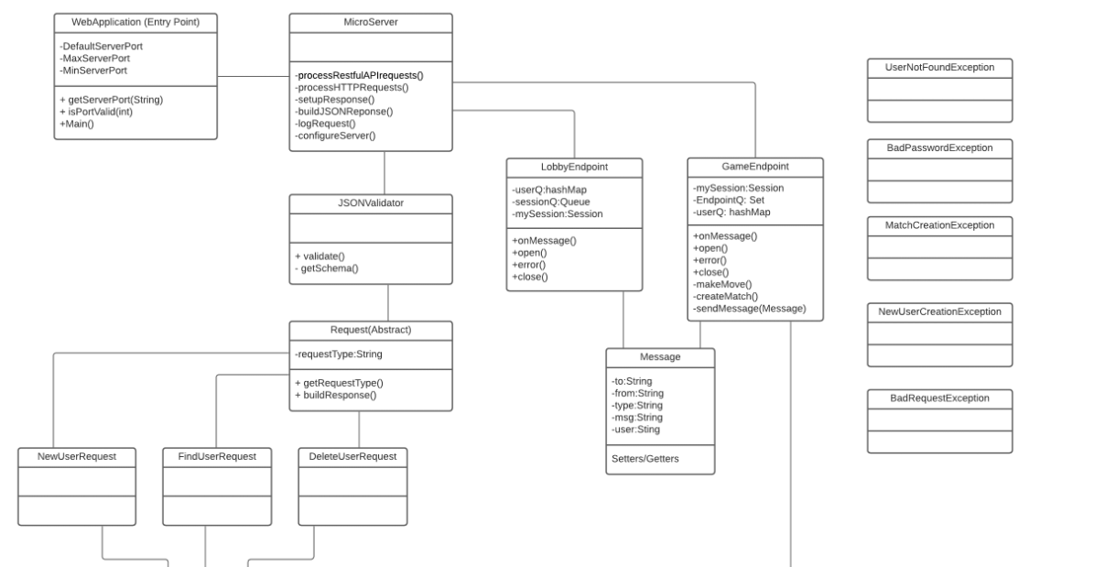
Class Diagram cont.

Slide 7
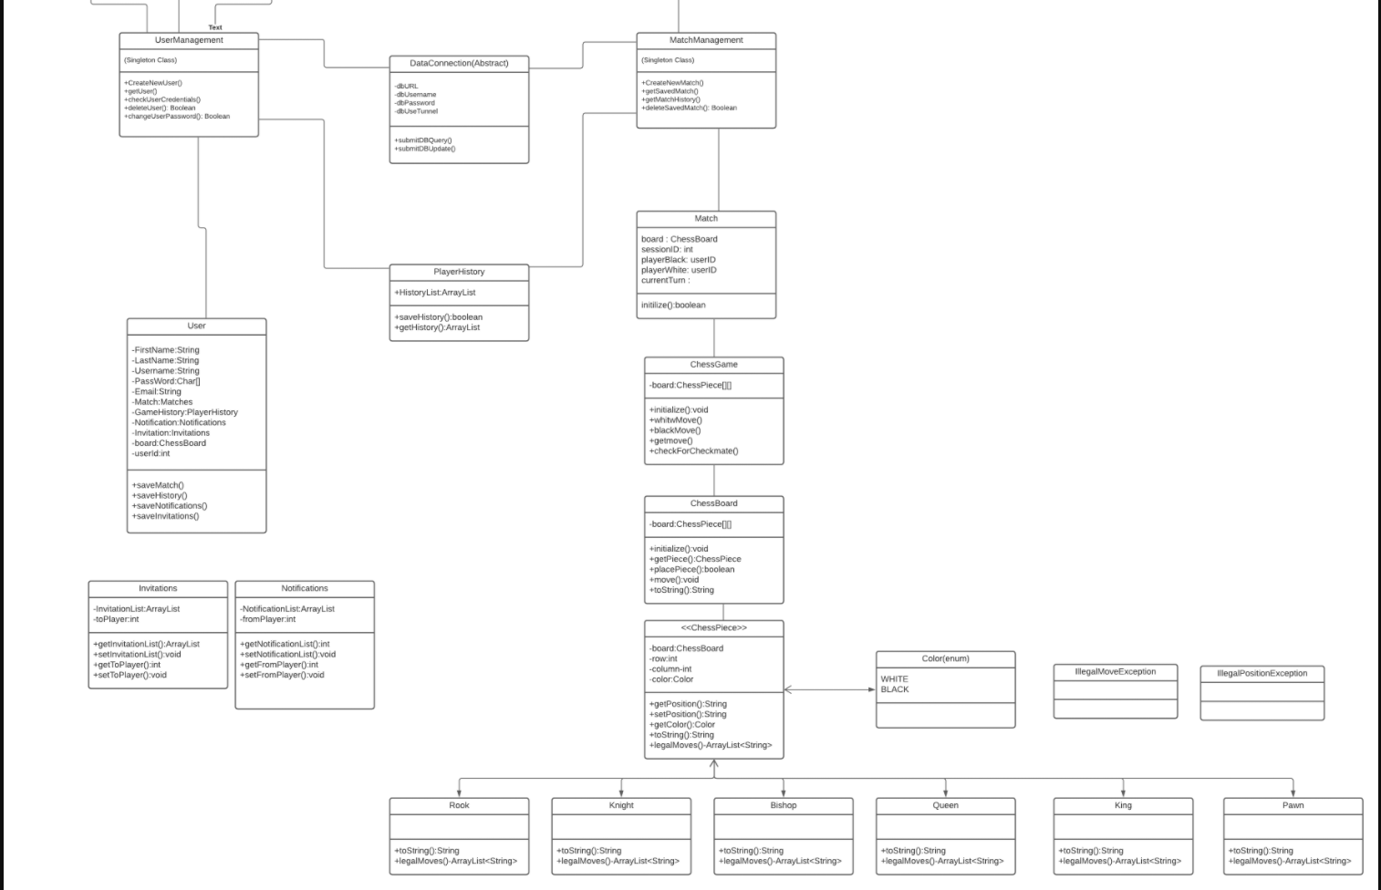
Class Diagram cont.

Slide 8
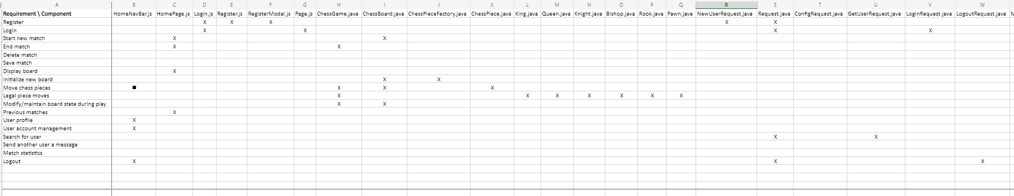
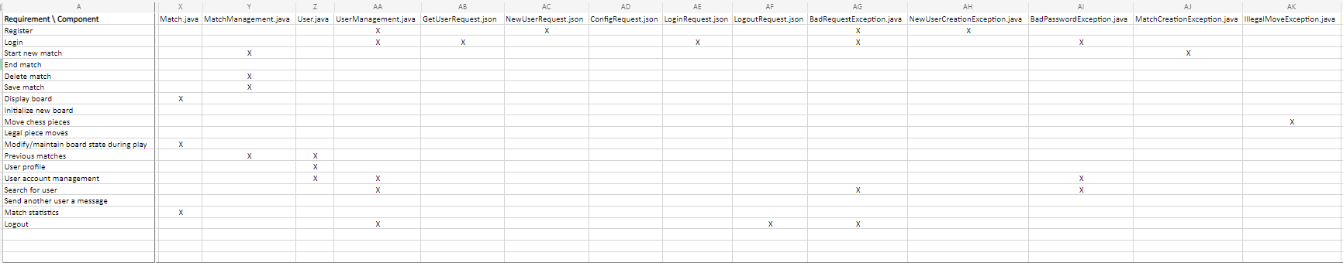
Trace Matrix

Slide 9
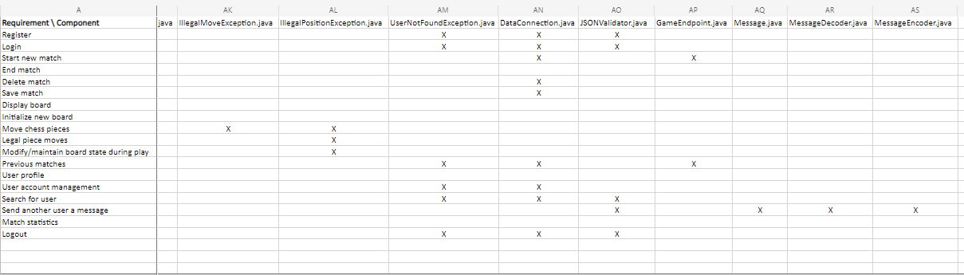
Trace Matrix cont.

Slide 10

Design Patterns Used
Factory Method for ChessPieces
Façade using MatchManagment, UserManagment and ChessGame to Access all chess classes

Slide 11
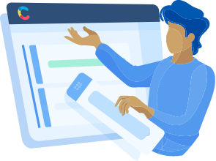
Project Demo
https://localhost:3000

Slide 12
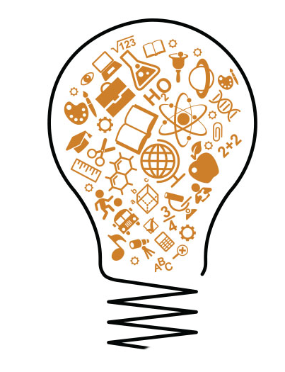
Lessons learned
More Smaller Tasks
Put more time into choosing the framework to use
Team environment setup
More Scrums
Develop More Incrementally
Remember the scope of the project over individual tasks

