Slide 1
CHAKRA
Crime Intelligence Console
Turning unstructured crime reports into actionable intelligence
Team Ragnarok — Varshil Parmar · Vikram Prajapati · Darshan Sankhala
IBM BOB AI HACKATHON

Slide 2




India's Crime Data is Broken
Siloed FIRs
The Repeat Offender Gap
Intelligence Delay
Thousands of First Information Reports filed daily — each a plain text narrative with no structure, no tags, no links. Pattern connections between crimes go completely undetected.
Senior officers have no real-time dashboard. Briefings are manually compiled — slow and incomplete. Analysts spend hours on pattern work that should take seconds.
The same criminal operates across 5 districts under 3 aliases. No system links these cases by behavior. Investigations restart from zero each time.
1,000 FIRs. Multiple states. Identical modus operandi. Zero connections made — until CHAKRA.

Slide 3




CHAKRA — What We Built
A full-stack crime intelligence platform that reads, connects, and explains.
Live Dashboard
Repeat Offender Fingerprinting
Real-time KPIs: total FIRs, arrest rates, estimated losses, high-priority cases. Bar and pie charts for crime type, time-of-day, and state breakdown.
Behavioral fingerprint = crime type + MO + weapon + vehicle + time + location. Same signature across districts = automatic flag.
Criminal Network Graph
Bob AI Integration
Interactive node graph linking accused, FIRs, states, and MO. Bob-powered natural-language search: "Show all motorcycle snatching gangs in Maharashtra."
Ask questions in plain English. Auto-generate FIR narratives. Smart classification, offender briefs, station summaries — grounded, no hallucinations.

Slide 4
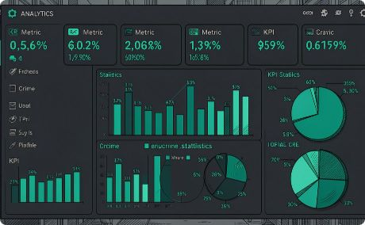
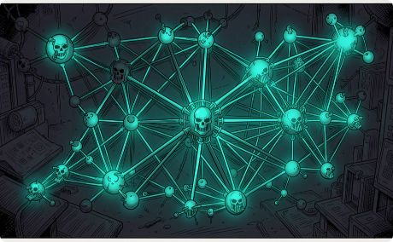
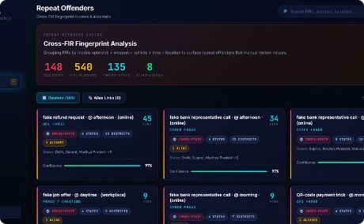
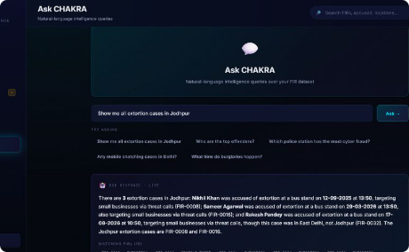
See It In Action
Live Dashboard
Network Graph
Repeat Offender Panel
Ask CHAKRA
1,000 FIRs, 6 KPI cards, crime type chart, time-bucket breakdown.
Accused nodes linked to FIRs, states, and MO. Repeat clusters highlighted.
Natural-language Q&A grounded in FIR data, with source citations.
Fingerprint clusters, cross-state gangs flagged, confidence scores.
Live at http://127.0.0.1:5500 · API at http://127.0.0.1:8000/docs

Slide 5
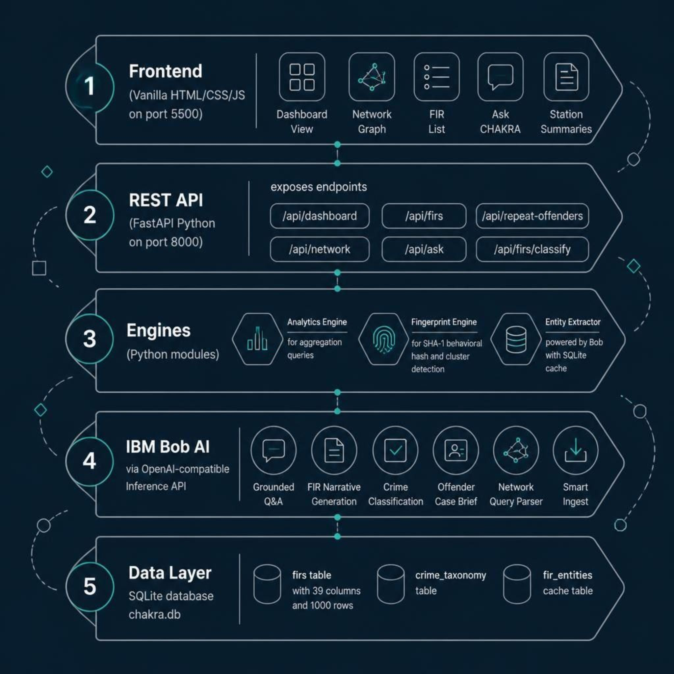
How CHAKRA Works — System Architecture
A clean five-layer stack — from raw FIR ingestion through AI-powered analysis to real-time dashboards and natural-language Q&A.
Every layer is modular. Every engine is independently testable. Bob features work offline in mock mode with deterministic rule-based fallbacks — zero dependency on a live API key for demo.

Slide 6

Where Bob is Load-Bearing
9 distinct Bob-powered capabilities — each one irreplaceable.
Extraction & Grounding
Intelligence & Ingestion
Entity Extraction — pulls accused names, aliases, MO, weapons, vehicles from raw narrative
Grounded Q&A — answers analyst questions using only retrieved FIRs; fabricated IDs auto-rejected
Narrative Generator — converts structured fields into formal FIR paragraphs
Station Briefing — Bob produces a 5-sentence commander summary; every number grounded
Network Query Parser — translates "motorcycle gangs in UP" into structured SQL filters
Smart Ingest — paste a messy WhatsApp complaint; Bob fills all 39 FIR fields
Classification & Briefing
FIR Classifier — rates severity, urgency, victim risk; suggests BNS sections
Taxonomy Normalizer — maps descriptions to canonical taxonomy; flags new crime types
Offender Case Brief — 5-paragraph brief: Profile → Pattern → Evolution → Network → Action
Anti-hallucination by design: strict system prompts, refusal scripts, post-response FIR ID validation, schema enforcement on every structured output.

Slide 7



What CHAKRA Becomes Beyond the Hackathon
Immediate · 0–3 Months
Scale · 3–12 Months
Vision · 1–3 Years
Deploy at any station via CSV export from CCTNS. Reduce pattern analysis from hours to seconds. Every station head gets a daily AI-generated briefing.
Connect districts and states for cross-jurisdictional repeat offender detection. Integrate directly with CCTNS. Real-time ingestion of new FIRs as filed.
Predictive hotspot mapping. National-level gang and alias network discovery. Bob becomes the analyst for every SHO in India.
1K
9
1
FIRs Processed
Bob Capabilities
Platform for Every Station

Slide 8

CHAKRA
Intelligence. Instantly. At Every Station.
Team Ragnarok — Varshil Parmar · Vikram Prajapati · Darshan Sankhala
Built on IBM Bob AI — grounded, explainable, anti-hallucination by design
Full-stack: FastAPI backend + SQLite + Vanilla JS frontend — runs anywhere
Open to integration: CCTNS, state police portals, mobile field officers
Every FIR tells a story. CHAKRA connects them all.
IBM BOB AI HACKATHON SUBMISSION — TEAM RAGNAROK

