Slide 1
Sadbhavna Tea
E-Commerce Platform Project Presentation
GROUP ID: [Group ID] Students: • Varshil Desai (3110) • Krish Vaghani (3272) • Om Kanpariya (3029)
Program & Semester: [Program] - Sem [X] College: K. S. School of Business Management & IT University: Gujarat University Internship Org: [Organization Name] Guide / Mentor: [Mentor Name]

Slide 2
Index / Table of Contents
1. Introduction 2. Project Overview 3. Scope of the Project 4. Software Development Methodology 5. Frontend Design 6. Backend Design 7. Database Design 8. Admin Dashboard

Slide 3
1. Introduction
Internship Overview This project serves as a practical implementation of full-stack software engineering concepts, building a real-world e-commerce application from scratch. Domain Software Development (Web Applications & APIs) Duration 120 Hours of intensive planning, designing, coding, testing, and deployment.

Slide 4
2. Project Overview
Project Name Sadbhavna Tea E-Commerce Platform Purpose of the Software To provide a seamless, secure, and fast online shopping experience for premium tea. It allows users to browse categories, add products to cart, securely pay online, and track their orders. Target Users Tea enthusiasts, wholesale buyers, everyday consumers, and the store administrators who manage the business.

Slide 5
3. Scope of the Project
Features Included: • Dynamic Product Catalog & Filtering • Secure Shopping Cart & Razorpay Checkout • Secure Login (Email OTP & Google OAuth) • Automated Order Tracking Notifications (Twilio WhatsApp) • Complete Admin Management Dashboard
User Roles: Customer, Admin Limitations: • Requires an active internet connection. • Restricted to digital payments only. • Initial rollout restricted to specific geographic delivery zones.

Slide 6
4. Software Development Methodology
SDLC Model Used: Agile Methodology
Phase-wise Explanation: 1. Requirement Gathering: Defining features, database schemas, and user flows. 2. Design: UI/UX planning using the orange & green cream theme. 3. Development: Building the MERN stack in iterative sprints. 4. Testing: API endpoint testing, payment gateway validation, and UI responsiveness. 5. Deployment: Hosting on Vercel for the world to see.

Slide 7
5. Frontend Design
Frontend Technology Used: React.js (Vite), Tailwind CSS, JavaScript, HTML5 UI Design: A fully responsive, mobile-first design. We used Tailwind CSS to create a 'two river' theme using primary Orange (#E67300), secondary Green (#007A33), and a Cream Surface (#FDFBF7) to give an authentic tea brand experience. User Interaction Flow: Visit Home → Browse Products → Add to Cart → Authenticate → Razorpay Checkout → Payment Success.

Slide 8
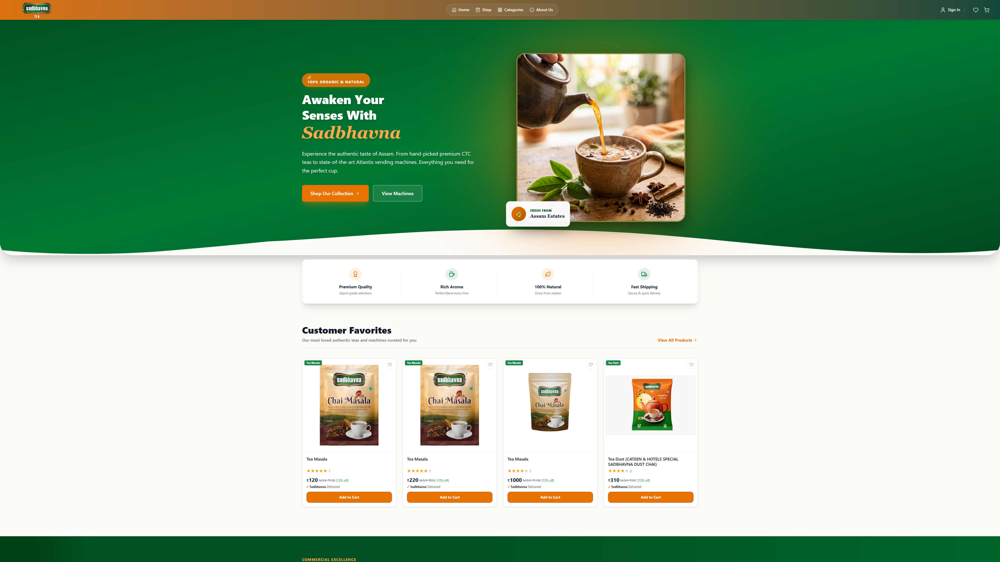
5.1 Frontend: The Home Page
Modern Hero Section The landing page instantly establishes brand identity with lush green imagery and clear navigation, inviting users to explore the tea collections.

Slide 9
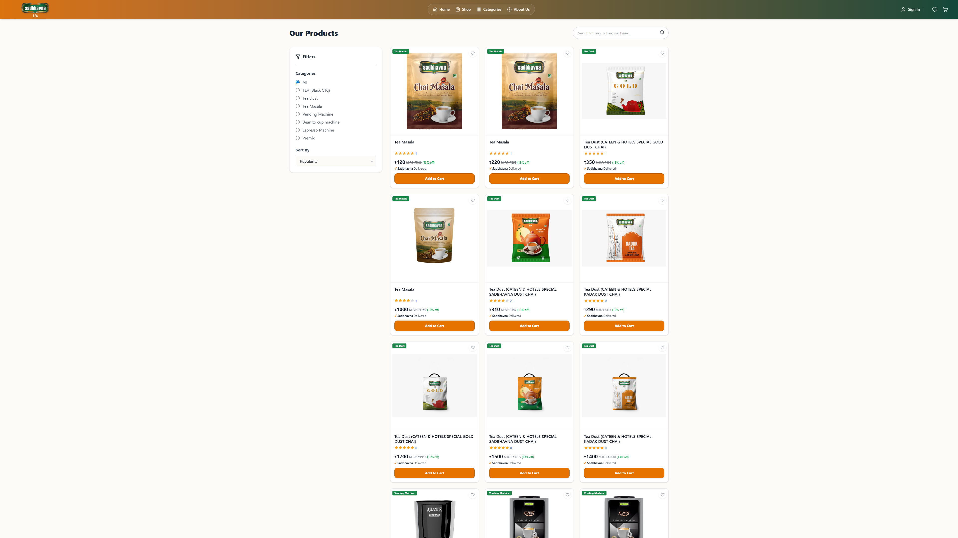
5.2 Frontend: Product Browsing
Dynamic Catalog A dynamic grid layout fetching data live from the MongoDB database, showing ratings, prices, and high-quality images.

Slide 10
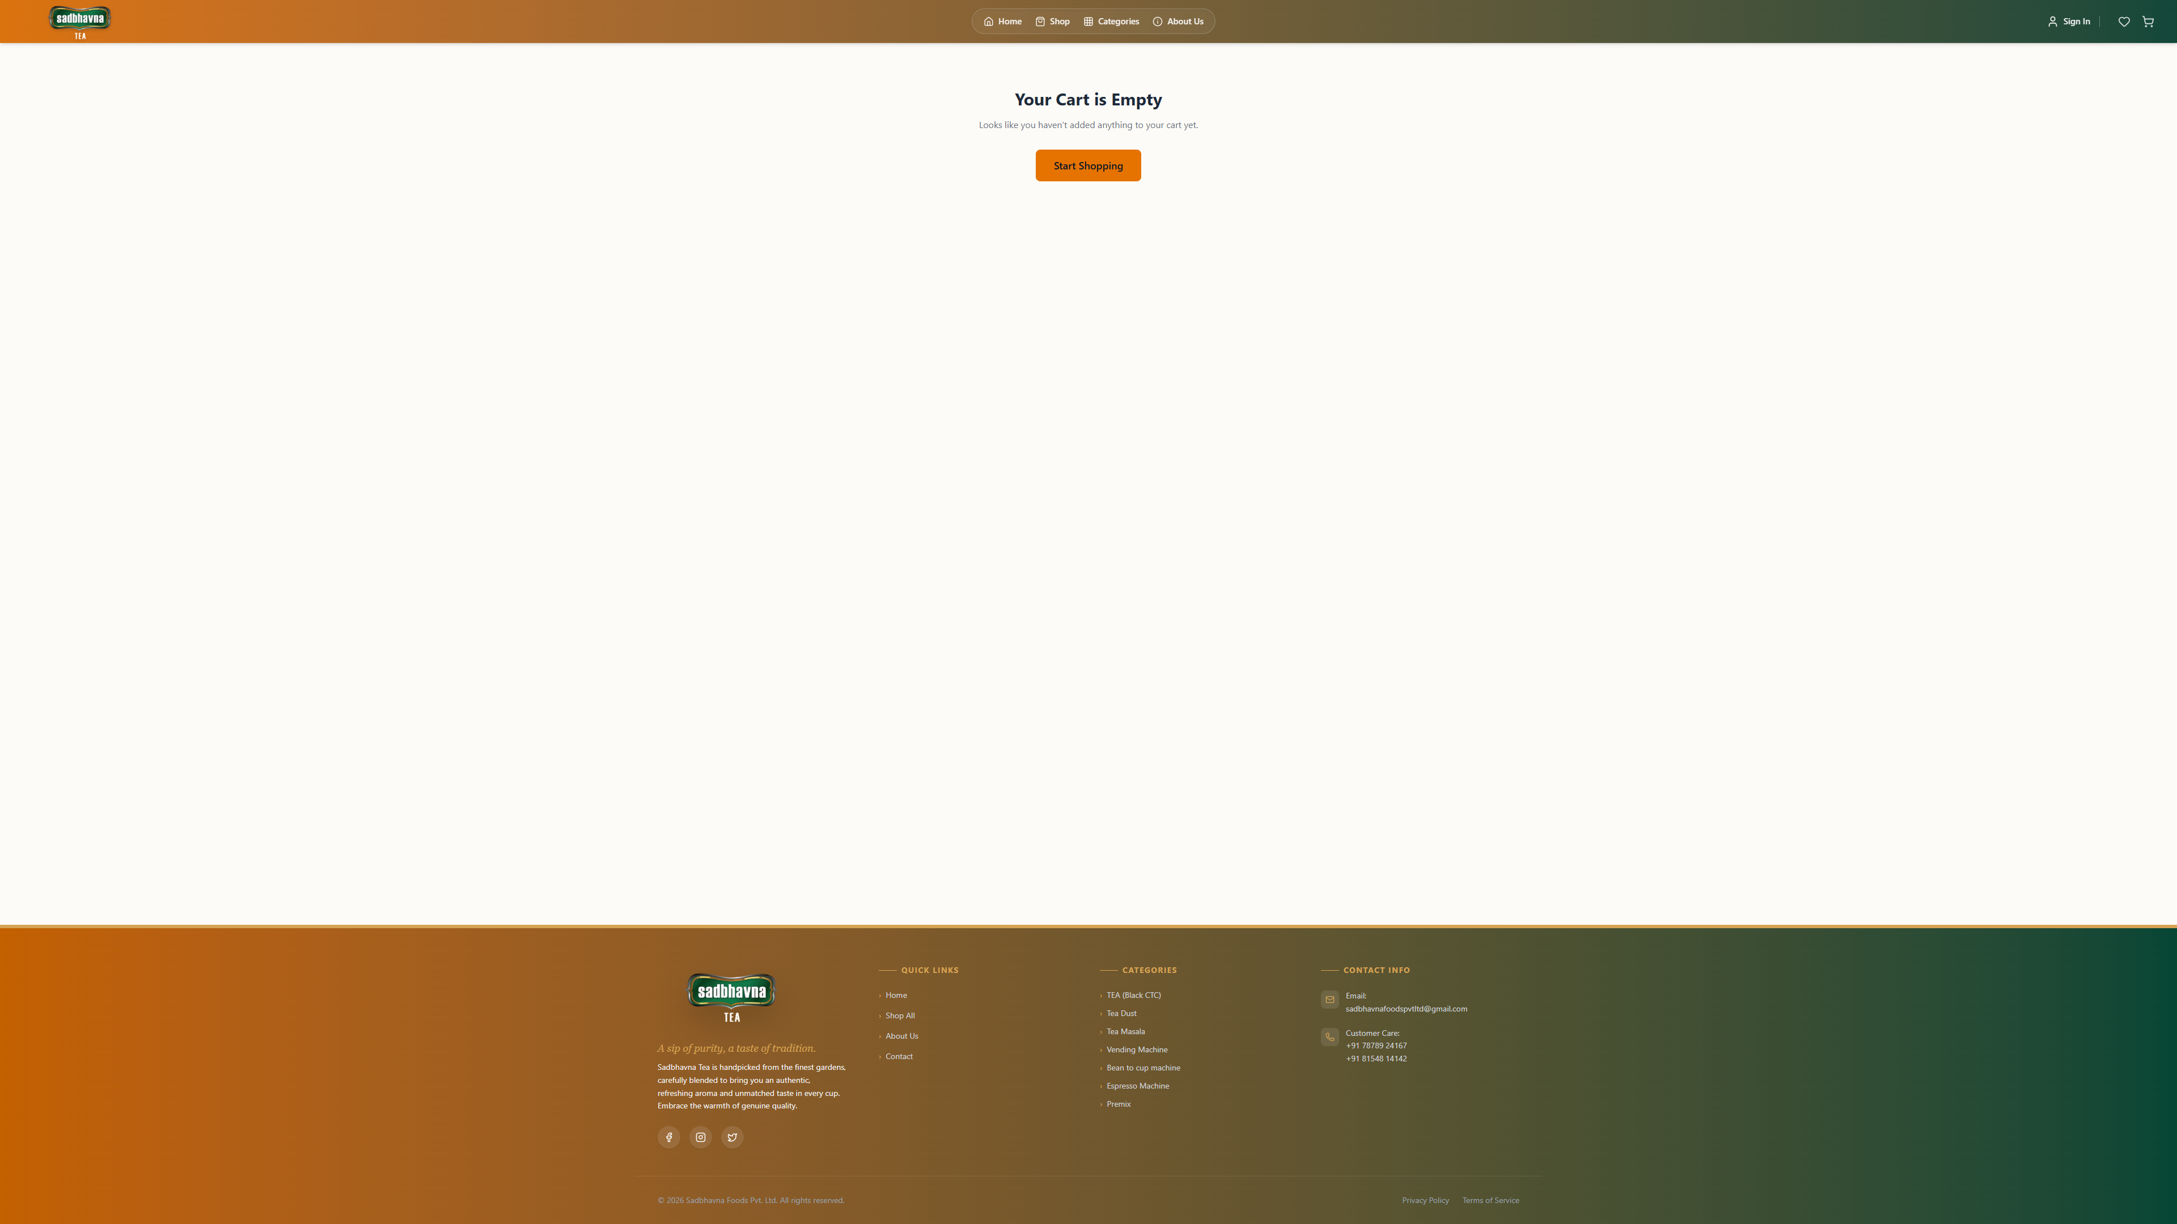
5.3 Frontend: Cart & Checkout
Secure Transactions The cart updates in real-time. Upon checkout, the Razorpay integration pops up seamlessly ensuring a fast, frictionless payment experience.

Slide 11
6. Backend Design
Backend Technology Used: Node.js, Express.js (RESTful APIs) Business Logic: • Advanced Authentication (JWT, Google OAuth, Email OTP) • E-Commerce Logic (Cart validation, total calculation, Razorpay signature verification) • Notification Triggers (Sending Twilio WhatsApp messages and SMTP emails upon order success) Server-side Processing: Handles all client HTTP requests securely, interacts with the MongoDB database, and returns JSON data.

Slide 12
6.1 Backend System Architecture
Node.js API Routes: • /api/auth: Handles login, registration, and sessions. • /api/products: Serves the product catalog and reviews. • /api/orders: Processes payments and creates order records. External API Integrations: • Razorpay API: For processing secure credit card & UPI payments. • Twilio API: For sending automated WhatsApp status updates. • Google Cloud OAuth: For 1-click secure login.

Slide 13
7. Database Design
Database Used: MongoDB (NoSQL) with Mongoose ODM Why MongoDB? It allows for flexible document structures, perfect for an e-commerce catalog where products can have varying attributes (sizes, flavors, etc.). Data Flow: React Frontend ↔ Express Server ↔ Mongoose Schema ↔ MongoDB Atlas Core Collections: Users, Products, Orders, Reviews, Categories

Slide 14
7.1 Core Database Collections
Users Collection Stores user profiles, secure hashed passwords, roles (Admin/User), and order history references. Products Collection Stores tea names, descriptions, prices, stock levels, category relations, and Cloudinary image URLs. Orders Collection Stores the shopping cart snapshot, total amounts paid, shipping addresses, Razorpay payment IDs, and fulfillment statuses.

Slide 15
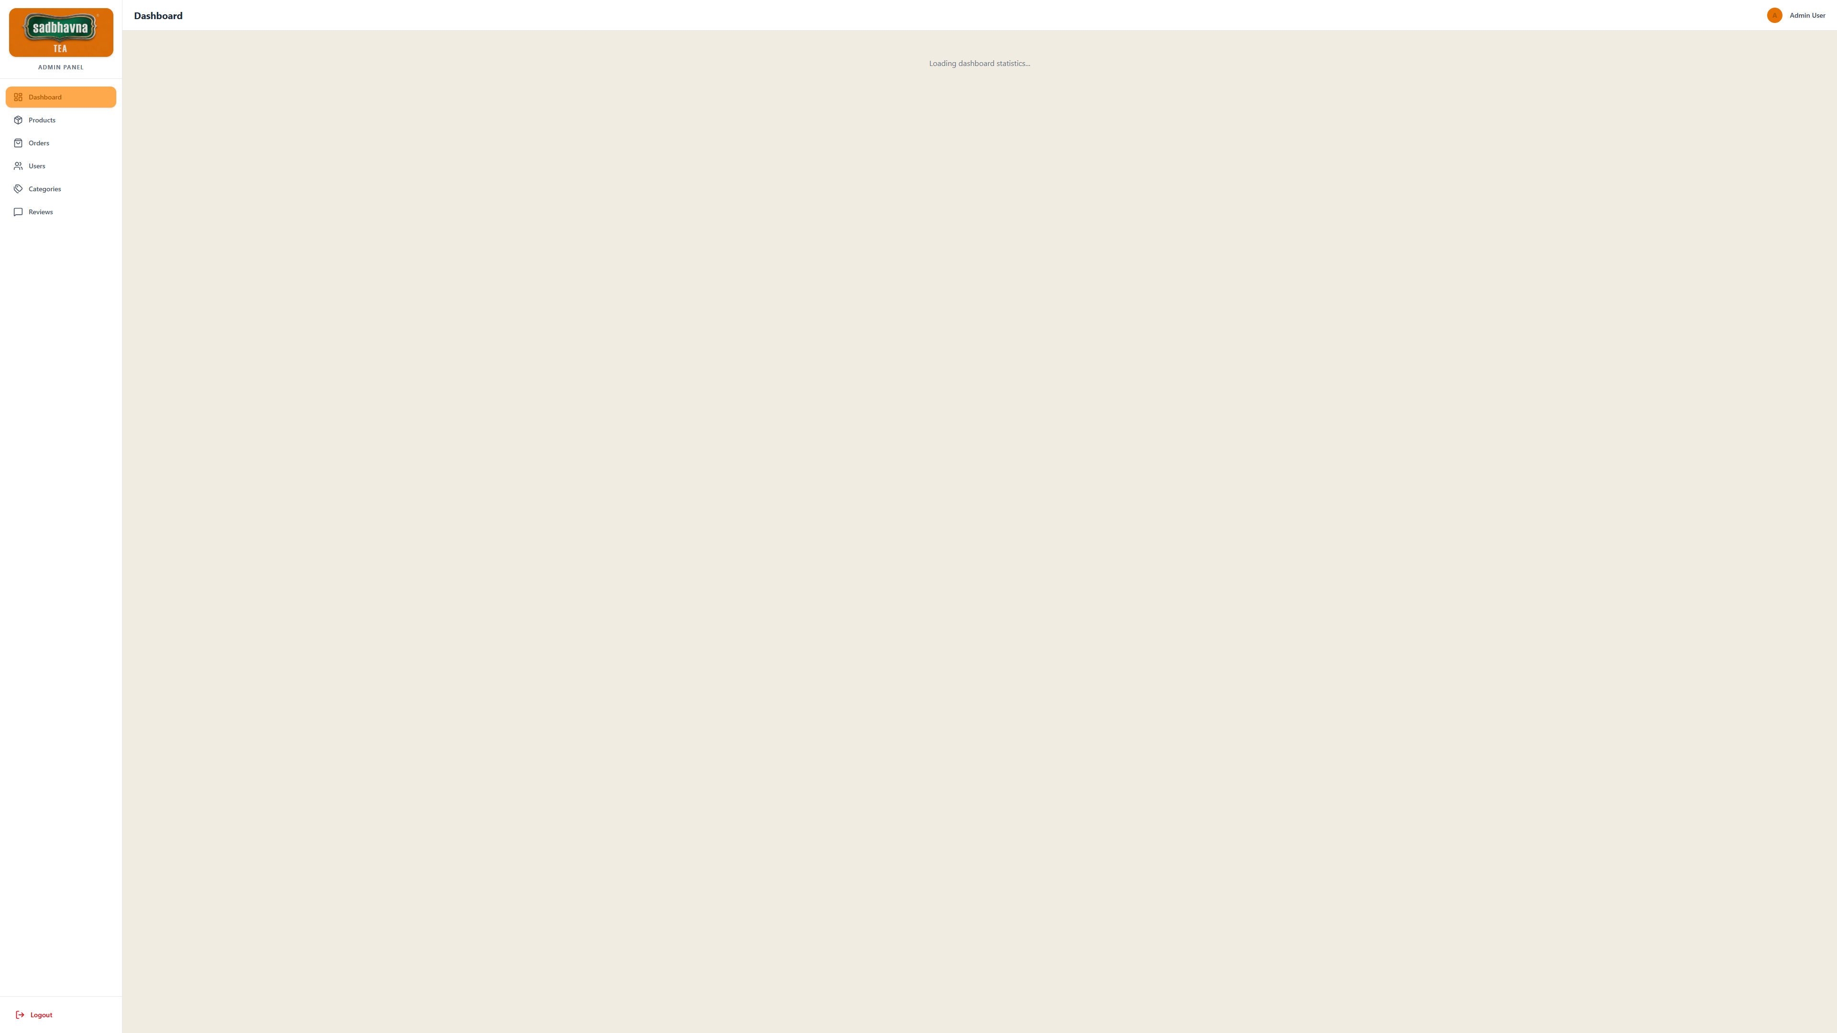
8. The Admin Dashboard
Owner Interface A protected route accessible only by verified administrators (e.g., varshildesai247@gmail.com). Features comprehensive CRUD (Create, Read, Update, Delete) operations for managing the entire store.

Slide 16
Thank You!
We hope you enjoyed learning about Sadbhavna Tea.
Any Questions?

