Slide 1
Sadbhavna Tea
Online Tea Store - Project Presentation
GROUP ID: [Group ID] Students: • Varshil Desai (3110) • Krish Vaghani (3272) • Om Kanpariya (3029)
Program & Semester: [Program] - Sem [X] College: K. S. School of Business Management & IT University: Gujarat University Internship Org: [Organization Name] Guide / Mentor: [Mentor Name]

Slide 2
1. What is Sadbhavna Tea?
About The Project We built a modern, fast, and easy-to-use website for selling premium tea online. Users can visit our site, look at different teas, and easily buy them. Who is it for? It's for people who love tea and want to buy high-quality tea easily from their phones or computers.

Slide 3
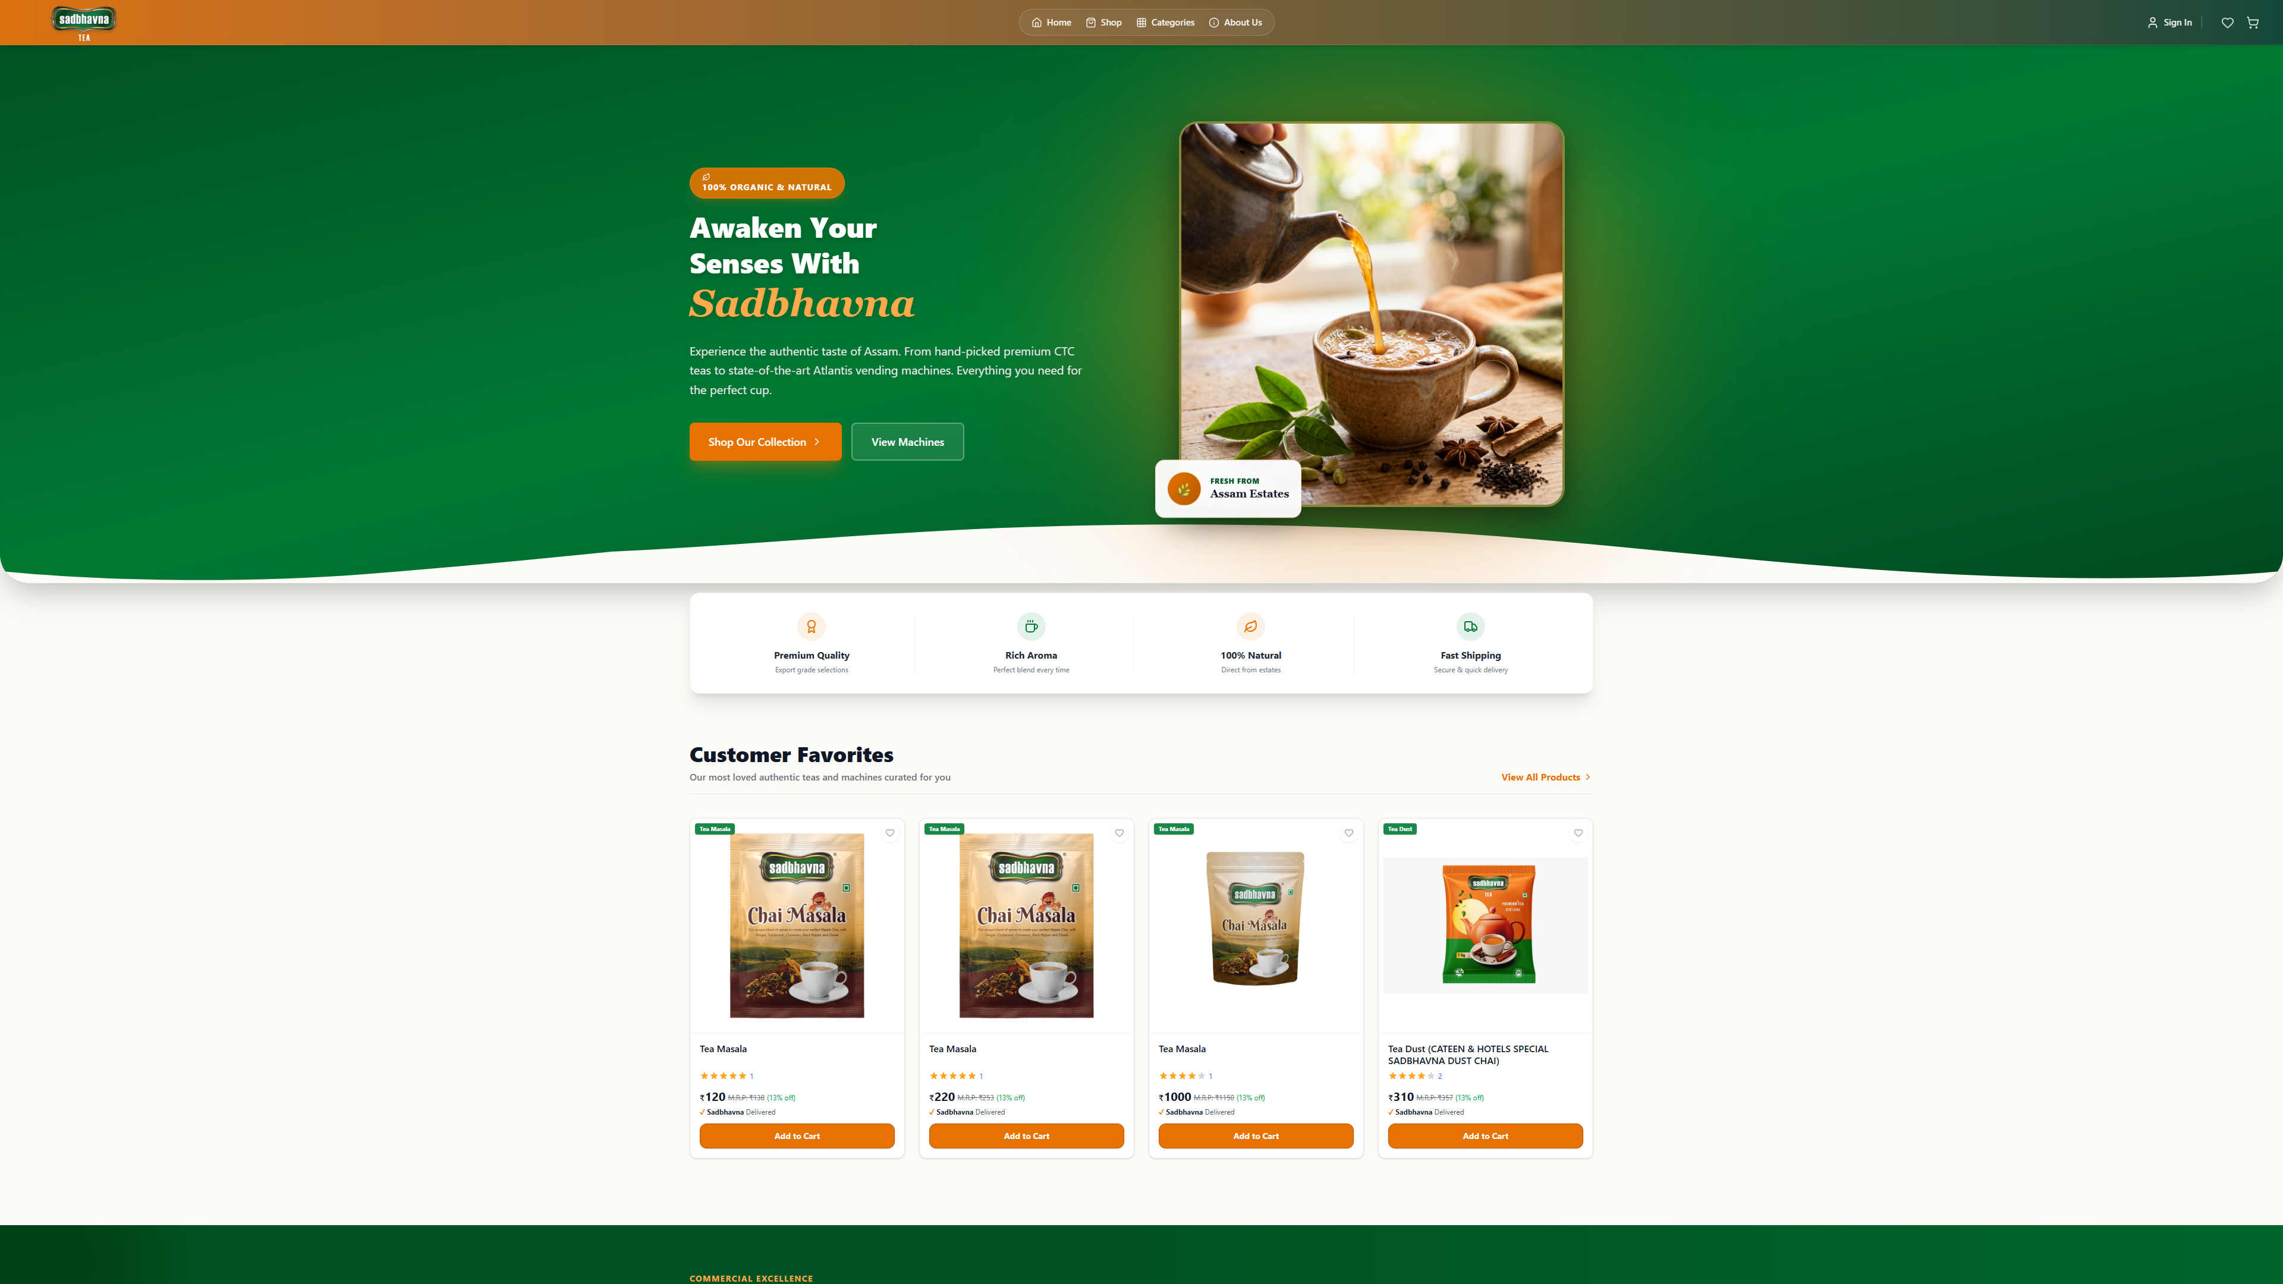
2. Live Website - Home Page
Welcome Screen This is what users see when they visit our live website (sadbhavnatea.vercel.app). It uses our Green and Orange theme to give a very fresh and premium 'tea' feeling.

Slide 4
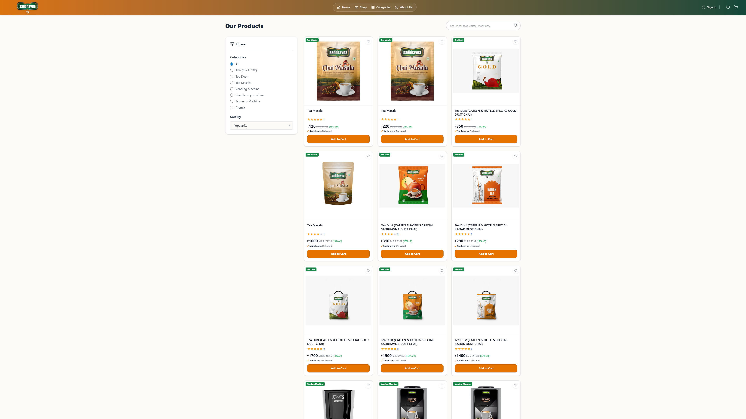
3. Browsing Our Teas
Our Products Customers can see all our different teas here. They can view prices, read reviews, and click 'Add to Cart' to buy.

Slide 5
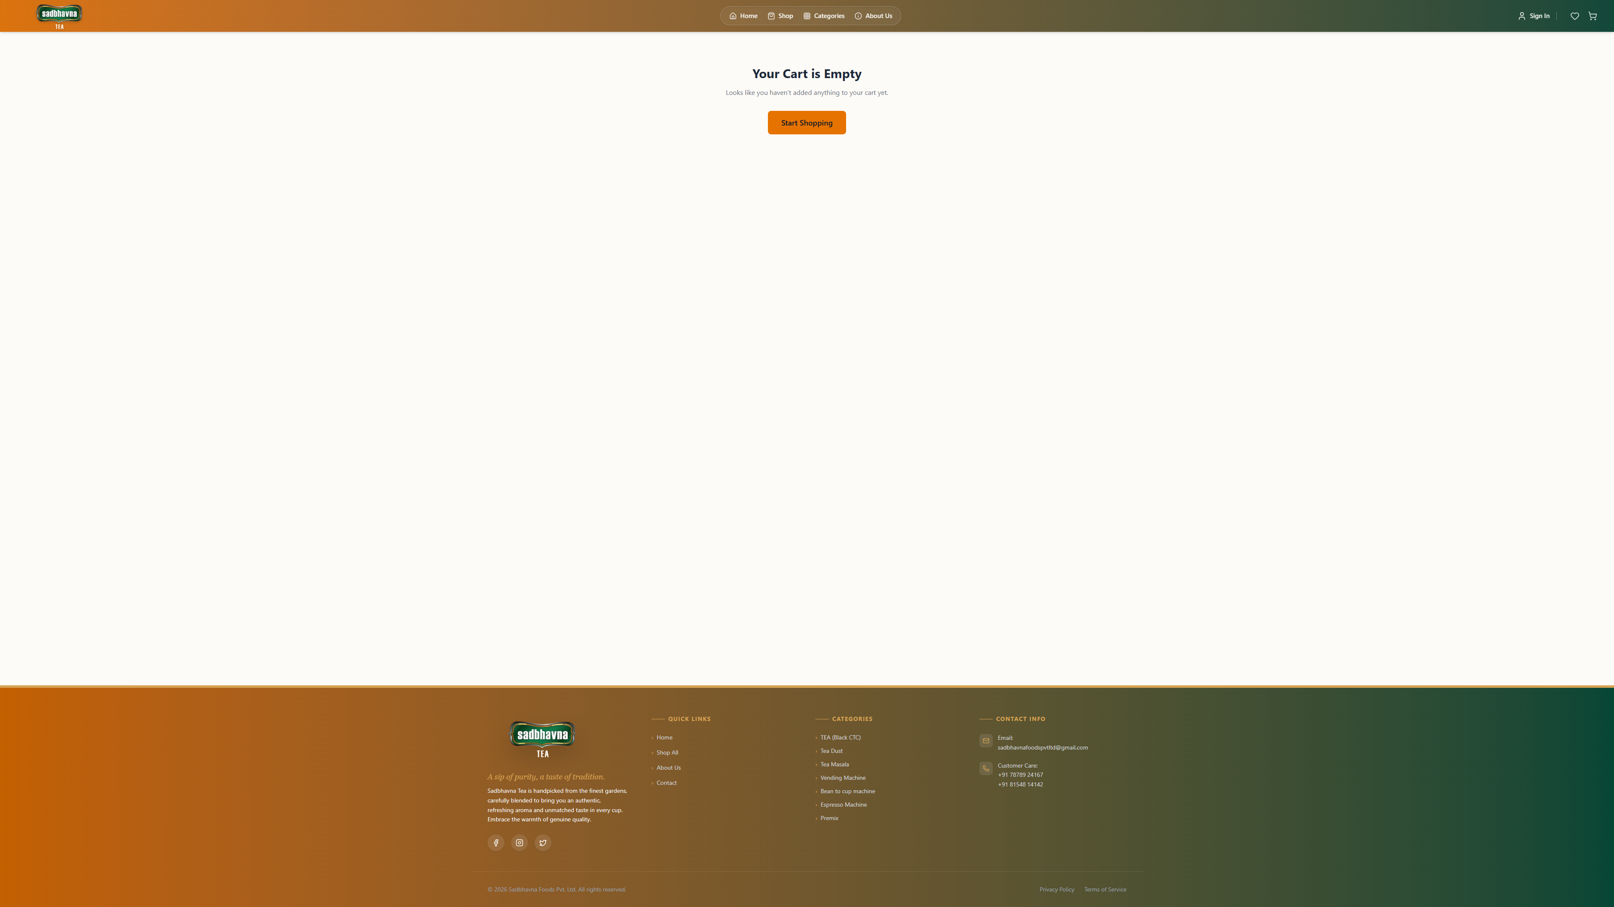
4. The Shopping Cart
Easy Checkout This is where customers review their order. They can increase quantity or remove items before paying securely online.

Slide 6
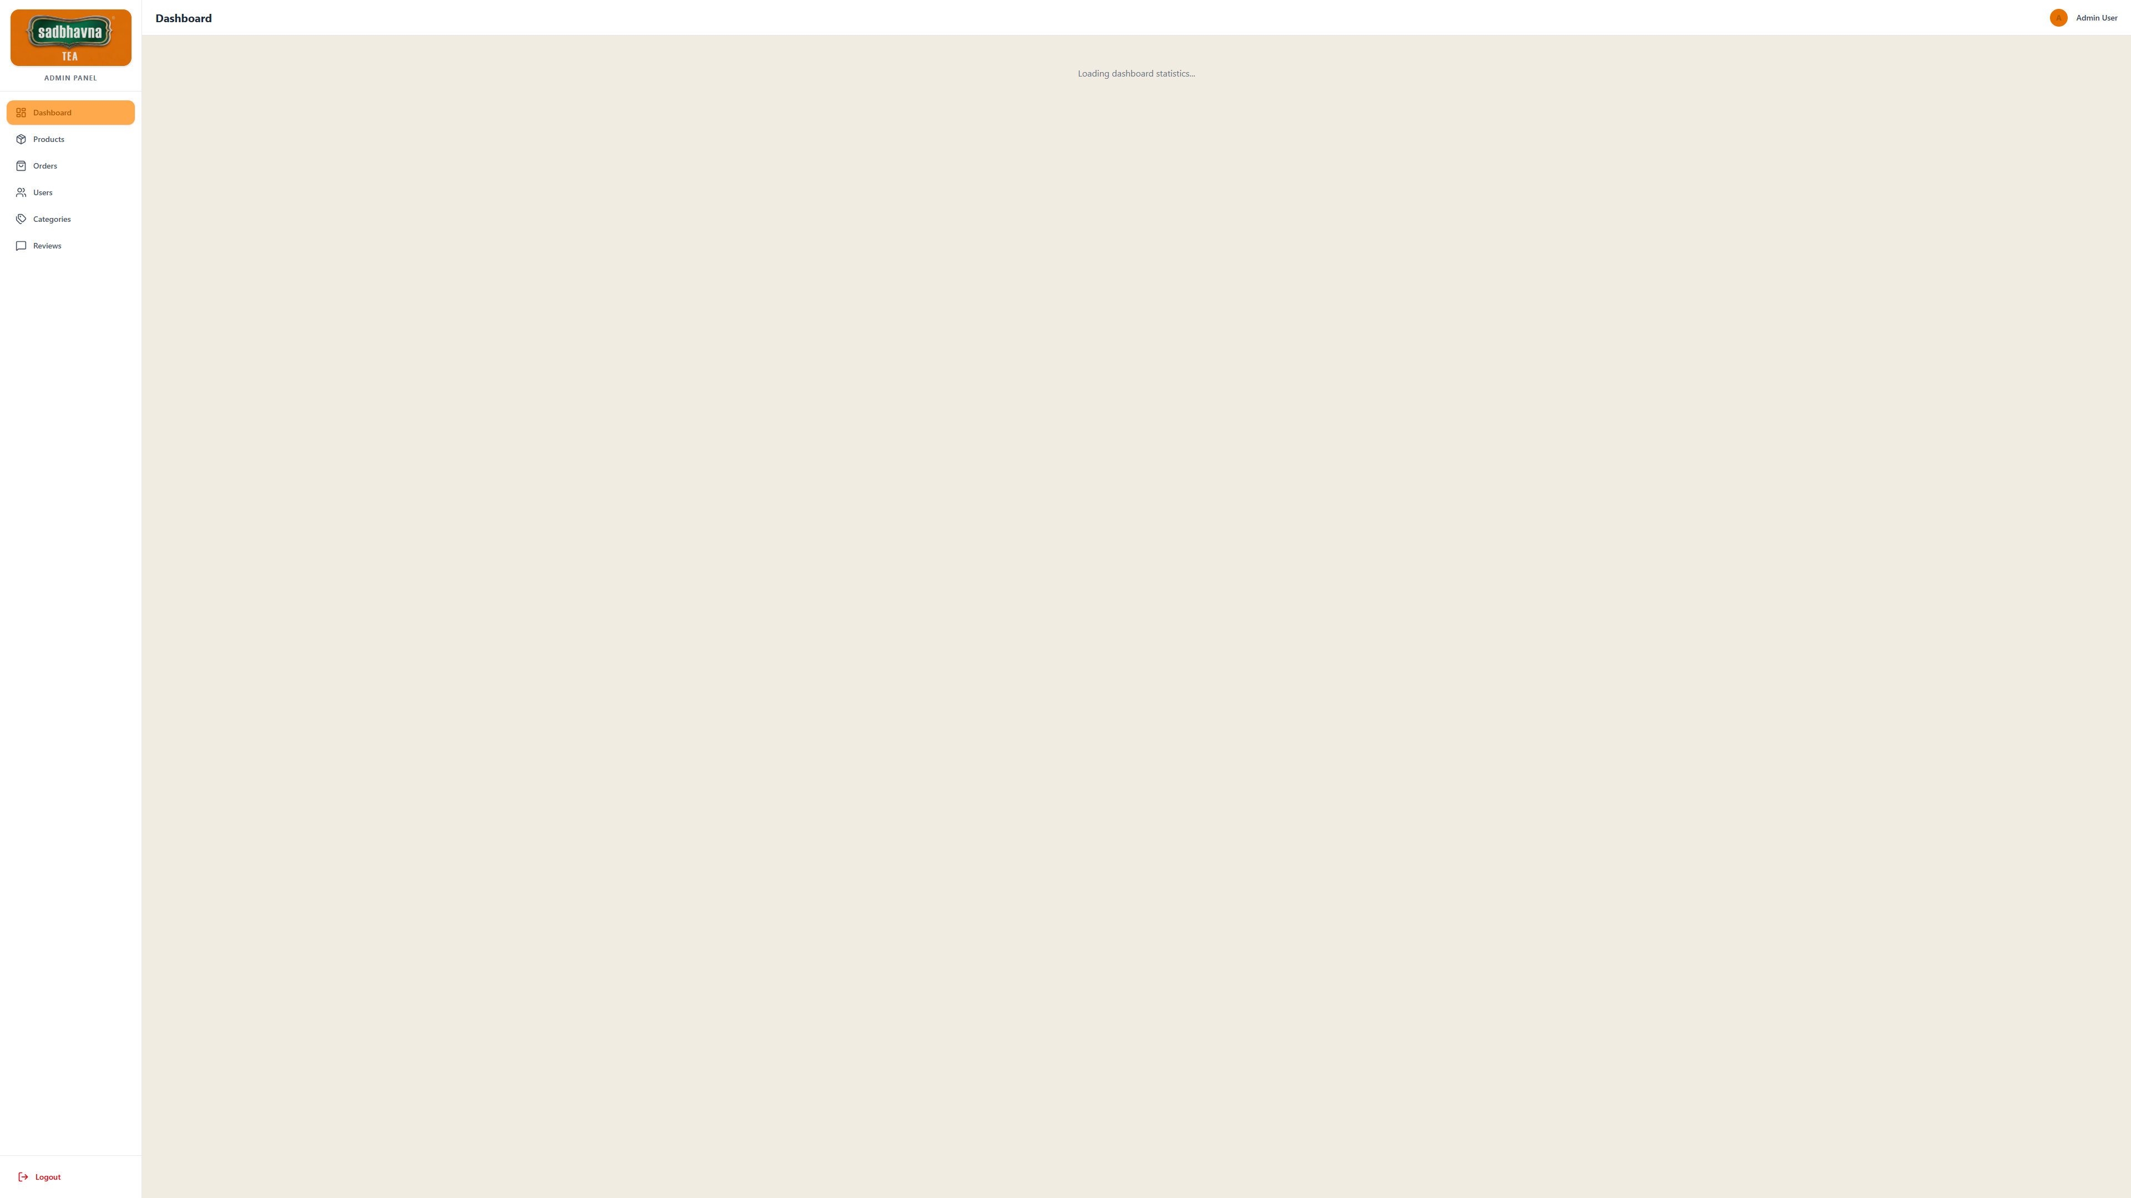
5. The Admin Panel
Owner Dashboard This is the secure backend panel for the website owner (varshildesai247@gmail.com). Here, we can see total sales, manage orders, and add new tea products to the store easily.

Slide 7
6. How We Built It
Frontend (What the user sees) We used React.js and Tailwind CSS. This makes the website look beautiful on both phones and computers. Backend (The brain of the website) We used Node.js. It handles the user login, payments, and shopping cart logic safely. Database (Where data is saved) We used MongoDB to store all user accounts, orders, and product details.

Slide 8
Thank You!
We hope you enjoyed learning about Sadbhavna Tea.

