Slide 1
Sadbhavna Tea
E-Commerce Platform Project Presentation
GROUP ID: [Group ID] Students: • Varshil Desai (3110) • Krish Vaghani (3272) • Om Kanpariya (3029)
Program & Semester: [Program] - Sem [X] College: K. S. School of Business Management & IT University: Gujarat University Internship Org: [Organization Name] Guide / Mentor: [Mentor Name]

Slide 2
1. Introduction
Internship Overview Practical implementation of full-stack software engineering concepts in a real-world e-commerce scenario. Domain Software Development (Web Applications) Duration 120 Hours

Slide 3
2. Scope of the Project
Features Included: • Dynamic Product Catalog & Wishlist • Secure Shopping Cart & Checkout (Razorpay) • User Authentication (Email OTP & Google OAuth) • Real-time Order Tracking & Notifications (Email/WhatsApp) • Comprehensive Admin Dashboard
User Roles: Customer, Admin Limitations: Restricted to online payments only. Delivery restricted to specific geographic zones initially.

Slide 4
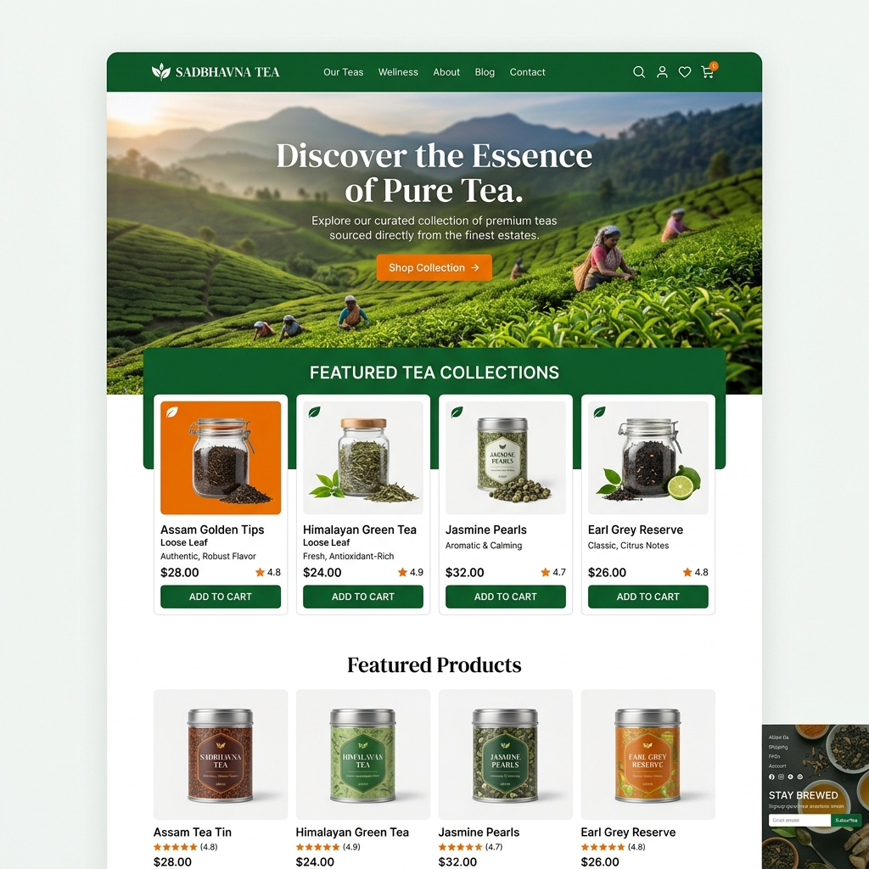
3. Step 1: User Lands on Home Page
Modern Hero Section Displays the vibrant blend of orange and green branding to give users a premium feel immediately upon visiting the site.

Slide 5
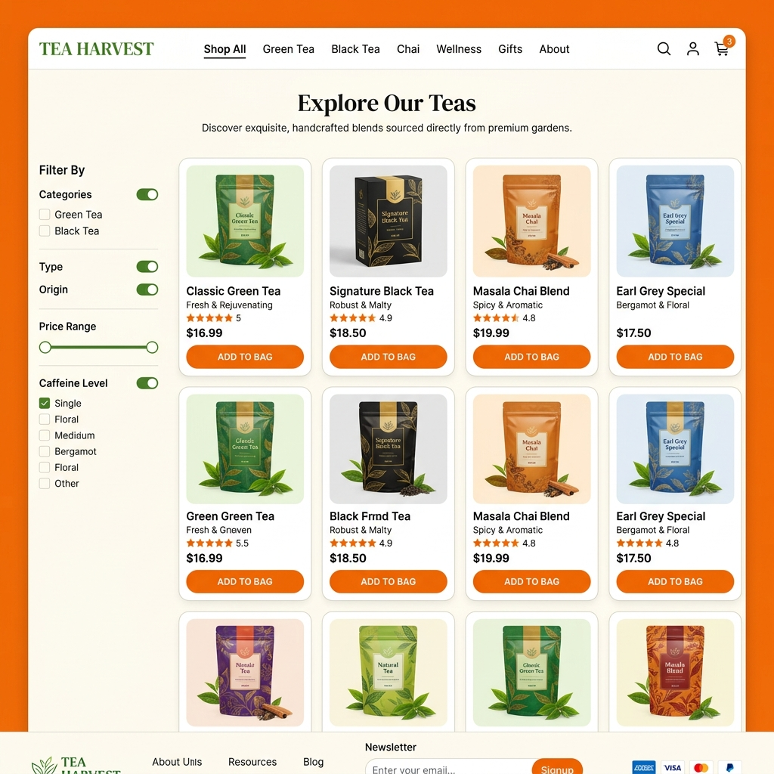
4. Step 2: Browsing Products
Dynamic Catalog Users can browse various premium tea products seamlessly with advanced filtering and mobile-friendly grid layouts.

Slide 6
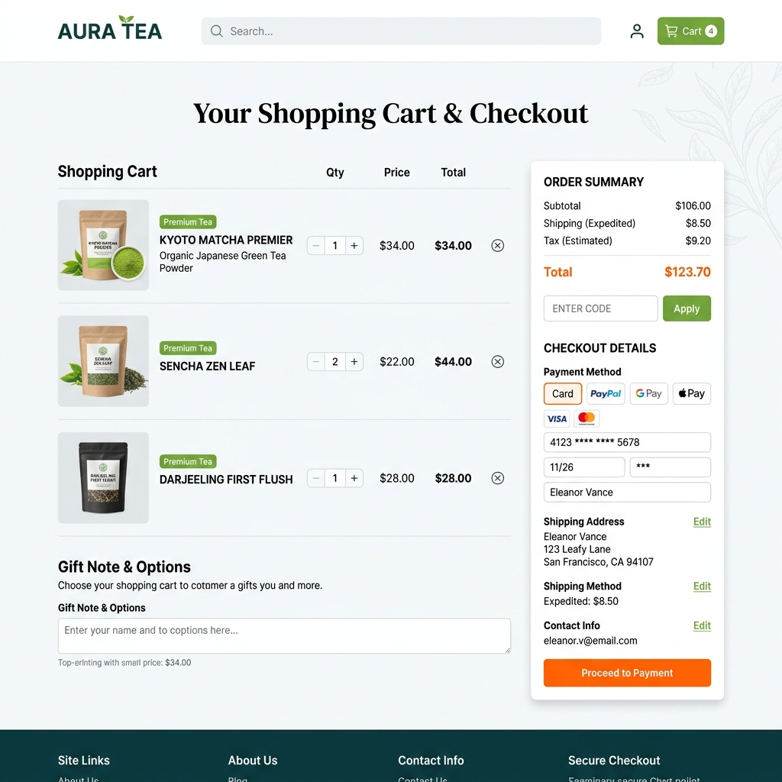
5. Step 3: Secure Checkout
Seamless Payment Fast checkout process with integrated payment gateways (Razorpay) ensuring a smooth transaction process.

Slide 7
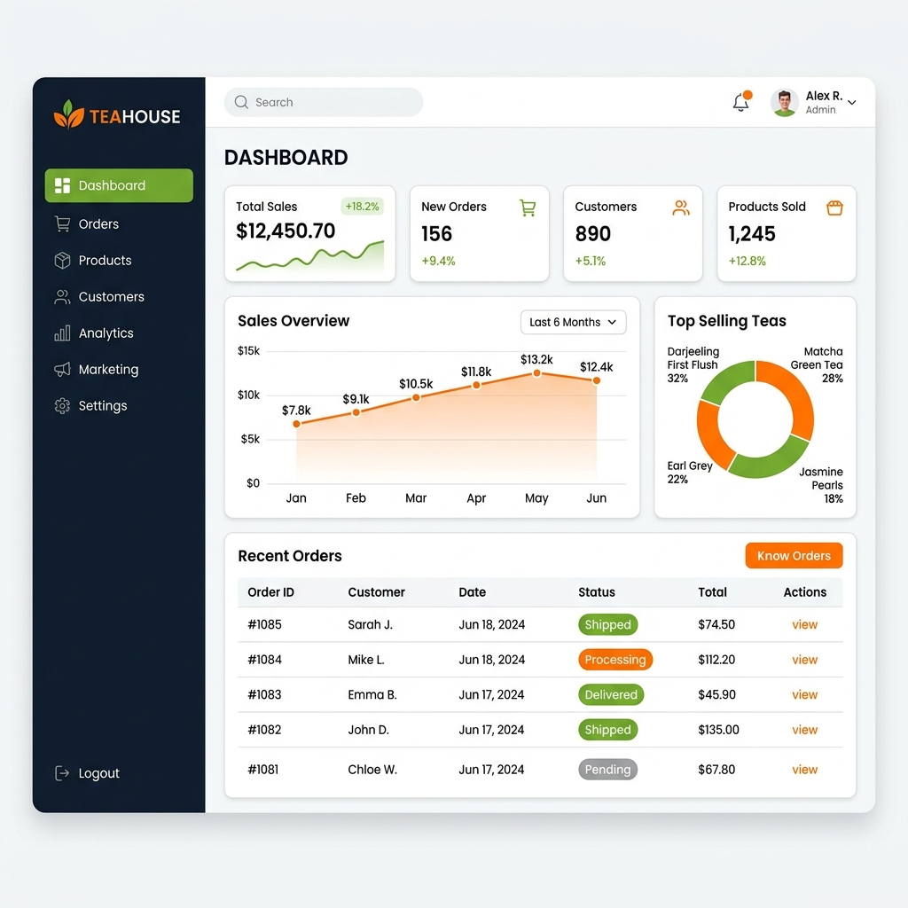
6. Step 4: Admin Dashboard
Data Management Admin console to track sales, manage inventory, and oversee user activities. Robust MERN stack backend powers it securely.

Slide 8
7. Technology Stack Overview
Frontend Design • React.js, Tailwind CSS • Responsive, mobile-first UI with custom CSS theming. Backend & Database • Node.js, Express.js • MongoDB (NoSQL) for Collections (Users, Products, Orders) • Twilio WhatsApp & Email SMTP for Notifications

Slide 9
Thank You!
Any Questions?

