Slide 1

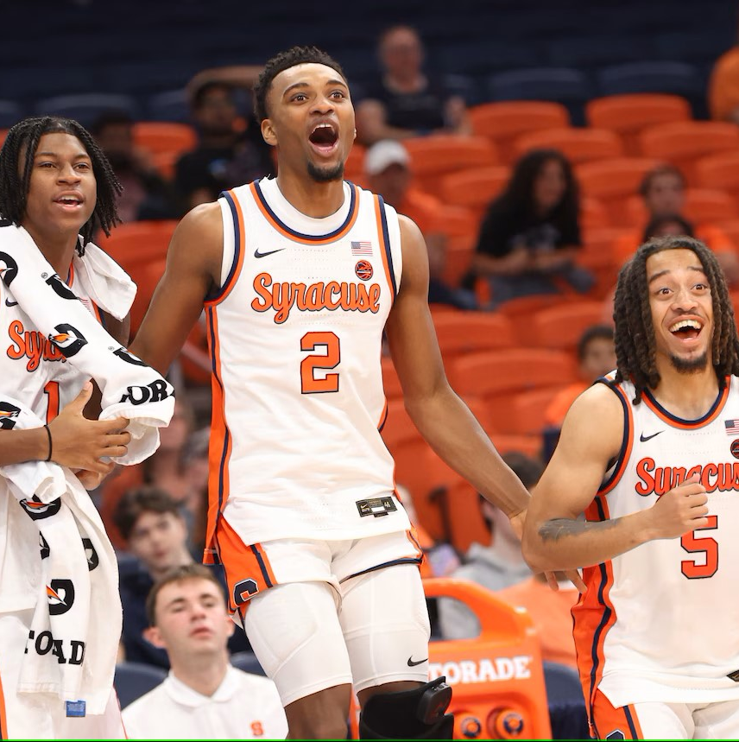
Clutch God: Who should take the shot?
Vishnu Charugundla
Varshin Bhaskaran Shashank Guda
Rithika Gurram

Slide 2

Agenda
Introduction
Data Overview
Exploratory Data Analysis (EDA)
Feature Engineering
Modeling

Slide 3
Introduction
Identify which player on a selected team is best suited to take the game-winning shot, using data-driven insights.
Leverage data science to analyze player performance and predict the highest probability shooter for critical game moments.
Provide coaches and analysts with actionable insights on player selection for high-stakes scenarios, optimizing team strategy and performance.

Slide 4
Data Overview
Dataset: 1956323 records, 34 columns.
Date Range: March 17, 2023 - june 11, 2023.
Top Key Features:
win_prob
shooter
shot_outcome
secs_remaining_absolute
Missing Data: High percentage of missing values in shot_team, shot_outcome, shooter, three_pt, free_throw (Around 55 Percent).

Slide 5
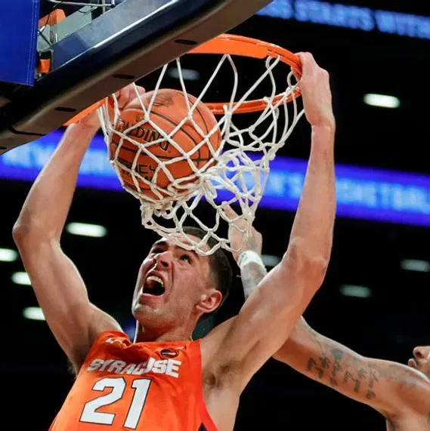
Exploratory data analysis

Slide 6
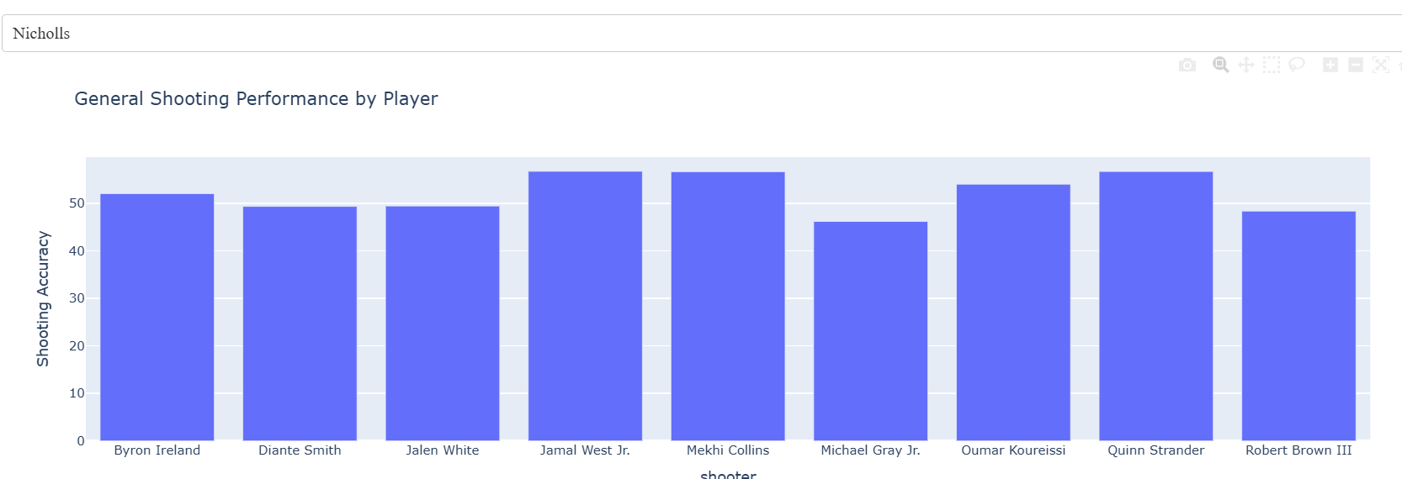
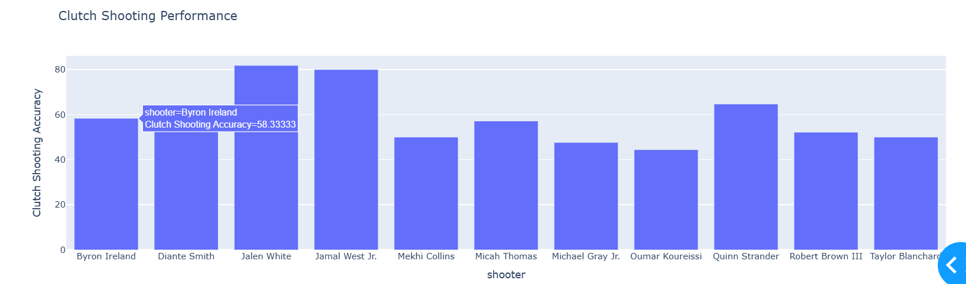
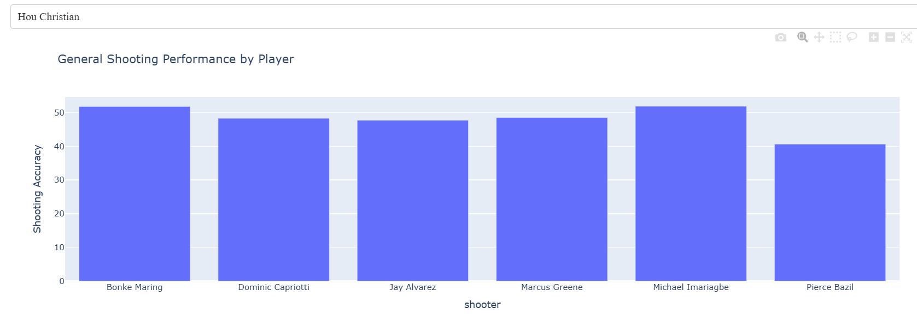
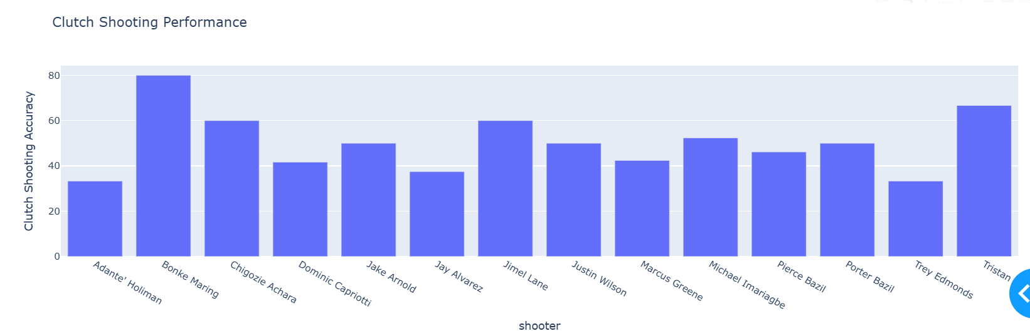
Shooting Accuracy to Clutch Performance
Team: Nicholls
High Accuracy Leads to Clutch Reliability: Players with high general shooting accuracy often excel in clutch situations.
Shooting Accuracy Correlates with Clutch Performance: Strong regular performance indicates better outcomes in high-stakes moments.
Team: Hou Christian

Slide 7
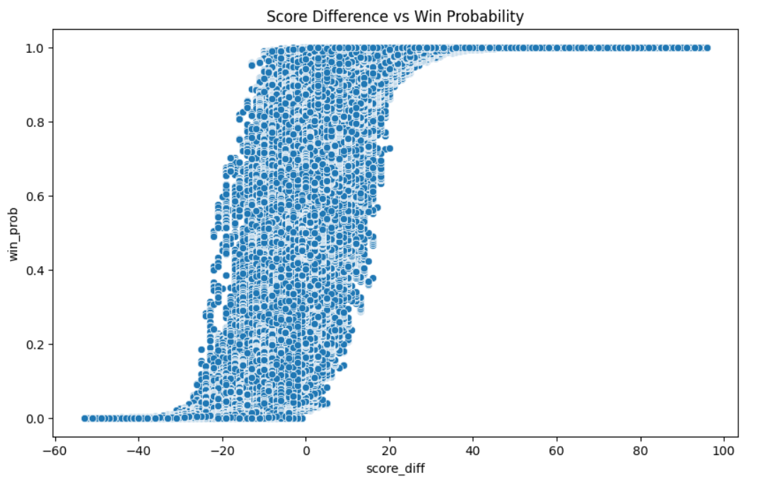
Score Difference and Win Probability
Highlights the impact of lead size on winning chances.
As the score difference grows, the likelihood of winning rises significantly.
The curve follows a sigmoidal shape, indicating rapid probability change around close scores.

Slide 8
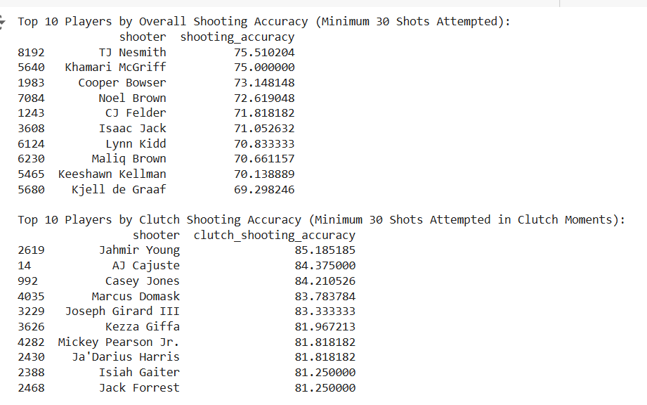
Top 10 Players by Shooting Accuracy and Clutch Shooting Accuracy (Minimum 30 Shots Attempted)
Top Scorers: TJ Nesmith and Khamari McGriff lead in overall shooting accuracy, making them reliable scorers in all game situations.
Clutch Leaders: Jahmir Young and AJ Cajuste excel in clutch moments, with shooting accuracies over 84%, ideal for high-pressure, end-of-game situations.
Strategic Insights: Players with high overall and clutch accuracy provide teams with both consistent scoring and dependable options for game-deciding shots.

Slide 9
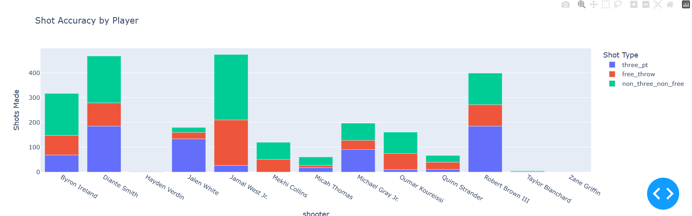
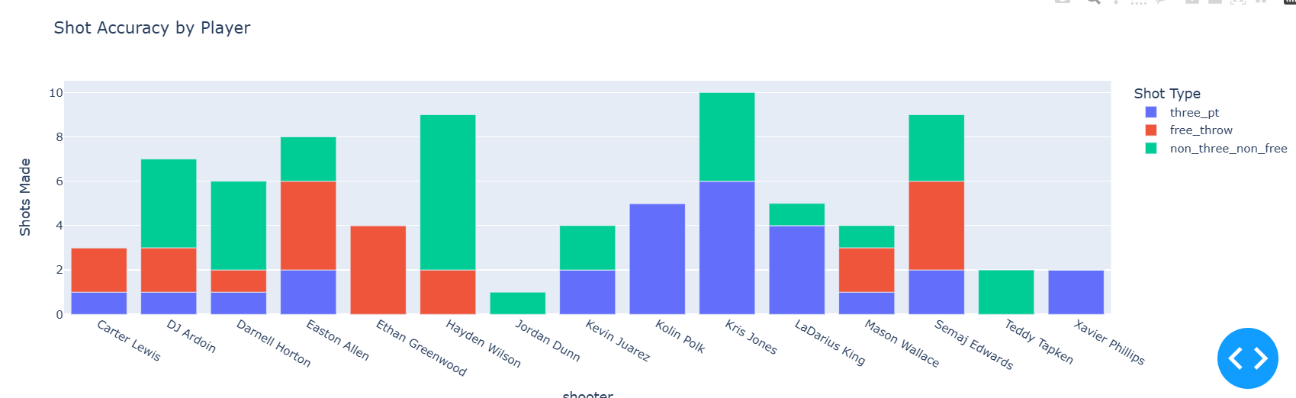
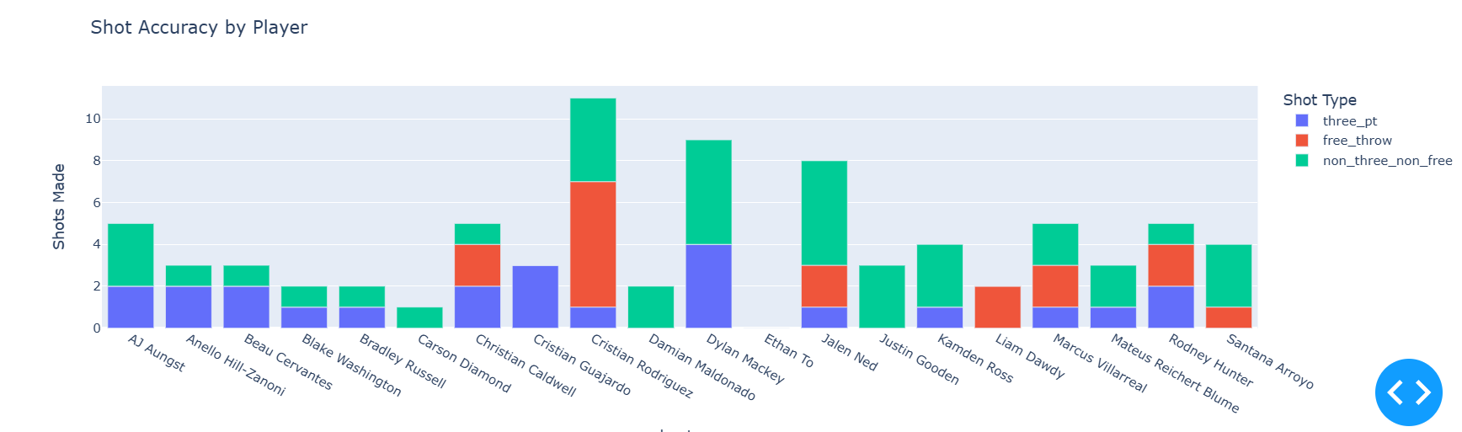
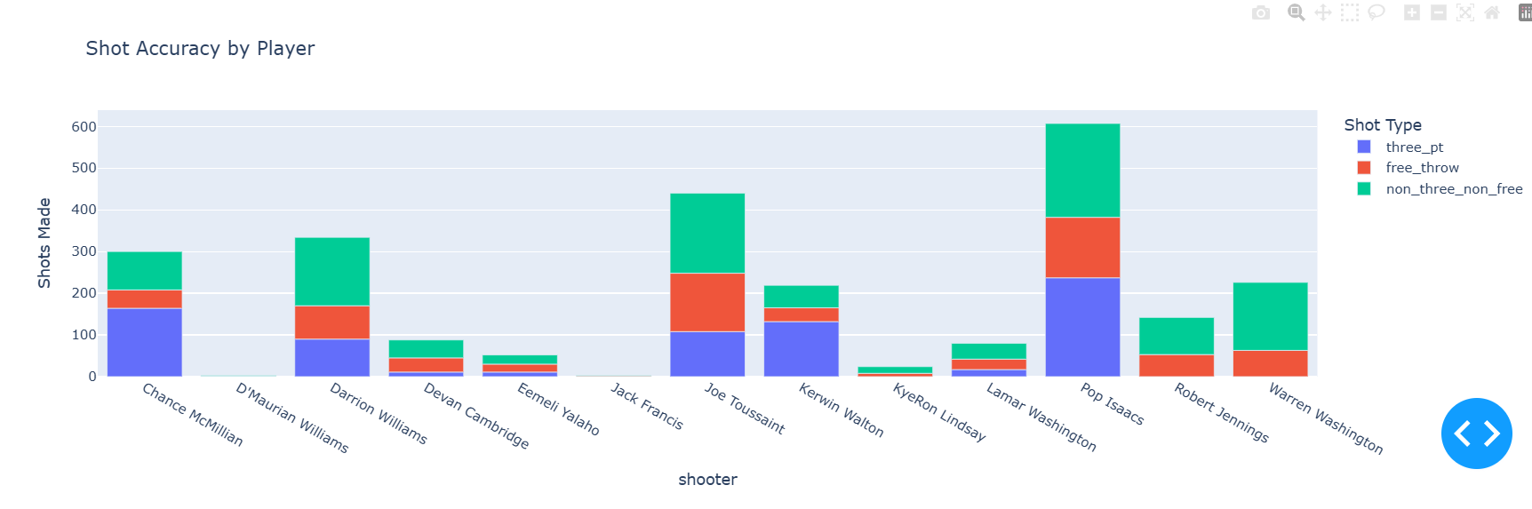
Key Trends in Player Shooting Performance
Team: Nicholls
Team: Lutheran
Shot Type Specialization: Players lean toward specific shot types (three-pointers, free throws, or regular shots), showing specialized roles.
Free Throws: Secondary scoring method; valuable for drawing fouls in close game situations.
Regular Shots Dominate: Most players focus on non-three-point shots, aiming for higher-percentage attempts closer to the basket.
Three-Point Reliance: Certain players are three-point specialists, providing critical long-range scoring options.
High-Volume Shooters: Players with high shot counts are likely the primary offensive choices.
Team: Schreiner
Team: Texas Tech

Slide 10
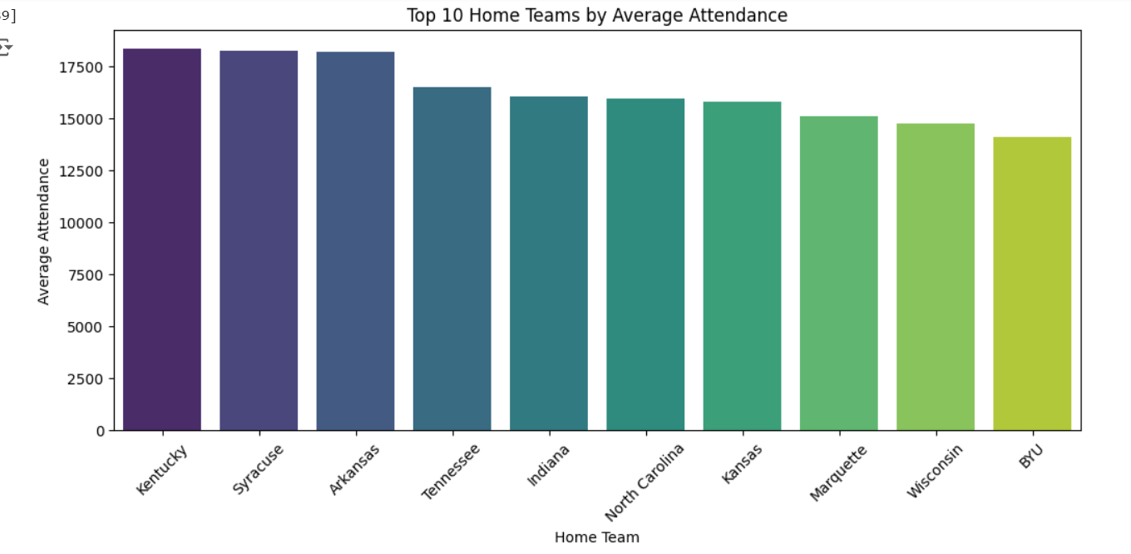
Top 10 Home Teams by Average Attendance
Kentucky, Syracuse, and Arkansas lead in average attendance, indicating a strong fan base and high demand for home games.
Consistent Attendance: The top 10 teams show relatively close attendance numbers, reflecting robust fan engagement across these prominent programs.

Slide 11
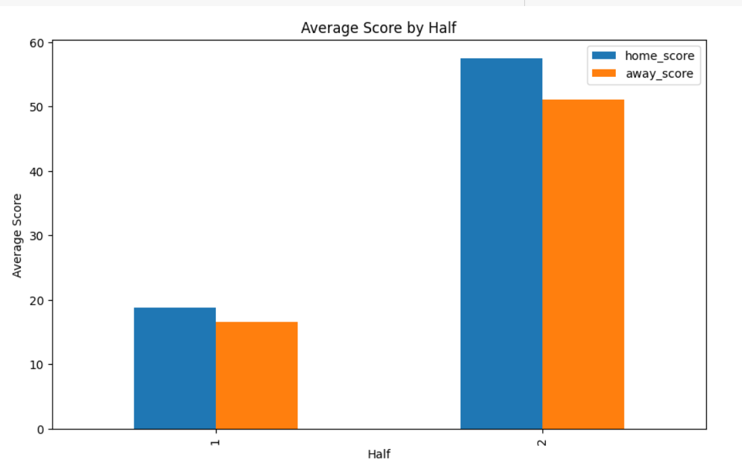
Average Score Comparison by Game Half
Both home and away teams tend to score significantly more in the second half compared to the first half, suggesting increased scoring intensity as the game progresses. Home teams consistently maintain a slight scoring advantage over away teams in both halves.

Slide 12
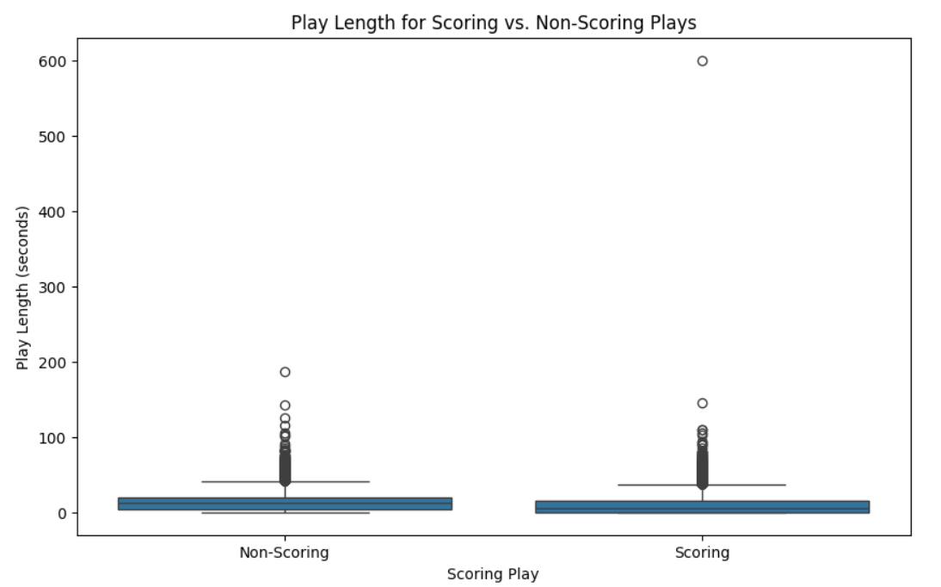
Injury Risk Model
Majority of both scoring and non-scoring plays have similar play lengths, with a few outliers extending significantly longer. Scoring plays do not generally require more time than non-scoring plays, indicating that quick plays can be equally effective for scoring.

Slide 13
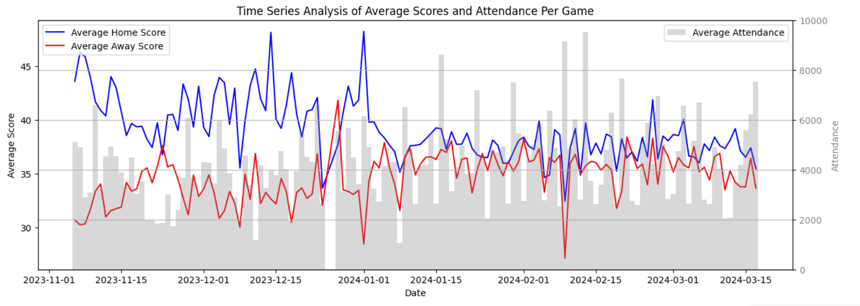
Time Series Analysis of Average Scores and Attendance Per Game
It illustrates trends and fluctuations in both scoring and audience engagement, suggesting a potential correlation between higher scoring games and increased attendance, especially noticeable during peak scoring periods. This analysis could be vital for strategizing game schedules, marketing efforts, and understanding fan interest dynamics in relation to game outcomes.

Slide 14
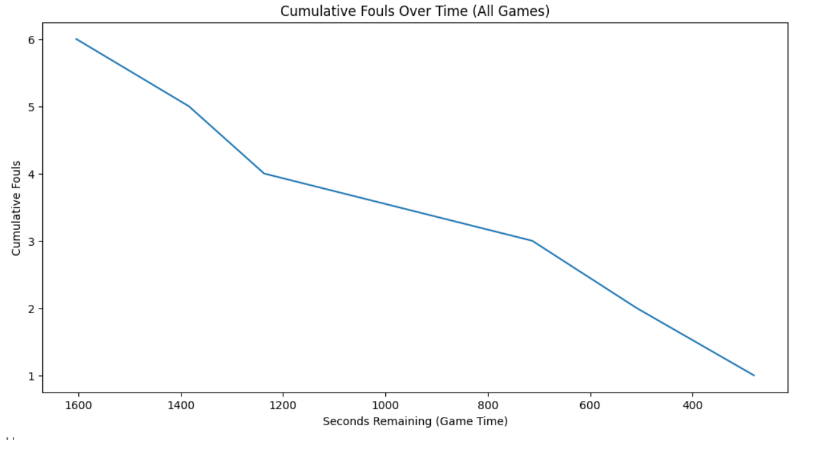
Fouls Over Time
The decline in cumulative fouls over time may be due to players becoming more cautious in the later stages of the game to avoid foul trouble or being benched, especially in close games. Additionally, teams may focus on strategic play rather than aggressive defense as the game nears its conclusion, reducing the likelihood of fouls.

Slide 15
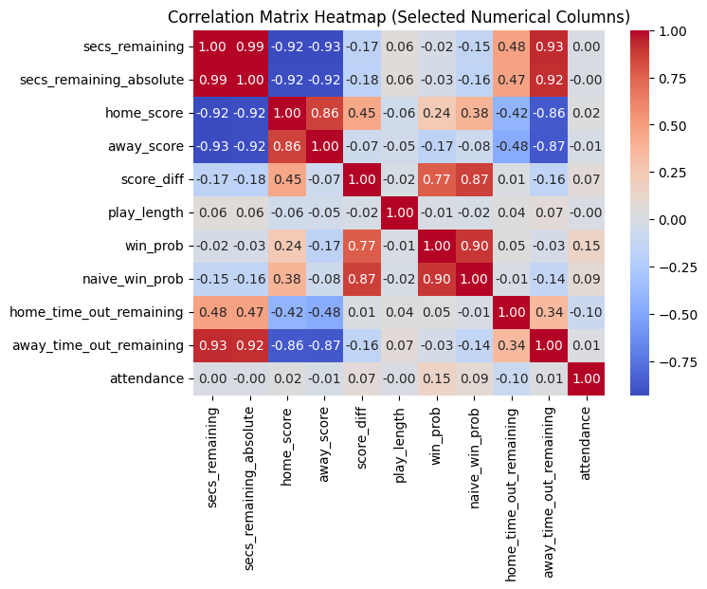
Correlation Analysis
Time and Timeout Correlation: secs_remaining and away_time_out_remaining show a high positive correlation, suggesting teams tend to preserve timeouts as time runs out, particularly the away team.
Score Impact on Win Probability: score_diff has a strong positive correlation with win_prob (0.77) and naive_win_prob (0.87), indicating that as the score difference grows, the likelihood of winning increases significantly.
Home and Away Scores: home_score and away_score are highly correlated with each other but also show a moderate positive correlation with score_diff. This suggests that while individual scores impact the score difference, the winning probability is closely tied to which team maintains the higher score.
Time Remaining and Timeout Usage: secs_remaining is strongly correlated with both home_time_out_remaining and away_time_out_remaining, indicating a strategic link between available time and timeout preservation.
Performance Metrics: Variables like play_length show minimal correlation with other metrics, suggesting that individual play durations have limited impact on overall game metrics such as win probability.

Slide 16
Statistical Significance
Home vs. Away Score Difference:
Result: Significant higher scoring by home teams (T-Statistic: 132.64, P-Value: 0.0).
Insight: Confirms a strong home-field advantage impacting game outcomes.
Win Probability Across Halves:
Result: Marked variation in win probabilities between halves (Chi2 Statistic: 784.68, P-Value: ~0).
Insight: Suggests significant halftime adjustments or performance shifts influencing game results.
Predicting Wins from Scores:
Result: Both home and away scores are statistically significant predictors of winning, with home scores increasing and away scores decreasing win probability (Pseudo R-squared: 0.5634).
Insight: Highlights the critical impact of scoring dynamics on win likelihood, useful for strategic game planning.

Slide 17
Feature Engineering
1. Shooting Accuracy of Players
2. Clutch Performance of the Players
3. Recent Player Performance
4. Free Throw Analysis
Created a Dashboard using dash in order to display the most important features

Slide 18
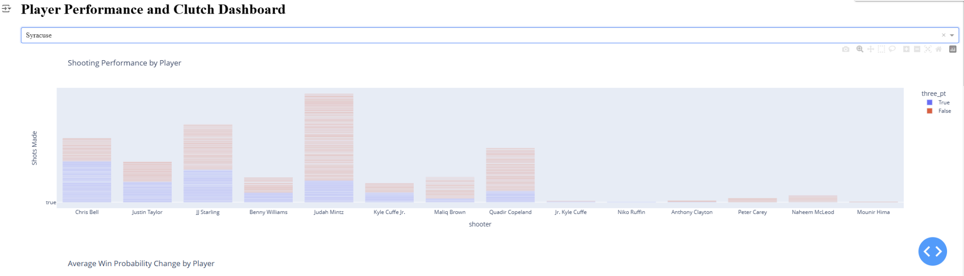
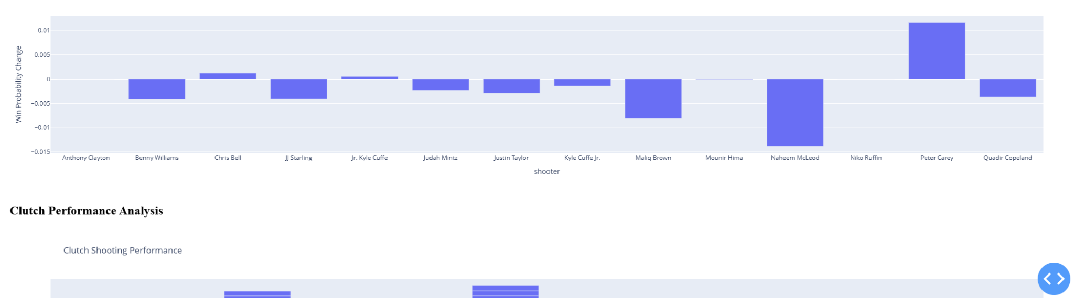
Feature Engineering

Slide 19
Modeling
Utilized a Random Forest Classifier model to analyze player data, considering the following metrics:
Overall Shooting Percentage
Clutch Shooting Performance
Three-Point Shooting Percentage
Win Impact
Team Contribution (Scoring Share)
Close Game Performance
Fouls Drawn

Slide 20
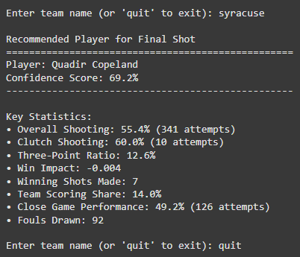
Modeling
Example Output with Syracuse as team name entered:

Slide 21
Key Takeaways
Employ Versatile Shooters: Utilize players with balanced shooting skills for adaptability in various game scenarios, enhancing strategic flexibility and readiness for any game condition.
Maximize Three-Point and Clutch Shooting: Prioritize players who excel in three-point shooting and clutch situations for high-pressure moments, aiming for quick, high-value points and reliable end-of-game performance.
Leverage Home Field Advantage: Capitalize on the statistically significant home advantage by tailoring game strategies to exploit venue familiarity and crowd support, which can elevate player performance and scoring.
Implement Effective Halftime Adjustments: Analyze first-half performance and apply data-driven insights for strategic halftime adjustments, which can significantly alter win probabilities and player efficiency in the second half.
Understand and Utilize Score Differences: Recognize the critical impact of maintaining or overcoming score differences on win probability, guiding strategic decisions to focus efforts on when and how aggressively to score or defend.

Slide 22
Thank you
Vishnu Charugundla
Varshin Bhaskaran
Shashank Guda
Rithika Gurram
Detailed Analysis is present in the Jupyter Notebook File

