Slide 1

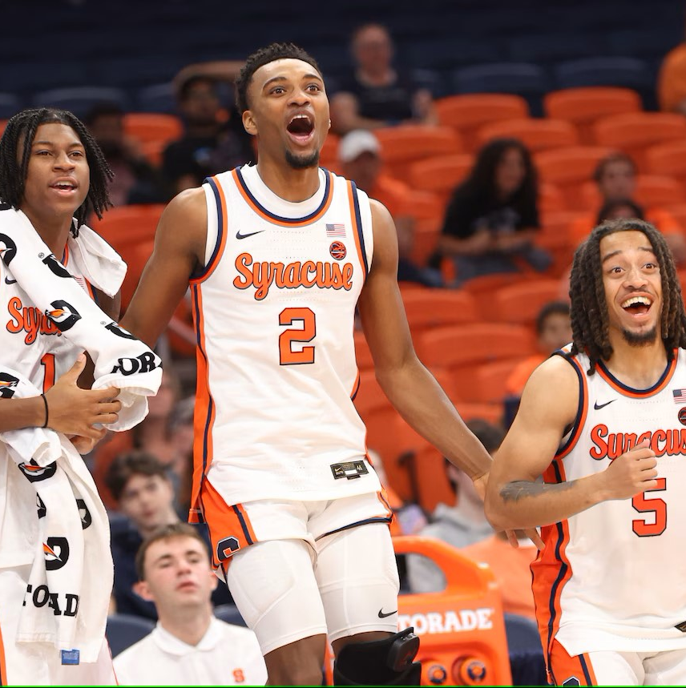
Injury Prediction
Shashank Guda
Rithika Gurram
Vishnu Charugundla
Varshin Bhaskaran

Slide 2
Agenda
Introduction
Data Overview
Exploratory Data Analysis (EDA)
Statistical Significance
Injury Risk Model
Risk Assessment
Key Takeaways & Recommendations

Slide 3
Introduction
Analyze injury risk in basketball players based on key performance metrics.
Identify and assess risk factors contributing to injuries (e.g., muscle imbalances, performance metrics).
Provide actionable insights for injury prevention strategies.

Slide 4
Data Overview
Dataset: 2604 records, 14 unique players.
Date Range: January 1, 2023 - December 30, 2023.
Key Features:
Performance metrics (e.g., distance, speed, jump load, heart rate).
Muscle imbalances (e.g., hamstring-to-quad ratio, calf imbalance).
Injury information (e.g., injury type, body part, recovery time).
Missing Data: High percentage of missing values in injury-related columns.

Slide 5
Exploratory Data Analysis (EDA)
Injury Rate: 226 injuries (8.68% injury rate).
Hamstring-to-Quad Ratio and Muscle Imbalances are significant predictors of injuries.
Position Analysis: Guards appear to have higher injury risk based on risk scores.
Injury Type: Muscle strains and tendonitis are most common injuries.

Slide 6
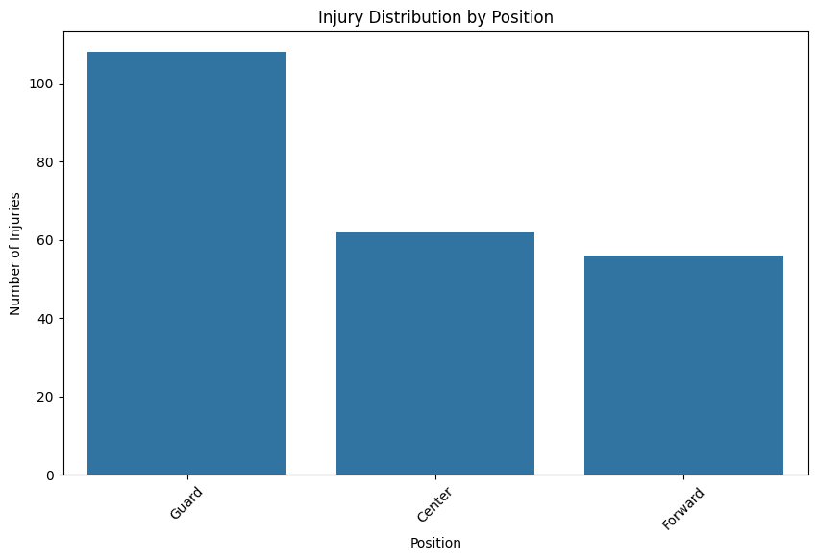
Injury Distribution by Position
The bar chart shows the distribution of injuries across different player positions: Guard, Center, and Forward.
Guard positions have the highest number of injuries, followed by Center, and Forward with the least.

Slide 7
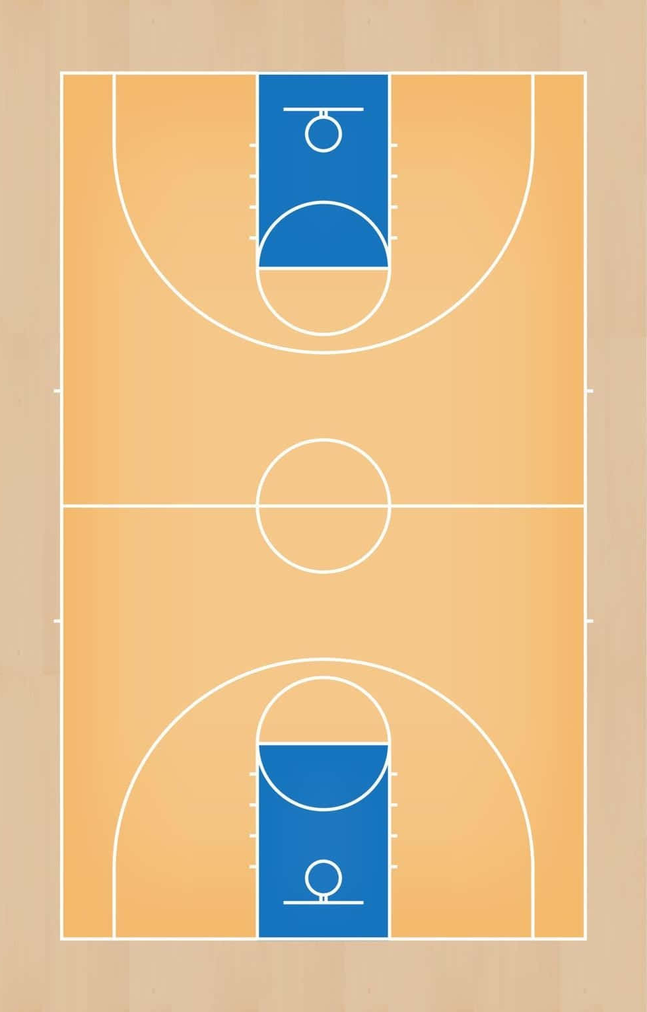
Positions
Forward
Center
Guard
Low Risk
Medium Risk
High Risk

Slide 8
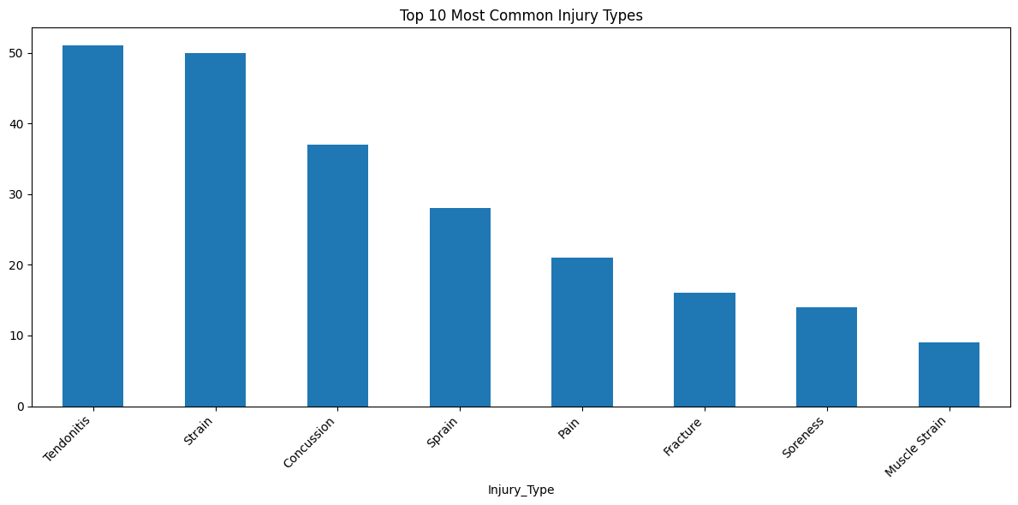
Top 10 Most Common Injury Types
The bar chart shows the top 10 most common injury types
The most common injuries are Tendonitis and Strain, followed by Concussion, Sprain, and others.

Slide 9
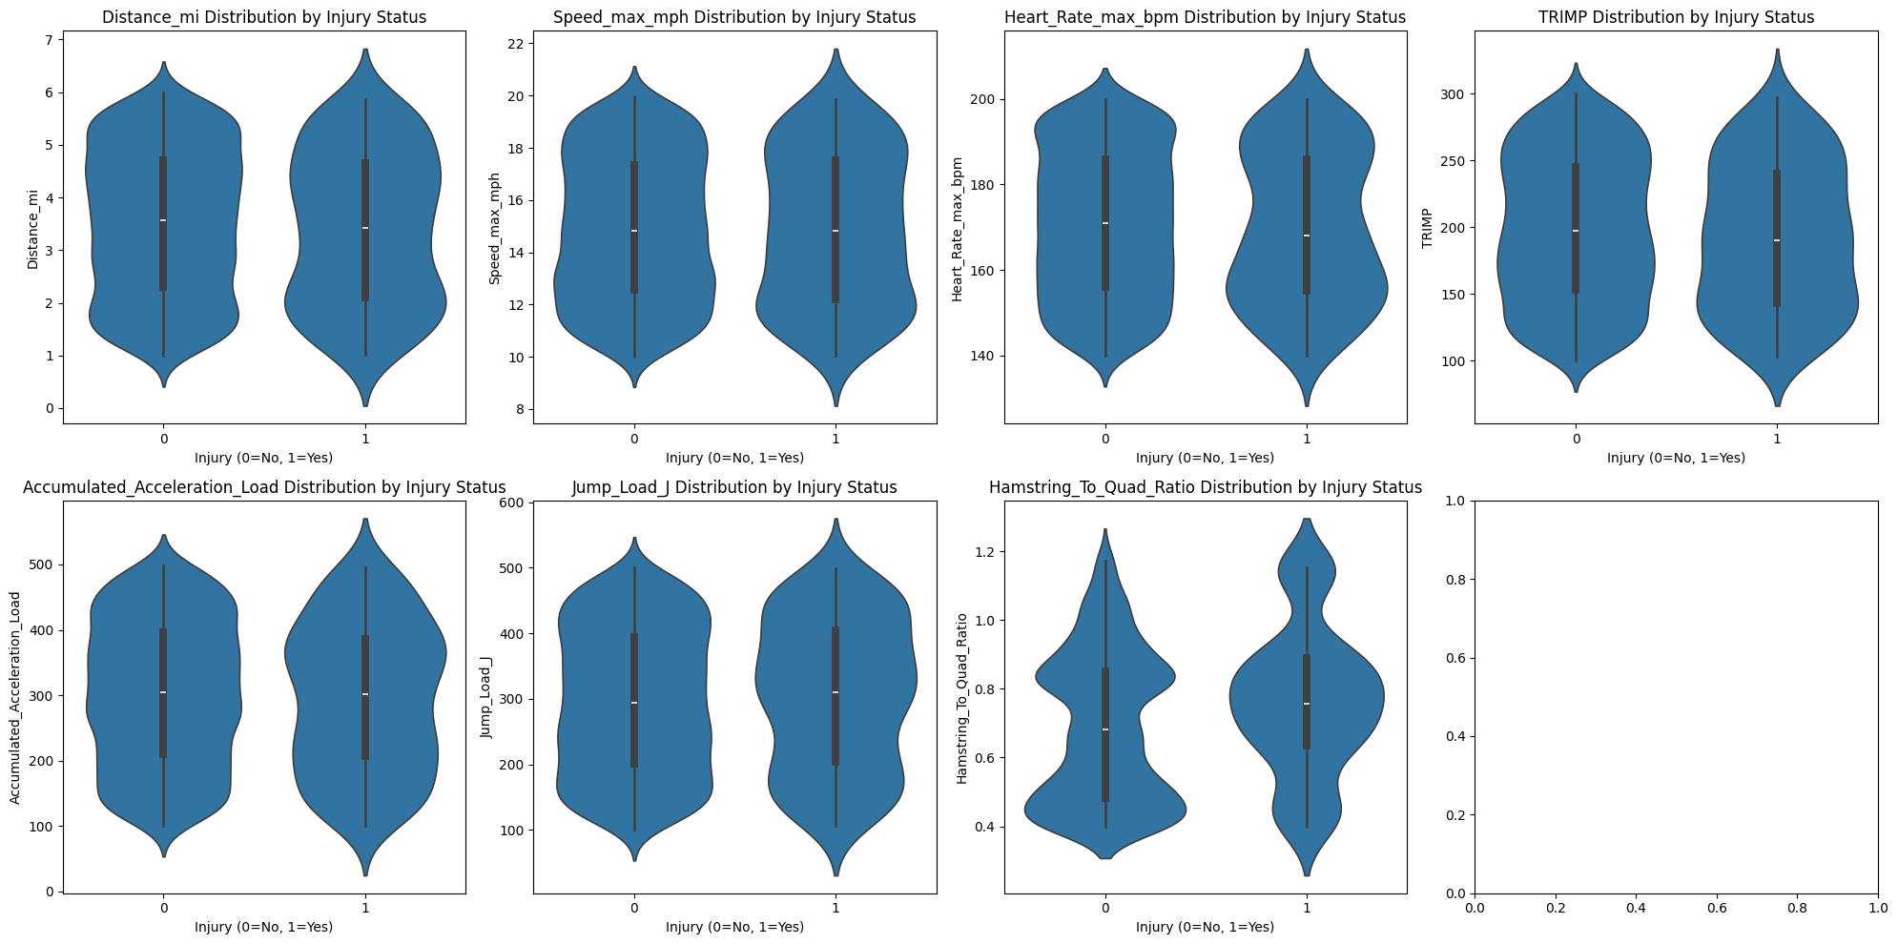
Key metrics distribution for injured vs non-injured players
Distance_mi: The distribution of distance covered by injured and non-injured players appears to have some overlap, but non-injured players tend to have a wider range of values.
Speed_max_mph: There is a clear separation between injured and non-injured players, with non-injured players generally achieving higher speeds.
Heart_Rate_max_bpm: The distribution of maximum heart rate shows a broader range for non-injured players, whereas injured players seem to have a more concentrated range.

Slide 10
Key metrics distribution for injured vs non-injured players
TRIMP (Training Impulse): Non-injured players show a higher variance in TRIMP values compared to injured players, indicating a higher intensity or variation in their training sessions.
Accumulated_Acceleration_Load: Injured players tend to have a higher accumulated acceleration load, which could be related to the physical strain they experience during play.
Jump_Load_J: Injured players have a more concentrated distribution of jump load, possibly suggesting they are more prone to injury due to higher exertion in jumps.

Slide 11
Key metrics distribution for injured vs non-injured players
Hamstring_To_Quad_Ratio: The distribution shows that the hamstring-to-quad ratio is generally higher for non-injured players, which could suggest a more balanced muscle strength ratio that may protect them from injury.

Slide 12
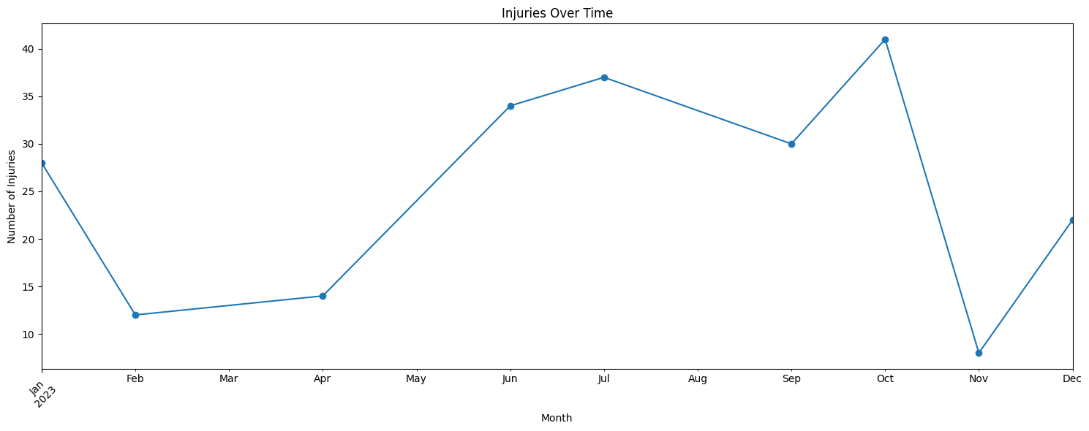
Injuries Over Time
The number of injuries seems to peak during mid-year, with sharp drops in between, particularly in the months of January and December.

Slide 13
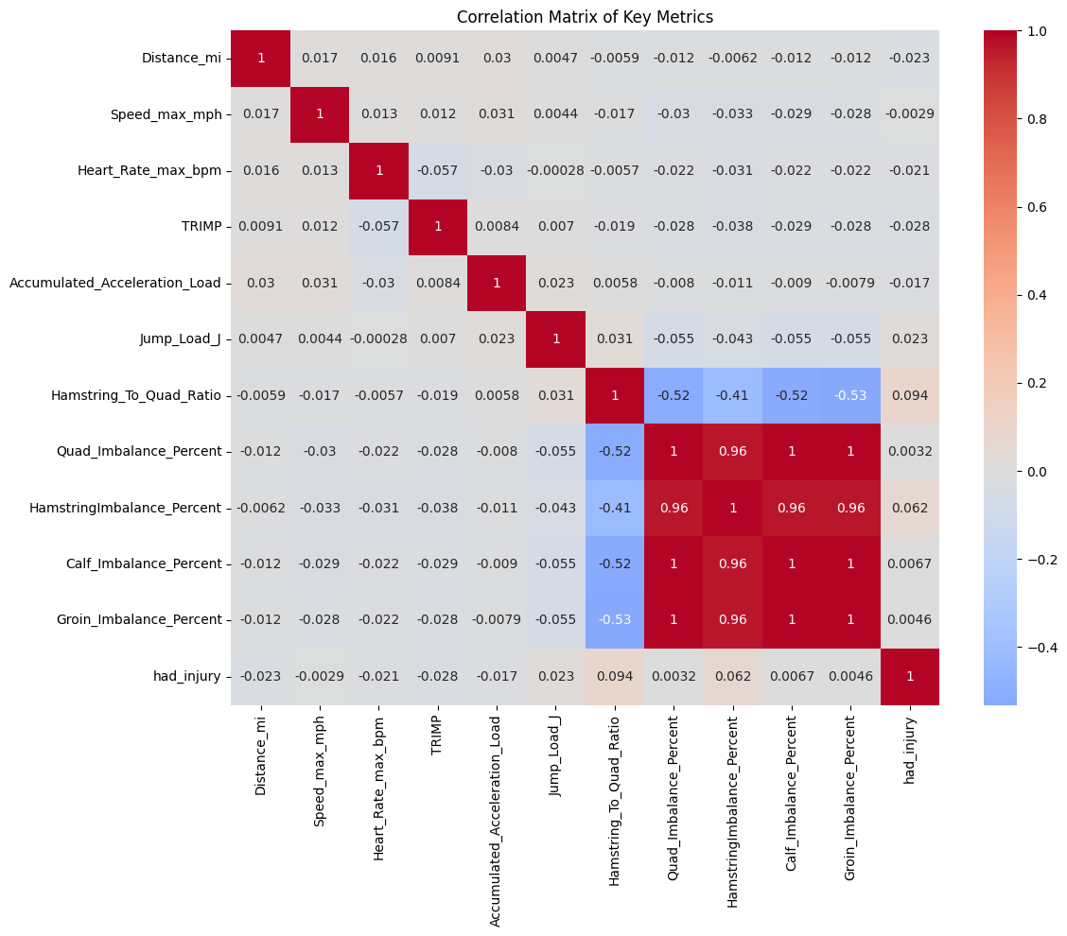
Correlation Analysis
Strong Positive Correlations:
The muscle imbalance percentages (Quad_Imbalance_Percent, HamstringImbalance_Percent, Calf_Imbalance_Percent, Groin_Imbalance_Percent) are highly positively correlated with each other, showing a strong relationship (close to 1.0). This suggests that players with higher imbalances in one muscle group tend to have higher imbalances in others.
Injury-Related Insights:
had_injury shows a moderate negative correlation with performance metrics such as Speed_max_mph and Heart_Rate_max_bpm, suggesting that injured players may exhibit lower performance in these areas. There is a weak correlation between `had_injury` and the other performance-related metrics like `Distance_mi`, `TRIMP`, and `Jump_Load_J`, suggesting that these metrics do not strongly predict injury status.
Imbalance-Performance Relationship:
The imbalance metrics (Quad_Imbalance_Percent, HamstringImbalance_Percent, etc.) show some moderate correlations with performance metrics like `Distance_mi` and `Speed_max_mph`, which could indicate that muscle imbalances may affect overall performance.

Slide 14
Statistical Significance
p-values show significant differences in Hamstring-to-Quad Ratio for injured vs. non-injured players.
Other features like Speed, Distance, Heart Rate show no significant differences between injured and non-injured players.
Key Insight: Muscle imbalance ratios are highly significant in injury prediction.

Slide 15
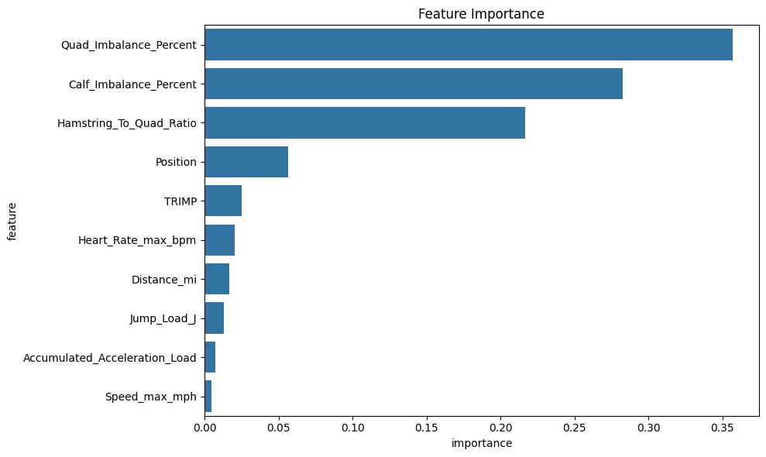
Injury Risk Model
Key Features:
Hamstring-to-Quad Ratio
Quad and Calf Imbalances
Position and Performance Metrics (e.g., speed, heart rate).
Metrics:
Precision for injured players: 0.32
Recall for injured players: 0.98
ROC AUC Score: 0.94.
Model: Random Forest Classifier trained to predict injury risks.

Slide 16
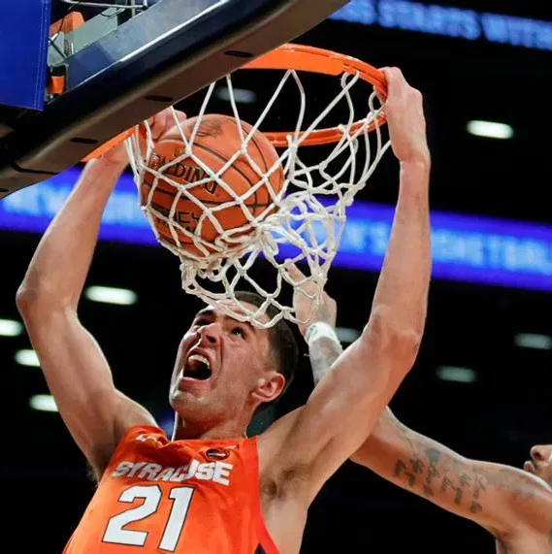
Risk Assessment
Risk Assessment for Players

Slide 17
Risk Scores
Risk Scores assigned based on model predictions.
Risk Levels: Very Low, Low, Moderate, High
Example of High-Risk Players:
Malik Robinson (Guard): Risk Score 0.76
Brandon Mitchell (Guard): Risk Score 0.75
Anthony Lopez (Center): Risk Score 0.72
Risk Level Distribution: Mostly High and Moderate risks.

Slide 18
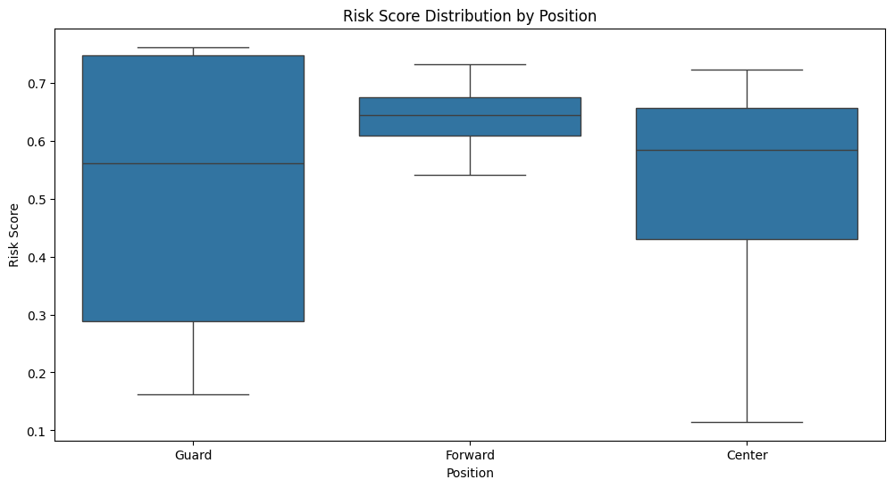
Risk Level Distribution by Position
Guards have higher average risk scores compared to Forwards and Centers.
Guards tend to be at higher risk due to their performance metrics and muscle imbalances.

Slide 19
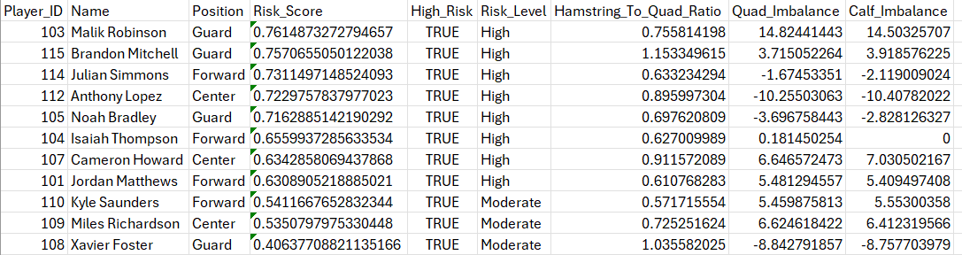
High Risk Players

Slide 20
Key Takeaways
Muscle Imbalances (especially Quad and Calf) are the most significant contributors to injury risk.
Guards are at higher risk compared to Forwards and Centers.
Injury prevention strategies should focus on improving muscle balance, particularly in the hamstring-to-quad ratio.
The Injury Risk Model is effective for identifying high-risk players, but further calibration and threshold adjustments can improve precision.

Slide 21
Recommendations
Focus on muscle imbalance rehabilitation:
Targeted exercises to address quad and calf imbalances.
Position-specific training:
Customize injury prevention strategies for Guards and Forwards, who are at higher risk.
Ongoing Monitoring:
Regular assessments to track players' injury risk levels and adjust training plans accordingly.

Slide 22
Thank you
Shashank Guda
Rithika Gurram
Vishnu Charugundla
Varshin Bhaskaran
Detailed Analysis is present in the Jupyter Notebook File

