Slide 1
sNNake:
Reinforcement Learning Strategies in Screen Snake
By Jack Weber, Dave Carroll, and David D’Attile

Slide 2
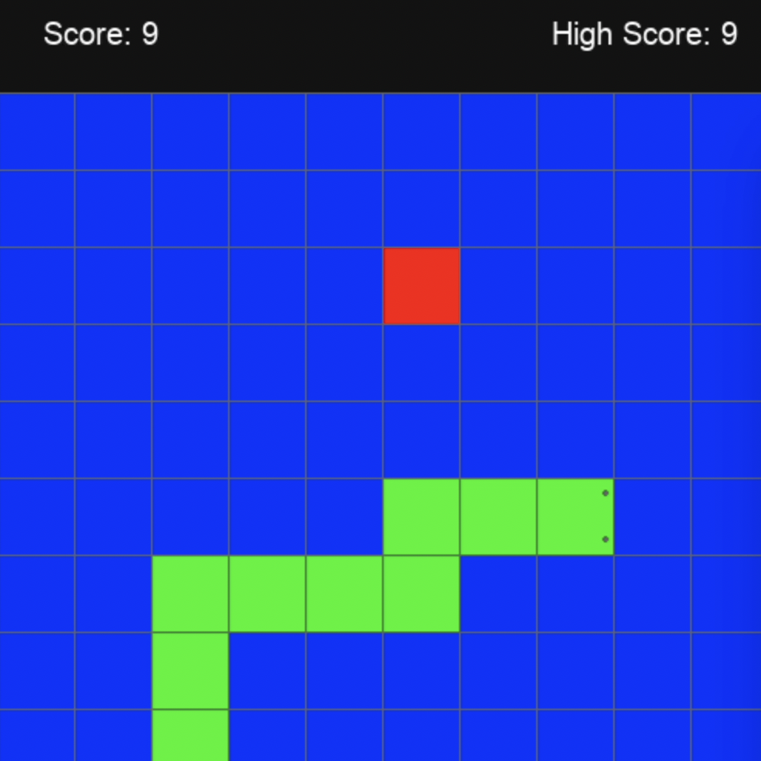
What did we do?
Using Reinforcement Learning techniques, we taught agents to play the Screen Snake game.
Game logic/visualization
OpenAI Gym for RL
Designing reward structures
Experimenting!

Slide 3
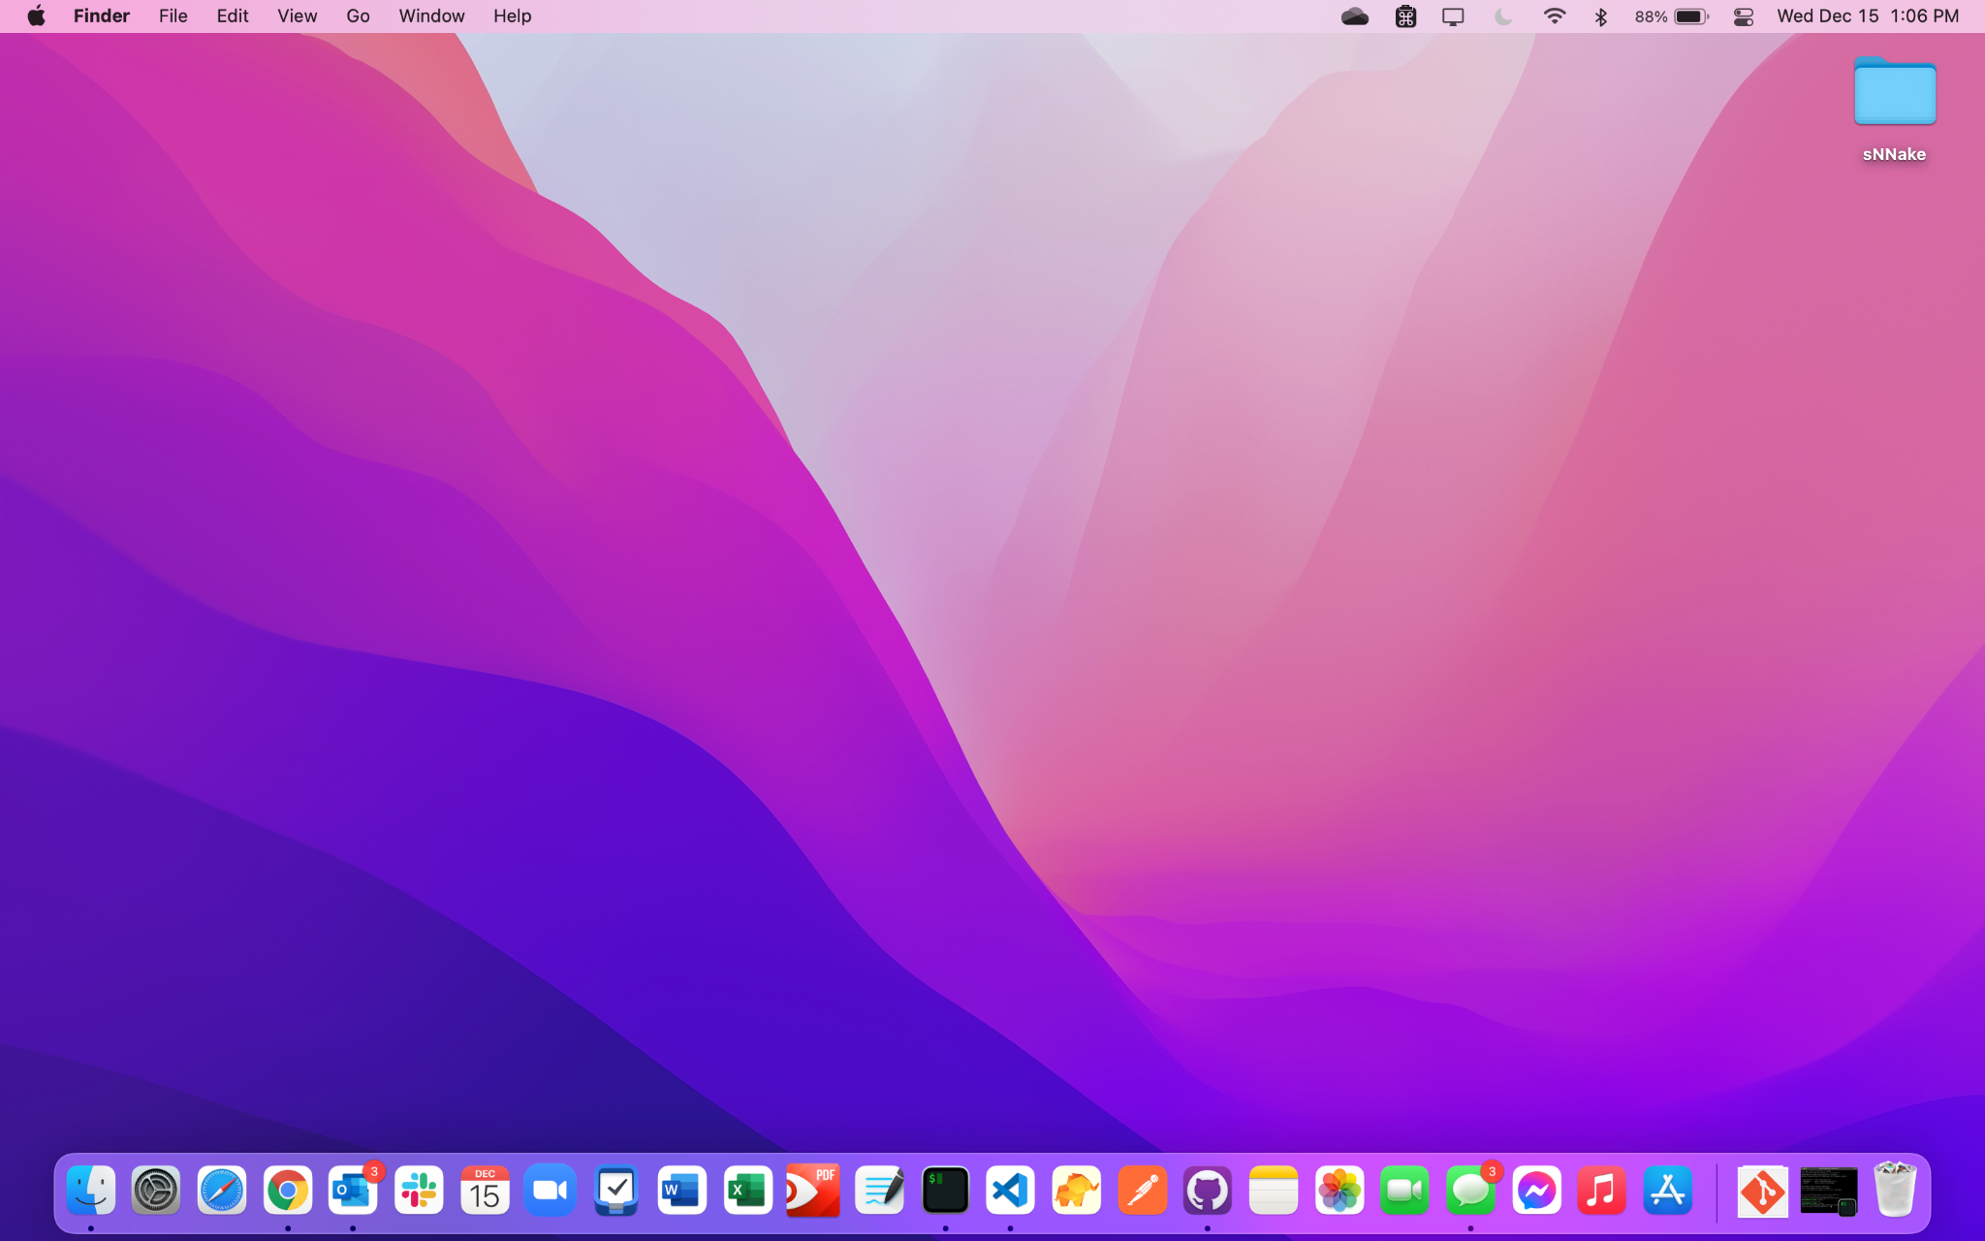
Game Logic/Visualization
Python/Jupyter
L,R,U,D
Fruit = Good
Wall = Bad

Slide 4

OpenAI Gym
OpenAI Gym is a framework that allows any game to be broken down to an RL environment! We had to define:
Initialization
Steps
When game is over
Game Reset

Slide 5
Based on these actions…
Reward structures!
“Reward” or “punish” the agent based on some of the following:
Consuming a fruit
Hitting a wall
Remaining idle
Moving toward/away from fruit
Observe
Step
Reward

Slide 6
Experiment!
We conducted a total of 46 “experiments”, where each experiment consisted of 9 training sessions with different reward structures. Other variables included:
Board size (5x5 vs 10x10)
Algorithm in use (DQN, A2C, PPO)
Reward structure tuning
Game border representation

Slide 7
Some Results:
5x5 board, 10M training steps, 100K testing steps, 45 experiments
Algorithm: | Border Represented: | Games Completed: | Avg. High Score: | Avg. Mean Score: | Avg. Median Score:
A2C | FALSE | 19374 | 13.88888889 | 5.430774889 | 5.888888889
A2C | TRUE | 55810 | 13.11111111 | 4.954668344 | 5.666666667
DQN | FALSE | 26665 | 11.88888889 | 3.624072304 | 3.666666667
DQN | TRUE | 26152 | 12.44444444 | 4.176643317 | 3.666666667
PPO | FALSE | 13638 | 16.66666667 | 8.650366698 | 11.05555556
PPO | TRUE | NA | NA | NA | NA
DQN, 10M training steps, 100K testing steps, 18 experiments
Board Size: | Border Represented: | Games Completed: | Avg. High Score: | Avg. Mean Score: | Avg. Median Score
5x5 | FALSE | 26665 | 11.88888889 | 3.624072304 | 3.666666667
10x10 | FALSE | 37330 | 4.777777778 | 0.9603501519 | 1.111111111

Slide 8
Some (More) Results:
DQN/A2C/PPO averages, 10M training steps, 100K testing steps, 27 experiments
Reward Structure: | Border Represented: | Games Completed: | Avg. High Score: | Avg. Mean Score: | Avg. Median Score
RS-A | FALSE | 10572 | 13 | 4.334880082 | 4.666666667
RS-B | FALSE | 5879 | 16 | 6.406670565 | 8.166666667
RS-C | FALSE | 9314 | 12.66666667 | 4.816928695 | 5.666666667
RS-D | FALSE | 9427 | 13 | 4.99856472 | 5.666666667
RS-E | FALSE | 9232 | 13.33333333 | 4.955595955 | 5.333333333
RS-F | FALSE | 5204 | 16.33333333 | 7.07376866 | 7.666666667
RS-G | FALSE | 4833 | 17.66666667 | 8.842809623 | 11.33333333
RS-H | FALSE | 4809 | 18.33333333 | 8.590624664 | 10.33333333
RS-I | FALSE | 407 | 7 | 3.095798707 | 3

Slide 9
Onto the demonstration!

