Slide 1

Title: Automatic Gun Detection and Recognition using Deep Learning
Presented by
245622733002: ADDAGULLA ISHIKA
245622733303: CHOLLETI SRI VARSHINI
245622733304: GOPU SREEJA
Students of CSE ‘A (G - 15)
Name of the Guide: Dr V. HARIKA

Slide 2

Abstract
Real-time object detection to improve surveillance methods is one of the sought -after applications of Convolutional Neural Networks (CNNs). This research work has approached the detection of handguns in areas monitored by cameras. Gun violence and mass shootings are also on the rise in certain parts of the world. Such incidents are time sensitive and can cause a huge loss to life and property. Hence, the proposed work has built a deep learning model based on the YOLOv3 algorithm that processes a video frame-by-frame to detect such anomalies in real-time and generate detects the Gun.
Key Words: Convolutional Neural Networks(CNN),Surveillance methods,YOLOv3 Algorithm

Slide 3



Requirements for the Proposed Project
Software Requirements:
Operating system: Windows 7 and above.
Programming Language: Python.
Frameworks: Darknet- 53
Hardware Requirements:
Processor: Intel i3 and above.
RAM: 8GB and above.
Hard Disk: 512 GB and above.
Key Board: Standard Windows Keyboard.
Monitor:14 color Monitor.

Slide 4
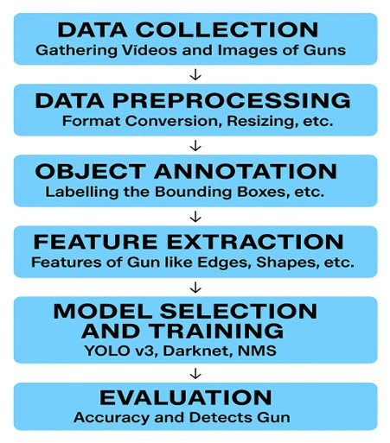
Proposed Methodology

Slide 5
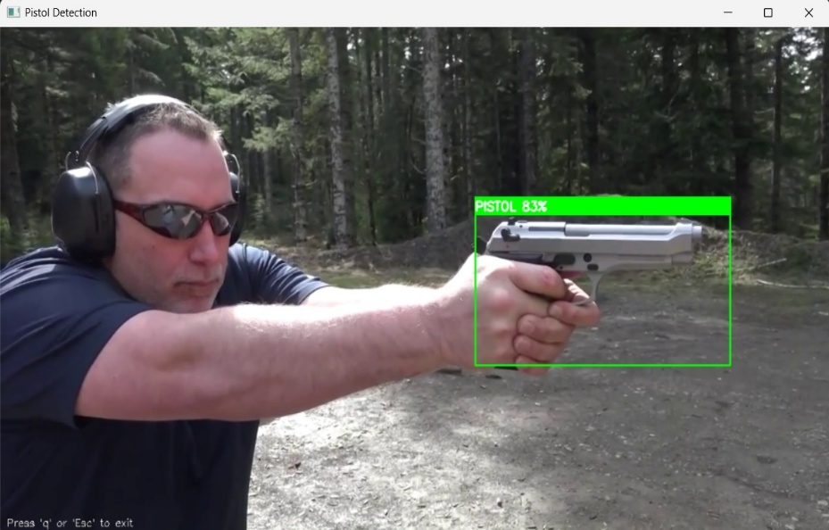
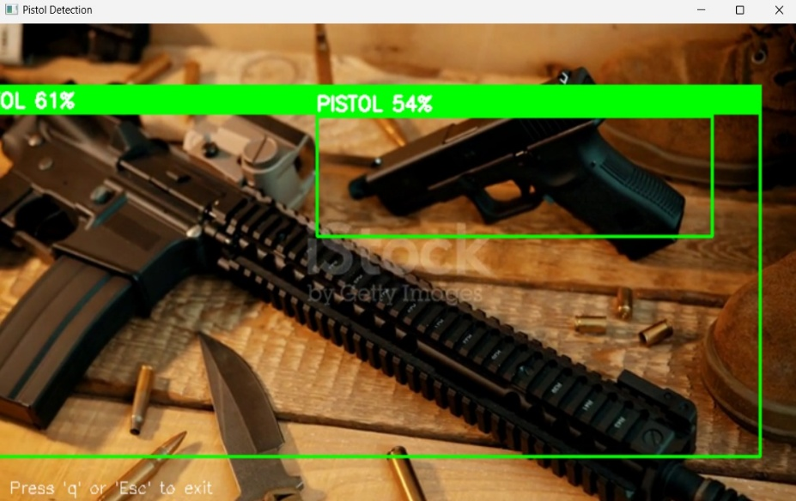
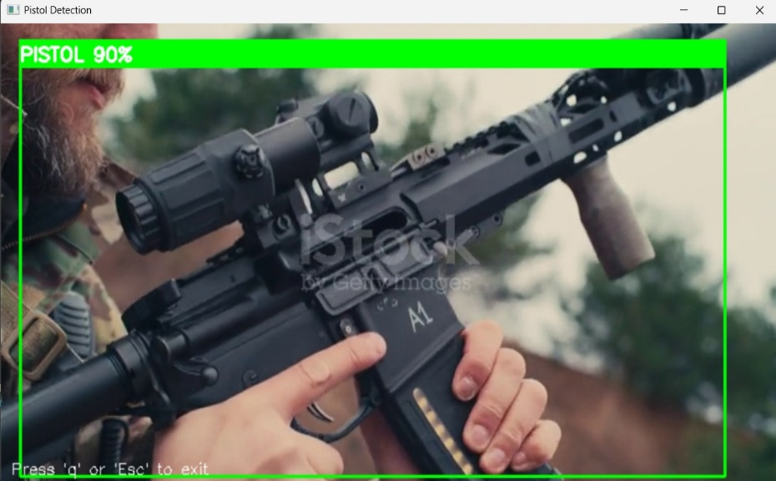
Results and Analysis
Gun detections:

Slide 6
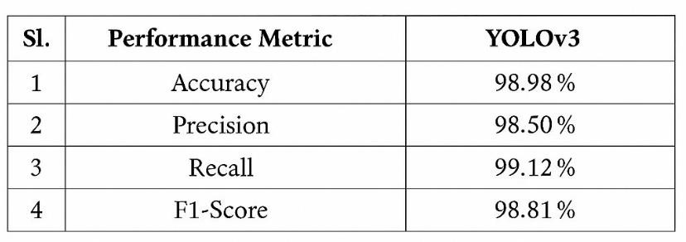
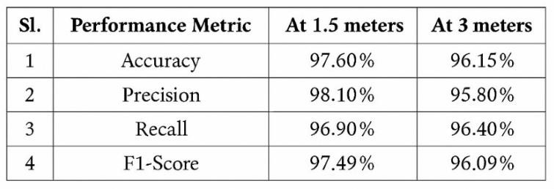
Performance Metrics
Performance Metrics for YOLOv3 on Custom Pistol Dataset
Performance at Varying Distances

Slide 7

Conclusion
The proposed system for automatic gun detection and recognition using deep learning demonstrates highly effective results in real-time surveillance applications. By utilizing the YOLOv3 (You Only Look Once) object detection algorithm, the model processes video frames to accurately identify handguns with remarkable precision and speed. Based on experimental evaluations referenced in our study, the YOLOv3-based model achieves an accuracy of approximately 98.98%, outperforming earlier models such as traditional CNNs and YOLOv2. This high level of accuracy confirms the robustness of deep learning for detecting guns in dynamic environments, offering a reliable solution for enhancing public safety and enabling early threat detection. The system can be integrated into existing CCTV infrastructures or smart surveillance robots, making it a scalable and impactful approach for real-world security challenges.
Notes:
Image source: https://www.sketchbubble.com/en/presentation-overcoming-challenges.html

Slide 8
Future Scope
1. Real-time Surveillance Integration
Integration with CCTV systems in public places (airports, schools, malls) for 24/7 automated monitoring.
Deployment in smart cities for proactive threat detection and response(Alert).
Use of edge AI devices (like NVIDIA Jetson, Google Coral) to reduce latency and run detection offline.
2. Integration with Law Enforcement Systems
Automated alert systems to notify police control rooms in real-time.
Automatic generation of evidence reports with timestamped detection and bounding boxes.
3. Crowd Behavior & Threat Level Analysis
Combining weapon detection with human pose estimation to detect threatening gestures (e.g., pointing a gun).

Slide 9
References
Anjum, M. Rizwan. "Weapon Detection Using YOLO V3 for Smart Surveillance System." (2021).
Weapon Detection Using YOLOv3 for Smart Surveillance System | researchgate.net
Warsi, M. Abdullah, M. N. Husen, M. Yahya, S. Khan, and N. Jawaid, “Gun detection system using YOLOv3,” in Proceedings of the 2019 IEEE International Conference on Smart Instrumentation, Measurement and Application (ICSIMA), pp. 1–4, IEEE, Kuala Lumpur, Malaysia, August 2019.
Gun Detection System Using Yolov3 | IEEE Conference Publication | IEEE Xplore
I-SMAC (IoT in Social, Mobile, Analytics and Cloud)(I SMAC), pp. 84–86, IEEE, Palladam, India, December 2019.
Weapon Detection using Yolov4, CNN
K.-E. Ko and K.-B. Sim, “Deep convolutional framework for abnormal behavior detection in a smart surveillance system,” Engineering Applications of Artificial Intelligence, vol. 67, pp. 226–234, 2018.
Deep convolutional framework for abnormal behavior detection in a smart surveillance system - ScienceDirect

Slide 10
THANK YOU!

