Slide 1
FOUNDATIONS OF DATA SCIENCE FINAL REVIEW
EMPLOYEE ATTRITION PREDICTION
211701057 Tinu A V
211701058 Varshini Karthikeyan

Slide 2
ABSTRACT
Employee attrition in an organization poses significant challenges, leading to increased recruitment costs, disrupted services, and loss of expertise. Identifying at-risk employees before they decide to leave is crucial but complex due to various influencing factors such as job satisfaction, work-life balance, performance, and compensation. This project aims to address this challenge by developing a machine learning model to predict employee attrition. The solution involves data preprocessing to clean and prepare the dataset, applying and evaluating various machine learning algorithms. By integrating the predictive model into HR systems, organizations can identify high-risk employees in real-time, enabling targeted retention strategies and fostering a more stable workforce.

Slide 3
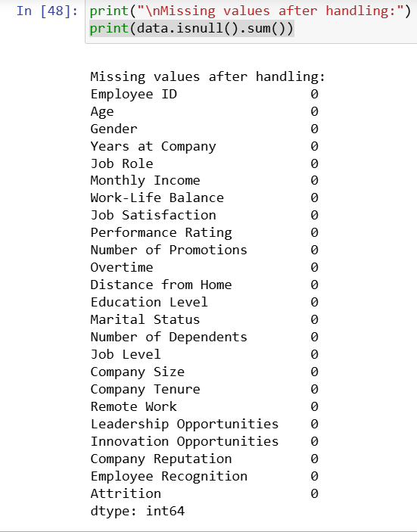
UNDERSTANDING THE DATASET
Dataset Size: 74,498 samples, split into training and testing sets.
Features: Includes demographics, job-related features, personal circumstances, and a unique Employee ID.
Target Variable: Attrition (whether an employee has left or is likely to leave, often coded as 0 for "Stayed" and 1 for "Left").

Slide 4
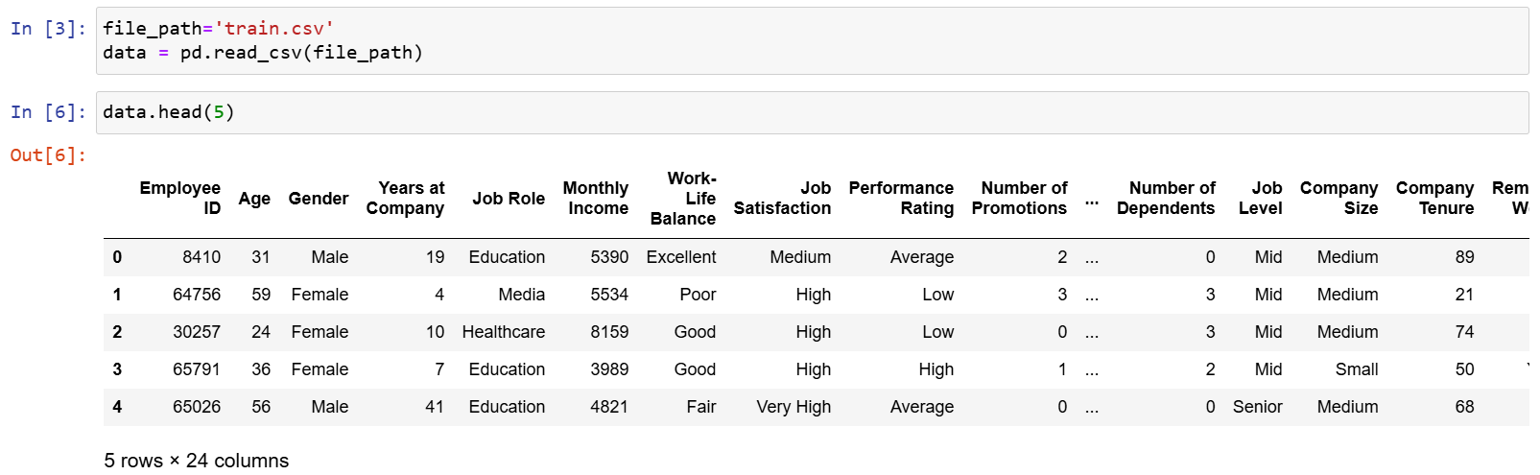
LOADING DATASET
Loading a dataset is the initial step in data preprocessing and model development . In Python, this typically involves using the pandas library to read data from a file and load it into a DataFrame. A DataFrame is a table-like structure that allows for easy manipulation and analysis of data.

Slide 5
DATA CLEANING
Missing Values: Identify and handle missing values.
Mean/Median Imputation: For numerical features.
Mode Imputation: For categorical features (e.g., Job Role or Department).
Dropping Rows/Columns: If a feature has too many missing values or is irrelevant (e.g., Employee ID might not be predictive).
Outlier Detection: Identify outliers in numerical features like MonthlyIncome, Age, or YearsAtCompany using box plots or Z-scores, and treat them by capping or removing them if they distort the analysis.

Slide 6
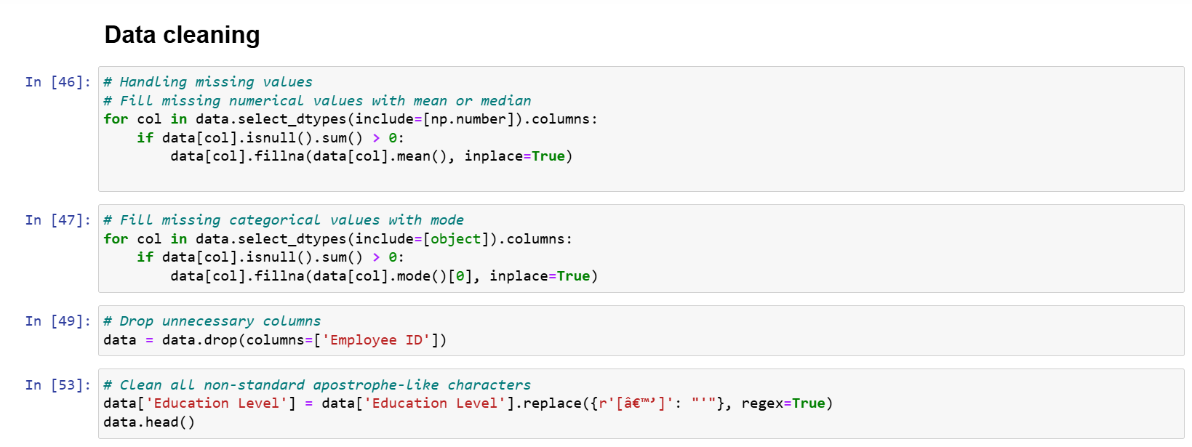
DATA CLEANING
HANDLING MISSING AND NON STANDARD VALUES

Slide 7
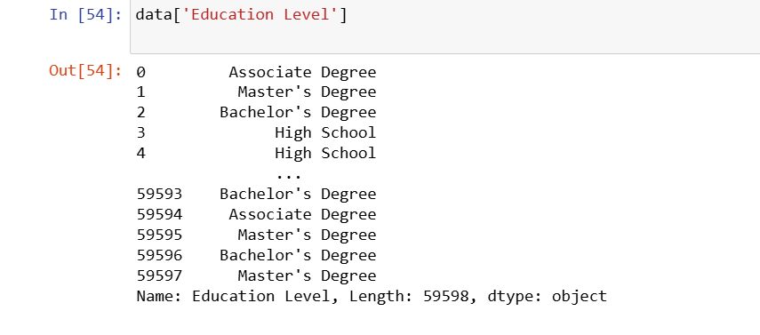
DATA CLEANING
HANDLING MISSING AND NON STANDARD VALUES - OUTPUT

Slide 8
DATA CLEANING
FINDING OUTLIERS
IQR (Interquartile Range): Calculate Q1 (25th percentile) and Q3 (75th percentile). Outliers are often defined as points lying outside Q1−1.5×IQRQ1 - 1.5 \times IQRQ1−1.5×IQR and Q3+1.5×IQRQ3 + 1.5 \times IQRQ3+1.5×IQR, where IQR=Q3−Q1IQR = Q3 - Q1IQR=Q3−Q1.
IQR is used with the rows having numerical continuous data(e.g., 'Age', 'Monthly Income', 'Number of Promotions', 'Distance from Home')
HANDLING OUTLIERS
Capping: Limit extreme values by capping them at a certain percentile (e.g., the 1st and 99th percentiles).

Slide 9
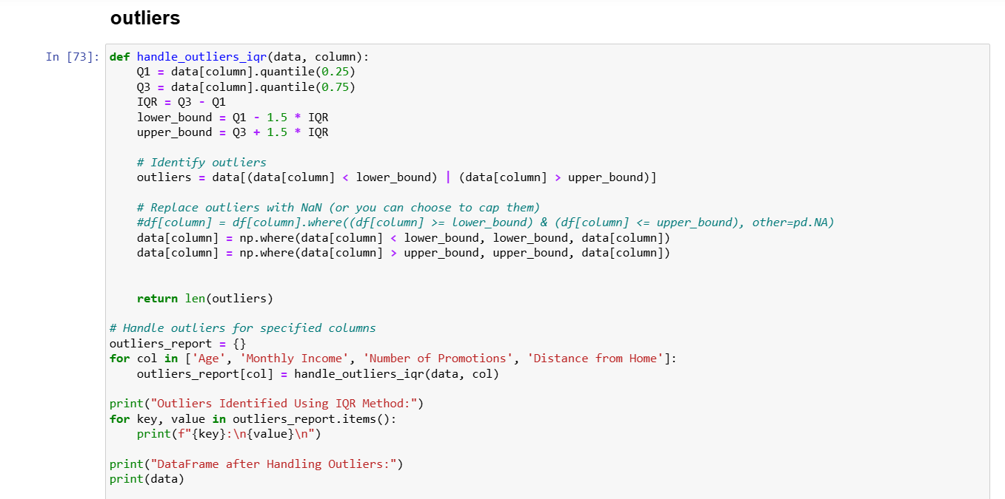
DATA CLEANING
HANDLING OUTLIERS

Slide 10
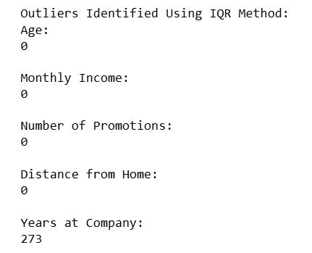
DATA CLEANING
HANDLING OUTLIERS - OUTPUT

Slide 11
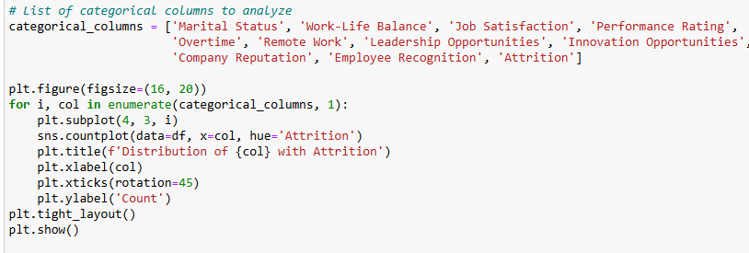
EXPLORATORY DATA ANALYSIS
COUNT PLOT
Identify the distribution of categorical features and their impact on attrition.
Examine the distribution of numerical features to identify patterns or potential outliers.

Slide 12
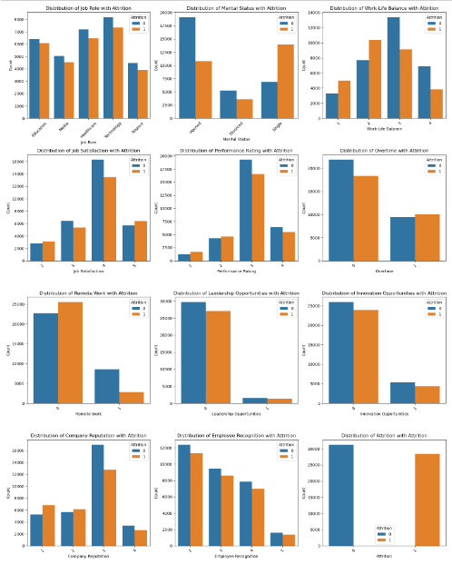
COUNT PLOT OUTPUT
INSIGHTS
Gender: Males tend to stay longer compared to females.
Work-Life Balance: Poor work-life balance increases the likelihood of attrition.
Job Satisfaction: Employees with very low or very high satisfaction tend to leave, while those with medium to high satisfaction stay longer
Overtime: Employees who work overtime are more likely to leave if not properly compensated.

Slide 13
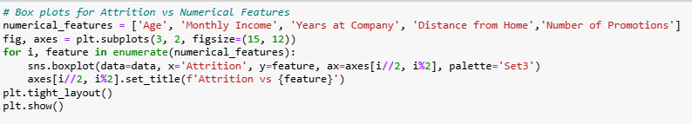
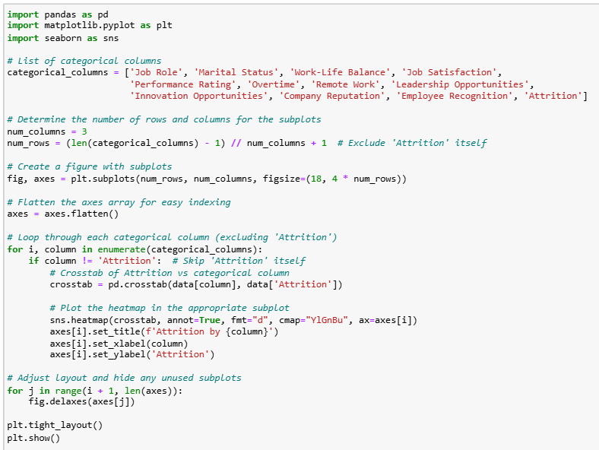
EXPLORATORY DATA ANALYSIS
BIVARIATE ANALYSIS
Analyze the impact of numerical features like Monthly Income and Years at Company on attrition.
Examine the influence of categorical features on attrition

Slide 14
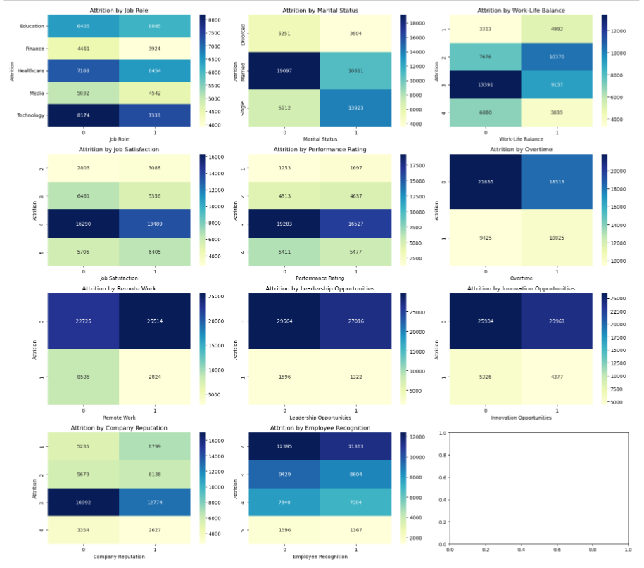
CATOGORICAL BIVARIATE ANALYSIS
INSIGHTS
Distance from Home: No clear pattern emerges, but it could indirectly influence attrition when combined with other factors.
Age: Older employees tend to stay longer, suggesting job stability with age.
Number of Dependents: Employees with more dependents tend to stay longer, possibly due to fewer mobility options.
Company Tenure: Longer-tenured employees are more likely to stay.

Slide 15
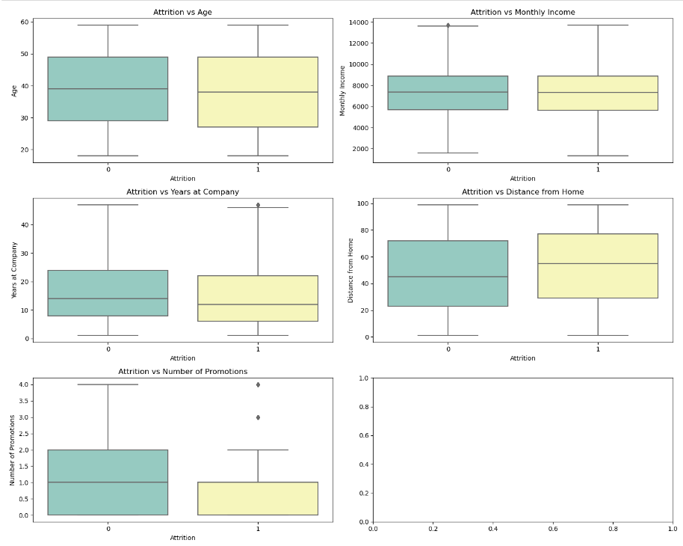
NUMERICAL BIVARIATE ANALYSIS
INSIGHTS
Monthly Income: No significant difference between employees who stay vs. leave, though high-income outliers could reflect senior roles.

Slide 16
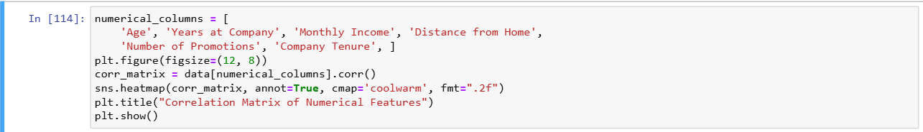
EXPLORATORY DATA ANALYSIS
MULTIVARIATE ANALYSIS
Investigate relationships among multiple numerical variables to identify significant patterns.
Correlation analysis helps understand if factors like Monthly Income, Years at Company, or Performance Rating are related. Strong correlations between variables might indicate interactions that influence attrition.

Slide 17
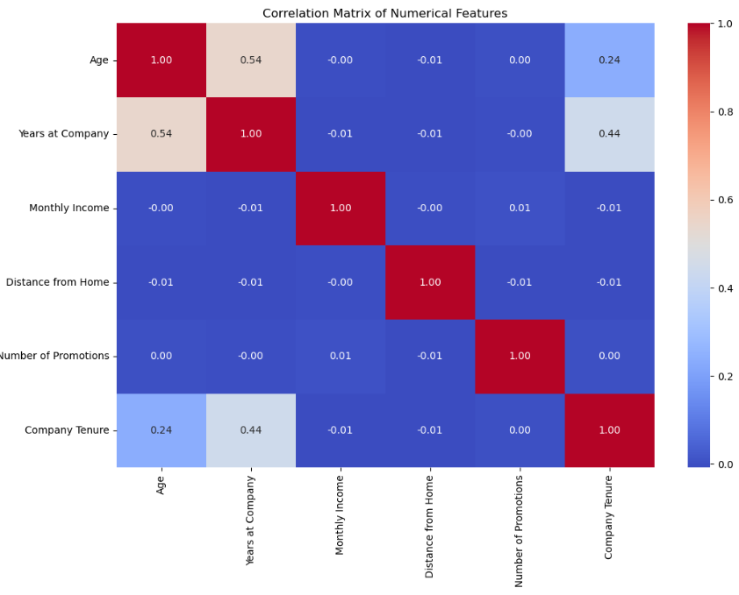
MULTIVARIATE ANALYSIS
INSIGHTS
Age vs. Years at Company: A moderate positive correlation suggests that older employees typically have longer tenure at the company.
• Age vs. Company Tenure & Years at Company vs. Company Tenure: These variables show slight correlations, indicating that while they are related, factors such as job changes prevent a perfect correlation.

Slide 18
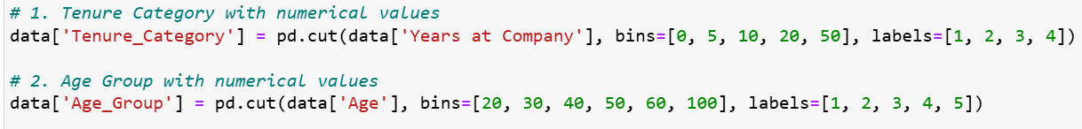
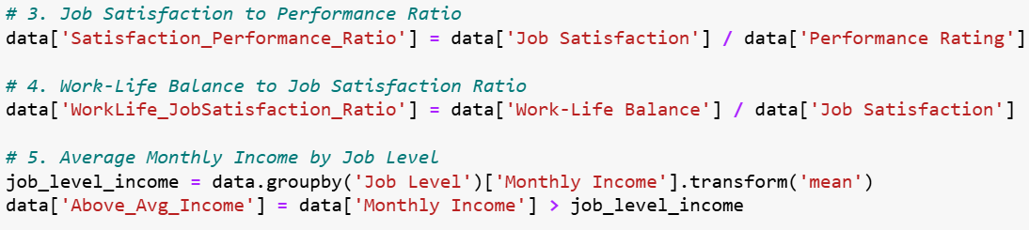
DATA TRANSFORMATION
FEATURE ENGINEERING
Creating new features or variables based on existing ones, such as aggregating, combining, or extracting meaningful information from raw data.

Slide 19
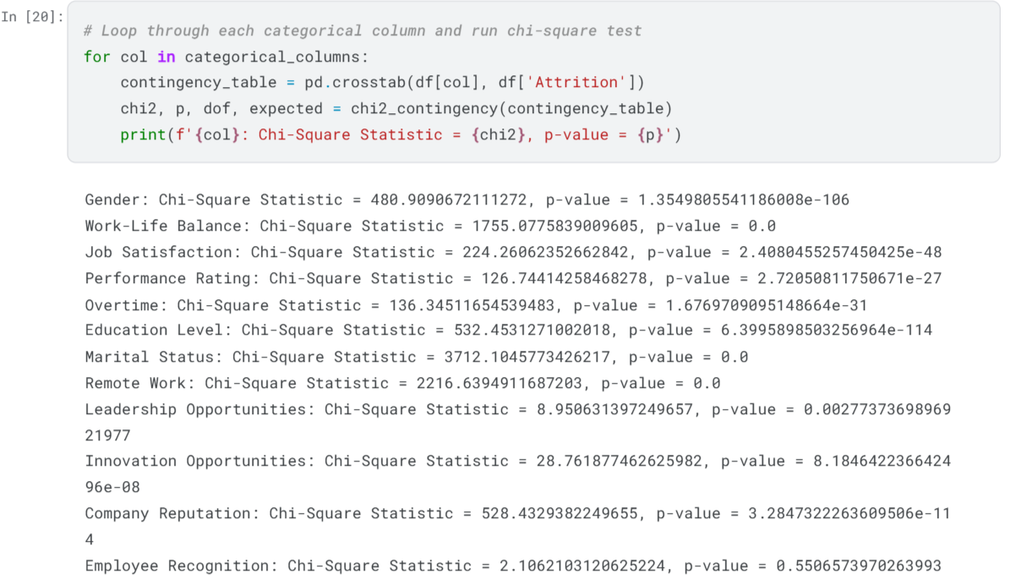
CHECKING SIGNIFICANT COLUMNS BASED ON P-VALUES (CHI SQUARE TEST)

Slide 20
INSIGHTS AND SIGNIFICANT FEATURES
Gender, Work-Life Balance, Job Satisfaction, Performance Rating, Overtime, Education Level, Marital Status, Remote Work, Company Reputation: These columns demonstrate significant relationships with attrition, indicating they are crucial predictors.
Leadership Opportunities, Innovation Opportunities, Employee Recognition: These columns do not show strong significance in relation to attrition. Leadership and innovation opportunities, while somewhat relevant, may not be prioritized by employees when deciding to leave.

Slide 21
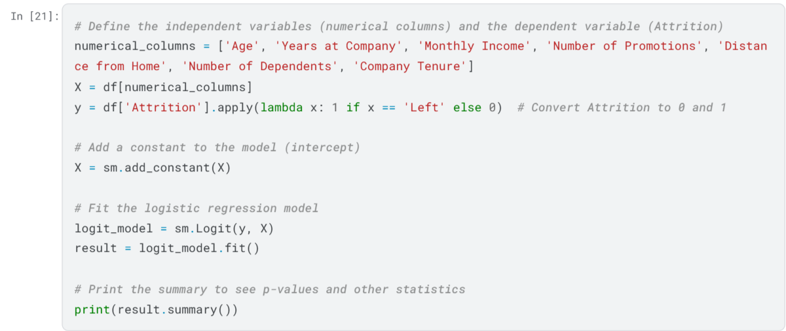
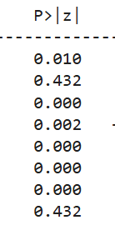
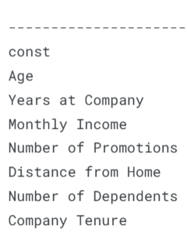
LOGISTIC REGRESSION MODEL'S P-VALUES FOR NUMERICAL VARIABLES:

Slide 22
INSIGHTS AND SIGNIFICANT FEATURES
Significant Factors:
Years at Company: Longer tenure reduces the likelihood of leaving.
Monthly Income: Higher income slightly decreases attrition.
Number of Promotions: More promotions strongly reduce the chance of leaving.
Distance from Home: Longer commutes increase the likelihood of leaving.
Number of Dependents: More dependents are linked to a greater likelihood of staying.
Not Significant Factors:
Age and Company Tenure: These factors don’t significantly affect attrition.

Slide 23
DATA CLEANING
ENCODING
Binary Encoding: Encodes binary categorical variables.
Binary Columns: Columns that have only two possible values, such as "Yes" or "No", "Stayed" or "Left".
Ordinal Encoding : The code block maps ordinal categorical variables to numeric values.
This approach is applied to columns where there is a natural order in the values (e.g., "Poor" < "Fair" < "Good" < "Excellent").
One-Hot Encoding : Performs one-hot encoding on nominal categorical variables.
Nominal Columns: Columns with categorical values that do not have a specific order, such as "Gender", "Job Role", and "Marital Status".

Slide 24
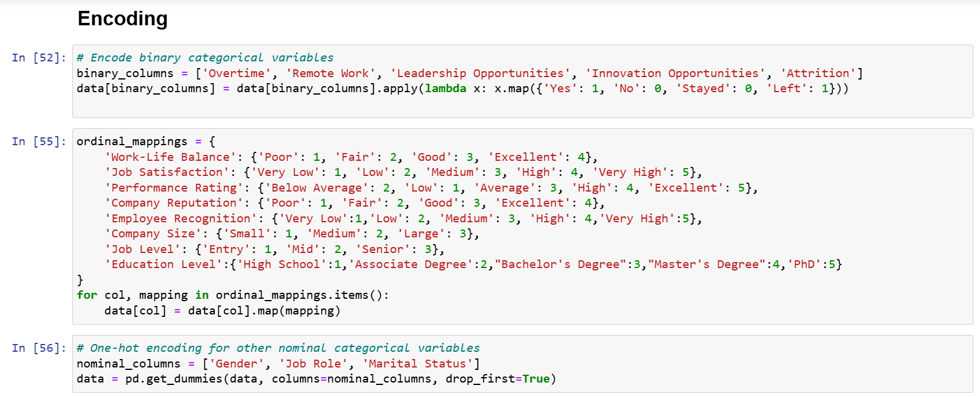
ENCODING

Slide 25
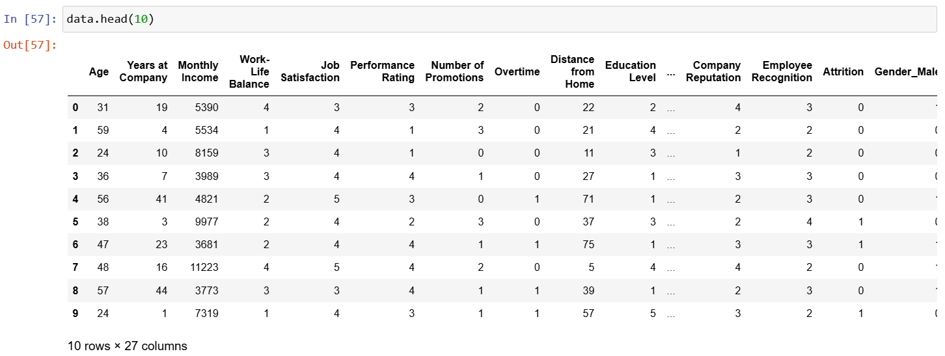
ENCODING - OUTPUT

Slide 26
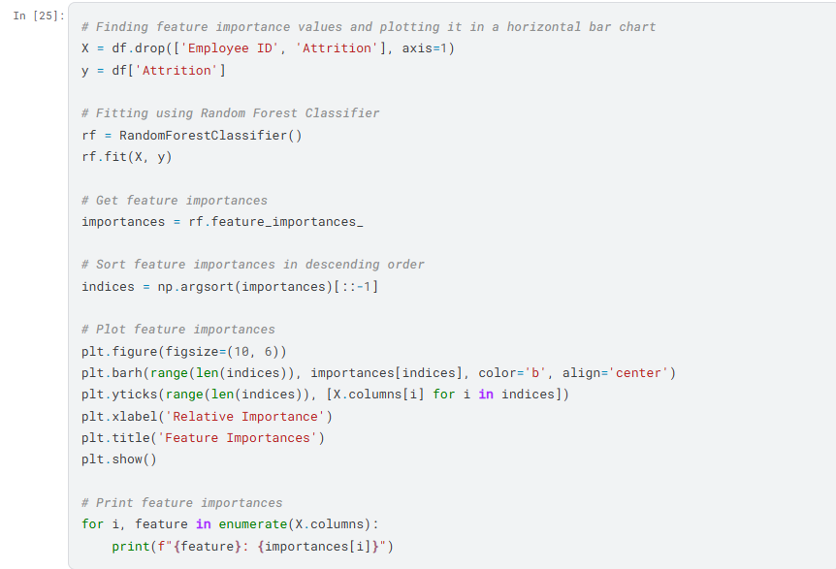
FEATURE IMPORTANCE USING RANDOM FOREST:

Slide 27
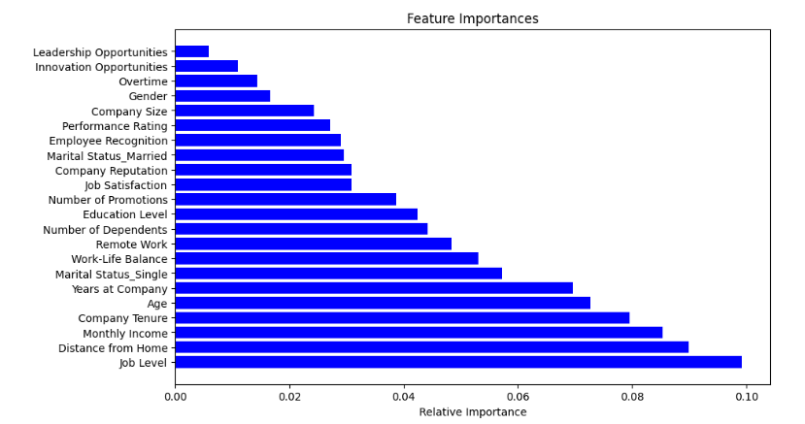
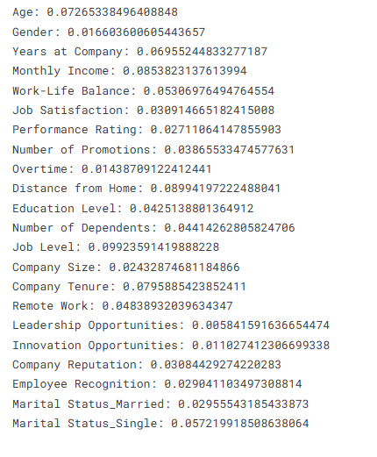
FEATURE IMPORTANCE USING RANDOM FOREST:

Slide 28
INSIGHTS AND SIGNIFICANT FEATURES
Significant Factors:
Job Level (0.0992): Strongly influences attrition, with higher job levels often being linked to greater turnover.
Distance from Home (0.0899): Employees with longer commutes tend to leave more often due to the inconvenience.
Monthly Income (0.0854): Lower income employees are more likely to leave in search of better financial opportunities.
Age (0.0727): Age affects attrition, with younger employees possibly seeking more growth opportunities.
Company Tenure (0.0796): Employees with longer tenure may stay longer, while newer employees are more likely to leave.
Not Significant Factor:
Employee Recognition (0.0290): While important, its effect on attrition is smaller compared to other factors.

Slide 29
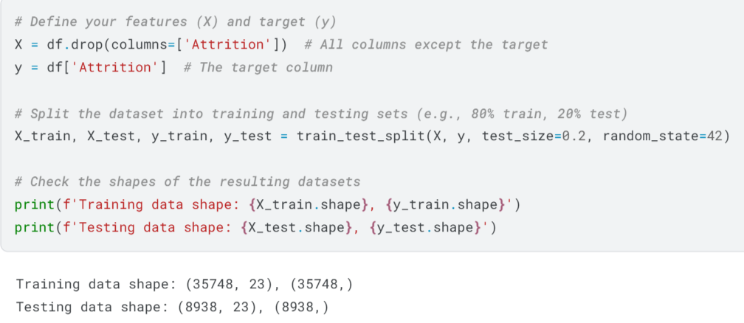
TRAIN-TEST SPLIT
This code splits the dataset df into features (X) and target (y), where Attrition is the target variable. It then divides the data into training and testing sets using an 80-20 split, with the train_test_split function. Finally, it prints the shapes of the training and testing datasets to confirm the division.

Slide 30
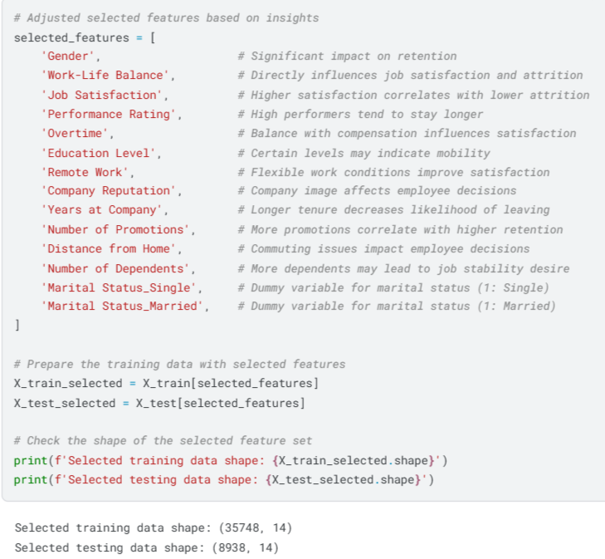
FEATURE SELECTION AND SCALING:
This code defines a list of selected features based on their impact on employee retention, such as gender, job satisfaction, and performance rating. It then creates new training and testing datasets using only these selected features. Finally, it prints the shapes of the resulting datasets to confirm the feature selection process.

Slide 31
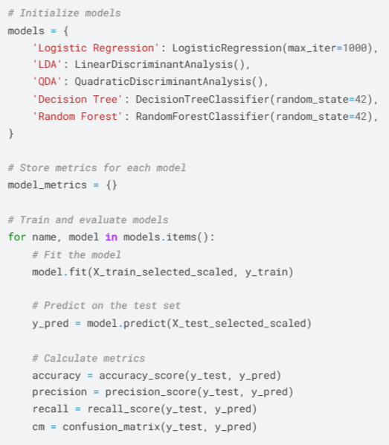
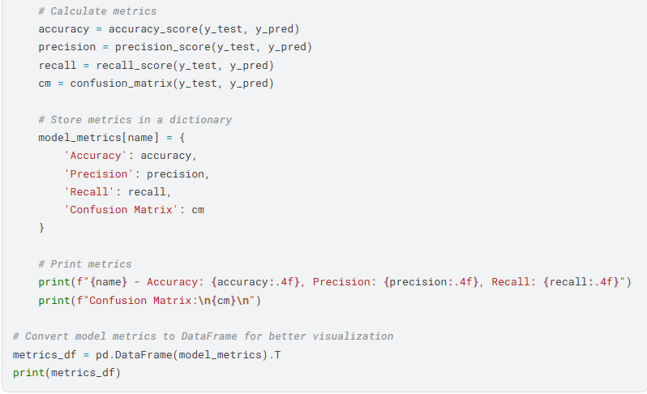
MODEL FITTING AND EVALUATION:
Model fitting trains a machine learning model by learning patterns from the training data. Model evaluation tests the model's performance on unseen data using metrics like accuracy and precision.

Slide 32
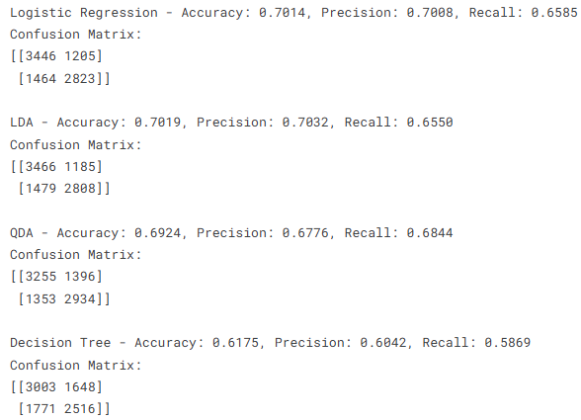
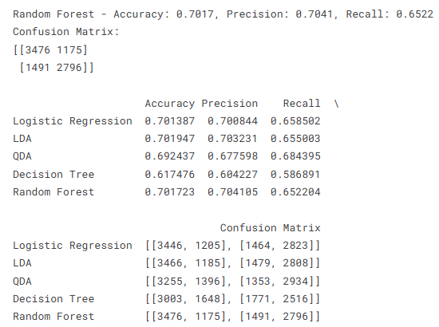
MODEL FITTING AND EVALUATION:

Slide 33
INSIGHTS AND SIGNIFICANT FEATURES
Best Model Selection: Quadratic Discriminant Analysis (QDA) was chosen as the optimal model for predicting employee attrition due to its balanced performance, particularly in terms of recall. Although QDA showed a slightly lower accuracy and precision compared to other models like Logistic Regression and Random Forest, its higher recall of 68.44% indicates that it is more effective at identifying employees who are at risk of leaving. In the context of employee attrition, minimizing false negatives (i.e., employees who may leave but are not predicted) is crucial for proactive retention efforts. By prioritizing recall, QDA ensures that more at-risk employees are identified, allowing for targeted retention strategies. This makes QDA a suitable choice for a problem where preventing attrition is the primary focus, and catching as many potential leavers as possible is a key priority.

Slide 34
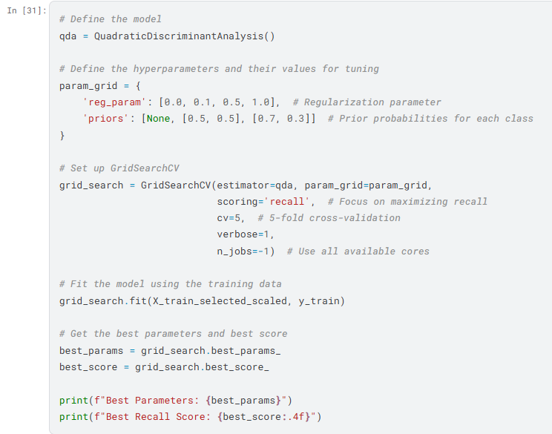

HYPERPARAMETER TUNING OF THE BEST MODEL
Hyperparameter tuning optimizes a model’s settings to improve performance. Techniques like grid search and random search are used to find the best combination of hyperparameters

Slide 35
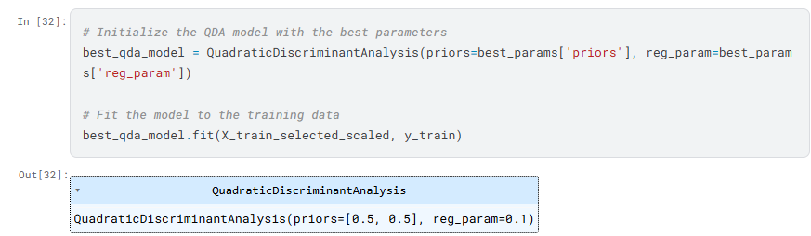
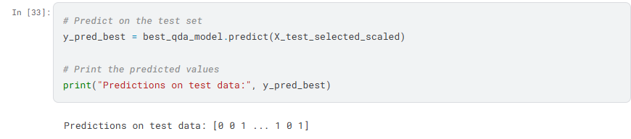
TRAINING AND PREDICTION
The QDA model is initialized with optimal parameters (priors=[0.5, 0.5], reg_param=0.1), trained on the scaled training data, and used to predict employee attrition on the test set. The predictions, stored in y_pred_best, are output as a series of 0s and 1s, representing the predicted attrition status for each test sample.

Slide 36
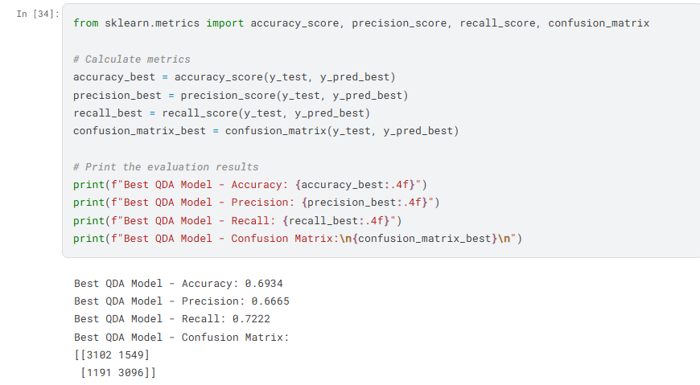
CALCULATE METRICS FOR THE PREDICTION
The Best QDA Model has an accuracy of 69.34%, precision of 66.65%, and recall of 72.22%. It correctly identifies 72.22% of attrition cases (high recall), but 33.35% of predicted attrition cases are false positives (lower precision). The confusion matrix shows 3102 true negatives, 1549 false positives, 1191 false negatives, and 3096 true positives. The model is good at detecting attrition but can improve precision.

Slide 37
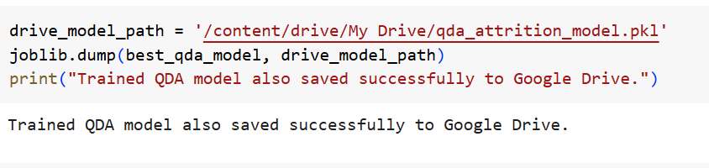
SAVE THE MODEL
This code saves the trained QDA model (`best_qda_model`) to a file using the **joblib** library, which allows for efficient serialization of Python objects. The `joblib.dump()` function stores the model in a file named `'qda_attrition_model.pkl'`. This is useful for persisting the model after training, enabling it to be loaded and used for predictions at a later time without the need to retrain it from scratch. The line `print("Trained QDA model saved successfully.")` provides a confirmation message to indicate that the model was saved successfully. By saving the model, you ensure that the trained QDA model can be deployed or reused for future predictions in production environments.

Slide 38
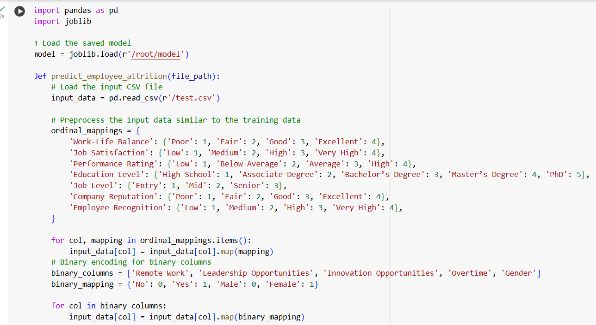
USING THE SAVED MODEL FOR PREDICTIONS

Slide 39
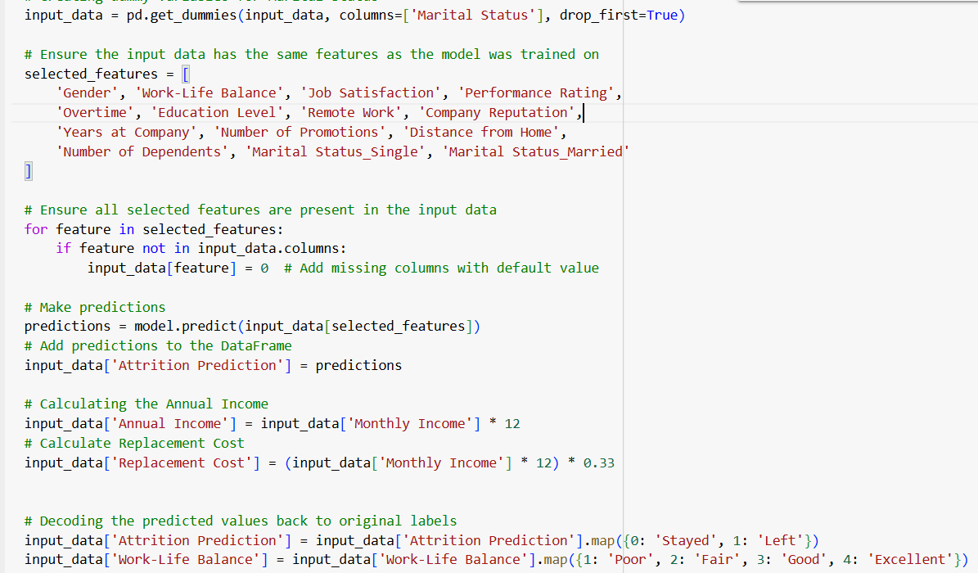
USING THE SAVED MODEL FOR PREDICTIONS

Slide 40
USING THE SAVED MODEL FOR PREDICTIONS
1. Load Input Data: Read the employee data from a CSV file.
2. Preprocess Data:
- Apply ordinal mappings to categorical columns.
- Encode binary columns (e.g., 'Yes' → 1, 'No' → 0).
- Create dummy variables for the 'Marital Status' column.
3. Feature Alignment: Ensure the input data has the same features as the trained model.
4. Make Predictions: Use the trained QDA model to predict attrition (stay or leave).
5. Post-Processing: Decode predicted values and map numerical features back to categories.
6. Calculate Financial Metrics: Calculate Annual Income and Replacement Cost.
7. Return At-Risk Employees: Filter and return employees predicted to leave.

Slide 41
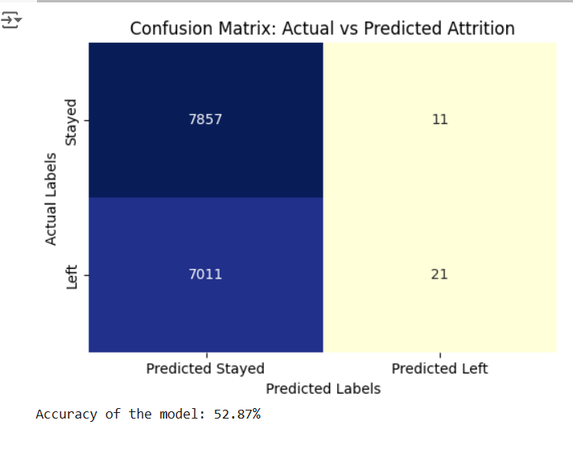
CONFUSION MATRIX

Slide 42
THANK YOU

