Slide 1




Business Intelligence & Interactive Data Visualization Using Microsoft Power BI
Presented by:
Vanapalli. Kanakavarshini
23A51A4457
Computer Science and Engineering(DataScience)
Your Organization
23A51A4457 VANAPALLI KANAKAVARSHINI
October 09, 2026

Slide 2






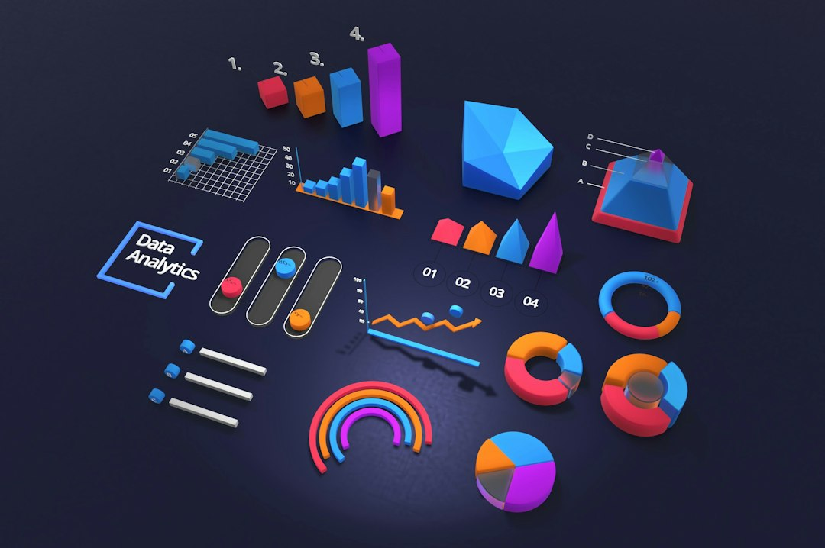






Business Intelligence & Interactive Data Visualization Using Microsoft Power BI
This presentation explores the integration of Business Intelligence and interactive data visualization through Microsoft Power BI. It highlights my internship experience at Cognifyz IT Solutions, focusing on data transformation, analytical modeling, and the creation of impactful dashboards. The insights gained during this capstone project will demonstrate the power of data in driving informed business decisions and enhancing operational efficiency.

Slide 3








Organization Profile & Internship Context
01
Cognifyz IT Solutions Overview
Cognifyz specializes in AI, Data Science, and Business Analytics, enhancing data-driven decisions.
02
Accreditations and Certifications
The company is ISO 9001:2015 certified and registered as an MSME enterprise.
03
Role as Power BI Intern
Focused on transforming data into actionable insights through Power BI analytics.

Slide 4
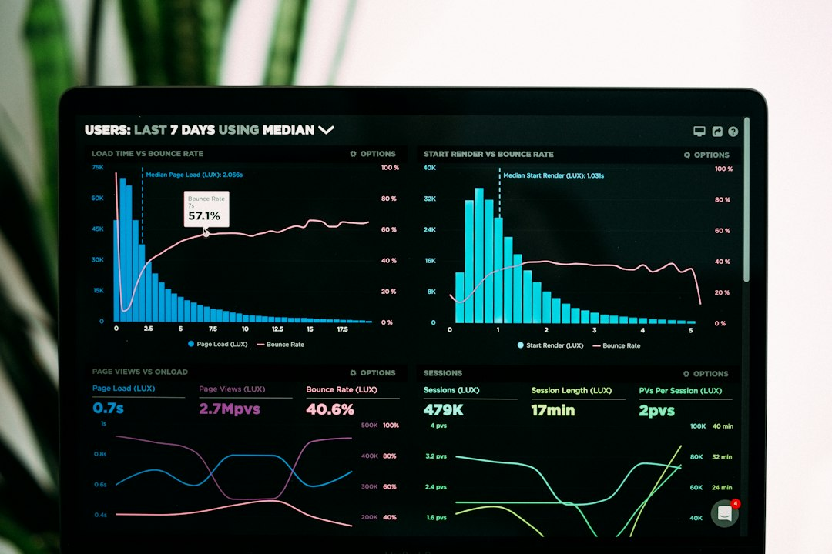
Transforming Messy Data into Meaningful Insights
Raw Data Challenges
Power Query Profiling
Real-world data often contains missing entries and inconsistent formats, complicating analysis.
Utilized Power Query for profiling, ensuring data quality before ingestion into models.
Data Standardization
Structured Data Outcome
Standardized formats and handled null entries, enhancing data consistency for analysis.
Transformed fragmented datasets into structured data, ready for analytical modeling and evaluation.
Photo by Luke Chesser

Slide 5


Excel vs Power BI for Data Analytics
Excel
Power BI
Ideal for preliminary exploration and ad-hoc audits.
Automates workflows and handles large datasets without row-count limits.
Utilizes Pivot Tables and XLOOKUP for initial data checks and summaries.
Enables dynamic multi-table data modeling and high-performance in-memory processing.
Facilitates quick, granular inspections of small to medium datasets.
Provides advanced visualizations and interactive dashboards for enterprise-scale analytics.

Slide 6

Analytical Data Modeling & Business Calculations
High-Performance Star Schema
01
Implemented a Star Schema to optimize data retrieval and analysis efficiency.
1-to-Many Relationships
02
Created 1-to-Many relationships to minimize data redundancy and enhance performance.
DAX Measures for KPIs
03
Developed DAX measures for key performance indicators, ensuring accurate business insights.

Slide 7




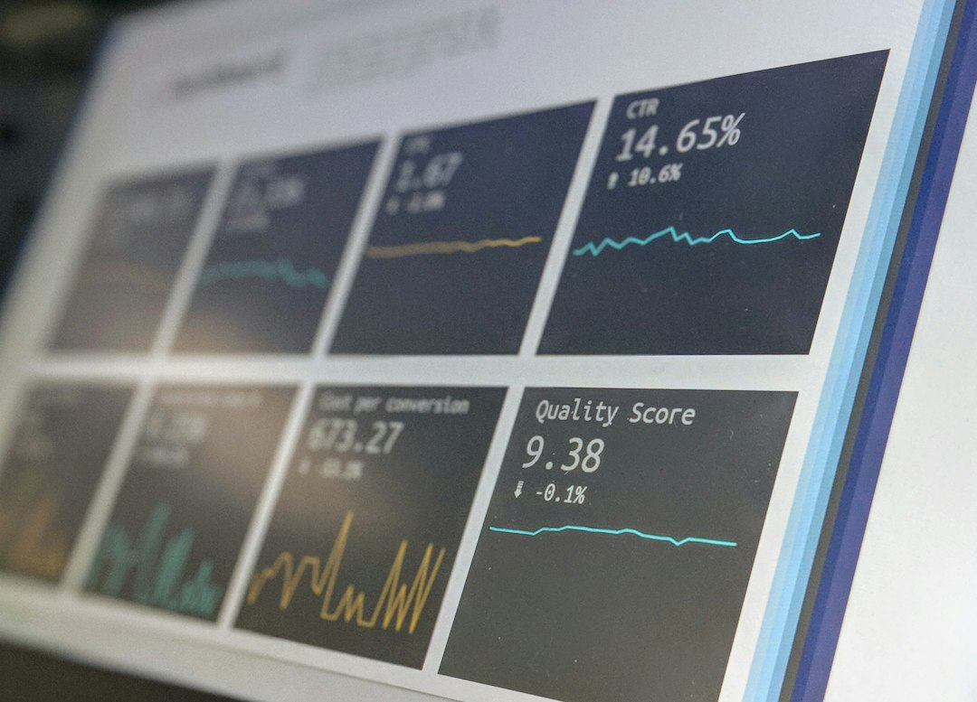

Visual Representation of Dashboards
This slide showcases interactive dashboards for sales and epidemiological analytics, highlighting key metrics and visual hierarchies. The visuals enhance data comprehension and decision-making.
Made with SlideMaker.app

Slide 8



Key Metrics & Impact
$1.2M
10,000+
15%
Total Revenue
Units Sold
Case Fatality Rate
Generated from sales analytics
Reflecting strong market demand
Informed public health strategies

Slide 9
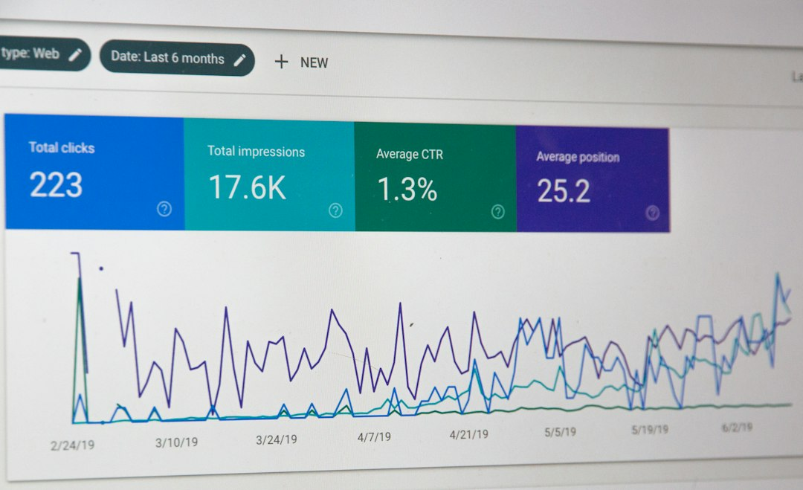
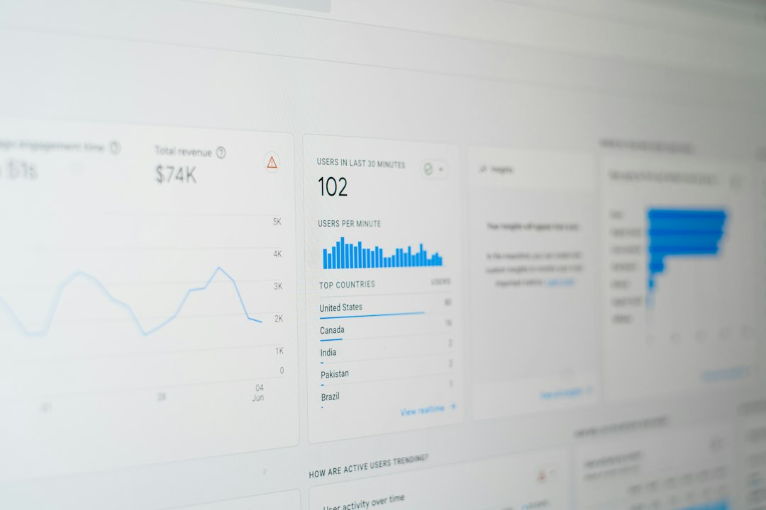

Summary of Analytical Applications
01
Versatile Modeling Principles
Applied dimensional modeling across sales and public health domains effectively.
02
Data-Driven Decision Making
Enabled stakeholders to make informed decisions through interactive dashboards.
03
Enhanced Decision Support
Interactive dashboards improved visibility of critical indicators for stakeholders.

Slide 10


Frequently Asked Questions
?
What tools were primarily used in this project?
The primary tools used were Microsoft Power BI for data visualization and Excel for preliminary data exploration and validation.
?
How was data validation ensured during the project?
Data validation was ensured through automated profiling methods in Power Query, which inspected column quality and value distributions before ingestion.
?
What was the biggest challenge faced during the project?
The biggest challenge was cleaning raw, messy datasets, which involved handling missing entries, inconsistent formats, and unstructured layouts.
?
How is data security handled in your project?
Data security is handled by adhering to ISO 9001:2015 standards, ensuring compliance with best practices for data protection and integrity.

Slide 11









Conclusion
This internship has solidified my skills in data transformation and visualization using Power BI. Key takeaways include mastering data cleansing, applying DAX for analytics, and creating impactful dashboards. Moving forward, I aim to leverage these insights in real-world applications, enhancing decision-making processes and driving data-driven strategies in organizations.

