Slide 1


Spotify X Tune Buds
Business Analysis for Launching Christmas Limited Edition Tune Buds and Spotify Collaboration
Data Analyst
Varshini S
Date: 25.02.2025

Slide 2
Project Scope
Company Background
Hack Ltd.
Business Statement
Marketing Department:
Specializes in electronic consumer goods.
•
Objective:
Identify the most popular songs and hottest
from the last month to create a joint marketing
campaign with Spotify.
Product Development Center:
Objective: Design product functions tailored to the features and genres of the top tracks.
Earbuds product line
consistently ranks as
artists
the best seller.
Project Concept
Christmas Limited Edition Hack Buds
Collaboration with Spotify, combining
advanced audio technology with exclusive
Spotify features.

Slide 3
Data Analysis
Methodology
Project Management: Utilize
Dataset Description
Spotify Top Tracks Dataset
Agile
methodologies and
Trello
Snapshot taken in October 2022.
Contains data on song popularity, artist rankings, and music genres.
Data Objectives
for project management to ensure flexibility and time-frame.
Exploratory Data Analysis (EDA):
Summary Statistics/ Visualizations/ Relationship Between Variables
Kanban
Find Dataset
Data Cleaning and Formatting
•
•
•
Constraints:
Difficulty in finding the data with the
Filter and Pivot
most timeliness
and includes all necessary elements for analysis.
Data Visualization
Limited time and skills to analyze a large dataset.
Limited time and skills to use
Business Analysis
Spotify API.
* Reference: Spotify Tracks Dataset (kaggle.com)

Slide 4


Data Wrangling and Cleaning
Data Noise Techniques
Obstacles
Missing values
Check and filling NaN: isnull().sum/fillna()
Inconsistency
Inconsistency: .str.replace()/str.title()
•
Special letters
•
UFT 8 encoding
Numbers
Numbers: round ().
•
Filter and structure
Filter and structure: Filter()/Pivot_table

Slide 5

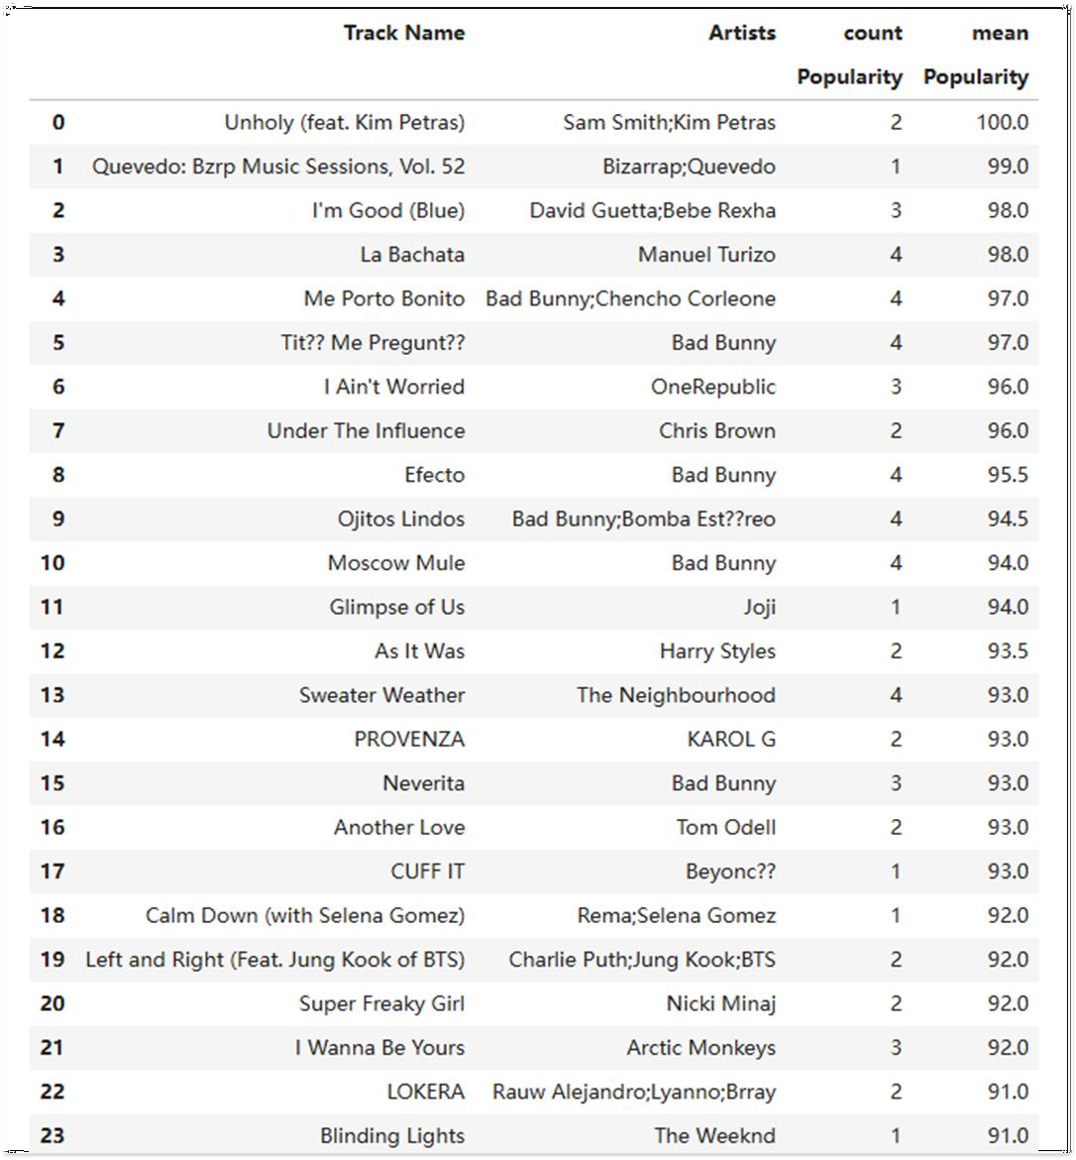








Business Insights
Top Tracks with Popularity > 90
About Us
Our Album
Conclusion:
There are a total of 24 songs with a popularity score above 90.
Playlist
Artists
Podcast & Shows
Your Library
EDA method:
Summary Statistics
Trending
Help
Report History
* The popularity of a track is a value between 0 and 100, with 100 being the most popular, which is calculated by algorithm and is based, in the most part, on the total number of plays the track has had and how recent those plays are. Generally speaking, songs that are being played a lot now will have a higher popularity than songs that were played a lot in the past.
1

Slide 6

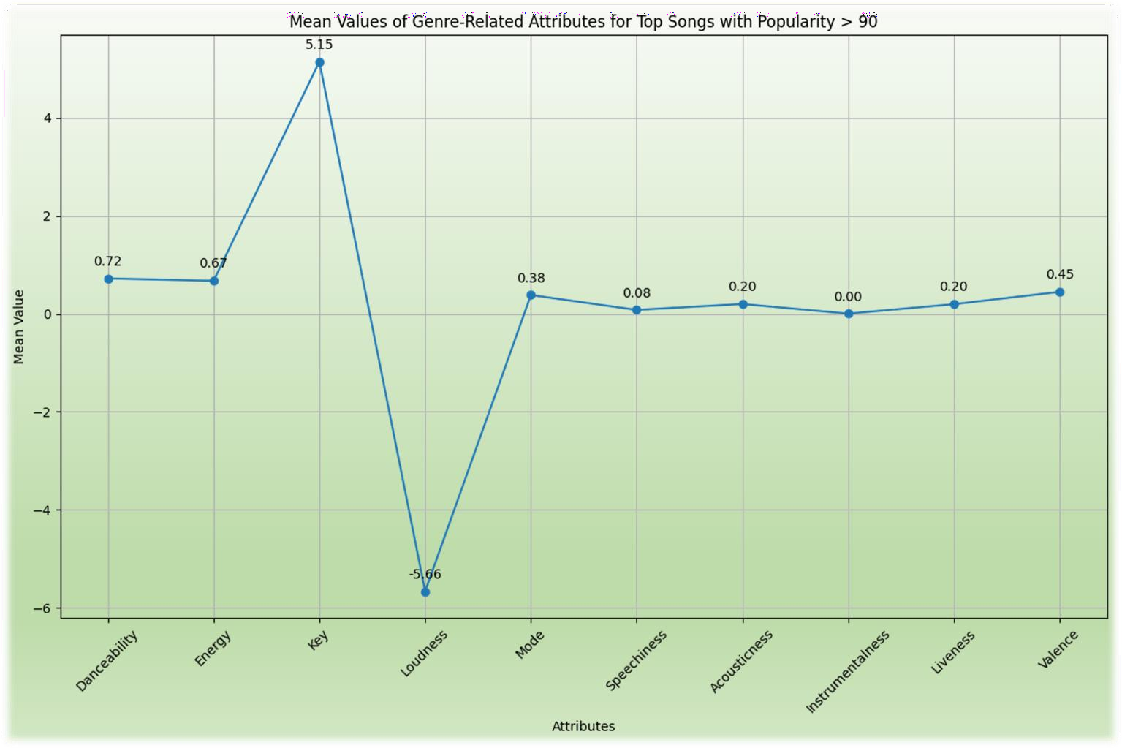







Business Insights
Features of Top Tracks with Popularity > 90
About Us
Our Album
Conclusion:
Considering these
Playlist
Artists
High
minor mode
Low
attributes, the most
Low
Low
fitting genres would be Dance Pop.
Moderate to high
Mid- range
Podcasts & Shows
Very Low
Your Library
EDA method:
Summary Statistics
Line Chart
Trending
Relatively loud
Help
Report History
2

Slide 7

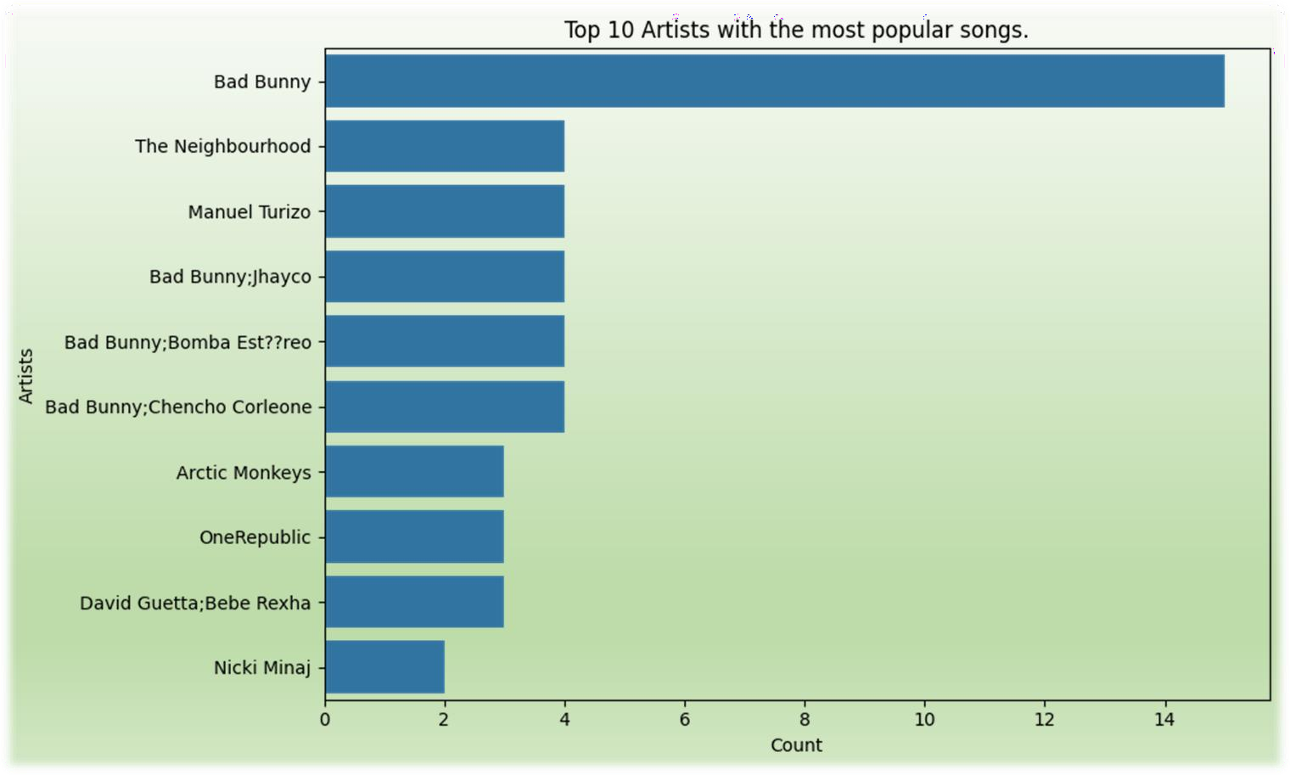








Business Insights
About Us
Top 10 Artists with the Most Popular Tracks
Our Album
Conclusion:
The most popular artist
Playlist
15
Artists
Podcasts & Shows Your Library
Trending
EDA method:
Summary Statistics
Horizontal Bar Chart
Help
Report History
3

Slide 8


Conclusion
Product Research
According to the analysis of the Spotify Top Tracks dataset, the following product functionalities are defined based on the music features – Dance Pop :
Joint-Marketing Campaign
Drawing from the Spotify Top Tracks data, it's evident that Bad Bunny was the most popular artist last month. This insight offers valuable direction for the marketing campaign to enhance brand visibility. For instance,
Collaborative limited edition earbuds release
Invitation for attending the product release event
More campaigns to be defined
Good Bass Response
Balanced Sound
Noise Isolation
Comfortable Fit
More functions to be defined

Slide 9



Thank You

