Slide 1
PROJECT TITLE
CAPSTONE PROJECT
Presented By: P. Abhi Varshini
Student Name : P. Abhi Varshini
College Name & Department : Vallurupalli Nageswara Rao Vignana Jyothi Institute of Engineering &Technology(VNRVJIET)
(Cyber Security)

Slide 2
OUTLINE
Problem Statement
Technology used
Wow factor
End users
Result
Conclusion
Git-hub Link
Future scope

Slide 3
Problem Statement
With the increasing need for secure communication, this project aims to provide a method for securely hiding sensitive information within images using steganography. Additionally, a digital signature is embedded to ensure data integrity and authenticity. This approach enhances security by preventing unauthorized access and verifying message authenticity.

Slide 4
Technology used
Libraries Used:
Flask – Web framework for backend development
Pillow – Image processing library for steganography
Cryptography – For encrypting/decrypting text and generating/verifying digital signatures
Werkzeug – Secure file handling
Platforms Used:
Python – Core programming language
Flask – Web application framework
HTML, CSS, JavaScript – Frontend technologies

Slide 5
Wow factors
Dual-Layer Security – Combines steganography with encryption & digital signatures, ensuring both data confidentiality and message integrity.
Tamper-Proof Authentication – Uses digital signatures to verify that the hidden message hasn’t been altered, making it resistant to forgery and modification.
Invisible & Untraceable Communication – Since the encrypted text is embedded within an image, it bypasses traditional security scans, making it stealthy and undetectable.
User-Friendly Web Interface – Unlike many CLI-based steganography tools, this project provides an intuitive web interface for seamless encryption, hiding, extraction, and verification.
Error Handling & Feedback System – Built-in exception handling ensures smooth operation, guiding users with real-time alerts and messages for incorrect inputs or tampering attempts.
Potential for Multi-Platform Expansion – Can be extended to mobile applications or integrated with cloud storage for secure, remote access.
Future-Proof Design – Modular implementation allows easy integration of advanced encryption algorithms (AES, RSA, ECC) and support for additional image formats (JPG, BMP, GIF).

Slide 6
End users
Government & Intelligence Agencies – Secure communication of classified information without attracting attention.
Cybersecurity Professionals – Protect sensitive data from interception by embedding it in images.
Journalists & Whistleblowers – Safely share confidential information while ensuring message integrity and authenticity.
Corporate & Financial Institutions – Secure transmission of business secrets, contracts, and financial documents.
Forensic Investigators – Hide and protect crucial forensic evidence within images to prevent unauthorized access.

Slide 7
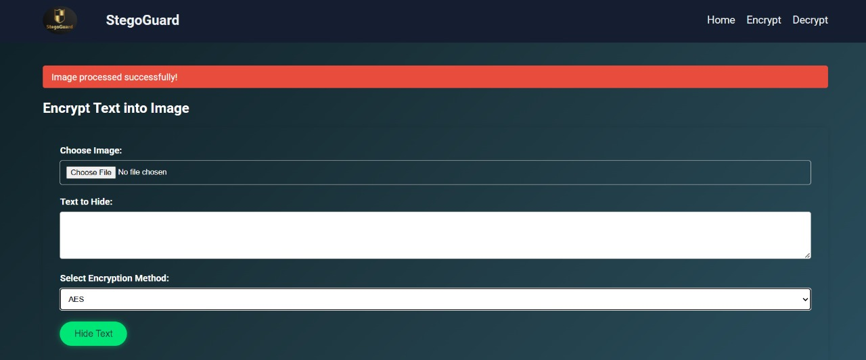
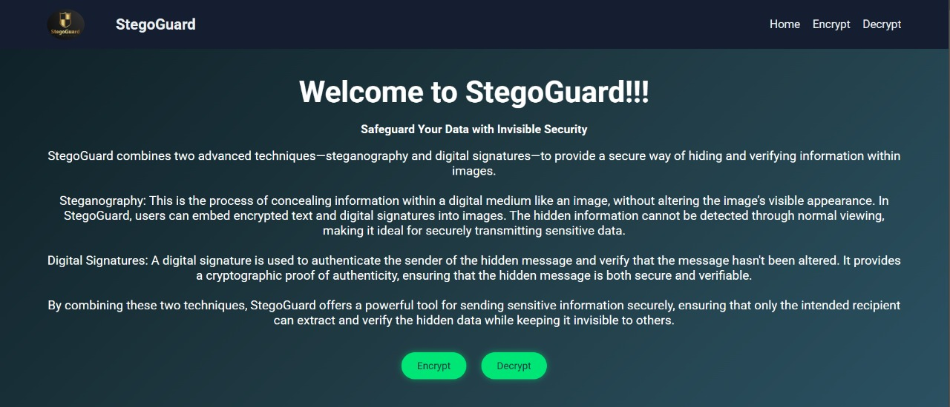

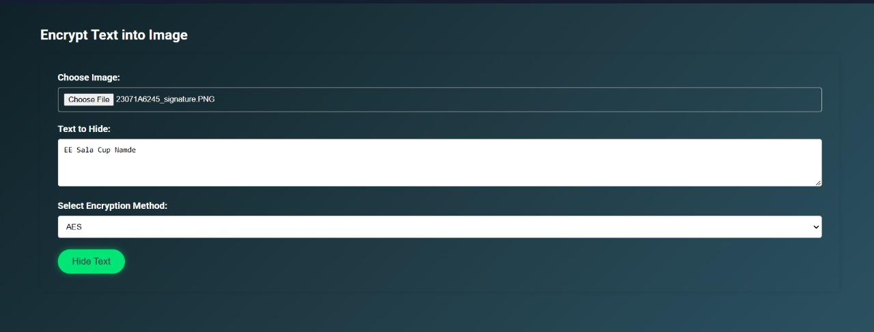
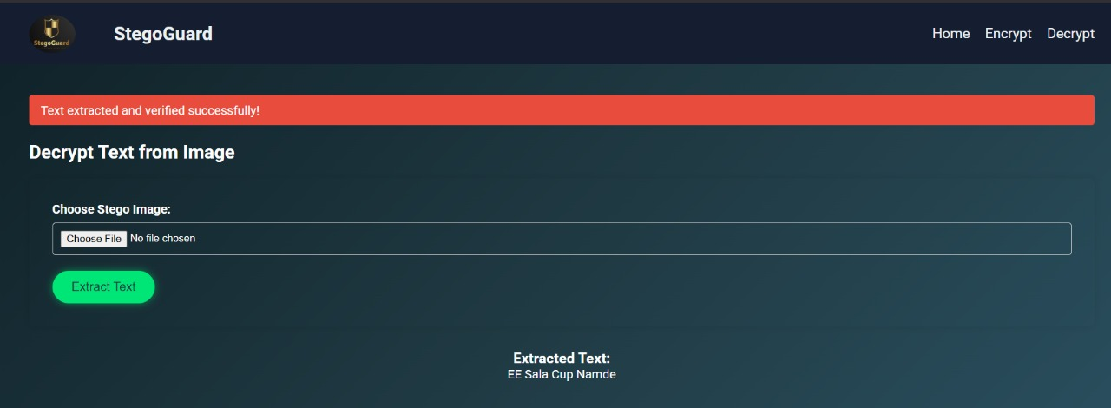
Results

Slide 8
Conclusion
This project, "Secure Data Hiding in Images Using Steganography," effectively addresses the need for confidential and tamper-proof communication by combining steganography, encryption, and digital signatures. By embedding encrypted messages within images and verifying their integrity through digital signatures, the system ensures that sensitive data remains hidden, secure, and unaltered.
The project not only enhances data confidentiality and authenticity but also provides a stealthy and untraceable communication method. With potential applications in government, cybersecurity, journalism, and financial security, this solution stands out as an innovative and future-proof approach to secure data transmission.

Slide 9
GitHub Link
https://github.com/varshini63/Steganography-app/

Slide 10
Future scope(optional)
This project has immense potential for future enhancements. It can be extended to support multiple image formats (JPG, BMP, GIF) and advanced encryption techniques (AES, RSA, ECC) for stronger security. Integration with cloud storage and blockchain can provide decentralized and tamper-proof data storage. Additionally, mobile and desktop applications can be developed for wider accessibility. AI-based steganography detection resistance and automated key management can further enhance security, making it a cutting-edge solution for secure, untraceable communication in the digital era

Slide 11
THANK YOU

