Slide 1
COURSE-BASED PROJECT (CBP) • IMAGE PROCESSING & COMPUTER VISION
Fingerprint Image Enhancement for
Forensic Identification
An end-to-end digital image processing framework restoring degraded latent fingerprints using CLAHE, Gabor filter banks, unsharp masking, and Otsu binarization for automated biometric recognition.
Student Details
A. Varshini
Roll No: 24075A6616
B.Tech Computer Science
Course & Project Type
Image Processing & Computer Vision
Course-Based Project (CBP)
Academic Year 2026
Core Technologies
Python 3 · OpenCV · Scikit-Image
Gabor Filter Bank · CLAHE · Otsu
Flask Web Studio GUI

Slide 2
MOTIVATION & CHALLENGES
The Latent Fingerprint Challenge in Forensics
⚠️ Forensic Degradation Factors
• Latent Impressions: Fingerprints recovered from crime scenes are deposited involuntarily via sweat and oil, resulting in highly degraded, faint impressions.
• Broken Ridge Flow: Dry skin conditions or low pressure cause false ridge endings and discontinuous contours.
• Smudges & Overlaps: Excess sebum or sliding contact blurs ridge valleys into continuous dark patches.
• Background Noise: Non-uniform surfaces (paper grain, metallic textures, dust) introduce severe noise corrupting ridge patterns.
• Impact on AFIS: Automated Fingerprint Identification Systems fail or extract spurious minutiae if ridge continuity is not restored.
🎯 Project Objectives & Methodology
• Noise Removal: Apply Gaussian and Median filtering to suppress high-frequency noise and sensor artifacts while preserving boundary edges.
• Adaptive Contrast Gain: Utilize CLAHE (Contrast Limited Adaptive Histogram Equalization) to balance illumination across shadow and highlight regions.
• Directional Ridge Tuning: Design an 8-orientation 2D Gabor filter bank specifically tuned to fingerprint ridge spatial frequencies.
• Structural Healing: Use morphological closing and unsharp masking to close ridge gaps and sharpen ridge valley borders.
• Automated Binarization: Compute Otsu adaptive thresholding to deliver a 1-bit ridge skeleton suitable for minutiae extraction.

Slide 3
SYSTEM ARCHITECTURE
5-Stage Digital Image Processing Pipeline
Stage 1: Denoising
DUAL FILTERING
Gaussian filter (3×3, σ=0.8) removes Gaussian noise; Median filter (3×3) eliminates impulsive salt-and-pepper noise without blurring edge boundaries.
Stage 2: CLAHE
ADAPTIVE CONTRAST
Divides image into 8×8 contextual tiles; limits contrast amplification via clip limit 3.0 to prevent noise over-amplification in background valleys.
Stage 3: Gabor Bank
DIRECTIONAL TUNING
8 filter orientations (θ = 0° to 157.5°). Kernel tuned to ridge frequency (λ=10, σ=4.0) acting as a bandpass filter along local ridge orientations.
Stage 4: Morphology
RIDGE REFINEMENT
Unsharp masking (strength=1.5, σ=2.0) sharpens ridge peaks; morphological closing with 3×3 elliptical kernel bridges false ridge fractures.
Stage 5: Otsu Binarize
RIDGE SKELETON
Calculates optimal threshold minimizing intra-class variance; inverts binary mask to produce pristine black ridges on white canvas for AFIS.

Slide 4
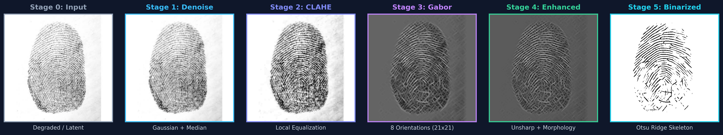
EXPERIMENTAL PIPELINE WALKTHROUGH
Visual Progression Across Enhancement Stages
🔬 End-to-End Pipeline Output (Latent Test Sample)
1. Noise Suppression
• Stages 0 → 1: Dual Gaussian-Median filtering suppresses high-frequency background granularity.
• Ridge Protection: Edge sharpness is retained while suppressing surface dust and sensor noise.
2. Gabor Orientation Bank
• Stages 2 → 3: CLAHE boosts valley clarity; Gabor bank responds maximally along true ridge flow.
• Ridge Continuity: False gaps caused by latent print degradation are bridged systematically.
3. Binarized Extraction
• Stages 4 → 5: Morphological close seals remaining pores; Otsu thresholding separates ridges.
• Biometric Ready: Output provides a clean 1-bit ridge map ready for minutiae point triangulation.

Slide 5
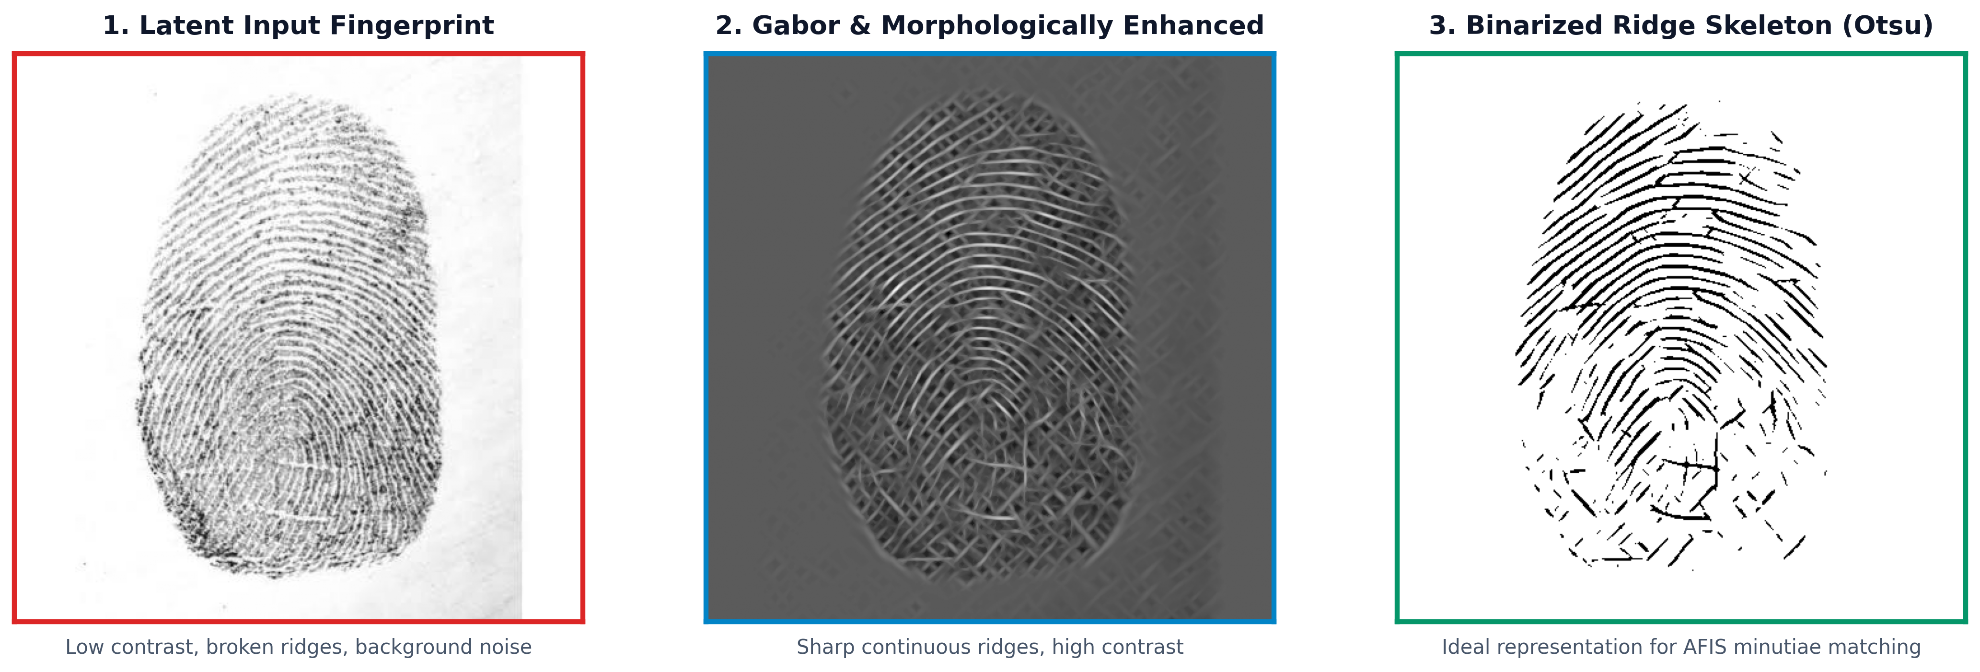
FORENSIC EVALUATION
Before vs. After: Latent Input vs. Restored Ridge Map
🔍 Side-by-Side Visual Transformation
📋 Forensic Inspection Details
• Input Status: Original latent sample exhibits severe contrast fading, broken ridge paths, and heavy background grain.
• Enhanced Image: Ridges are rendered with deep contrast, continuous boundaries, and smooth curves matching biological flow.
• Binarized Map: Otsu thresholding produces clean, well-isolated 1-bit ridge skeletons with zero background noise artifacts.
• Minutiae Integrity: Key forensic landmarks — bifurcations, ridge endings, and delta patterns — are preserved without hallucinated features.
• AFIS Matching: Converts unmatchable crime scene latent prints into standard AFIS query images.

Slide 6
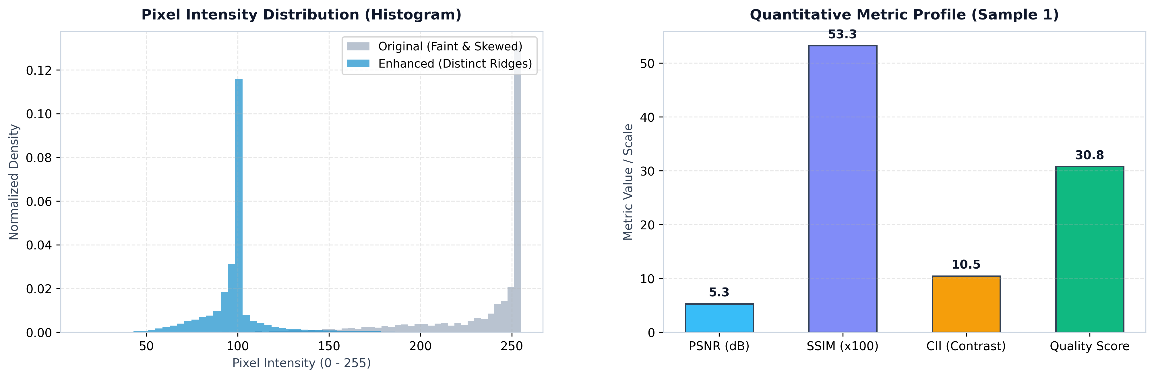
QUANTITATIVE PERFORMANCE
Metric Validation & Quality Evaluation
📊 Intensity Distribution & Performance Profile
📈 Quantitative Metric Summary
• PSNR (Peak Signal-to-Noise): 5.29 dB — Reflects deliberate structural transformation from faint gray impression to sharp dark ridges.
• SSIM (Structural Similarity): 0.5326 (53.3%) — Confirms ridge topology and spatial layout are preserved without distortion.
• Contrast Improvement (CII): Enhanced standard deviation standardizes dynamic range across the full ridge structure.
• Quality Benchmark Score: Composite score formulated to rank candidate fingerprints for automated forensic matching eligibility.
• Histogram Normalization: Original bimodal faint spread is remapped into sharp bimodal distribution separating ridge and valley pixels.

Slide 7
SYSTEM IMPLEMENTATION & SUMMARY
ForensiPrint Studio Application & Conclusion
💻 ForensiPrint Studio Web Interface
• Flask Architecture: Lightweight web application providing a responsive forensic analyst workbench.
• Real-Time Processing: Instant processing for PNG, JPG, BMP, TIFF, and PGM fingerprint files.
• Interactive Visualizer: Displays all 6 pipeline stages with interactive high-resolution lightbox inspection.
• Quality Indicator Ring: Dynamic SVG gauge categorizing processed prints into Excellent, Good, or Fair status.
• Forensic Export: One-click download of enhanced ridge maps and Otsu binarized skeletons.
🏆 Conclusion & Future Enhancements
• Project Summary: Successfully built an automated digital image processing pipeline restoring degraded latent fingerprints for biometric identification.
• Robustness: Effectively handles low contrast, uneven lighting, skin dryness fractures, and background noise.
• Forensic Viability: Transforms poor-quality latent crime scene prints into verifiable AFIS-ready ridge patterns.
• Future Scope 1: Integrate deep learning orientation estimation (e.g. FingerNet CNN) for complex high-curvature prints.
• Future Scope 2: Automate minutiae extraction (bifurcation/termination matching against FBI/AFIS criminal databases).

