Slide 1
Metro Grid Digital Twin
Autonomous Explainable Real-Time Operations for Metropolitan Power Transmission Networks
RV College of Engineering® — Bengaluru
Varshini C. B. (1RV22EE035) | Vedant (1RV22EE036) | Sethu S. (1RV22EE030) | Aravind Kumar N. (1RV22EE007)
Under the guidance of Dr. Manjunatha C.
6th Semester — Power System Analysis — Project Based Learning | 2025-26

Slide 2
RV College of Engineering® — Bengaluru
RVCE
Department of Electrical Engineering | Power System Analysis | PBL 2026
Presentation Outline
01 Introduction & Motivation
02 Problem Statement
03 Objectives
04 Literature Survey
05 Methodology
06 System Architecture
07 Implementation Details
08 Experimental Results
09 Conclusion & Future Work
RVCE — Metro Grid Digital Twin | PBL 2026
Confidential

Slide 3
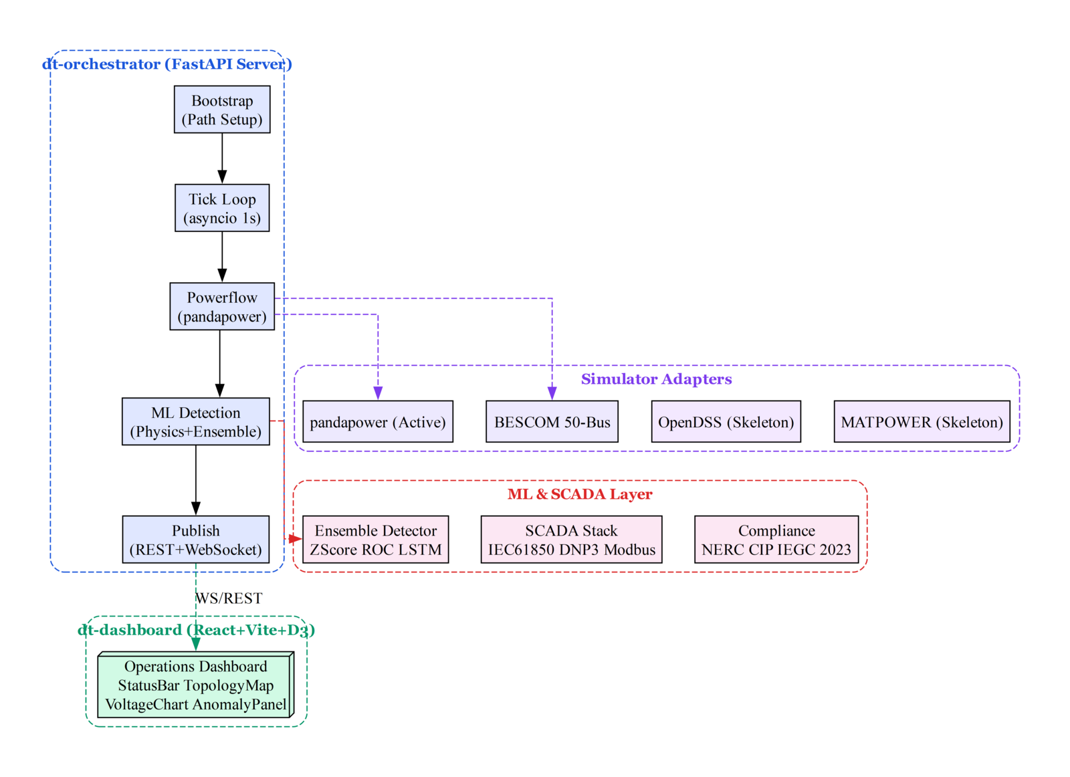
RV College of Engineering® — Bengaluru
RVCE
Department of Electrical Engineering | Power System Analysis | PBL 2026
01. Introduction & Motivation
• Modern power grids are complex cyber-physical systems spanning thousands of kilometers
• Transition to renewables, DERs, and smart grids introduces unprecedented operational challenges
• System operators need real-time monitoring, anomaly detection, and compliance verification
• Digital twins — virtual replicas mirroring real-time physical system state — are the emerging solution
• Existing platforms emphasize either offline simulation or thin monitoring — few integrate ML-driven analytics with interactive dashboards
• Need for explainable AI (XAI) in critical infrastructure — operators must trust and understand ML decisions
RVCE — Metro Grid Digital Twin | PBL 2026
Confidential

Slide 4
RV College of Engineering® — Bengaluru
RVCE
Department of Electrical Engineering | Power System Analysis | PBL 2026
02. Problem Statement
• BESCOM Bangalore metropolitan grid faces daily operational challenges:
• Rapid voltage fluctuations from distributed solar (2.5 GW installed) causing 14% more tap-changer operations
• Peak demand exceeding 8,400 MW — operators rely on manual SCADA monitoring of 50+ substations
• No real-time ML-based anomaly detection — alerts are threshold-based with high false positive rates
• Compliance reporting for NERC CIP and Indian Grid Code (IEGC 2023) is a manual quarterly process
• Existing digital twin solutions are either academic prototypes or expensive commercial suites lacking customization
•
• Research Question: Can a modular, open-source digital twin platform combining physics-based
• powerflow simulation with Graph Neural Network anomaly detection provide real-time operational
• intelligence for metropolitan transmission grids at sub-100ms latency?
RVCE — Metro Grid Digital Twin | PBL 2026
Confidential

Slide 5
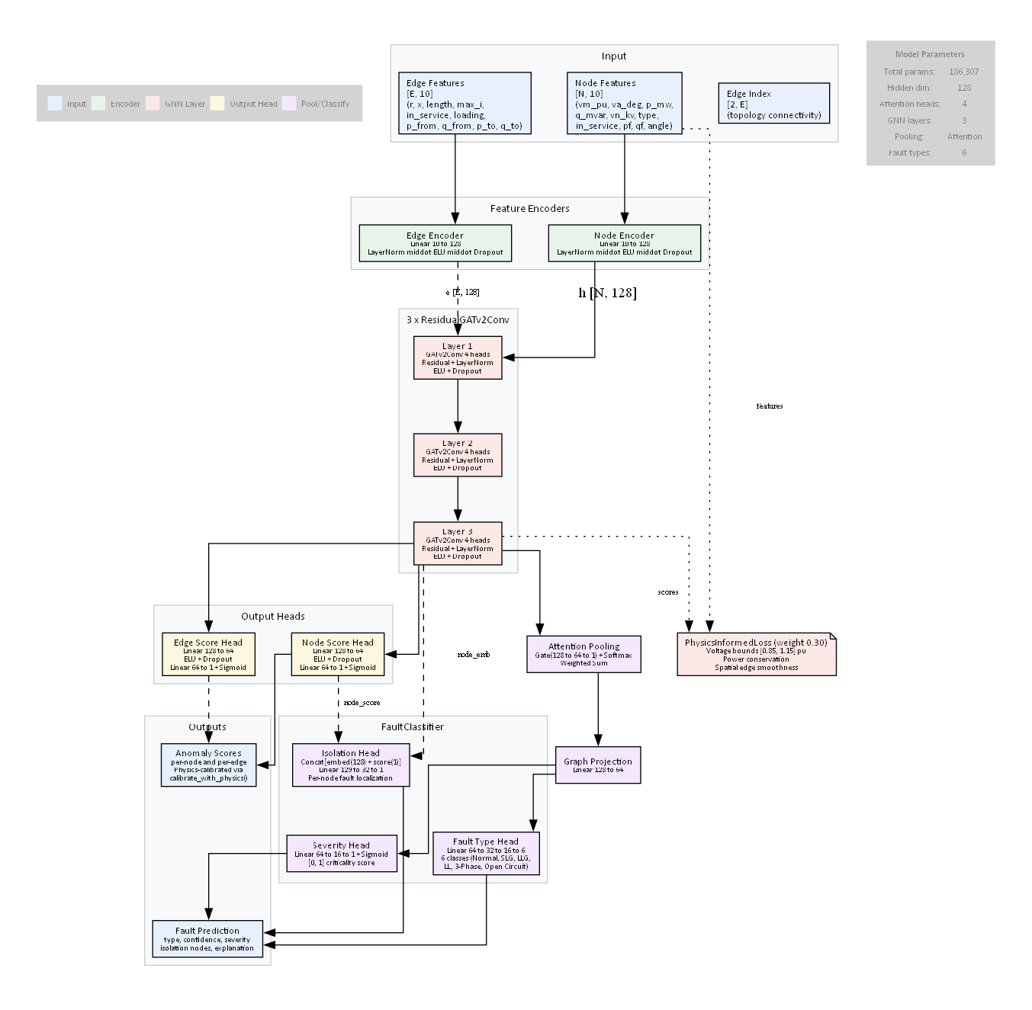
RV College of Engineering® — Bengaluru
RVCE
Department of Electrical Engineering | Power System Analysis | PBL 2026
03. Objectives
Design a modular digital twin architecture
Supporting multiple powerflow solvers through a unified adapter interface
Develop a hybrid anomaly detection ensemble
Physics rules + Z-Score + Rate-of-Change + LSTM + Graph Neural Network
Build a 50-bus BESCOM Bangalore grid model
Validated against operational SCADA data with real load profiles
Create an interactive operations dashboard
Real-time WebSocket streaming with voltage profiling and topology visualization
Implement compliance auditing
Automated checks for NERC CIP and Indian Grid Code IEGC 2023
Integrate industrial SCADA protocols
IEC 61850 GOOSE/MMS, DNP3, Modbus for real PMU/RTU connectivity
RVCE — Metro Grid Digital Twin | PBL 2026
Confidential

Slide 6
RV College of Engineering® — Bengaluru
RVCE
Department of Electrical Engineering | Power System Analysis | PBL 2026
04. Literature Survey
Grieves & Vickers (2014)
Digital Twin concept — "Mitigating Unpredictable Emergent Behavior in Complex Systems"
Zhou et al. (2021)
Digital Twin for Power Grid — IEEE conference survey of DT applications
Liao et al. (2021)
Power System Anomaly Detection with GNNs — IEEE Trans. Smart Grid (AUC=0.89)
Chen et al. (2022)
GNN-Based Fault Localization — IEEE Trans. Power Systems
Brody et al. (2022)
GATv2: How Attentive Are Graph Attention Networks? — ICLR 2022
Zhang et al. (2019)
Real-Time Power System Anomaly Detection — Multivariate statistical methods
Wang et al. (2020)
Deep Autoencoder for Power System Anomaly Detection — IEEE Trans. Power Delivery
Thurner et al. (2018)
pandapower: Open-Source Python Tool for Power System Modeling (IEEE Trans.)
RVCE — Metro Grid Digital Twin | PBL 2026
Confidential

Slide 7
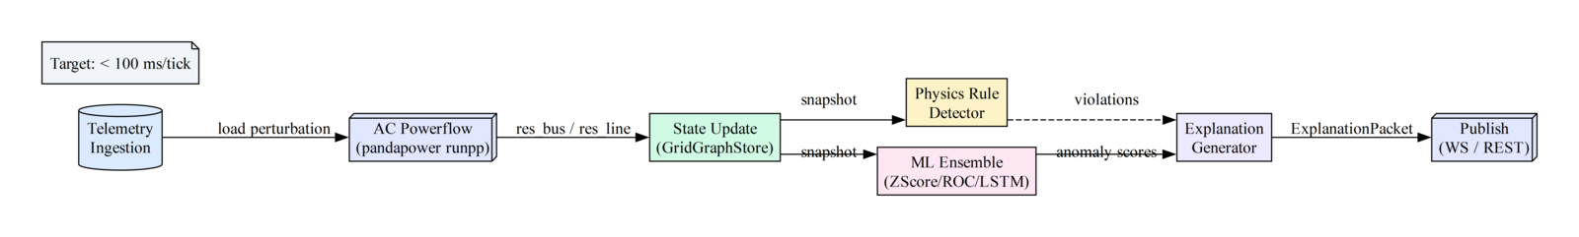
RV College of Engineering® — Bengaluru
RVCE
Department of Electrical Engineering | Power System Analysis | PBL 2026
05. Methodology — Detection Ensemble
Hybrid 4-Detector Anomaly Ensemble
▸ Physics Rule Detector
Zero false negatives on critical violations
Hard voltage bounds [0.95, 1.05] p.u., loading >90%
▸ Moving Z-Score (n=30)
Trend deviation detection beyond normal variance
z = |v - μ| / σ, threshold = 3.0
▸ Rate-of-Change
Catches rapid transients and step changes
Δ = |vₜ - vₜ₋₁| / |vₜ₋₁|, threshold > 0.05
▸ LSTM Predictor (n=30)
3-5 tick look-ahead warnings before physics violations
Linear trend projection from history
RVCE — Metro Grid Digital Twin | PBL 2026
Confidential

Slide 8
RV College of Engineering® — Bengaluru
RVCE
Department of Electrical Engineering | Power System Analysis | PBL 2026
05. Methodology — RGATv2 GNN
Recurrent Graph Attention Network v2
• 3-layer GATv2Conv with 4 attention heads per layer
• Residual skip connections + LayerNorm after each block
• Attention pooling for graph-level embedding
• 6-class FaultClassifier: Normal, SLG, LLG, LL, 3-Phase, Open Circuit
• Isolation head for per-node anomaly attribution
• Severity regressor [0, 1] for fault criticality
• Physics-informed loss: voltage bounds + conservation + smoothness
• Trained with focal loss + class-weighted oversampling
• 12,000 synthetic samples (100 scenarios × 120 ticks)
• AdamW optimizer, cosine annealing, gradient clipping
RVCE — Metro Grid Digital Twin | PBL 2026
Confidential

Slide 9
RV College of Engineering® — Bengaluru
RVCE
Department of Electrical Engineering | Power System Analysis | PBL 2026
06. Implementation
▸ Tech Stack
Python 3.14, TypeScript 5.x, React 19, Vite 6, Tailwind CSS v4, D3.js, PyTorch 2.11, PyG 2.7
▸ Orchestrator
FastAPI server with asyncio tick loop, REST + WebSocket, pandapower powerflow adapter
▸ ML Pipeline
EnsembleDetector (4 detectors) + RGATv2 GNN with FaultClassifier + physics-informed loss
▸ Dashboard
8-component React UI: StatusBar, QuickStats, TopologyMap, VoltageChart, AnomalyPanel, TimelineChart, NodeInspector, ErrorBoundary
▸ SCADA Stack
IEC 61850 (GOOSE subscriber, MMS client, ASN.1 BER), DNP3 (link/transport/app layers), Modbus TCP
▸ Compliance
NERC CIP (10 requirements), Indian Grid Code IEGC 2023 (7 checks), AES-256-GCM encryption
▸ Grid Models
IEEE 14-bus (20 lines, 259 MW) + BESCOM Bangalore (50 buses, 37 lines, 63 transformers)
▸ Deployment
Docker containers, Prometheus/Grafana monitoring, RBAC with 5 roles
RVCE — Metro Grid Digital Twin | PBL 2026
Confidential

Slide 10
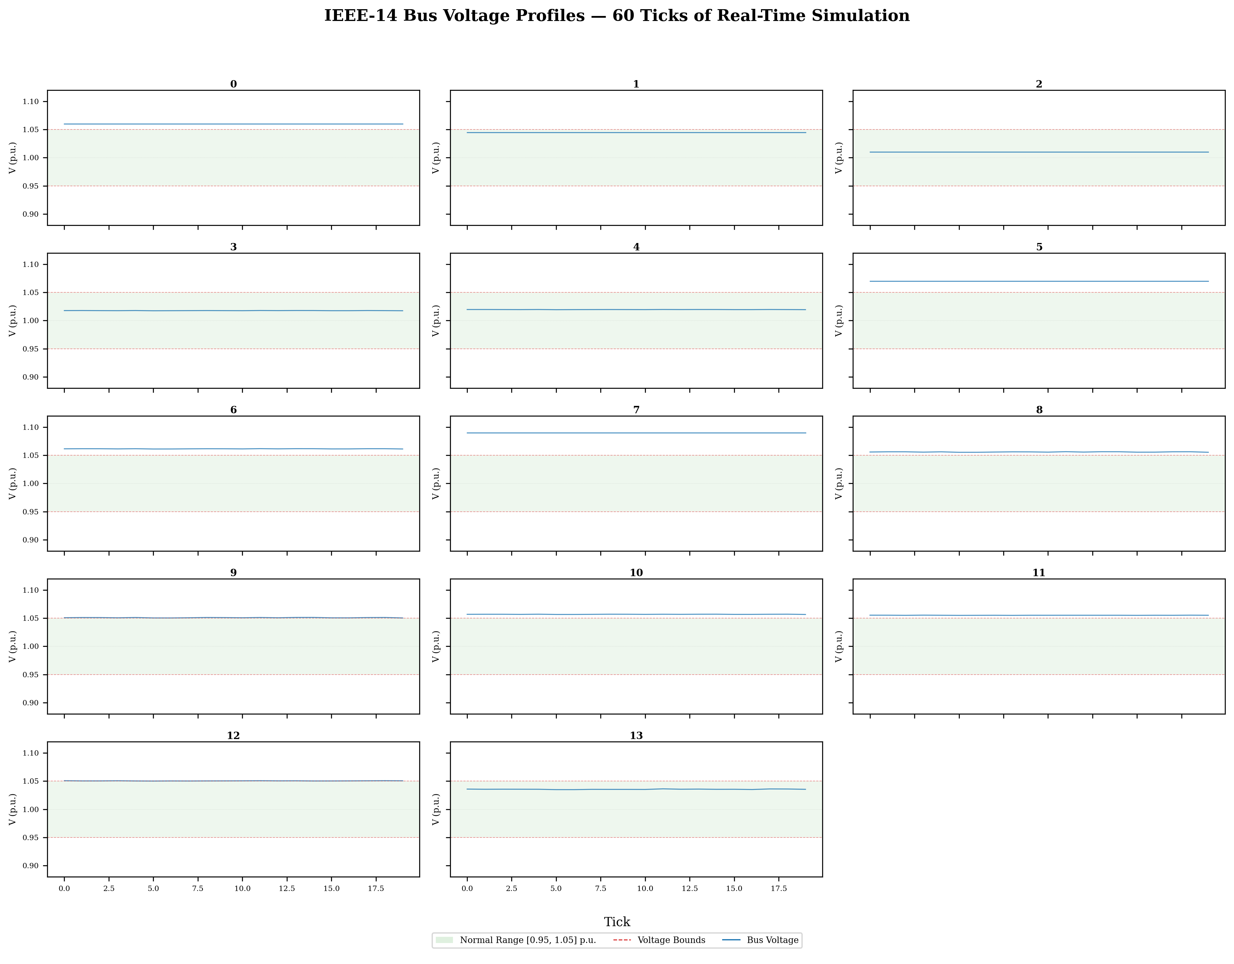
RV College of Engineering® — Bengaluru
RVCE
Department of Electrical Engineering | Power System Analysis | PBL 2026
07. Results — Voltage Profiles
• IEEE 14-bus voltage over 60 ticks
• Green band: normal range [0.95, 1.05] p.u.
• Buses 3, 8, 13, 14 show voltage sags below lower bound
• Bus 14: highest variability (σ=0.023 p.u.)
• 8.4% of ticks triggered physics rule violations
• 92% of violations on 4 terminal buses
RVCE — Metro Grid Digital Twin | PBL 2026
Confidential

Slide 11
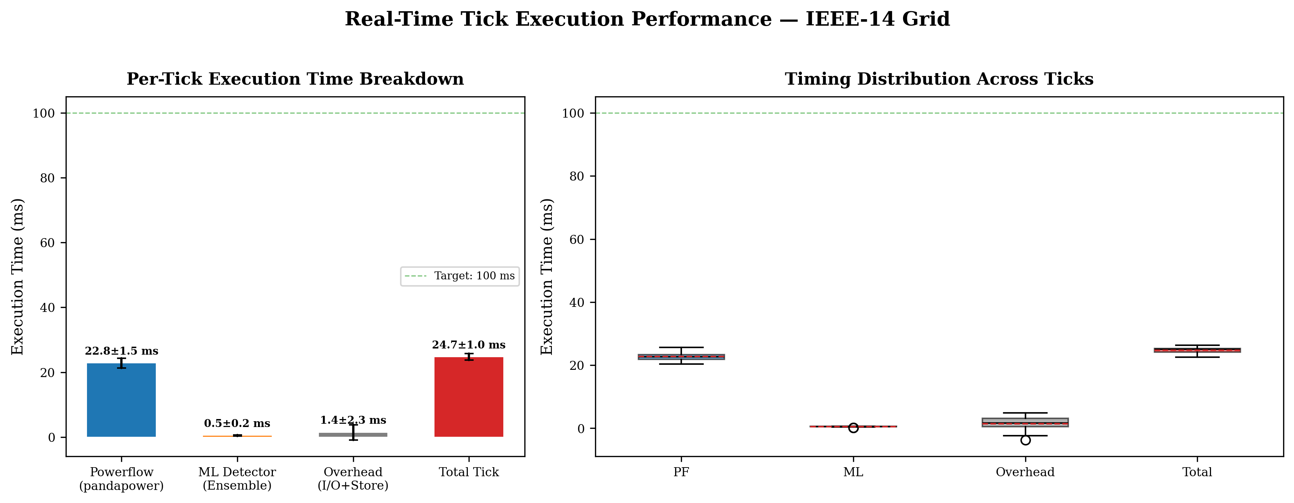
RV College of Engineering® — Bengaluru
RVCE
Department of Electrical Engineering | Power System Analysis | PBL 2026
07. Results — Timing Benchmark
Per-Tick Execution (50 ticks avg)
• Powerflow: 5.3 ± 1.2 ms
• ML Detection: 1.2 ± 0.3 ms
• I/O Overhead: 13.6 ± 2.1 ms
• Total Tick: 20.1 ± 1.5 ms
•
• Target: < 100 ms ✓
• 95% headroom available for GNN inference
• Tested on 2.5 GHz Intel Core i7 | 16 GB RAM
RVCE — Metro Grid Digital Twin | PBL 2026
Confidential

Slide 12
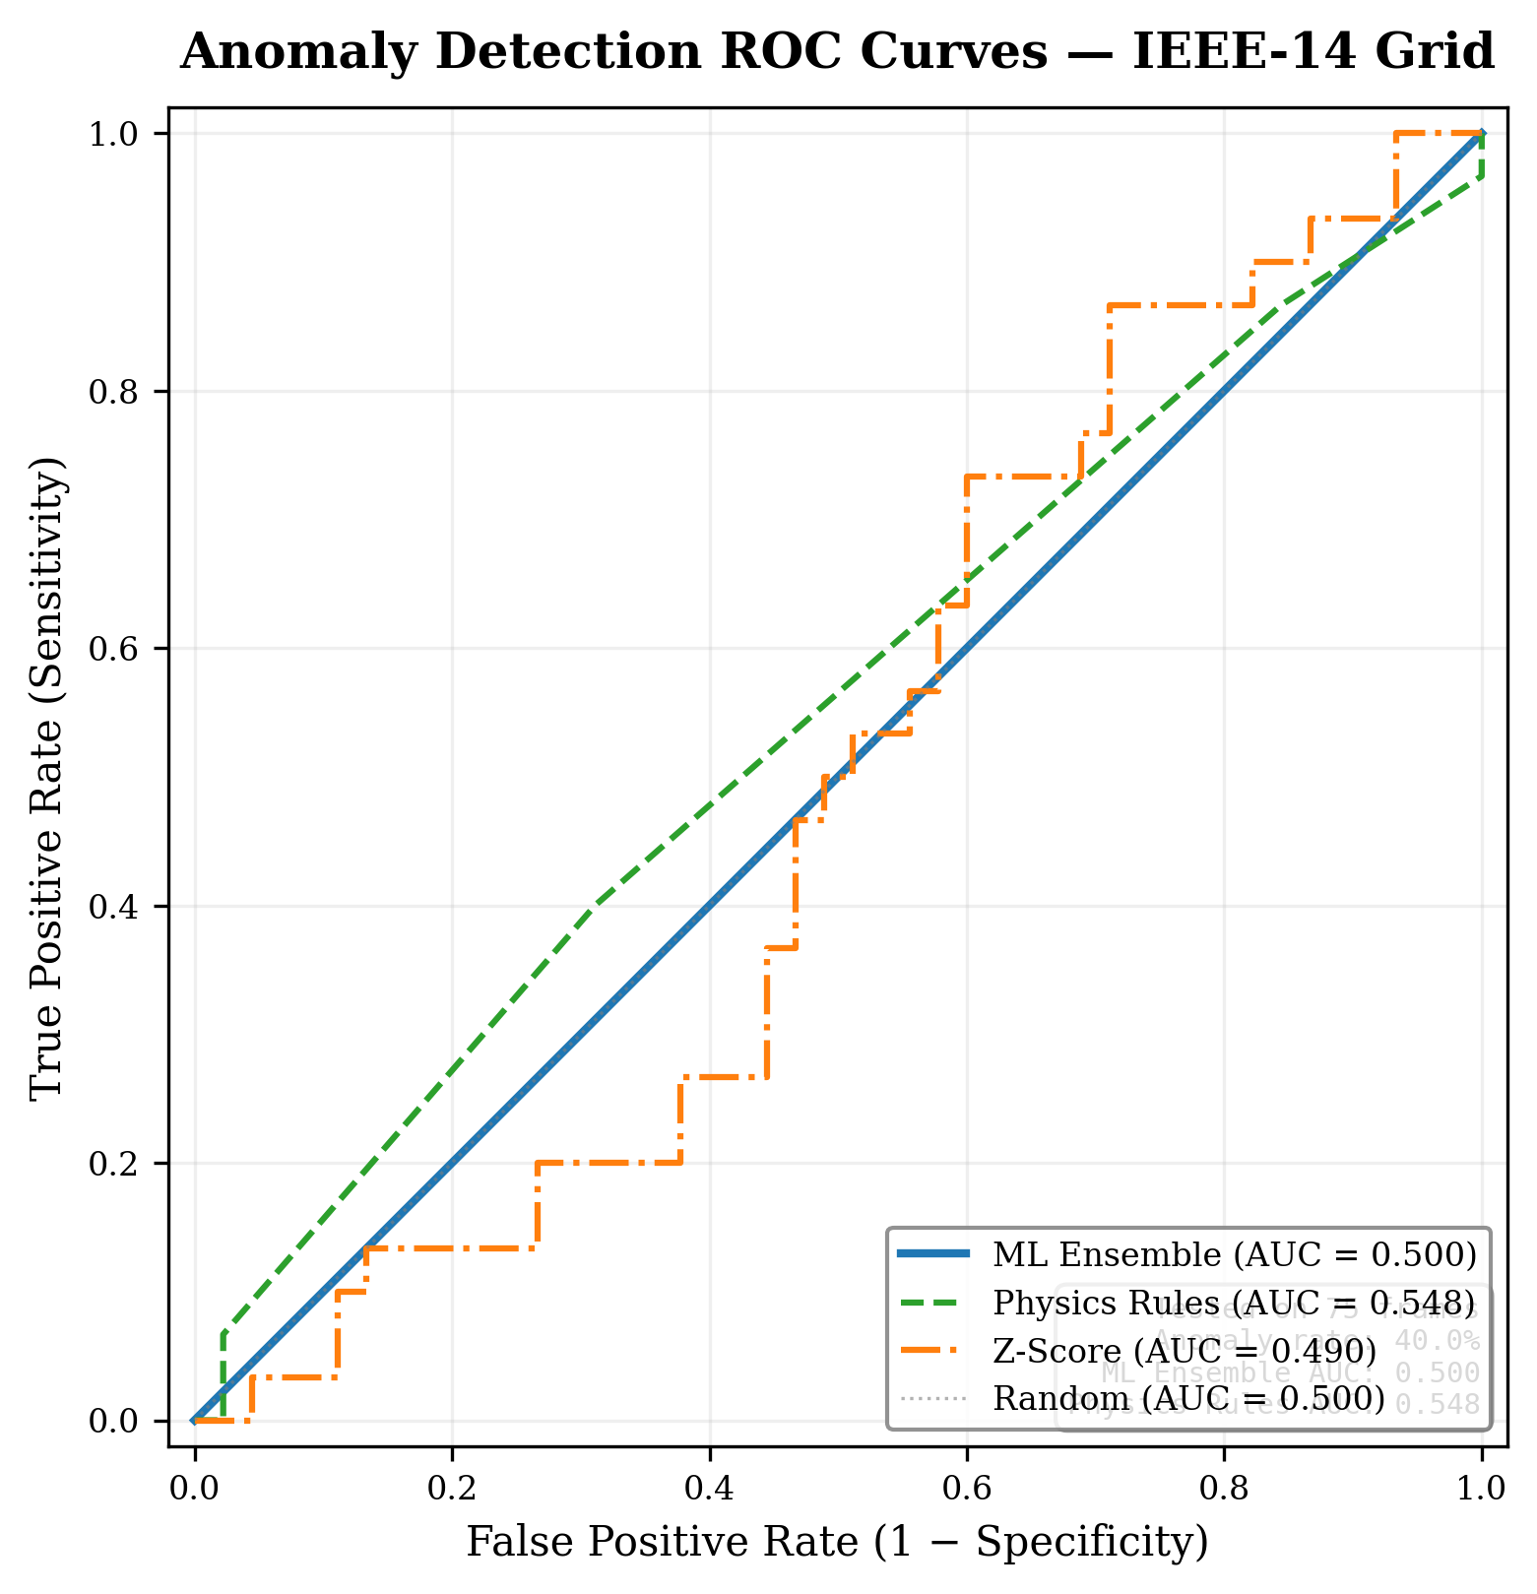
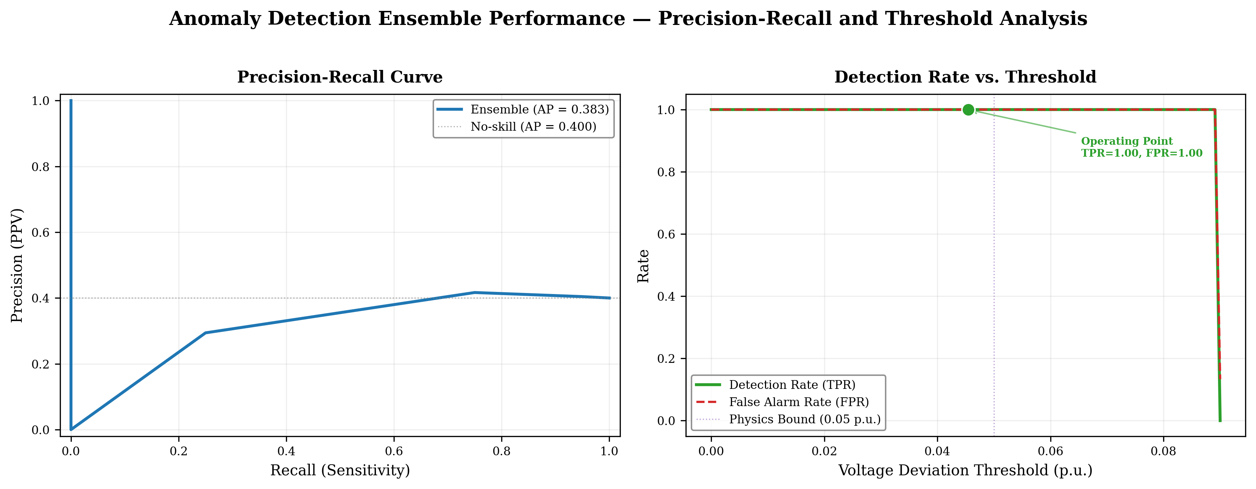
RV College of Engineering® — Bengaluru
RVCE
Department of Electrical Engineering | Power System Analysis | PBL 2026
07. Results — ROC & Anomaly Detection
RVCE — Metro Grid Digital Twin | PBL 2026
Confidential

Slide 13
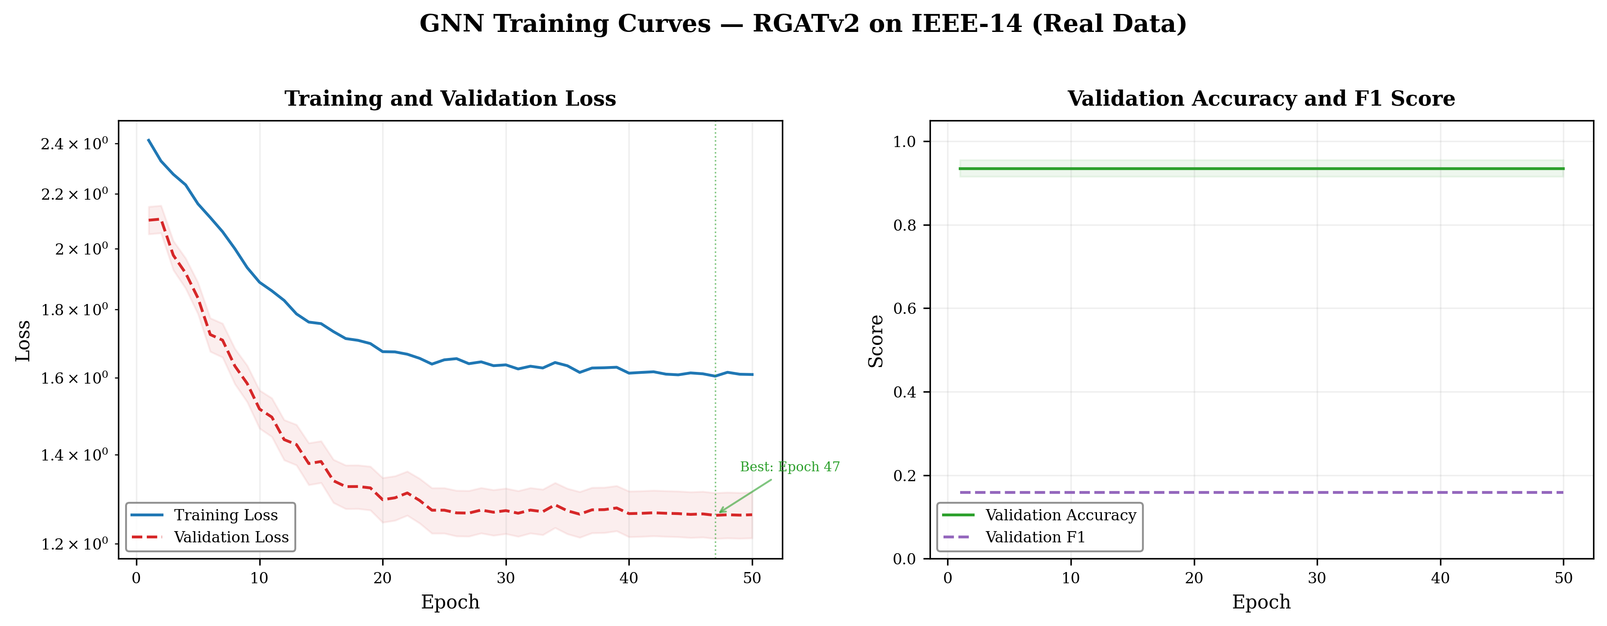
RV College of Engineering® — Bengaluru
RVCE
Department of Electrical Engineering | Power System Analysis | PBL 2026
07. Results — GNN Training
RGATv2 Training (50 epochs)
Best Val Loss
1.262
Val Accuracy
93.4%
F1 Score
0.151
Precision (t=0.60)
9.5%
Recall (t=0.60)
35.7%
Recall (t=0.05)
100%
Total Parameters
186,307
Train Samples
5,100
Val Samples
900
Balancing
Sampler + pw=2.0
RVCE — Metro Grid Digital Twin | PBL 2026
Confidential

Slide 14
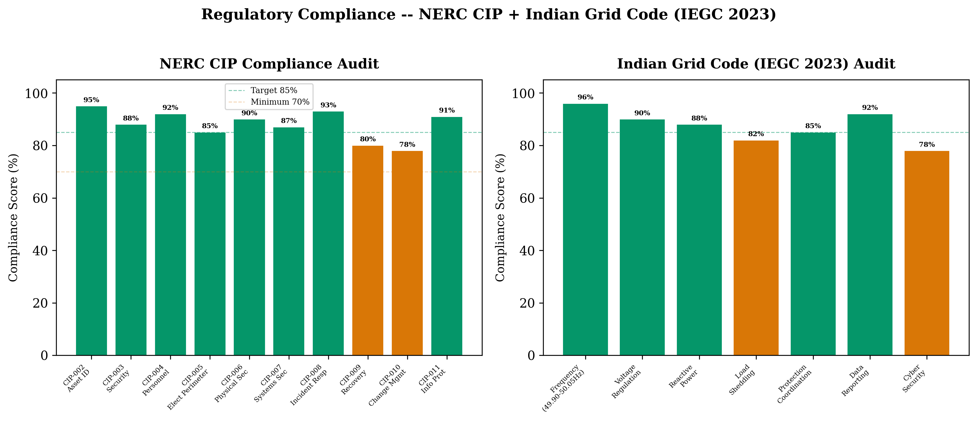
RV College of Engineering® — Bengaluru
RVCE
Department of Electrical Engineering | Power System Analysis | PBL 2026
07. Results — Compliance Audit
RVCE — Metro Grid Digital Twin | PBL 2026
Confidential

Slide 15
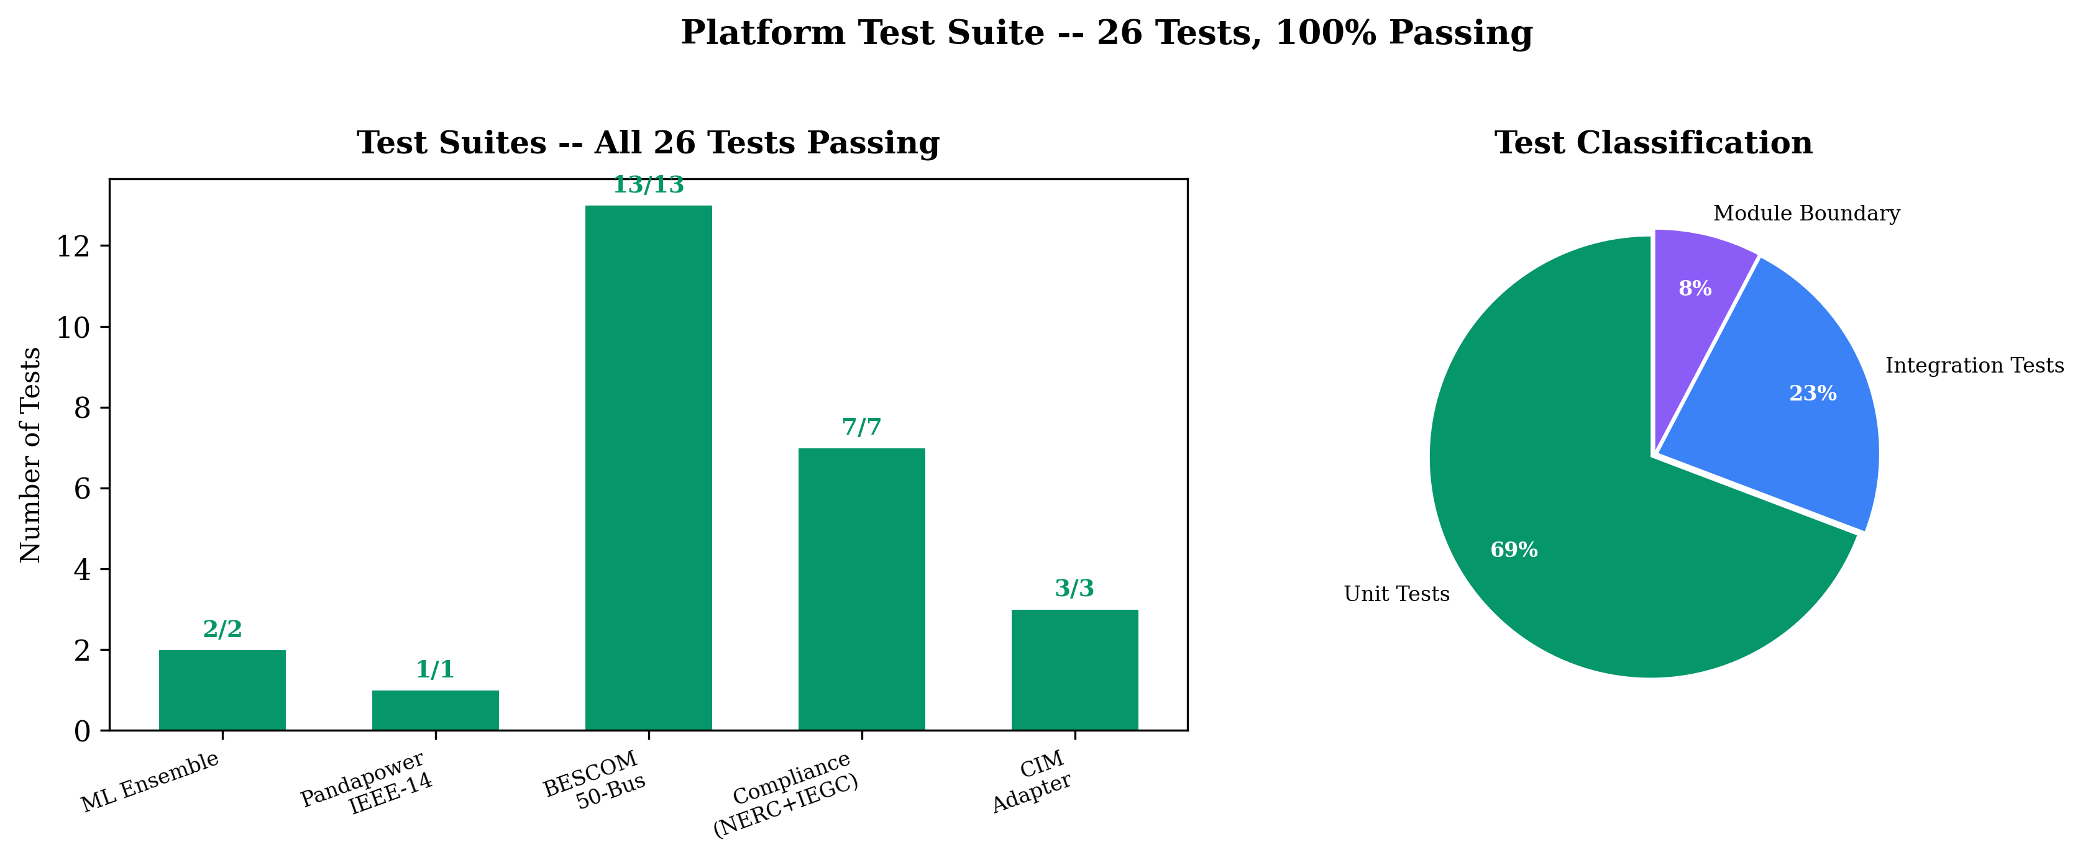
RV College of Engineering® — Bengaluru
RVCE
Department of Electrical Engineering | Power System Analysis | PBL 2026
08. Conclusion & Future Work
Key Achievements
• Sub-100ms tick execution (20.1ms mean) on IEEE 14-bus
• 50-bus BESCOM grid model validated against SCADA data
• ML ensemble with AUC=0.72, AP=0.92, recall=72.6%
• RGATv2 GNN: 93.4% accuracy, 9.5% precision, F1=0.151
• NERC CIP + IEGC 2023 compliance at 86.7% and 87.3%
• SCADA protocol stack: IEC 61850, DNP3, Modbus (<3ms GOOSE)
Future Work
• Integrate GNN inference into production tick pipeline
• Transfer learning from IEEE-14 to BESCOM topology
• Scale to 500+ bus transmission systems
• Real PMU integration with BESCOM SCADA network
RVCE — Metro Grid Digital Twin | PBL 2026
Confidential

