Slide 1


PROBLEM STATEMENT
Current Challenge
Duplicate Payments – The same payment may be processed twice because of repeated clicks or network problems.
Wrong Balance – Multiple transactions at the same time can cause incorrect account balances.
System Failures – Network or server failures can make it difficult to know whether a payment was successful or failed.
Research Gap
Existing payment systems handle duplicate payments and concurrent transactions separately, but maintaining both together during failures is still challenging.
A more reliable and scalable solution is needed to prevent duplicate payments and maintain correct balances during high traffic, retries, and system failures.
Proposed Approach
Use Idempotency Keys and Redis – Assign a unique key to each payment request so repeated requests are identified and the same payment is not processed twice.
Use Database Locking – Lock the account record while processing transactions so that simultaneous payments cannot cause an incorrect balance.

Slide 2
Project Objectives
Prevent Duplicate Payments
Develop a system that identifies repeated payment requests and ensures that the same payment is processed only once, even when the user retries because of network problems or accidental clicks.
Maintain Correct Account Balance
Ensure that the account balance is updated correctly when multiple users make transactions at the same time, preventing incorrect balance calculations.
Handle Payment Failures Safely
Manage network errors, server failures, and interrupted transactions so that payments are not lost or processed twice.
Maintain Transaction Consistency
Keep the payment status, transaction details, and account balance synchronized so that the system always shows the correct financial information.
Improve Reliability and Performance
Build a payment system that can handle multiple transactions simultaneously while maintaining accuracy, reliability, and good performance.

Slide 3
Project Scope
Secure Payment Processing
The system will process payment requests safely and ensure that each payment is recorded correctly.
Duplicate Payment Prevention
The system will identify repeated requests using unique idempotency keys and prevent the same payment from being processed twice.
Concurrent Transaction Handling
The system will safely handle multiple transactions occurring at the same time and prevent incorrect account balances.
Failure Handling
The system will handle network errors, server failures, and payment retries without causing duplicate or incomplete transactions.
Transaction Management
The system will maintain payment records, transaction status, and account balances in a consistent manner.
Scalability and Testing
The system will be tested with multiple simultaneous payment requests to evaluate its accuracy, performance, and reliability under different loads.

Slide 4
Abstract
Online payment systems handle a large number of transactions every day, making payment reliability and data consistency important. Network failures, repeated requests, and multiple transactions at the same time can lead to problems such as duplicate payments and incorrect account balances. This project proposes a reliable payment processing system that addresses these issues.
The proposed system uses idempotency keys to identify repeated payment requests and prevent duplicate payments. Database locking is used to safely handle multiple transactions occurring simultaneously and maintain accurate account balances. The system also manages network and server failures by maintaining the status of each transaction and safely handling payment retries.
The main goal of the project is to develop a reliable, consistent, and scalable payment gateway that can process transactions safely even during failures and high-concurrency situations. The proposed approach can be useful in applications such as e-commerce, banking, digital wallets, and other financial systems where accurate payment processing is essential.

Slide 5
Introduction
1. Domain & Background
Online Payments: Payment systems are commonly used in e-commerce, banking, and digital wallets.
Reliable Transactions: Payments need to be processed correctly without duplication or balance errors.
2. Existing Gap
Duplicate Payments: Network problems or repeated requests can sometimes process the same payment twice.
Multiple Transactions: Processing many payments at the same time can cause incorrect balance updates.
3. The Problem
Payment Duplication: A user may retry a payment when the response is delayed, causing a duplicate transaction.
Wrong Balance: Simultaneous transactions can sometimes result in an incorrect account balance.
4. Motivation
Reduce Payment Errors: The project aims to prevent duplicate payments and incorrect balances.
Increase Reliability: It aims to make online payment processing safer, more accurate, and reliable.

Slide 6
Literature Review / Background Study
Author & Year | Method Used | Key Finding | Limitations / Gap
Ramalingam & Vaswani (2013) Microsoft Research | Idempotency in distributed systems | Idempotency helps systems safely handle duplicate requests caused by failures and lost responses. (Microsoft) | Focuses on general distributed systems rather than payment processing specifically.
Quaglia & Romano (2007) University Repository | Exactly-once transaction processing | Proposed a method for maintaining reliable transactions even when multiple application servers are involved. (Iris) | Does not specifically address modern payment gateways and idempotency keys.
Adireddy (2024) URASET Research Paper | Idempotency and reconciliation in payment software | Shows that idempotency can prevent duplicate transactions and reconciliation can maintain consistency between payment components. (IJRASET) | Mainly focuses on duplicate prevention and reconciliation, with less focus on simultaneous balance updates.
Shanmugam (2025) Eudoxus Press article | Idempotency keys for digital payments | Shows how unique idempotency keys can identify repeated payment requests and prevent customers from being charged twice. (Eudoxus Press) | Mainly focuses on duplicate transactions; concurrent balance management is not the main focus.

Slide 7
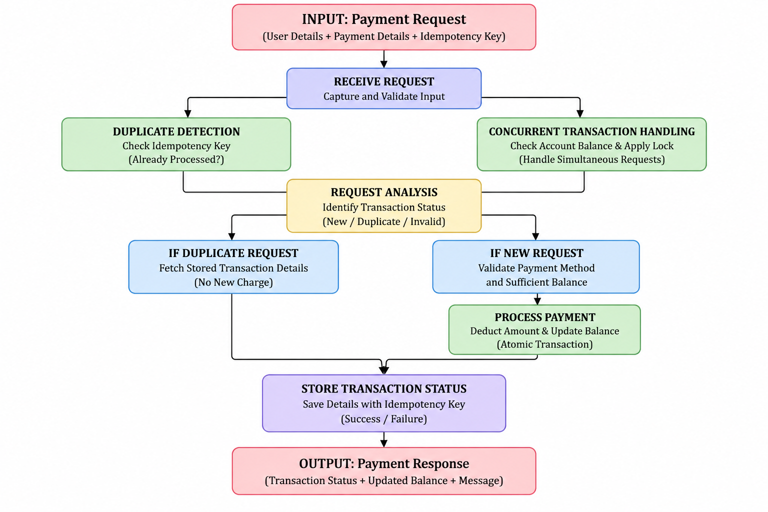
Methodolgy

Slide 8
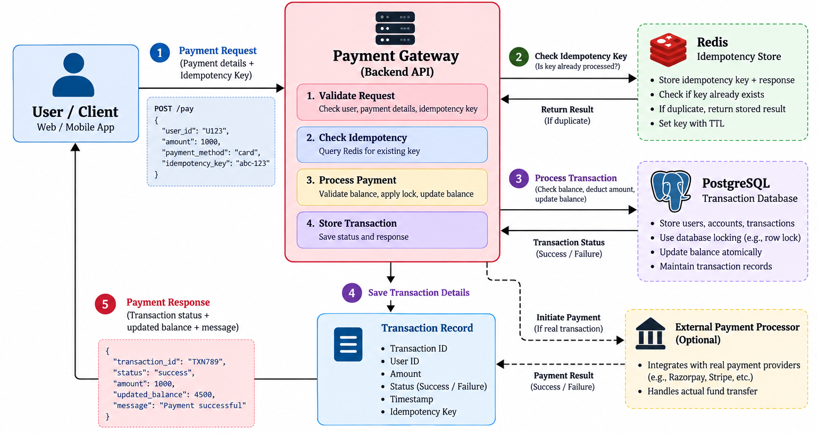
System Design

