Slide 1
SECURECORP
Cybersecurity Assessment Capstone
Junior Cybersecurity Consultant — Final Presentation

Slide 2
1. Executive Summary
Controlled lab assessment covering discovery, application security, monitoring and risk.
Nmap confirmed a broad legacy attack surface.
DVWA access and Wazuh Cloud agent enrollment were verified.
No unsupported exploitation or compromise is claimed.

Slide 3
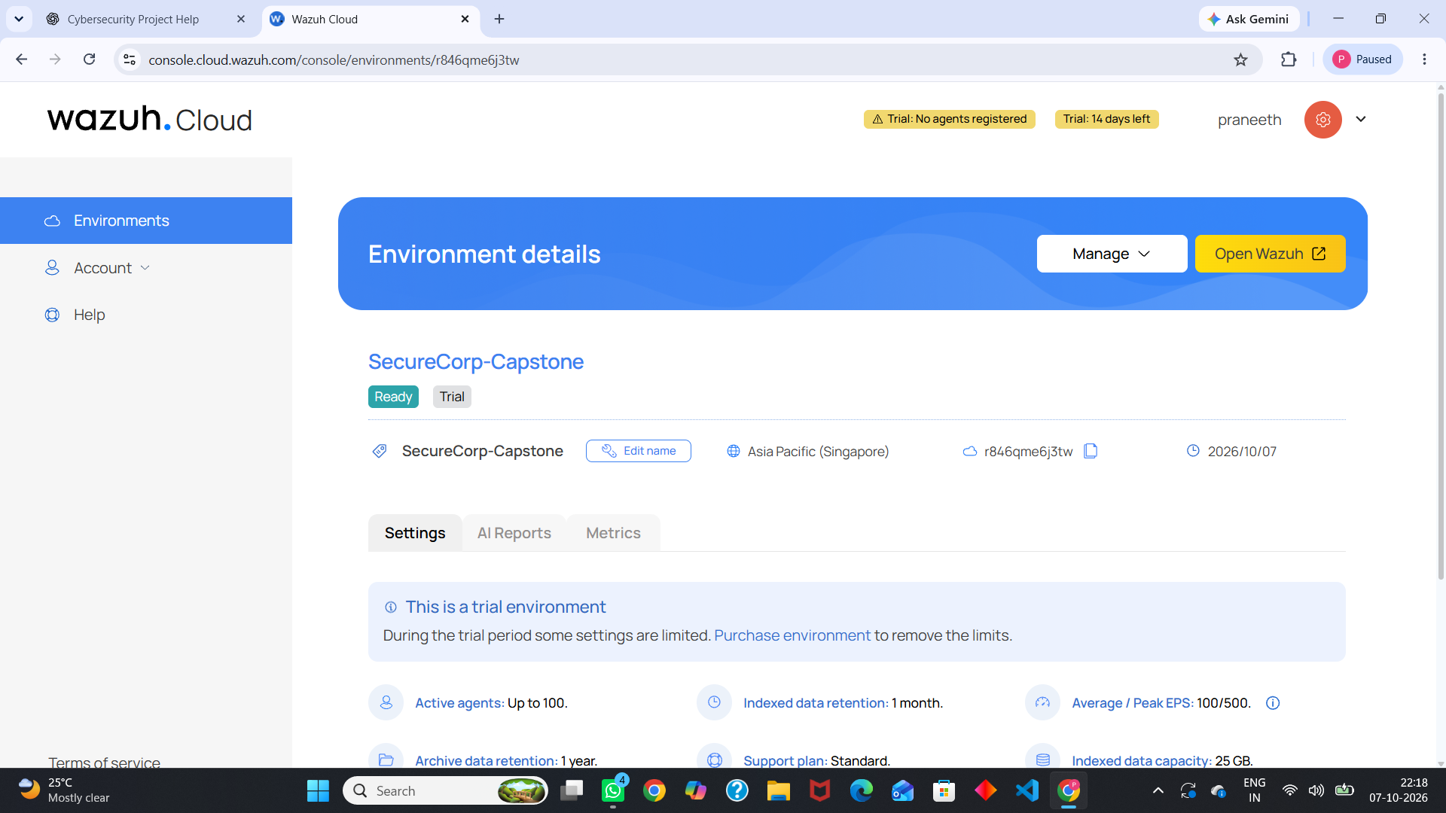
2. Lab Architecture
Attacker/analyst: Ubuntu WSL 26.04
Target: Metasploitable2 + DVWA
Monitoring: Wazuh Cloud
Verified Wazuh agent: SecureCorp-WSL on WSL Ubuntu
Target-side Wazuh telemetry was not established.
Wazuh Cloud environment

Slide 4
3. Asset & CIA Assessment
Primary assets: target VM, DVWA, WSL analyst, Wazuh Cloud, lab network and evidence.
Confidentiality and integrity are high for critical assets.
Availability is high for core systems and medium for supporting evidence.

Slide 5
4. Nmap Discovery
17 exposed services were identified in the recorded scan.
Key examples: FTP 21, SSH 22, Telnet 23, HTTP 80.
High-risk legacy exposure includes Samba, NFS, MySQL, PostgreSQL, VNC and X11.
MySQL 3306 was exposed to the attacker network.

Slide 6
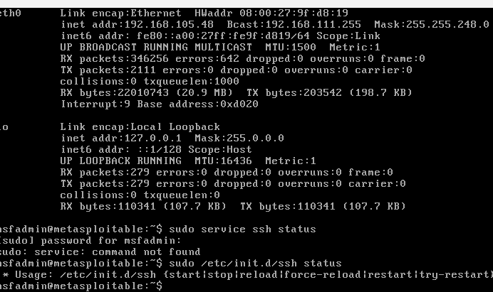
5. DVWA Application Testing
DVWA access was successfully verified.
Required modules: Brute Force, SQL Injection, XSS and Command Injection.
Successful exploitation was not claimed without evidence.
This keeps the report technically defensible.
Lab/target evidence

Slide 7
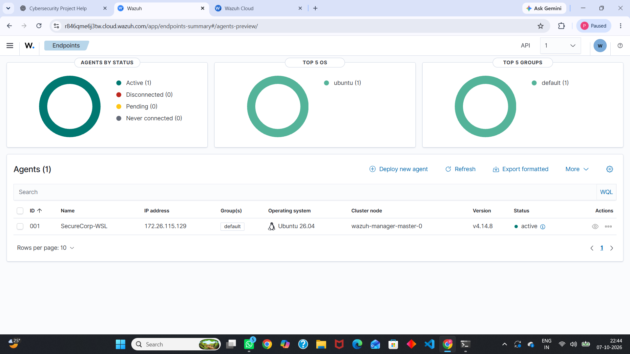
6. Wazuh Monitoring
SecureCorp-Capstone Wazuh environment created.
Linux agent deployed successfully.
Dashboard showed SecureCorp-WSL as Active.
Local agent state reported connected.
Target-side attack detection remains not visible in captured evidence.
Active agent evidence

Slide 8
7. Risk Assessment
Critical: command injection risk in vulnerable web applications.
High: legacy exposed services and authentication surfaces.
High: exposed database services.
High: remote administration services such as Telnet/VNC/X11.
High: insufficient target-side monitoring.

Slide 9
8. Key Recommendations
Restrict inbound services with firewall/network segmentation.
Remove or isolate Telnet, VNC, X11 and unnecessary FTP/RPC/NFS.
Patch/replace obsolete software.
Use strong passwords, lockout/rate limiting and MFA where supported.
Install target-side Wazuh and ingest Linux + Apache/DVWA logs.

Slide 10
9. Incident & Detection Conclusion
No confirmed compromise is asserted.
Automatic detection is claimed only when an actual alert is evidenced.
Target-side telemetry must be established before claiming Week 2 attack detection.
Replay attacks with timestamps, source IP, evidence and Wazuh rule references.

Slide 11
10. Final Deliverables
PDF final assessment report
DOCX editable report
PowerPoint presentation
Evidence screenshots embedded in the report
Evidence-based status: completed items are verified; missing practical evidence is explicitly marked Not Verified.

