Slide 1

A Project f Meeting on Healthcare Domain
By
Name B. Sai Saranya roll 2520030258
Name G. Varshini roll 2520030017
Team Number: 10
Under the guidance of
Dr. Narisetty Nirmalajyothi
Associate Professor
Department of Computer Science and Engineering
Koneru Lakshmaiah Education Foundation (Deemed to be University estd. u/s. 3 of the UGC Act, 1956) Off-Campus: Bachupally - Gandimaisamma Road, Bowrampet, Hyderabad, Telangana - 500 043. Phone No: 7815926816, www.klh.edu.in

Slide 2
Outline of the Presentation
Abstract
Introduction
Problem Statement
Project Flow Diagram
Objectives with Justification
Modules[Frontend web pages]
Expected Outcomes of the Proposed Work
Conclusion
References

Slide 3
Abstract
The healthcare domain is undergoing rapid digital transformation aimed at improving the quality, accessibility, and efficiency of medical services. One of the key advancements in this domain is the integration of Patient Registration Systems and Electronic Medical Record (EMR) portals, which streamline administrative and clinical workflows while enhancing patient care. The Patient Registration System serves as the initial point of interaction between patients and healthcare providers. It captures essential demographic details, medical history, insurance information, and contact data, ensuring accurate identification and reducing redundancy. The EMR portal is a centralized digital platform that stores and manages patients’ medical records in real time. Together, Patient Registration and EMR systems contribute to improved data accuracy, enhanced patient safety, reduced paperwork, and compliance with healthcare regulations. They also enable data analytics for population health management and support telemedicine and remote care services. As healthcare continues to evolve, these digital solutions play a critical role in delivering efficient, patient-centered care.

Slide 4
Introduction
The healthcare industry is rapidly adopting digital technologies to improve patient care, streamline administrative processes, and enhance data management. Traditional paper-based systems for patient registration and medical record maintenance are often time-consuming, prone to errors, and difficult to access when needed. These challenges can lead to delays in treatment, inefficient workflows, and reduced quality of healthcare services.
A Patient Registration System and Electronic Medical Report (EMR) Portal is designed to address these issues by providing a centralized digital platform for managing patient information and medical records. The patient registration module enables healthcare providers to efficiently collect, store, and update patient details, reducing manual paperwork and improving data accuracy. The EMR portal allows authorized medical professionals to securely access, maintain, and share patient medical histories, diagnoses, prescriptions, laboratory reports, and treatment plans in real time.

Slide 5
Problem Statement
Patient Registration System and Electronic Medical Report (EMR) Portal

Slide 6
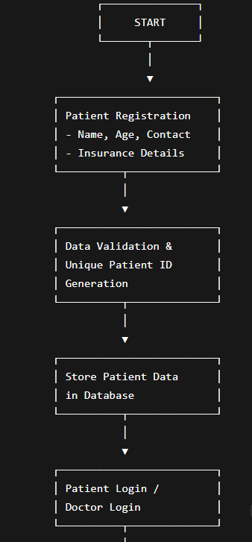
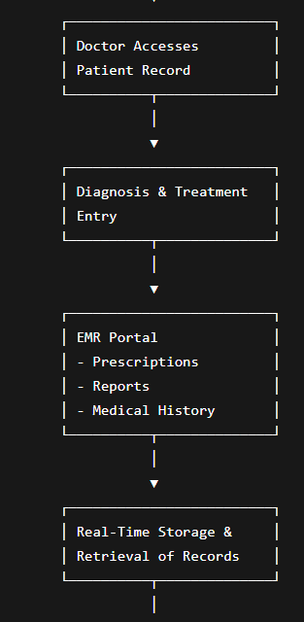
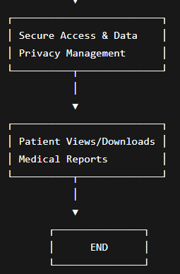
Project Flow Diagram

Slide 7
Objectives with Justification
Objectives
To develop a digital patient registration system that enables efficient collection and management of patient information.
To generate unique patient identification numbers for accurate record tracking and retrieval.
To create a centralized Electronic Medical Record (EMR) portal for storing and managing patient medical histories, diagnoses, prescriptions, and reports.
To reduce paperwork and manual record-keeping through digital data management.
To ensure secure access to patient information while maintaining privacy and confidentiality.
Justification
The healthcare sector generates a large volume of patient data that must be managed accurately and securely. Traditional paper-based registration and record management systems are often inefficient, time-consuming, and susceptible to errors, data loss, and duplication. These limitations can negatively impact patient care and administrative efficiency.
The proposed Patient Registration System and Electronic Medical Record (EMR) Portal provides a modern solution by digitizing patient information and medical records. The system enables healthcare providers to store, retrieve, and update patient data efficiently while ensuring data accuracy and security. It reduces administrative workload, minimizes paperwork, and facilitates quick access to patient records during diagnosis and treatment.

Slide 8
Modules [Frontend web pages]
1. Home Page – Portal overview and navigation
2. Patient Registration Page – Register patients and generate IDs
3. Patient Dashboard – View profiles and medical history
4. Appointment Booking Page – Schedule and manage appointments
5. Doctor Dashboard – Access patients and update diagnoses
6. Medical Records (EMR) Page – Manage prescriptions, reports, and records
7. Admin Dashboard – Manage users, records, and reports

Slide 9
Expected Outcomes of the Proposed Work
The proposed Patient Registration System and Electronic Medical Record (EMR) Portal is expected to deliver the following outcomes:
Efficient Patient Registration
Faster and more accurate registration of patients through a digital platform.
Reduction in manual paperwork and registration errors.
Centralized Medical Record Management
Secure storage of patient information, medical history, prescriptions, diagnoses, and laboratory reports in a centralized database.
Easy retrieval and updating of patient records whenever required.
Improved Data Accuracy and Reliability
Elimination of duplicate records through unique patient identification.
Enhanced consistency and integrity of healthcare data.
Enhanced Healthcare Service Delivery
Quick access to patient information enables doctors to make informed decisions and provide timely treatment.
Improved coordination among healthcare professionals.
Increased Data Security and Privacy
Implementation of authentication and access control mechanisms to protect sensitive patient information.
Compliance with healthcare data privacy standards and regulations.

Slide 10
Conclusion and Future Scope
The Patient Registration System and Electronic Medical Report (EMR) Portal successfully addresses the challenges associated with traditional paper-based healthcare record management. By digitizing patient registration and medical record maintenance, the system improves efficiency, accuracy, and accessibility of healthcare information. It enables healthcare providers to manage patient data securely, reduce administrative workload, and facilitate faster decision-making through instant
Future Scope
The Patient Registration System and EMR Portal can be further enhanced with advanced features to meet the growing demands of modern healthcare. Future improvements may include:
Integration with Telemedicine Services: Enable virtual consultations and remote patient monitoring through the portal.
Mobile Application Development: Provide patients and healthcare professionals with convenient access to records and services through mobile devices.
Artificial Intelligence Integration: Implement AI-based disease prediction, clinical decision support, and automated report analysis.
Cloud-Based Storage: Enhance scalability, data availability, and disaster recovery through secure cloud infrastructure.
Appointment and Billing Management: Incorporate scheduling, payment processing, and insurance claim management within the same platform.
access to medical histories and reports.

Slide 11
References
[1] React.js Documentation – https://react.dev/
[2] TanStack Router – https://tanstack.com/router
[3] Tailwind CSS – https://tailwindcss.com/docs
[4] TypeScript – https://www.typescriptlang.org/docs/
[5] React Hook Form – https://react-hook-form.com/
[6] Zod – https://zod.dev/
[7] Radix UI – https://www.radix-ui.com/
[8] TanStack Query – https://tanstack.com/query
[9] Recharts – https://recharts.org/
[10] Electronic Medical Records (EMR) Systems Literature

Slide 12
Thank you

