Slide 1
PICK AND PLACE AUTOMATION USING DIGITAL TWIN-DRIVEN ROBOTIC COORDINATION
Presented By:
K.LOGAVARSHINI
B.Tech-ROBOTICS AND ARTIFICIAL INTELLIGENCE
Guided by:
Dr. B. Vijayabaskar
School of Electrical and Electronics Engineering
SASTRA Deemed University

Slide 2
INTRODUCTION
A digital twin describes the virtual representation of a real process.
This twin is constantly updated with real data and can thus control and adapt the real model.
For optimal control and mapping of the environment a so-called digital twin can be used.

Slide 3
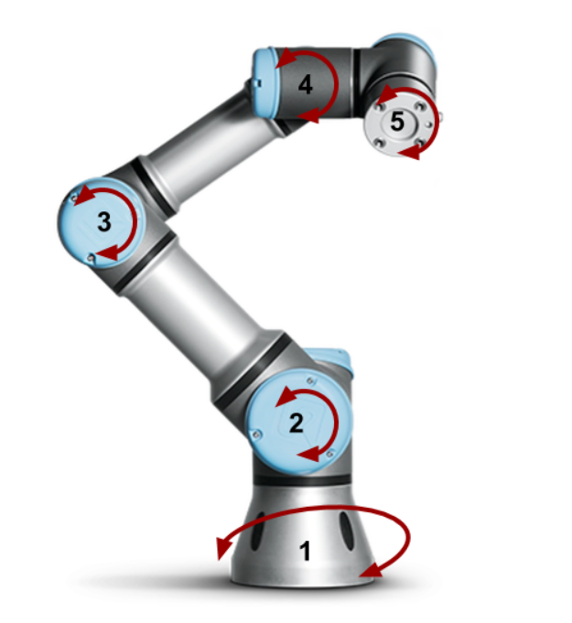
INTRODUCTION
A pick and place robot arm is a type of industrial robot designed to automate repetitive tasks such as picking up objects from one location and placing them in another.
These robots are commonly used in manufacturing and production lines to improve efficiency, accuracy, and safety.
The two main benefits of pick and place robots
are speed and consistency.

Slide 4
OVERVIEW
Simulation Environment:
The PyBullet simulation is initialized with a ground plane and a KUKA iiwa robotic arm.
An object (a cube) is placed at a specified starting position. The robot's task is to move this object from the starting position to a predefined goal position.
Obstacles are defined in a grid-based environment, and each obstacle is also visually represented as a cube in PyBullet.
Path Planning Algorithms:
The digital twin enables the testing of different algorithms like A* algorithm.

Slide 5
LITERATURE REVIEW
S.NO | TITLE | AUTHOR | ABOUT
1) | Digital Twin-Based Path Planning and Obstacle Avoidance for a Quadruped Robot | Ayan Naskar, Pranav Pothapragada & P. Vivekananda Shanmuganathan | Demonstrates the communications between robots, each with its own digital twin.
2) | Integrating digital twin and computer vision system for efficient pick-and-place operation using Tecnomatix Process Simulate | Yash Jakhotiya, M.R. Rahul & Shital. Chiddarwar | The study provides a methodology for digital twin creation
3) | Development of Digital Twin for Robotic Arm | Stepan Bratchikov, Artur Abdullin, Galina L. Demidova, Dmitry V. Lukichev | Shown that the use of polynomial algorithms in the control system provides the best solution

Slide 6
OBJECTIVE
To design suitable digital twins for pick and place of objects.
To develop a digital twin of a robotic manipulator capable of performing autonomous pick-and-place tasks with real-time path planning and obstacle avoidance, simulating real-world interactions and optimizing operational efficiency.
To enhancing performance, safety, and adaptability in robotic pick-and-place tasks using digital twin’s value.

Slide 7
MOTIVATION
This project aims to leverage digital twin technology to optimize real-world pick-and-place operations, ensuring high efficiency, accuracy, and adaptability in environments where physical prototyping is costly or risky.
To simulate real-time path planning and obstacle avoidance, the project seeks to advance robotics capabilities in complex environments while providing data-driven insights for improved decision-making.
To bridge the gap between physical and virtual robotics by creating a simulation environment that allows for precise, safe, and cost-effective testing of robotic tasks.

Slide 8
METHODOLOGY
Start
Initialise PyBullet
Load plane, robot and object
Define goal position
Define end effector index
Define grid and size resolution
Visualise grid
Add
Obstacles to simulation
A* pathfinding
No path found message
Plan path with retries
Reconstruct path
Check the current node for goal node
Initialise open set(while not empty)
Check obstacles and update
Get neighbours
Place the object
Move the robot

Slide 9
CONCLUSION
The digital twin-based pick-and-place system demonstrated the effectiveness of using simulation to improve the accuracy, efficiency, and safety of robotic manipulator tasks. Through virtual testing and path planning, the digital twin enabled real-time adjustments and optimal performance, reducing costs and minimizing physical risks associated with traditional prototyping. The project highlighted the feasibility of using digital twins in complex robotics applications, proving valuable for real-world deployments in manufacturing, logistics, and automation.

Slide 10
FUTURE SCOPE
Integration with Machine Learning: Future work could involve integrating machine learning algorithms to enhance adaptive control and decision-making, allowing the manipulator to refine pick-and-place tasks autonomously based on real-time feedback and environment changes.
Real-Time Synchronization with Physical Twin: Expanding the digital twin to synchronize in real time with a physical manipulator would allow for seamless monitoring, enabling predictive maintenance, faster troubleshooting, and enhanced overall system reliability.
Augmented Reality (AR) Interfaces: AR could be used to visualize the digital twin alongside the physical system, providing operators with a more intuitive way to monitor, control, and debug robotic tasks.

Slide 11
REFERENCES
https://www.sciencedirect.com/science/article/pii/S187705092400118
https://ieeexplore.ieee.org/abstract/document/9812004
https://arxiv.org/html/2403.13090v1

Slide 12
THANK YOU

