Slide 1

TEMPORAL AND MOTION MODELLING INTO OBJECT- SCENE FUSION IN VIDEO UNDERSTANDING
IMAGE ANALYSIS AND COMPUTER VISION
A PROJECT SUBMITTED BY:
K. Logavarshini
126179023
B.Tech – ROBOTICS AND ARTIFICIAL INTELLIGENCE
GUIDED BY:
Dr. N.R. Rajan
School of Electrical and Electronics Engineering
SASTRA Deemed University

Slide 2
OBJECTIVE
To build a video understanding module that captures how things move over time and fuses that motion with higher-level cues (OSF = Object–Scene Fusion) to produce stable, discriminative descriptors for downstream tasks (activity cues, shot change/motion saliency, retrieval, or tracking quality).
Analyse motion inside videos using optical flow and feature tracking over time.
Model the temporal change of motion patterns across frames and model how object movement evolves temporally.
Fuse motion and scene context for meaningful video interpretation and for better video understanding.
To extract, analyse and visualise motion behaviour in videos using temporal modelling and object-scene fusion.

Slide 3
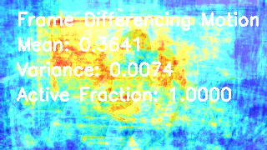
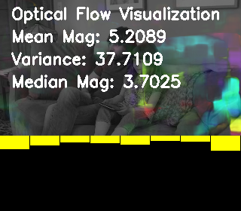
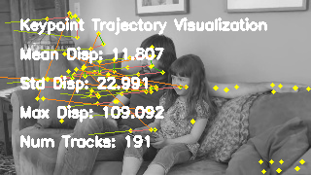
HOW??
Frame extraction:
The input video is extracted into a sequence of frames at a fixed FPS. The frames are extracted to ensure temporal consistency and provide the base data for all later motion computations.
2. Preprocessing and Motion Saliency:
It computes per-pixel motion energy using the equation Mt​=∣It​−It−1​∣.
→Mean: 0.3641 – average motion energy in this frame
→Variance: 0.0074 – motion is relatively uniform
→Active Fraction: 1.0000 – nearly all the motion exceeds
the threshold.
3. Optical Flow:
Estimate per-pixel flow and compute magnitude stats
→ Median < mean implies a tail of fast movers.
→Variance: 37.7109 – heterogeneous speed
4. Keypoint Trajectories:
Detect good features to track and follow with KLT.
This complements dense flow with a longer horizon motion coherence.
The number of tracks implements a healthy coverage and the displacements indicate
outliers and fast objects.

Slide 4
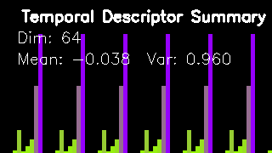
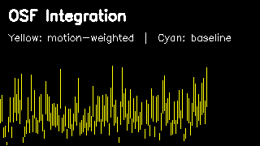
5. Temporal Descriptor Construction:
Aggregate motion into a fixed-length vector
From the values they represent near-zero mean,
high variance: well-spread, informative descriptor.
6. OSF – Integration:
Fuse motion-weighted signal (yellow) with a baseline
scene/object logits or prior saliency.
The overlaid timeline shows yellow tracking peaks where
motion strengthens confidence.
RESULT: Robustness to camera shake and sensitivity to truly
dynamic regions.

Slide 5
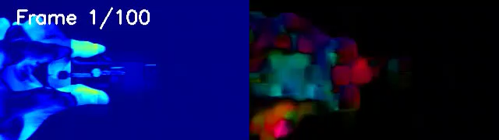
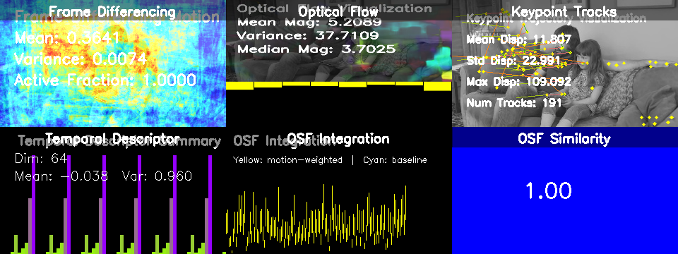
FINAL RESULTS
LEFT SIDE:
This is the scene/video frame with motion intensity applied
Mostly blue → meaning low or no motion
Brighter or lighter areas (cyan/green) → regions with movement
Text “Frame 1 / 100” indicates temporal position in the video
RIGHT SIDE:
This is a pure optical flow visualization
Colour represent direction + magnitude of motion
Each colour encodes pixel motion vector direction
Brightness = motion strength
This only shows motion field
Gives a complete temporal understanding view: raw motion → statistical encoding → fused higher-level representation
Demonstrates temporal stability
(Cosine Sim = 1.00 → consistent signature)

Slide 6
THANK YOU…!!

