Slide 1

DemandIQ
AI-Driven Retail Demand Forecasting and Inventory Optimization System
Smart Demand. Smarter Inventory.
Mini Project Presentation | Varshini L (24619234) | Guide: Ms. S. J. Kavitha

Slide 2
Introduction
The Challenge
The Solution
Retail demand changes fast, making inventory hard to predict. This can lead to stockouts or overstock.
DemandIQ uses AI and machine learning to forecast demand from historical sales data. This helps retailers make faster, smarter inventory decisions.
Objectives
1
2
3
4
Build an AI-based demand forecasting system
Predict future product demand using historical sales data
Reduce stock shortages and excess inventory
Enable better inventory decisions

Slide 3
Abstract
Small retail stores often struggle to maintain optimal inventory levels, leading to stock shortages or excess unsold goods. DemandIQ is an AI-driven retail demand forecasting and inventory optimization system that predicts future product demand from historical sales data. Instead of manual estimation, it uses a Random Forest model with calendar and lag-based features to forecast demand, and turns the forecast into safety stock, reorder point and restocking guidance on a Streamlit dashboard. The system helps retailers reduce stockouts, minimize overstocking and manage inventory efficiently, offering a practical, low-cost solution for small businesses.
Keywords: Inventory Management; Demand Forecasting; Machine Learning; Time-Series Forecasting; Retail Analytics; Predictive Modelling

Slide 4
Literature Review
S.No. | Author & Year | Research Paper / Topic | Methodology / Models | Key Finding / Relevance
1 | Deivanayagampillai et al. (2025) | Random Forest for inventory forecasting | Random Forest-based inventory/demand forecasting. | Shows the usefulness of Random Forest for modelling nonlinear retail demand patterns.
2 | Yadav (2025) | Random Forest/XGBoost with external big-data signals | Random Forest and XGBoost with external/contextual data. | Shows that additional external signals can improve forecasting, but such data may not be readily available to small retailers.
3 | Fatima & Salam (2025) | XGBoost, ARIMA, Prophet and SVR with context features | Comparison of ML and time-series models with contextual features. | Shows that model choice and contextual information can influence retail inventory forecasting performance.
4 | Hammam et al. (2025) | Adaptive Demand Forecasting Framework with Weighted Ensemble of Regression and Machine Learning Models Along Life Cycle Variability | ARIMA-family regression + XGBoost weighted ensemble; product life-cycle variability. | Combines linear and nonlinear forecasting strengths to handle different demand patterns and product life cycles.
5 | Muluk & Akbar (2025) | Pengembangan Sistem Prediksi Permintaan untuk Reorder Point Berbasis Machine Learning | Decision Tree, Random Forest and XGBoost; Reorder Point; Safety Stock; Streamlit. | Connects ML demand prediction with Reorder Point, Safety Stock and restocking recommendations.

Slide 5
Base Paper
Said, Kabir, Msadaa & Mirmohammadsadeghi (2026). Data-Driven Demand Forecasting for Retail Decision-Making: A Hybrid Machine Learning and Time Series Approach to Inventory Optimization. J. Intell. Sustain. Decis. Anal., 1(1), 1–27.
Best model: hierarchical hybrid
Uses Walmart's historical weekly sales data for 45 stores
AutoML (PyCaret) compares 18 time-series and 17 regression models
Five deep learning models tuned by grid search: RNN, LSTM, Bidirectional LSTM and GRU variants
Hybrid model: Bidirectional LSTM with Random Forest on residuals
Hierarchical hybrid: store-level models combined into total sales
Forecasts support replenishment planning and safety stock decisions
306,361.11
MAE
528,096.34
RMSE
0.99
R²

Slide 6
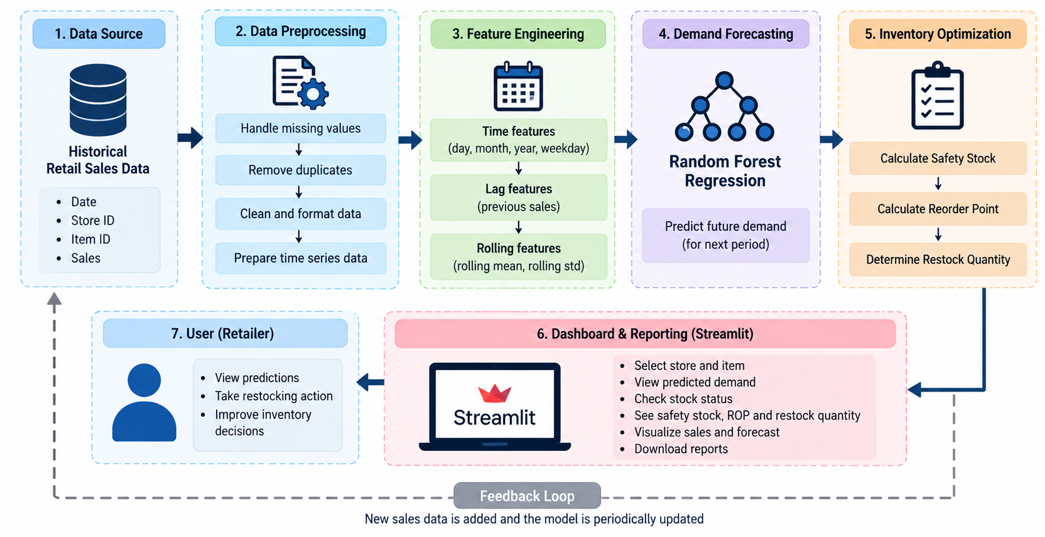
System Architecture

Slide 7
Modules
1
2
3
4
5
6
Data Ingestion
Data Preprocessing
Feature Engineering
Demand Forecasting
Inventory Optimization
Dashboard & Reporting
Loads daily sales records
Cleans and sorts by date
Creates calendar, lag and rolling features
Random Forest predicts next-day demand
Safety stock, reorder point and restock quantity
Streamlit dashboard for the retailer
Raw sales records
Clean time series
Model-ready features
Predicted demand
Inventory indicators
Forecast and report
Prepare the data
Predict and decide
Present

Slide 8
Modules Explained (1–3)
1
Data Ingestion
2
Data Preprocessing
3
Feature Engineering
Loads historical daily sales records
Fields used: date, store, item and sales
Date converted to date/time type
Sorts records chronologically
Checks missing and non-numeric values
Keeps each store–item series separate
About 913,000 rows reduce to about 909,500 usable rows
Calendar: day, month, year, weekday, weekend flag
Lag-1 and Lag-7 sales per store–item
7-day rolling mean from past values only

Slide 9
Modules Explained (4–6)
4
Demand Forecasting
5
Inventory Optimization
6
Dashboard & Reporting
Random Forest Regressor, 30 trees, depth 15
Trained on earlier 80% of data, tested on latest 20%
Predicts next-day demand
Safety stock and reorder point
Suggested restock = max(0, reorder point − current stock)
Stock coverage in days and inventory status
Streamlit Control Center: store, item, stock, lead times
Shows forecast, status, safety stock, reorder point, restock
Sales trend, insights and downloadable shop-owner report

Slide 10
Implementation
Load sales data
Prepare and sort by date
Create features
Chronological 80/20 split
Train Random Forest
Evaluate MAE, RMSE, R²
Streamlit dashboard
Data & Features
Model
Inventory Rules
About 913,000 daily records; about 909,500 usable after feature creation
Calendar features, Lag-1, Lag-7
7-day rolling mean
Random Forest Regressor (scikit-learn)
30 trees, max depth 15, random_state 42
Earlier 80% to train, latest 20% to test
Safety Stock = (Max daily sales × Max lead time) − (Avg daily sales × Lead time)
Reorder Point = (Avg daily sales × Lead time) + Safety Stock
Restock = max(0, Reorder Point − Stock)

Slide 11
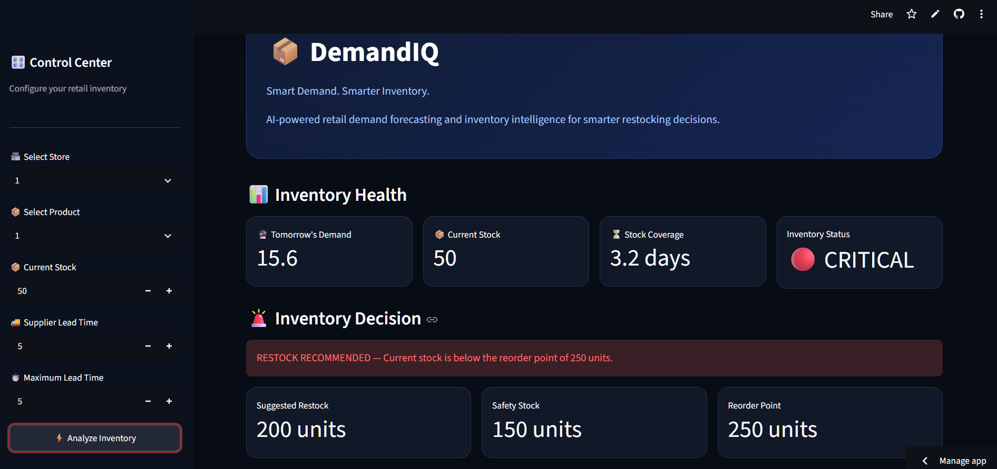
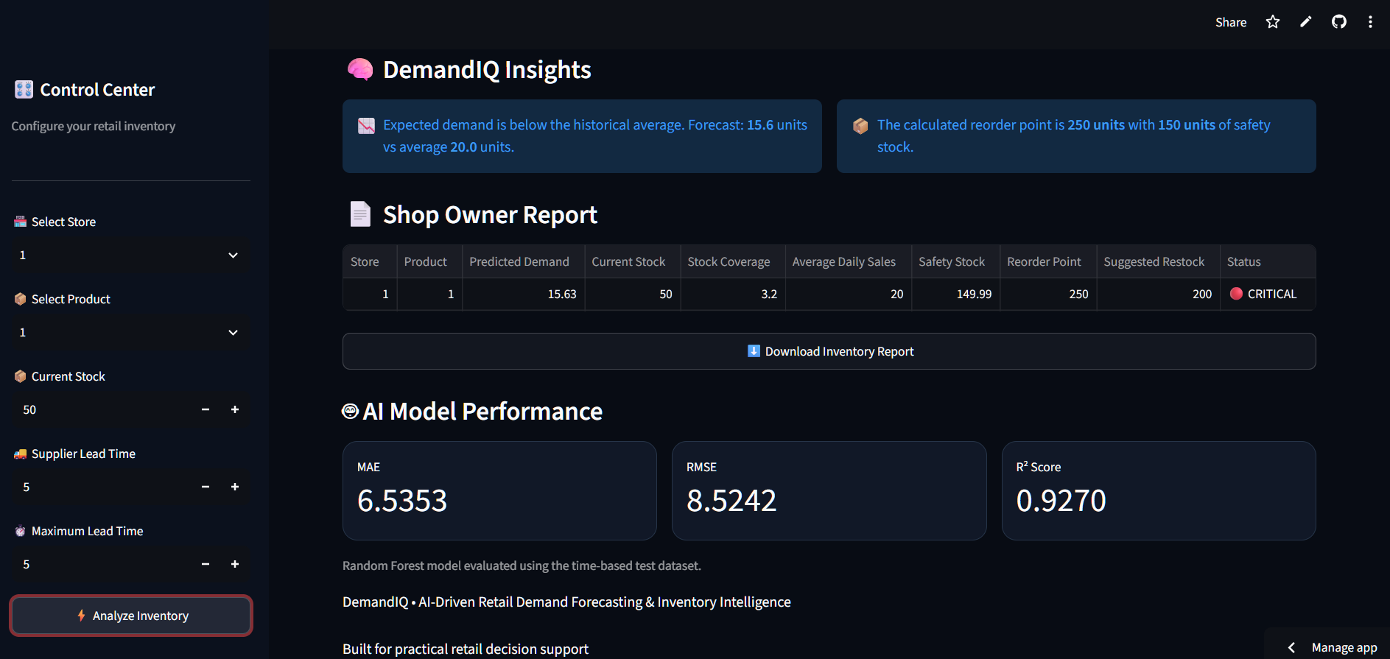
Results
Inventory health and decision (Store 1, Item 1)
Insights, shop-owner report and model performance
6.5353
8.5242
0.9270
200 units
MAE
RMSE
R² score
Suggested restock (status: CRITICAL)
Live app: demandiq-stock.streamlit.app

Slide 12
References
[1] Deivanayagampillai et al. (2025). Random Forest for Inventory Forecasting.
[2] Yadav (2025). Retail demand forecasting using Random Forest/XGBoost with external big-data signals.
[3] Fatima, & Salam (2025). Retail inventory forecasting using XGBoost, ARIMA, Prophet and SVR with contextual features.
[4] Hammam, I. M., El-Kharbotly, A. K., & Sadek, Y. M. (2025). Adaptive Demand Forecasting Framework with Weighted Ensemble of Regression and Machine Learning Models Along Life Cycle Variability. Scientific Reports, 15, 38482. https://doi.org/10.1038/s41598-025-23352-w
[5] Muluk, A., & Akbar, A. N. (2025). Pengembangan Sistem Prediksi Permintaan untuk Reorder Point Berbasis Machine Learning. Jurnal Inovasi Rekayasa Mekanikal dan Termal, 3(1), 79–84. https://doi.org/10.25077/inomet.3.1.79-84.2025
[6] Breiman, L. (2001). Random Forests. Machine Learning, 45, 5–32.
[7] scikit-learn Developers. RandomForestRegressor documentation. Scikit-learn User Guide.
[8] Streamlit, Inc. Streamlit documentation: building data applications in Python.
[9] pandas Development Team. pandas documentation: data structures and time-series data handling.
[10] NumPy Developers. NumPy documentation: numerical computing in Python.
[11] Said, N. B., Kabir, G., Msadaa, I. C., & Mirmohammadsadeghi, S. (2026). Data-driven demand forecasting for retail decision-making: A hybrid machine learning and time series approach to inventory optimization. J. Intell. Sustain. Decis. Anal., 1(1), 1–27. https://doi.org/10.56578/jisda010101

