Slide 1
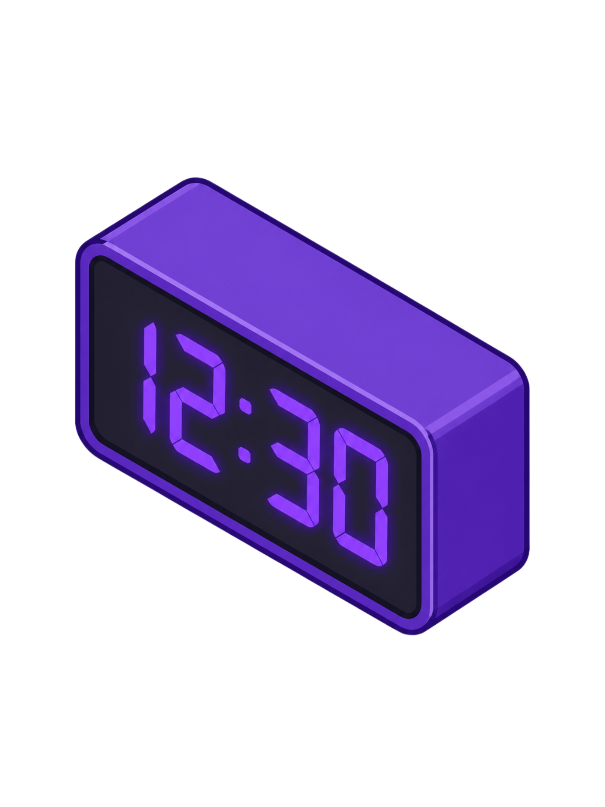
DIGITAL CLOCK
A Real-Time Web-Based Clock Application
Presented by: Vaishnavi | Bachelor of Computer Applications (BCA)

Slide 2


Introduction
A Digital Clock is a web application that displays the current time in real time.
Real-time clock
Auto-updates every second
Simple interface
Browser-based application

Slide 3




Objectives
Real-Time Clock
Auto Update
Develop a digital clock displaying accurate current time
Update time automatically every second
Attractive UI
Apply Web Skills
Create a clean and attractive user interface
Apply HTML, CSS, and JavaScript concepts in practice

Slide 4
Technologies Used
HTML5
CSS3
JavaScript
Structure
Styling & Effects
Time Logic & Updates
VS Code
Web Browser
Development
Testing

Slide 5

Working Principle
Current Time
JS Retrieval
Extract H:M:S
Format Time
JavaScript's setInterval() function triggers a time refresh every 1000 milliseconds, keeping the display perfectly in sync with the system clock.

Slide 6
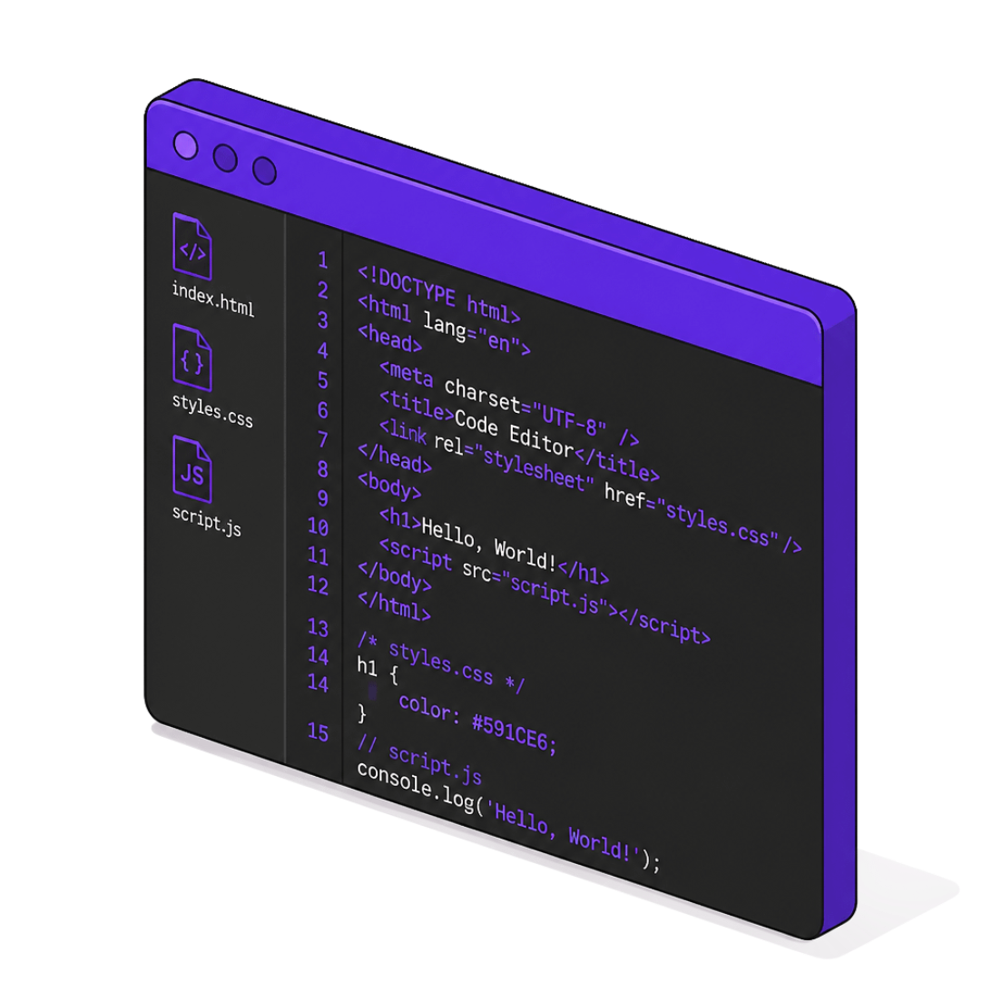
Project Development
1
HTML
2
CSS
Clock structure & layout
Design, glow effects & styling
3
JavaScript
Time logic & real-time updates
Planning → Coding → Designing → Testing → Final Application

Slide 7

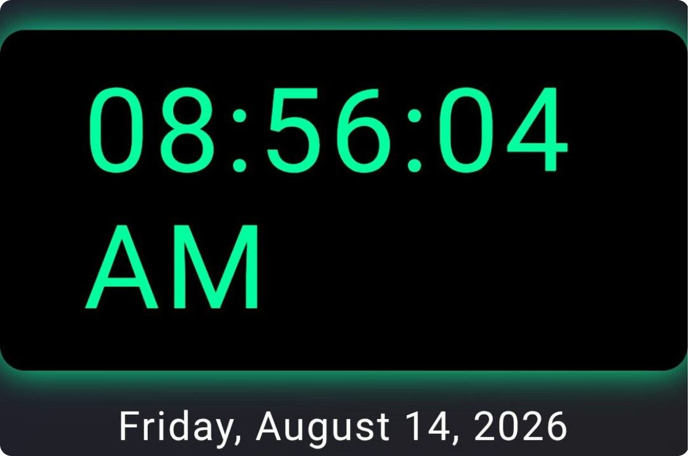
User Interface & Features
Large, readable time display
Real-time updates
Second-by-second changes
Clean & attractive design
Lightweight & fast
Works in any web browser

Slide 8
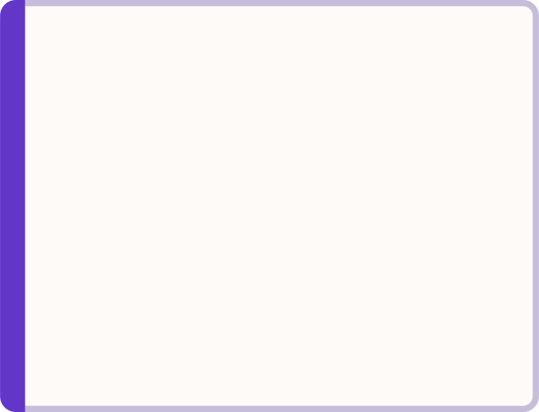
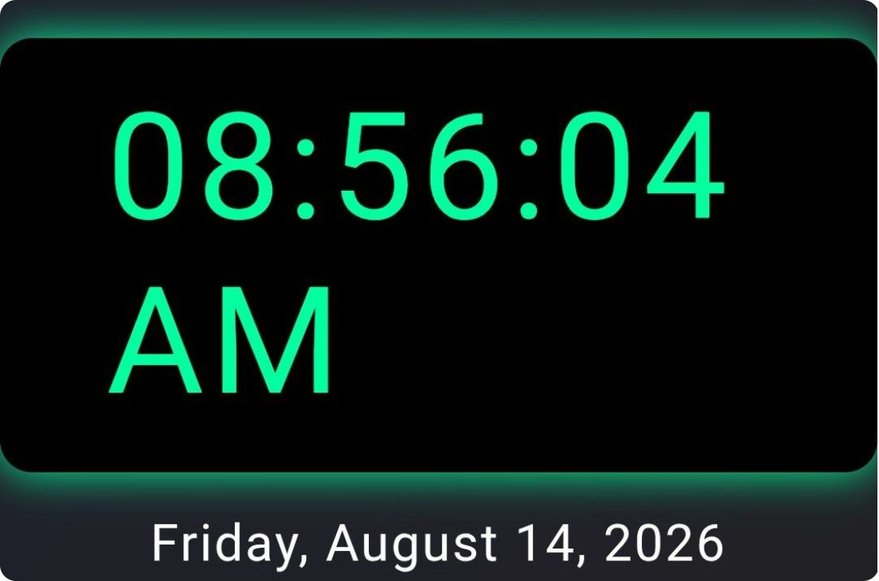


Testing & Results
Testing Performed
Opened the webpage successfully
Verified hours and minutes display
Confirmed second-by-second updates
Tested after page refresh
Validated in web browser
Successfully displays current time with automatic updates every second.

Slide 9
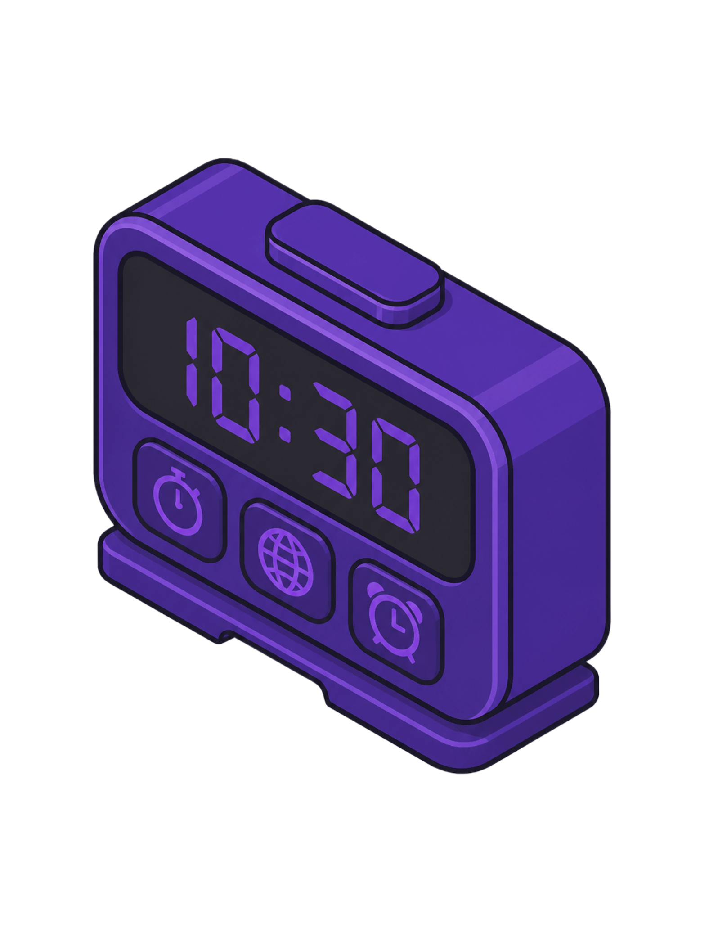
Future Enhancements & Learning
Future Enhancements
What I Learned
12-hour & 24-hour format
Date and day display
Alarm, stopwatch, countdown timer
Multiple time zones
Dark / light mode
HTML structure & CSS styling
JavaScript programming & DOM manipulation
Real-time data updating
Project testing & presentation

Slide 10
Conclusion
HTML, CSS, and JavaScript combined create a real-time interactive web application.
Practical knowledge gained: web development, JavaScript logic, DOM manipulation, real-time updates, testing, and project development.
THANK YOU
Vaishnavi – BCA Student

