Slide 1
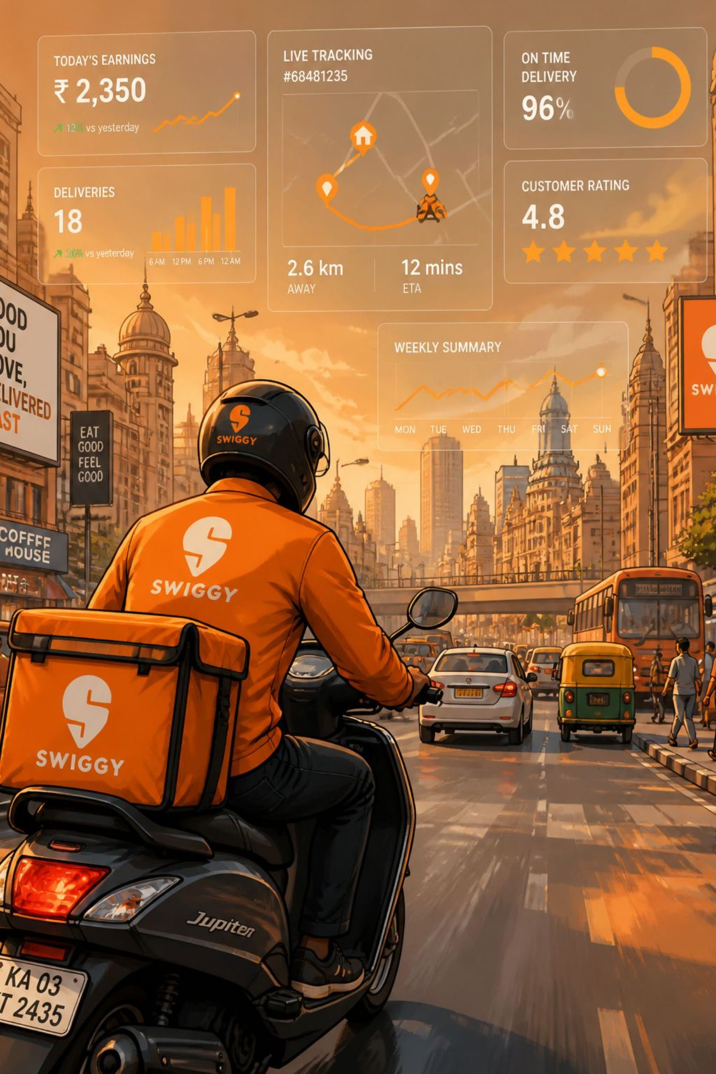
SWIGGY SALES & BUSINESS ANALYTICS DASHBOARD
An Interactive Sales Analysis Project Using Microsoft Excel
Presented by: Varshini M V

Slide 2
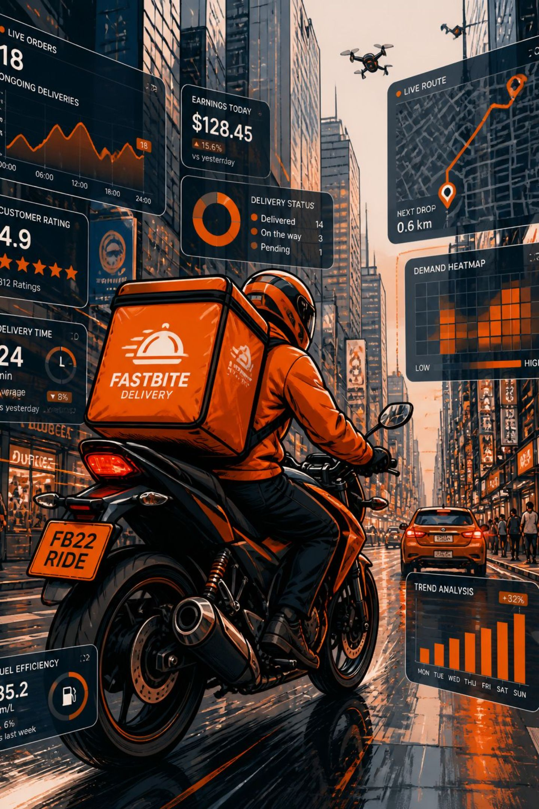
Introduction
Swiggy is a leading online food delivery platform generating high-volume transactional data across orders, restaurants, items, locations and ratings. Converting this raw data into structured analysis reveals sales performance, ordering behaviour, restaurant health, food preferences and geographic trends. This project builds an interactive Excel dashboard to turn data into quick, actionable insights.

Slide 3

Purpose of the Project
01
Goal
Transform raw Swiggy sales data into business insights using Excel dashboards for operational and strategic decisions.
02
Objectives
1. Analyze total sales & orders • 2. Identify monthly & weekly trends • 3. Compare food categories
03
Objectives (cont.)
4. Analyze by state & city • 5. Study customer ratings • 6. Highlight top cities & quarterly performance
04
Outcome
Deliver an interactive, user-friendly dashboard to support data-driven decisions.

Slide 4
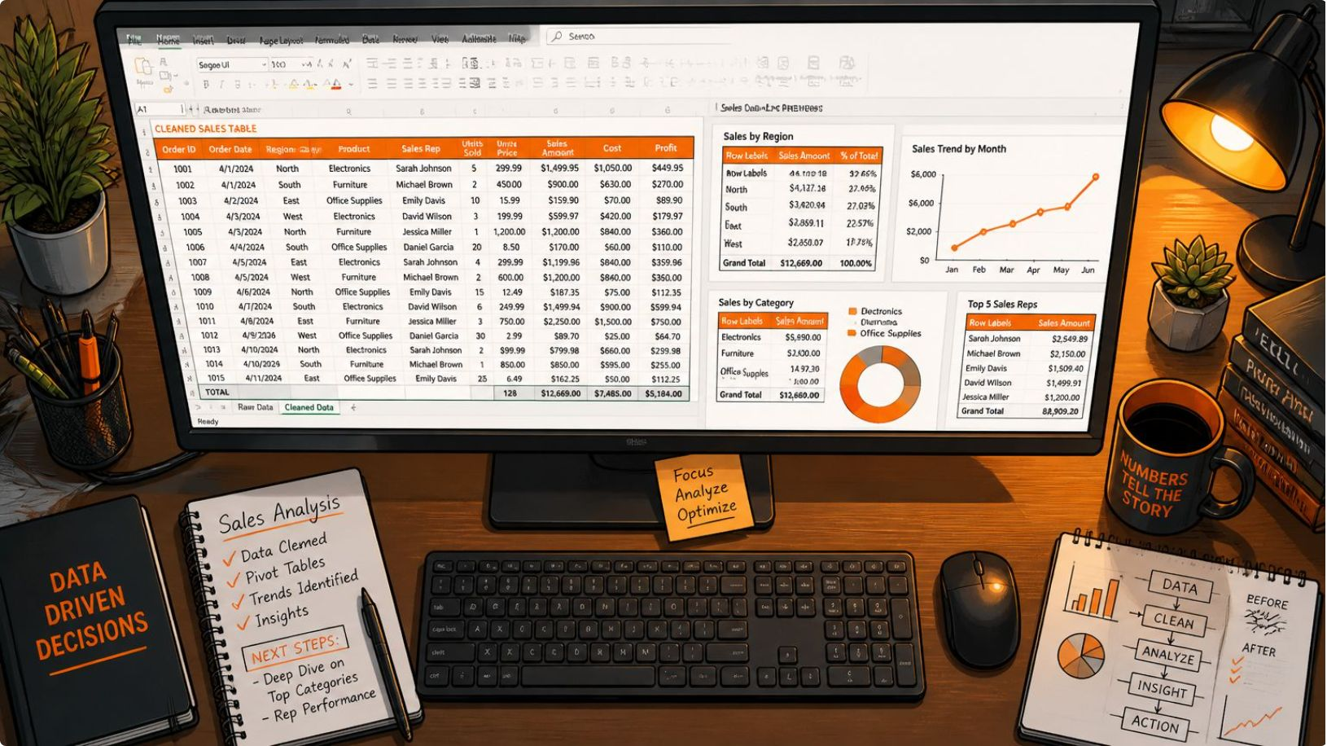
Dataset & Key Parameters
The dashboard is built from transactional order data with fields such as order details, date, food category, restaurant, city, state, sales amount and rating.
Total Sales
Average Rating
Avg Order Value
Rating Count
₹53.01M
4.34
₹268.51
5.59M
Total Orders
197.43K

Slide 5
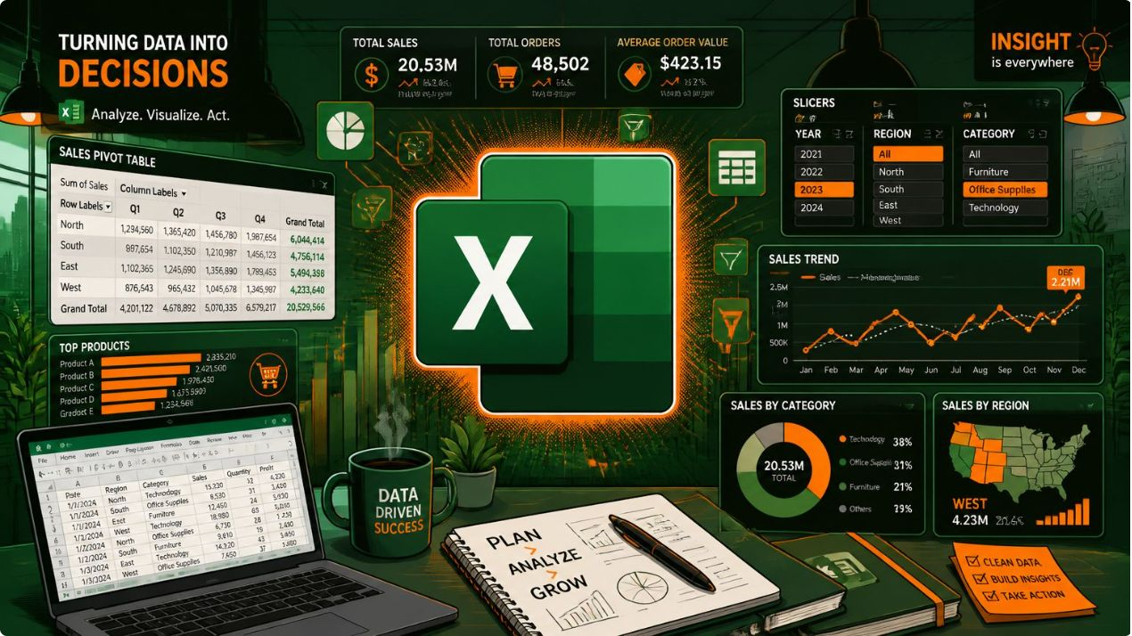
Tools & Technologies
Main Tool: Microsoft Excel
Key Excel features used:
Data cleaning & filtering
Formulas & calculated fields
Pivot Tables & Pivot Charts
Slicers & Conditional Formatting
Dashboard layout & visualization
Excel offers fast iteration, low barrier to entry and robust visualization for business-focused dashboards without complex programming.

Slide 6

From Raw Data to Interactive Dashboard
Workflow: Data is collected, validated and structured. Calculated fields and categories are created, followed by pivot-based analysis and chart creation. Filters and slicers produce an interactive single-screen dashboard that supports exploratory analysis and quick reporting.

Slide 7
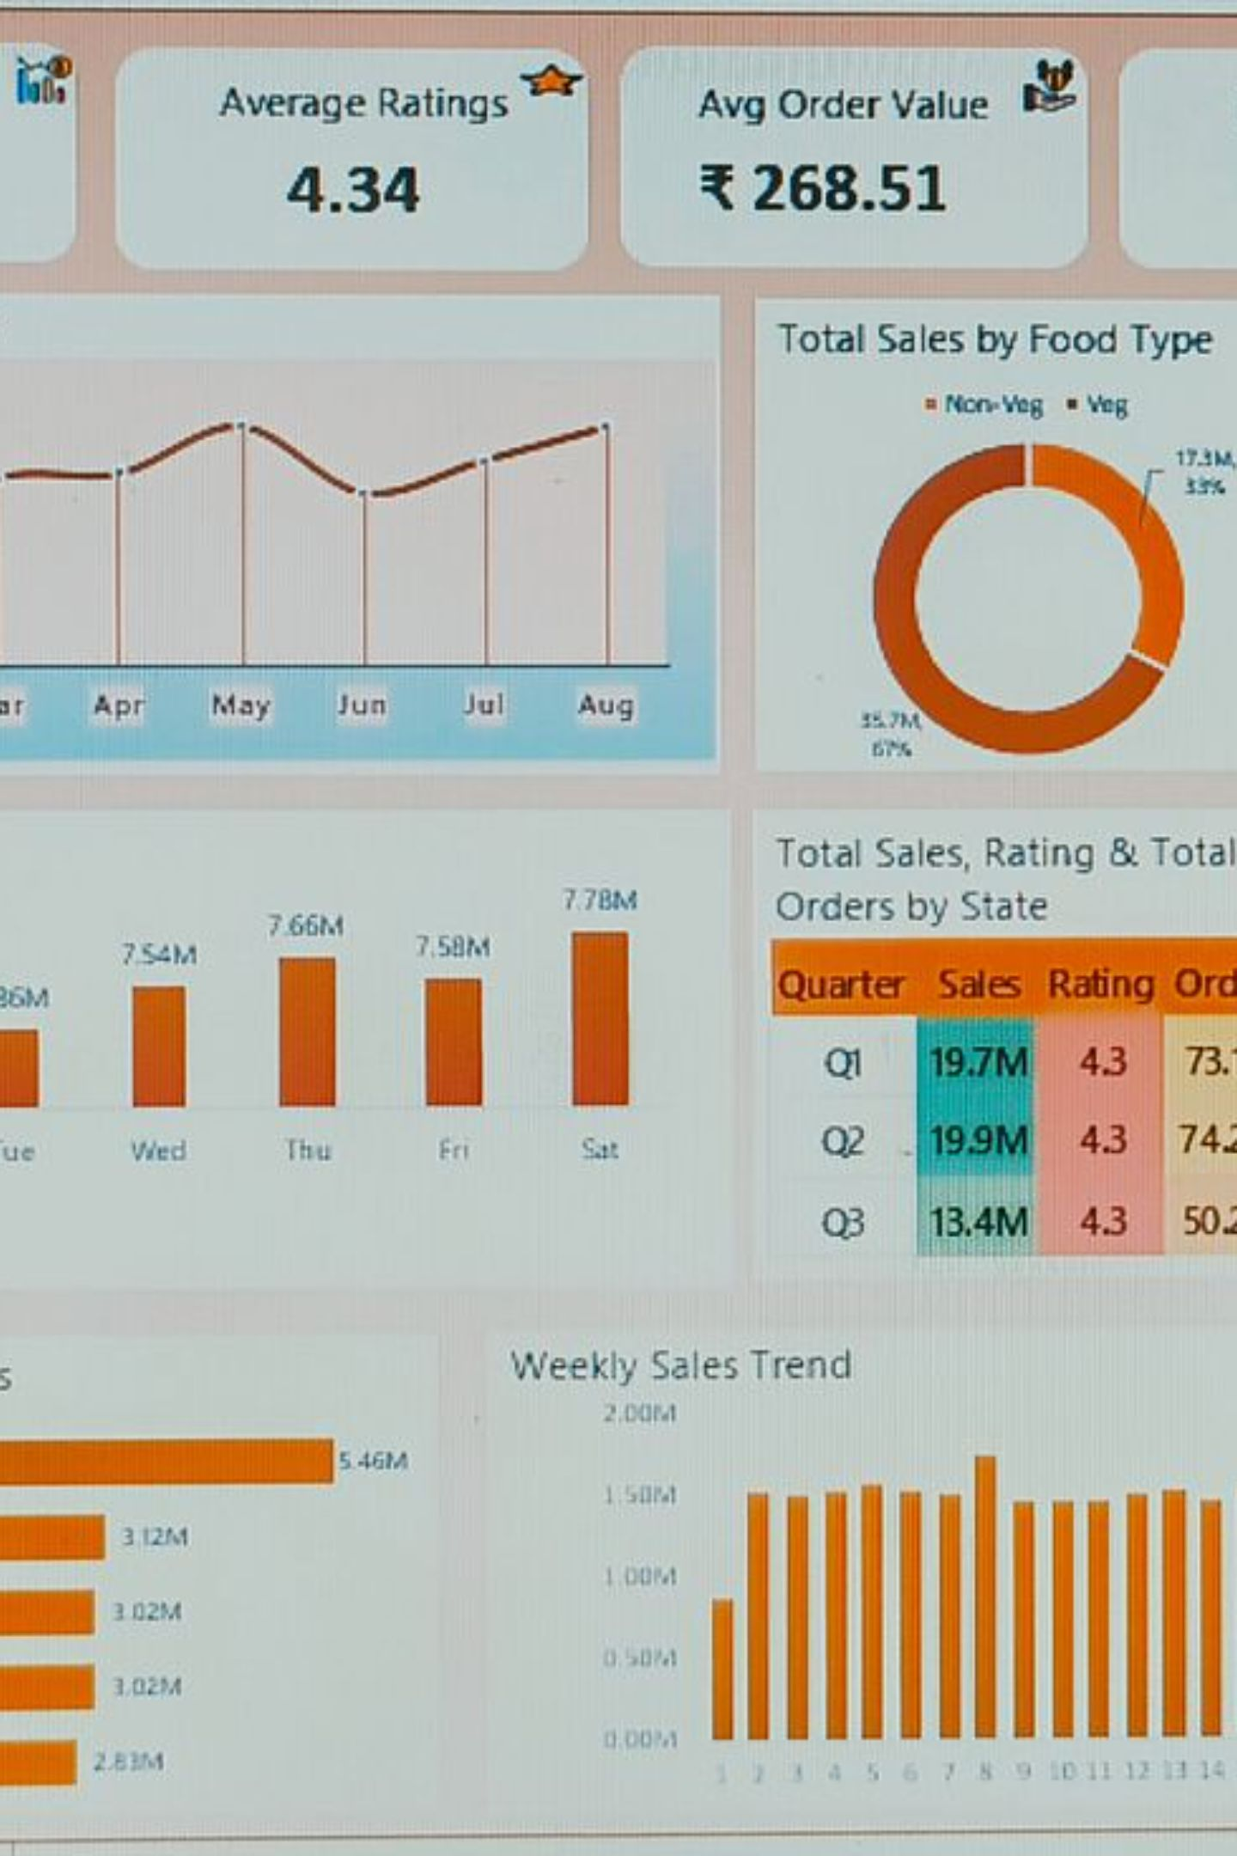
Interactive Swiggy Dashboard — Overview
The dashboard consolidates core business views into one screen:
KPI cards (Sales, Orders, AOV, Rating)
Monthly, Weekly & Daily trend charts
Sales by food type and state
Top 5 cities & quarterly breakdown
Interactive filters: Date, City, Food Category, Restaurant
This single-screen layout enables quick answers and faster decision-making for operations and strategy.

Slide 8





Key Performance Indicators
Total Sales
These KPI cards provide an at-a-glance summary of business health and customer engagement. Presenting them prominently helps stakeholders assess performance immediately and drill down for root-cause analysis using slicers.
₹53.01M
Average Rating
4.34
Avg Order Value
₹268.51
Rating Count
5.59M
Total Orders
197.43K

Slide 9
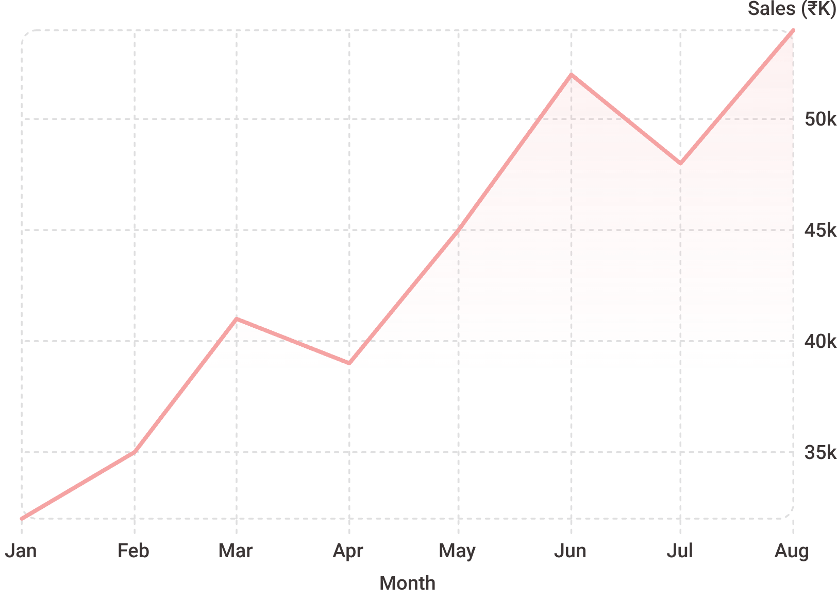
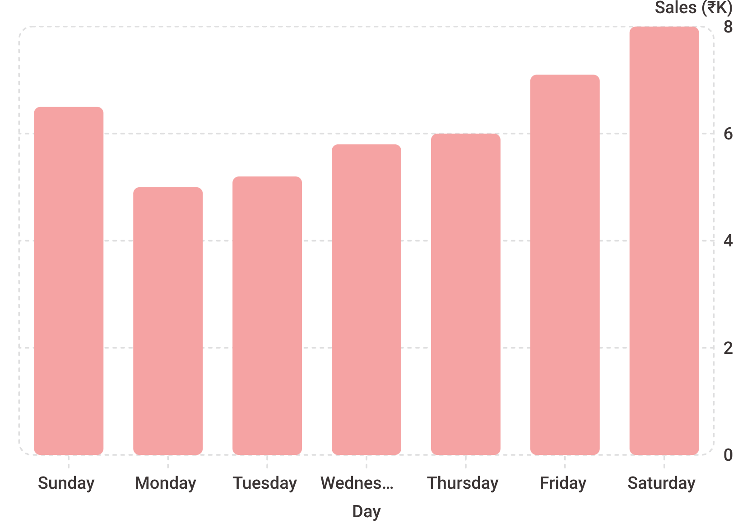
Monthly Sales Trend (Jan–Aug) — line shows overall momentum and seasonal shifts.
Daily & Weekly Trends — identify peak weekdays and weekend spikes to optimise operations and marketing.

Slide 10
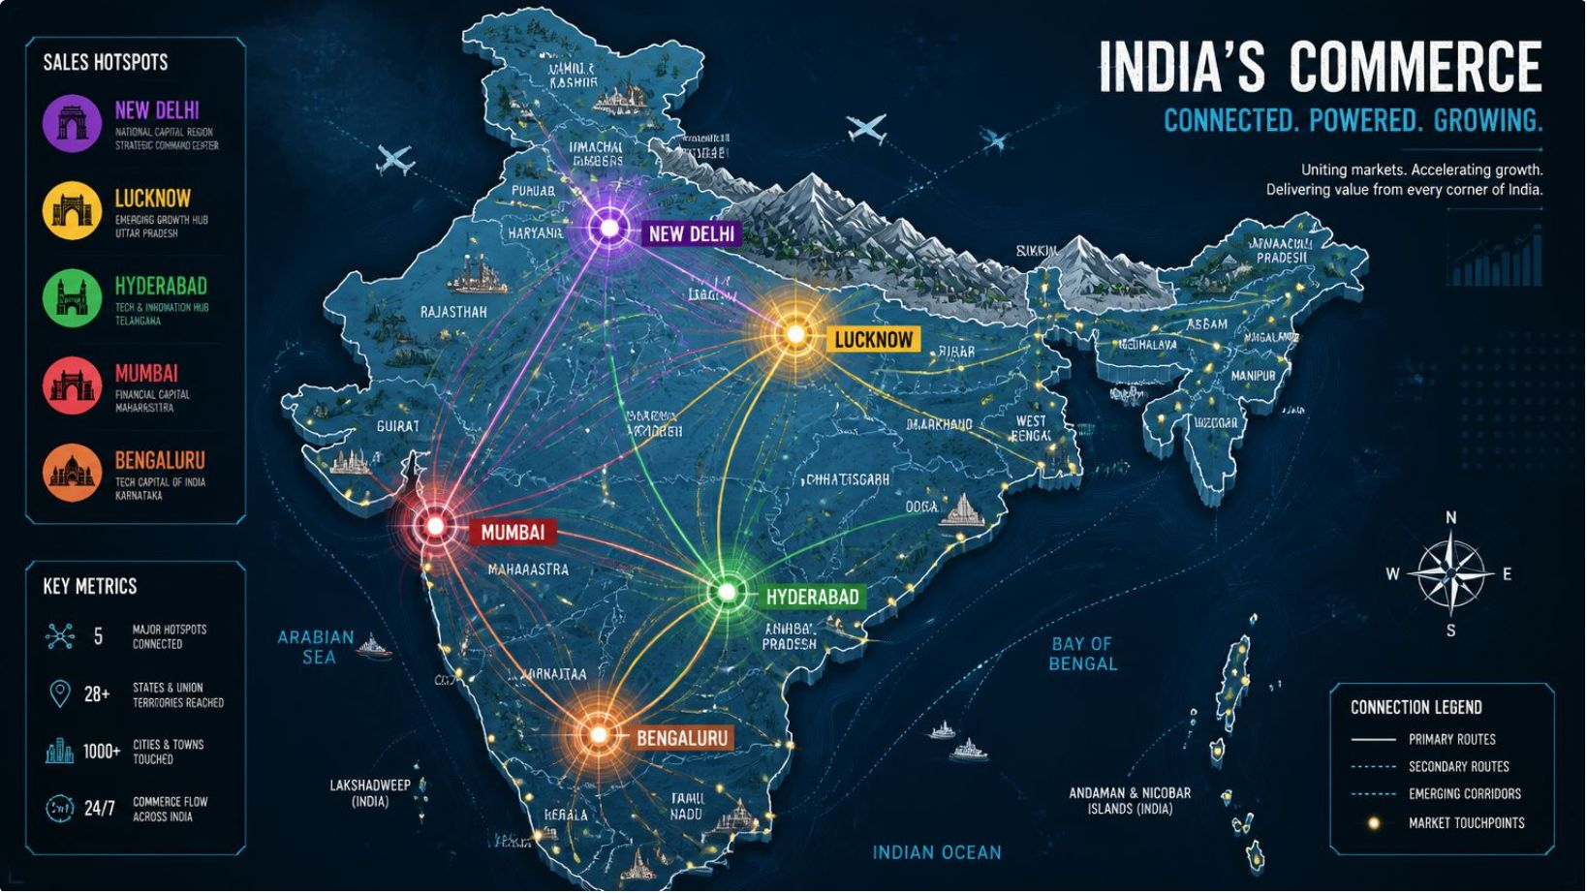
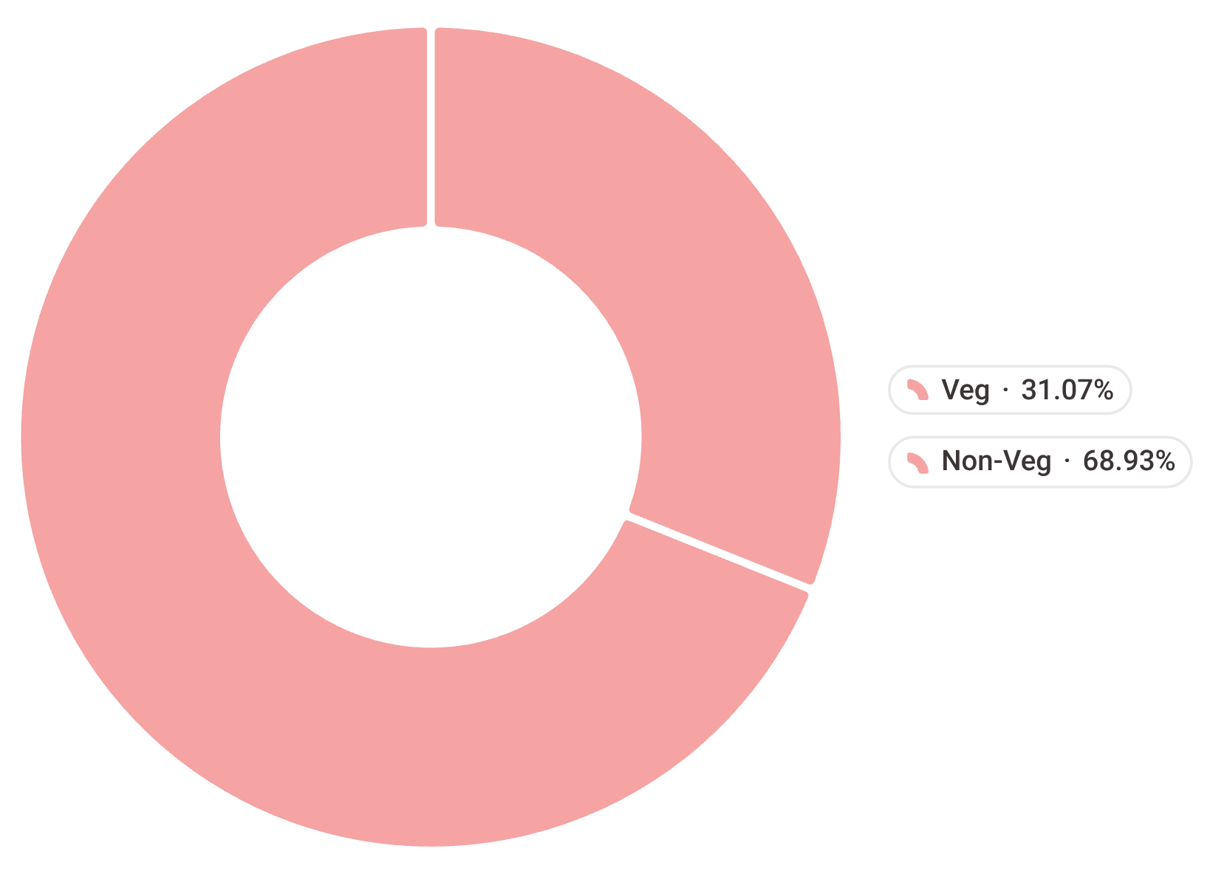
Top 5 Cities by Sales
Bengaluru — ₹5.46M
Lucknow — ₹3.12M
Hyderabad — ₹3.02M
Mumbai — ₹3.02M
New Delhi — ₹2.82M
Food Type Contribution — donut chart compares Veg vs Non-Veg sales share.
Geographic analysis helps target city-level operations and promotional spend.

Slide 11
Thank You for Your Attention!
We appreciate your time and engagement today. We hope this interactive dashboard project has provided a clear and valuable understanding of Swiggy's sales and business analytics.
Presented by: Varshini M V

