Slide 1
Job Data Pipeline

Slide 2
AGENDA
1
UseCase
2
Data Extraction
3
Data Ingestion
4
Medallion Architecture – Bronze Layer
5
Medallion Architecture – Silver Layer
6
Data Modelling
7
Medallion Architecture – Gold Layer

Slide 3
AGENDA
8
KPIs Overview
9
Reports
10
Challenges & Solutions
11
Impact & Applications
12
Future Enhancements
13
Conclusion
14
Q&A

Slide 4
UseCase
End-to-End Data Pipeline for TN Private Jobs Portal
The objective is to automate the extraction, transformation, and analysis of job fair and employer data from the TN Private Jobs Portal. The process begins with scraping dynamic content using Playwright and BeautifulSoup. Extracted data is ingested into Snowflake using dbt for efficient storage. The pipeline follows the Medallion Architecture, organizing data into raw (Bronze), cleaned (Silver/SSOT), and KPI-driven (Gold) layers. Data is standardized in the staging layer, with business logic applied in the core layer. Finally, KPIs are derived to generate insights for both HR and job seekers, supporting informed decision-making.
Understanding of Problem
The TN Private Jobs Portal contains valuable jobs data, but it is scattered and difficult to analyze
manually.HR departments lack centralized insights into job postings, company activity, and skill demands, while job
seekers struggle to access personalized opportunities. Current manual processes are inefficient for tracking real-time
data. The extraction, transformation, and analysis of this data can provide meaningful insights, streamline
HR decision-making, and empower job seekers with data-driven career choices.

Slide 5
AGENDA
1
UseCase
2
Data Extraction
3
Data Ingestion
4
Medallion Architecture – Bronze Layer
5
Medallion Architecture – Silver Layer
6
Data Modelling
7
Medallion Architecture – Gold Layer

Slide 6
Data Extraction
Objective: Scrape job details from the TN Private Jobs portal for further analysis.
Steps:
1.Job Link Collection:
Scrape job listing URLs across multiple pages using requests and BeautifulSoup.
Filter and collect unique job links from the portal.
Job Detail Scraping:
Extract detailed job information such as title, company, location, salary, and skills using specific HTML selectors.
Use helper functions like safe_extract and extract_salary for structured data extraction.
Concurrency:
Implement multi-threading using ThreadPoolExecutor to speed up the scraping process.
Run up to 10 threads concurrently, allowing efficient extraction of job details from multiple pages simultaneously.
Error Handling & Retries:
Incorporate retry logic with a maximum of 3 attempts for each request in case of failures or timeouts.
Skip pages with structural issues or errors during scraping.
Data Saving:
Collect all job data and save it in a CSV file for further analysis.

Slide 7
AGENDA
1
UseCase
2
Data Extraction
3
Data Ingestion
4
Medallion Architecture – Bronze Layer
5
Medallion Architecture – Silver Layer
6
Data Modelling
7
Medallion Architecture – Gold Layer

Slide 8
Data Ingestion
Objective: Loading Extracted Data into Snowflake
Process:
CSV Preparation: Ensure the scraped job data is saved in a clean CSV format.
Use of dbt Seed:
Utilize dbt’s seed functionality to upload the CSV file directly into Snowflake.
dbt seed command reads the CSV file and loads it into a corresponding Snowflake table.
dbt automatically creates a table with the same name as the CSV file and populates it with the data.
The raw data is stored in Snowflake’s raw layer for further processing.

Slide 9
AGENDA
1
UseCase
2
Data Extraction
3
Data Ingestion
4
Medallion Architecture – Bronze Layer
5
Medallion Architecture – Silver Layer
6
Data Modelling
7
Medallion Architecture – Gold Layer

Slide 10
Medallion Architecture – Bronze Layer
Objective: Raw Data Storage and Initial Processing
The Bronze Layer consists of two primary stages: Raw and Staging.
In this stage, raw job data is ingested into Snowflake, and some basic transformations are performed in the Staging layer to prepare data for further processing in the Silver layer.
Raw Layer (raw_job_postings):
This layer holds the raw, untransformed job data directly from the source (e.g., CSV via dbt seed).
Data is stored in the bronze_raw schema as a table. This is the initial raw data, untouched and in its original format.
Staging Layer (stg_job_postings):
In this layer, the data undergoes some standardization and cleaning to prepare it for downstream processes.
Fields like job titles, roles, and locations are cleaned using macros (clean_text), while special fields (e.g., skills) are standardized (field_standardization).
Other fields, such as salary and open_until, are also processed and cleaned.

Slide 11
AGENDA
1
UseCase
2
Data Extraction
3
Data Ingestion
4
Medallion Architecture – Bronze Layer
5
Medallion Architecture – Silver Layer
6
Data Modelling
7
Medallion Architecture – Gold Layer

Slide 12
Medallion Architecture – Silver Layer
Objective: Core Data and Standardization
In this step, transformations are applied to clean and standardize data for more consistent and actionable insights.
Data Transformations:
Gender Requirement: Categorize job postings based on gender (e.g., male-only, female-only).
Age Limit: Parse and categorize age limits, ensuring missing data is handled.
Experience Level: Assign experience levels (e.g., Fresher, Junior, Senior) based on years of experience.
Salary Conversion: Normalize salary data into an annual LPA (Lakhs Per Annum) format, using regex to extract and calculate ranges.
The transformed data is now ready for deeper analysis and KPI derivation, forming a Single Source of Truth (SSOT).

Slide 13
AGENDA
1
UseCase
2
Data Extraction
3
Data Ingestion
4
Medallion Architecture – Bronze Layer
5
Medallion Architecture – Silver Layer
6
Data Modelling
7
Medallion Architecture – Gold Layer

Slide 14
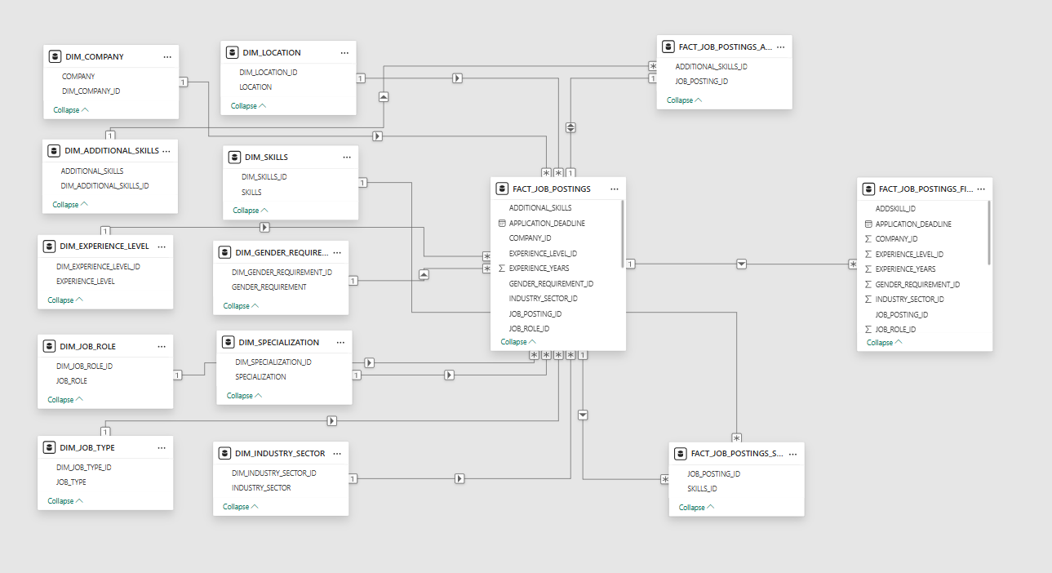
Data Modelling
This shows database schema with multiple interconnected tables. The schema appears is snowflake type due to its normalized structure, where some tables are connected to other tables that are not directly linked to the central fact table. The Snowflake schema is a highly normalized database structure where dimension tables are split into related sub-dimensions, reducing data redundancy. The central fact table connects to dimension tables through primary-foreign key relationships.

Slide 15
AGENDA
1
UseCase
2
Data Extraction
3
Data Ingestion
4
Medallion Architecture – Bronze Layer
5
Medallion Architecture – Silver Layer
6
Data Modelling
7
Medallion Architecture – Gold Layer

Slide 16
Medallion Architecture – Gold Layer
Objective: KPI Models for HR & Jobseekers
Built KPI models on top of the core fact table core_job_postings_final.
Created dimension tables for company, location, job_type, gender, and experience level.
Applied business logic to extract insightful metrics for HR and jobseekers.
Input: Core table (cleaned, transformed job data).
Dimension Integration: Joined relevant dimensions.
Metric Aggregation: Calculated KPIs like demand, diversity, urgency.
Model Structuring: Separate dbt models for each KPI use-case.
Materialization: Final results stored as tables in gold_mart_hr and gold_mart_jobseeker.
Outcome:
Enables role-based analytics for different user personas.
Supports dashboarding and stakeholder reporting with ready-to-use marts.

Slide 17
AGENDA
8
KPIs Overview
9
Reports
10
Challenges & Solutions
11
Impact & Applications
12
Future Enhancements
13
Conclusion
14
Q&A

Slide 18
KPIs Overview
Objective: Targeted Metrics for Hr and Jobseeker Analysis
HR-Focused KPIs help assess:
Gender diversity in job postings
Urgent openings nearing deadlines
Experience level demand across roles
Top hiring companies and their vacancy counts
Salary vs job type analysis
Geographical demand across sectors
Jobseeker-Focused KPIs help with:
Finding location-specific opportunities
Tracking job vacancy trends over time
Evaluating salary benchmarks by role/type
Identifying urgent job roles to act fast
Mapping gender-aligned roles
Filtering jobs by experience suitability
All KPIs were built using fact_job_postings and associated dimension tables, powered by dbt models in the Gold layer for dashboard readiness and reporting.

Slide 19
AGENDA
8
KPIs Overview
9
Reports
10
Challenges & Solutions
11
Impact & Applications
12
Future Enhancements
13
Conclusion
14
Q&A

Slide 20
Reports
Objective: Data-Driven Insights for HR and Jobseekers
HR Report: Data Overview The HR report aggregates job postings, including critical details like vacancies, salary, and experience level, alongside key attributes such as company, location, industry sector, and job role.
Key Features:
Data from fact and dimension tables.
Joined with bridge tables for multi-valued attributes (skills, additional skills).
Tracks job vacancies, salary in LPA, and experience requirements.
Job Seeker Report: Insights for Candidates A job seeker-focused report designed to help candidates filter jobs based on their preferences, such as salary, experience, and location.
Key Features:
Similar structure to HR report but tailored for job seekers.
Includes skills and additional skills linked to job postings.
Salary in LPA, experience levels, and application deadlines are emphasized for job seekers.

Slide 21
AGENDA
8
KPIs Overview
9
Reports
10
Challenges & Solutions
11
Impact & Applications
12
Future Enhancements
13
Conclusion
14
Q&A

Slide 22
Challenges & Solutions
Objective: Overcoming challenges for consistent and better Job Portal Insights
Handling Multi-Value Fields (e.g., Skills, Experience)
Problem: Many job postings contain multiple skills or experience levels, which need to be captured and mapped accurately.
Solution:
Implemented bridge tables in the data model to handle many-to-many relationships, ensuring that multiple skills, experience levels, and other multi-valued attributes are captured and linked to job postings correctly.
Inconsistent Salary Formats
Problem: Salary data appears in various formats, including monthly, annual, and range formats (e.g., “50000 p.m.”, “3-5 LPA”).
Solution:
Applied complex regex transformations in dbt to clean and convert all salary data into a consistent annual salary format, ensuring uniformity for reporting and analysis.

Slide 23
AGENDA
8
KPIs Overview
9
Reports
10
Challenges & Solutions
11
Impact & Applications
12
Future Enhancements
13
Conclusion
14
Q&A

Slide 24
Impact & Applications
Objective: Transforming HR Decision-Making and Jobseeker Insights
Impact of the Project:
HR Decision-Making: Improves talent acquisition and workforce planning by providing data-driven KPIs such as gender diversity, location demand, and experience level distribution.
Jobseeker Experience: Offers personalized job recommendations and insights into market trends, helping job seekers make better career choices.
Data-Driven Insights: Real-time KPIs and reports help businesses and job portals adjust strategies based on evolving market needs.
Applications:
Talent Acquisition: Refine recruitment strategies and optimize efforts for high-demand locations and roles.
Workforce Planning: Forecast job needs and identify skill gaps for future hiring.
Industry Benchmarking: Compare recruitment efforts with industry trends to stay competitive.
Job Portal Enhancement: Personalize job recommendations and improve user experience for job seekers.
Career Development: Guide individuals in choosing in-demand roles and skills for better career growth

Slide 25
AGENDA
8
KPIs Overview
9
Reports
10
Challenges & Solutions
11
Impact & Applications
12
Future Enhancements
13
Conclusion
14
Q&A

Slide 26
Future Enhancements
Automation, Real-Time Data, and Scalability
Automated Data Loading with Hooks and Triggers:
Adding Database Hooks and Triggers to automatically load new job postings in real time as soon as they are posted on the job portal. This ensures the data pipeline is continuously updated without manual intervention.
Real-Time Job Analysis:
Implement real-time data streaming for continuous analysis of job trends, skill demand, and hiring patterns. This allows for dynamic and up-to-date insights that reflect the latest market conditions.
Data Ingestion from Multiple Sources:
Use webhooks and API integrations to ingest data from multiple job portals and HR systems for a holistic view of the job market, enabling continuous updates and more reliable insights.
Dynamic Reporting and KPI Monitoring:
Integrate real-time KPI dashboards that update automatically as new job postings are processed, allowing HR teams and job seekers to make data-driven decisions on the fly.

Slide 27
AGENDA
8
KPIs Overview
9
Reports
10
Challenges & Solutions
11
Impact & Applications
12
Future Enhancements
13
Conclusion
14
Q&A

Slide 28
Conclusion
………………………….
Successfully built a scalable and modular data pipeline for job portal analysis.
Leveraged Snowflake, dbt, and Medallion Architecture for efficient data organization.
Delivered actionable KPIs and reports for both HR teams and job seekers.
Solved real-world data challenges through thoughtful modeling, bridge tables, and reporting layers.
Set the stage for future enhancements like real-time ingestion, automation, and predictive insights.

Slide 29
AGENDA
8
KPIs Overview
9
Reports
10
Challenges & Solutions
11
Impact & Applications
12
Future Enhancements
13
Conclusion
14
Q&A

Slide 30
Q&A

Slide 31
THANK YOU
paluri.v@jmangroup.com
….

