Slide 1
IBM University Engagement Project Submission
“Exploring the Power of Agentic AI with IBM Granite and IBM Watsonx.ai”

Slide 2
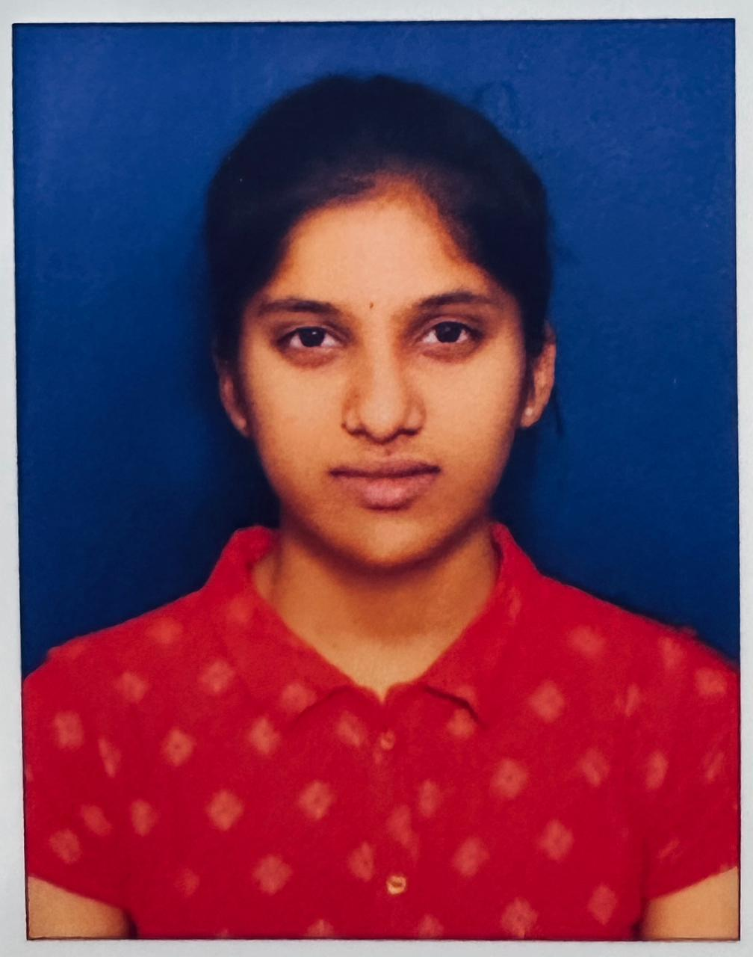
Project Title – JalDrishti-AI : AI-Powered Improved Drinking Water Access Analytics
Domain of Project – Water, Health & Sanitation
Student Name | Recent Passport Photo | Email ID | Mobile number [WhatsApp]
Paripelli Varshini |  | Varshiniparipelli@gmail.com | 7569813678

Slide 3
Problem Statement
Problem Statement #38: Improved Source of Drinking Water
The Challenge
Safe drinking water remains a critical issue in India. MIS 78th Round data shows 95.7% improved access nationally, but Kerala (55.2%), Lakshadweep (73.8%) and Manipur (75.6%) lag behind. Piped water covers only 24.8% of rural vs 61.5% of urban areas.
The Objective
Analyse MIS 78th Round (AI Kosh: nss78_21.xlsx) for evidence-based policy insights:
State-wise Water Access Analysis – improved access across 37 States & UTs
Rural–Urban Disparity Mapping – visualise the rural–urban gap
AI-Powered Prediction – IBM Watson ML (GradientBoosting, 5-Fold CV MAE: 4.97 pp)
Generative AI Policy Insights – IBM watsonx.ai Granite-4 recommendations
SDG 6.1 Progress Tracker – annual rate and 2030 projection
Interactive Dashboard – 6 KPI cards + 7 Plotly charts
Live AI Chat – Granite-4 answers water-access questions in real time

Slide 4
Proposed Solution
Proposed Solution: JalDrishti-AI — AI-Powered Water Access Analytics Platform
JalDrishti-AI is an end-to-end AI analytics platform built on IBM watsonx.ai, Watson ML, Cloud Object Storage and Db2. It analyses the real MIS 78th Round dataset (nss78_21.xlsx — 222 data points, 37 States & UTs) for SDG 6.1 insights.
Four key layers:
1. Data Analysis Layer – pandas KPIs, piped water coverage, rural–urban gaps.
2. IBM Watson ML Layer – GradientBoosting on 72 state × sector points; 5-Fold CV MAE 4.97 pp; Train MAE 3.46 pp.
3. IBM watsonx.ai Granite Layer – ibm/granite-4-h-small for policy insights, state recommendations and chat.
4. IBM Cloud Storage Layer – dataset in Cloud Object Storage (jaldrishti-data-bucket), analytics in Db2.
A Flask dashboard (HTML + Plotly.js) adds 6 KPI cards, 7 charts, an AI predictor, an SDG 6.1 tracker and a live IBM Granite chat assistant.

Slide 5
Technology Used
IBM watsonx.ai — ibm/granite-4-h-small for live policy insights, state recommendations and chatbot. Project ID: d35a6f68-c129-4634-b823-ff9583f7fde6.
IBM Watson ML (Lite) — GradientBoosting on 72 state × sector points; 5-Fold CV MAE 4.97 pp; REST scoring.
IBM Cloud Object Storage (Lite, 25 GB) — nss78_21.xlsx in jaldrishti-data-bucket (us-south) via ibm_boto3.
IBM Db2 on Cloud (Lite, 200 MB) — table MIS_DRINKING_WATER; SSL connection via ibm_db.
IBM Watson Assistant (Lite, 10,000 msgs/month) — fallback chatbot when watsonx.ai is unavailable.
Python 3 + Flask — REST backend (16 endpoints) with pandas, scikit-learn, joblib.
Plotly.js — 7 interactive charts: state bar, sector comparison, piped vs improved, rural-urban gap, top/bottom 10, SDG 6.1 tracker.

Slide 6
IBM watsonx.ai & IBM Cloud Components Used
1) IAM Authentication — POST https://iam.cloud.ibm.com/identity/token exchanges the API key for a short-lived bearer token for all watsonx.ai and Watson ML calls.
2) watsonx.ai Text Generation — POST /ml/v1/text/generation?version=2024-05-01 with ibm/granite-4-h-small for policy insights, state recommendations and chat.
3) Watson ML Model Scoring — POST /ml/v4/deployments/{id}/predictions; GradientBoosting trained on 72 state × sector samples.
4) Cloud Object Storage SDK (ibm_boto3) — upload/download nss78_21.xlsx; bucket: jaldrishti-data-bucket; endpoint: https://s3.us-south.cloud-object-storage.appdomain.cloud
5) Db2 on Cloud (ibm_db) — CREATE TABLE MIS_DRINKING_WATER; GROUP BY state, sector queries; SSL port 50001; database: bludb.
6) Watson Assistant v2 — create_session and message calls for water-access Q&A; fallback when watsonx.ai is unavailable.

Slide 7
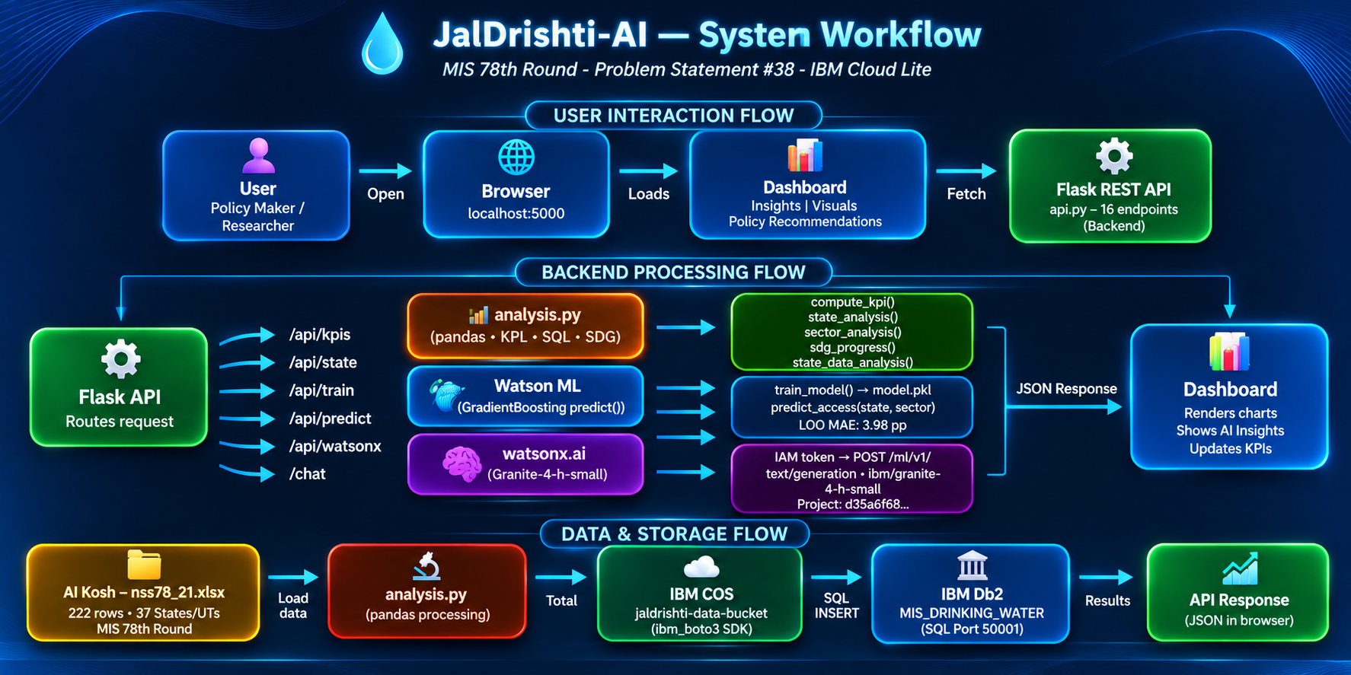
Workflow

Slide 8
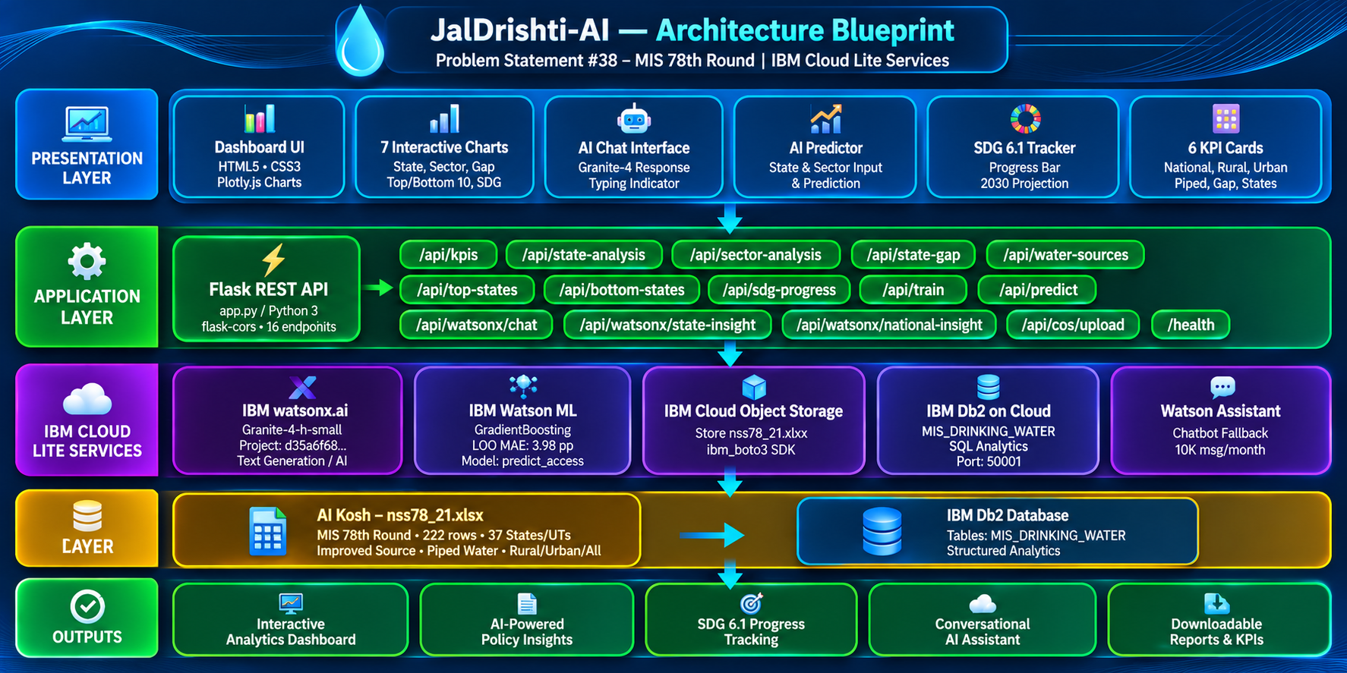
Architecture

Slide 9

Role of IBM watsonx.ai Granite AI in JalDrishti-AI
IBM watsonx.ai makes JalDrishti-AI an intelligent, autonomous policy analytics system, not a static dashboard. Its ibm/granite-4-h-small model delivers data-grounded insights from the real MIS 78th Round survey.
Three roles: national policy insights, per-state water access recommendations, and live answers to user questions.
It is context-aware: e.g. Bihar (rural 99.2%, piped 13.3%) → Granite recommends piped infrastructure investment, generated fresh on every API call.
Chat uses a priority chain: Granite first, Watson Assistant second, local fallback third.
Overall: proactive, personalised and evidence-driven — a smart AI water policy analyst for SDG 6.1.

Slide 10
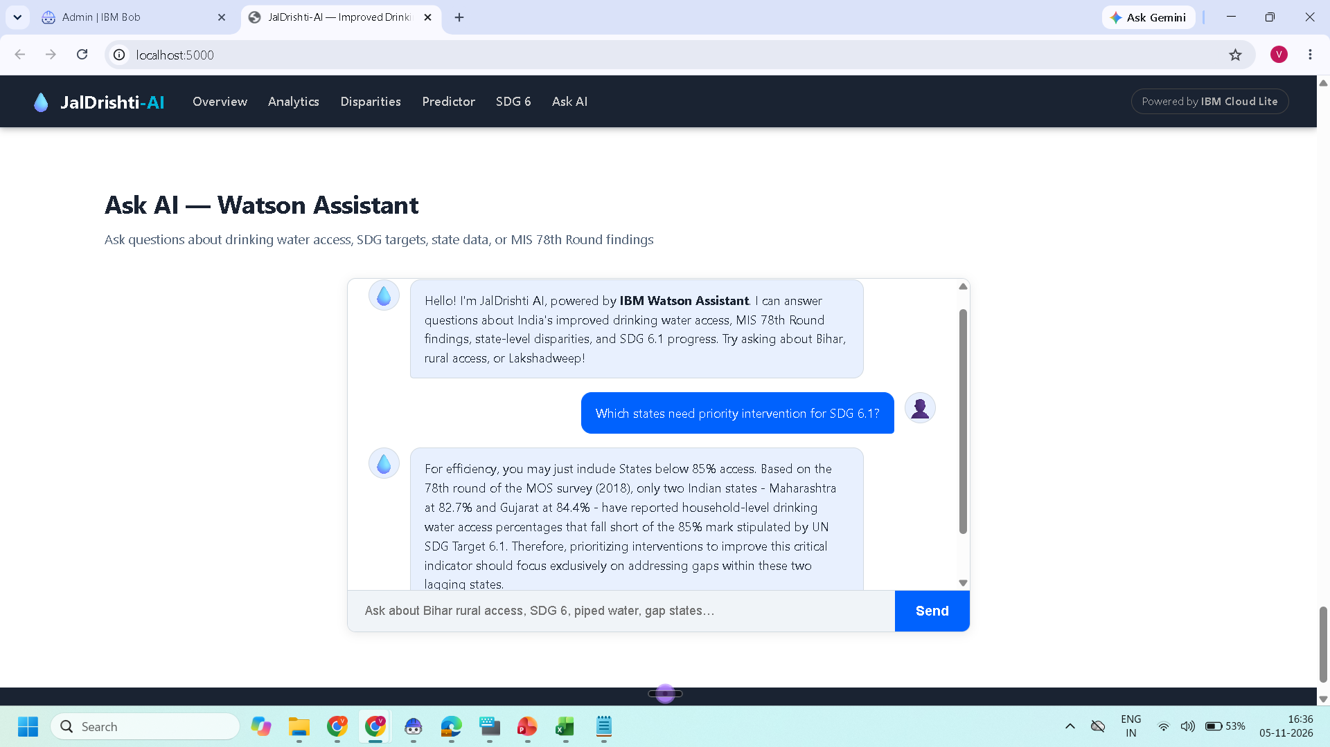
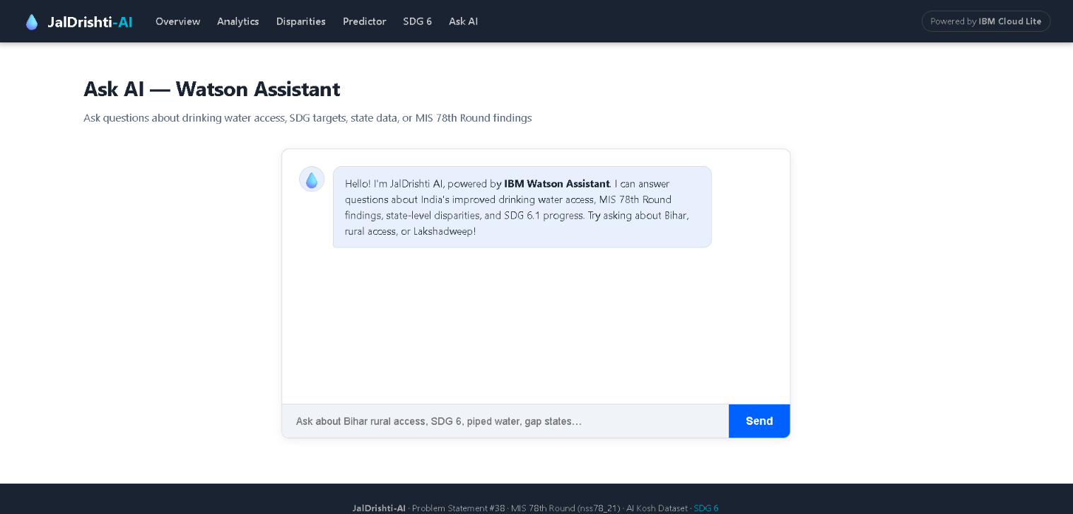
Token Usage
Token Usage — IBM watsonx.ai
Before Prompt
After the Prompt

Slide 11
Novelty and Uniqueness
JalDrishti-AI combines real government survey data, IBM Granite AI and a full-stack dashboard into one evidence-based policy tool.
1. Real Dataset — AI Kosh MIS 78th Round (nss78_21.xlsx): 222 real data points across 37 States & UTs, not synthetic data.
2. Live AI Policy Generation — Granite-4 writes state-specific recommendations on demand from actual rural, urban and piped %.
3. End-to-End IBM Cloud Lite Integration — watsonx.ai, Watson ML, Object Storage and Db2 wired with a real Project ID (d35a6f68...) and live API key.
4. SDG 6.1 Alignment — annual improvement rate (+3.21%/year), 2030 projection (100%) and on-track status.
5. Equity-Focused Disparity Analysis — rural–urban gap chart and Bottom-10 ranking highlight Kerala (55.2%), Lakshadweep (73.8%), Manipur (75.6%).
6. Dual AI Stack — GradientBoosting predictor (5-Fold CV MAE 4.97 pp) plus Granite-4 narrative insights.

Slide 12
GitHub Link
GitHub Repository: https://github.com/varshiniparipelli/JalDrishti-AI
Live Application (Render): https://jaldrishti-ai-4.onrender.com/

Slide 13
Future Scope
1. Real-Time Data Pipeline — integrate Jal Jeevan Mission and NITI Aayog APIs for live SDG 6.1 monitoring.
2. Multi-Indicator SDG Dashboard — add cooking fuel, sanitation and migration to cover Goals 3, 6, 7 and 11.
3. IBM Watson NLU — extract insights from NITI Aayog reports, state water policies and budgets.
4. District-Level Intervention Scoring — add HDI, literacy and poverty data to predict districts below 80% access by 2027.
5. Mobile-First PWA on IBM Cloud Foundry — field access for district water officers, NGOs and officials.
6. Hindi and Regional Language Support — Granite multilingual answers in Hindi, Tamil, Telugu and Bengali.

Slide 14
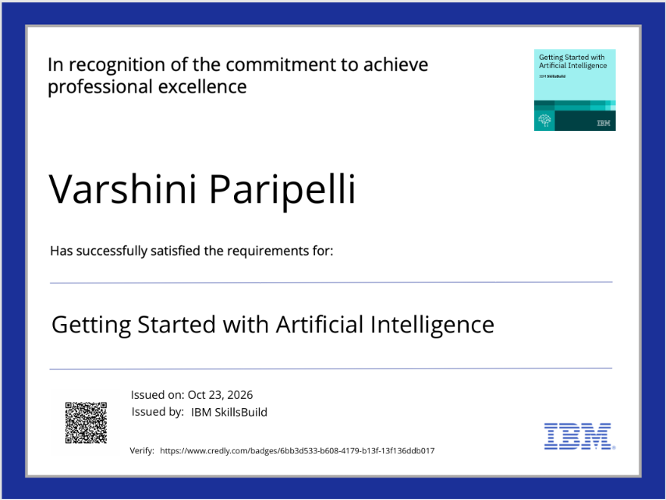
Certificates Earned
Credly Certificate

Slide 15
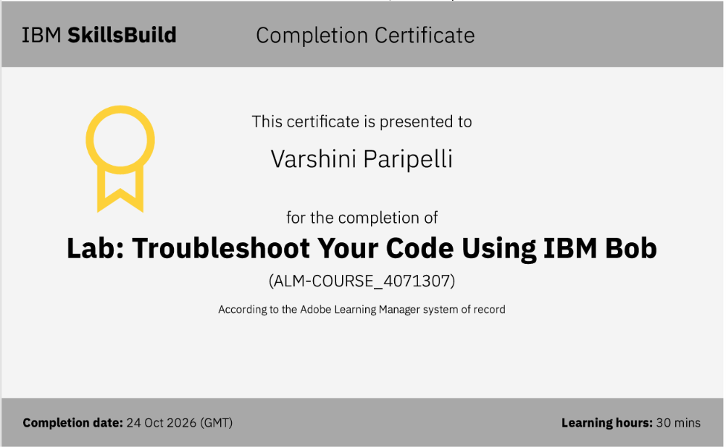
Certificates Earned
IBM Bob Certificate

Slide 16


