Slide 1

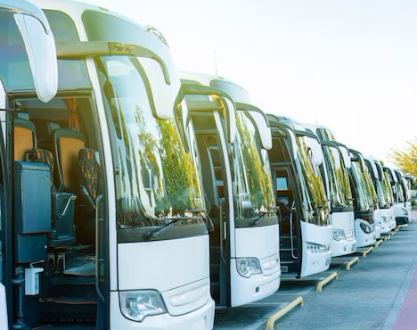
Panimalar Engineering College
Department of CSE
TOUR PACKING AND TICKET BOOKING SYSTEM
Project done by
VARSHINI.R (211422104528)
SRINITHI.A (211422104479)
Under the guidance of
Mrs.DEEPA

Slide 2
ABSTRACT
The system simplifies online bus ticket tour package booking system with real-time seat availability and secure payment options.
Operators can manage routes, schedules, and fleets, optimizing services for efficient operations.
Reporting and analytics provide insights into ticket sales and revenue for data-driven decisions.
It enhances overall travel experience by streamlining workflows and offering a user-friendly platform for passengers.
This presentation uses a free template provided by FPPT.com
www.free-power-point-templates.com

Slide 3
PROBLEM STATEMENT
The traditional bus ticketing process is inefficient, with limited real-time seat availability and cumbersome booking methods, leading to passenger frustration and operational challenges for operators. Outdated payment systems and a lack of analytical tools hinder decision-making and service quality.
SOLUTION
Current methods rely on manual bookings and paper-based ticketing, causing difficulties for passengers in accessing real-time information and compromising payment security. Operators struggle with route and schedule management, resulting in service disruptions and customer dissatisfaction.

Slide 4
EXISTING SYSTEM
The current bus ticketing system relies on manual bookings and paper-based ticketing, making it difficult for passengers to access real-time information on routes and seat availability.
This leads to frustration due to last-minute changes or unavailability. Operators face challenges in managing routes and schedules, resulting in inefficiencies and service disruptions.
Additionally, the lack of data analytics prevents optimization of services, while cash payment reliance increases fraud risk. Overall, these methods create a fragmented experience, highlighting the need for a more efficient and secure solution.
This presentation uses a free template provided by FPPT.com
www.free-power-point-templates.com

Slide 5
PROPOSED SYSTEM
The Tour and Ticket Management System is a web-based application designed to improve the bus ticket tour package booking system process for passengers and operators.
It features a user-friendly interface for easy route searching and real-time seat availability, along with secure payment integration for safe transactions.
Operators benefit from management tools for routes and schedules, while real-time data updates ensure accurate information.
The system also includes analytics and reporting tools for data-driven decision-making, and is designed for scalability to accommodate future enhancements. Overall, it aims to streamline operations and enhance the travel experience.
This presentation uses a free template provided by FPPT.com
www.free-power-point-templates.com

Slide 6
TECHNOLOGIES USED
Frontend Development: HTML, CSS, and JavaScript for creating a user-friendly interface.
Backend Development: Python (Django) or Java (Spring Boot) for handling server-side operations and business logic.
Database: MySQL or PostgreSQL for storing user, booking, and operator data.
Payment Gateway: Secure payment integration using APIs like Stripe or PayPal.
Real-time Data: WebSocket or AJAX for real-time seat availability and updates.
Analytics and Reporting: Custom-built reporting dashboards for performance tracking and data insights.

Slide 7
LITERATURE SURVEY
Topic | Description | Author | Year
1. User Experience in Online Booking | This study explores the significance of user interface design and user experience in online booking systems ,emphasizing that a user-friendly design increases customer satisfaction and conversion rates | Shresth aetal | 2020
2. Security Challenges in E commerce | This paper reviews the security threats faced by e-commerce platforms, particularly focusing on online payment systems. It discusses various methods to enhance security, such as encryption and two-factor authentication | Gupta & Kumar | 2019
3. Dynamic Pricing Models | The research examines the effectiveness of dynamic pricing in various industries, including transportation. It discusses how dynamic pricing can optimize revenue but also raises ethical concerns about customer per caption and trust. | Chen & Wang | 2021
4. Integration of Third-Party Services | This article analyses the challenges and benefits of integrating third-party services in booking systems, such as airlines and car rentals ,highlighting theimportanceofAPIsandinteroperabilityforseamlessuserexperiences. | Martin & Smith | 2022
5. Sustainable Transportation Solutions | . This study discusses the role of technology in promoting sustain able travel, including the adoption of electric vehicles and carbon foot print tracking in booking systems. It emphasizes the need for the travel industry to adopt eco-friendly practices | Johnson & Green | 2023

Slide 8
LITERATURE SURVEY
Topic | Description | Author | Year
6. .Adoption of Technology by Operators | The paper investigates the barriers that bus operators face when adopting new technologies in booking systems, including cost, training, and resistancetochange.Itsuggestsstrategiestofacilitatethetransition. | Lee & Tan | 2020
7. Fleet Management in Transportation | This research reviews fleet management systems and their impact on operational efficiency, focusing on real-time tracking and maintenance scheduling to optimize service delivery in the transportation sector. | Patel & Agarwal | 2021
8. Customer Trust in Online Transactions | This paper explores factors influencing customer trust in online transactions , particularly in the context of travel and booking systems. It highlights the importance of transparency, security measures, and customer service inbuilding trust | Williams et al. | 2018
9. Data-Driven Decision Makin | This study discusses the importance of analytics and reporting tools in the travel industry, emphasizing how data can be leveraged for decision making , optimizing routes , and improving service offerings for operators. | Singh & Bansal | 2022
10. Impact of COVID-19onTravel Booking | This article analyzes how theCOVID-19pandemic has affected travel booking systems, including changes in consumer behavior, the rise of contactless services, and the increased importance of health and safety features in booking applications | Brown & Jones. | 2021

Slide 9
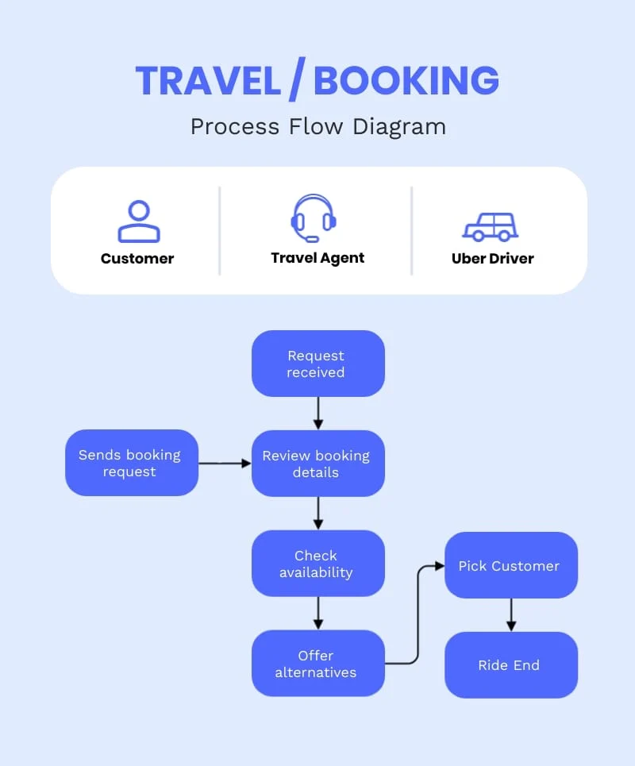
ARCHITECTURE DIAGRAM

Slide 10
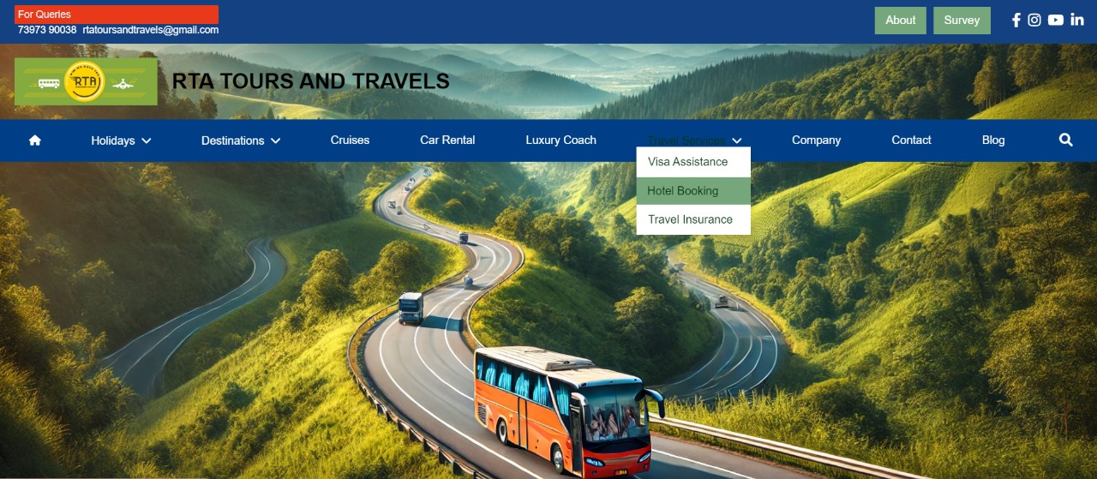
HOME PAGE

Slide 11
METHODOLOGY
The development of the Tour and Ticket Management System involves gathering requirements through stakeholder analysis, followed by designing a robust architecture and user-friendly interfaces.
The implementation includes front-end and back-end development, rigorous testing, and deployment on a cloud platform. Continuous maintenance and user feedback will guide iterative improvements to meet evolving needs.
This presentation uses a free template provided by FPPT.com
www.free-power-point-templates.com

Slide 12
ADVANTAGES & DISADVANTAGES
Advantages:
Streamlined Booking: Easy online ticket booking improves the user experience.
Real-Time Availability: Passengers can view real-time seat availability, reducing overbooking.
Operational Efficiency: Operators can better manage routes, schedules, and fleets, ensuring timely service.
This presentation uses a free template provided by FPPT.com
www.free-power-point-templates.com

Slide 13
FUTURE SCOPE
Mobile Application Development: Expanding the platform into a mobile app for easier access and booking on-the-go.
Enhanced Analytics Features: Implementing advanced analytics and AI for predictive insights, personalized recommendations, and dynamic pricing strategies.
Sustainability Initiatives: Developing features that promote eco-friendly travel options and carbon footprint tracking.
This presentation uses a free template provided by FPPT.com
www.free-power-point-templates.com

Slide 14
CONCLUSION
The Tour and Ticket Management System represents a significant advancement in the bus ticketing industry, addressing existing inefficiencies and enhancing both passenger experience and operator capabilities. By leveraging modern technology, it facilitates a seamless booking process, improves operational efficiency, and provides valuable insights for data-driven decision-making. As the industry evolves, continued improvements and adaptations will ensure the system remains relevant and effective in meeting user needs.
This presentation uses a free template provided by FPPT.com
www.free-power-point-templates.com

Slide 15
REFERENCES
Shrestha, et al. (2020). User Experience in Online Booking Systems.
Gupta, & Kumar. (2019). Security Challenges in E-commerce.
Chen, & Wang. (2021). Dynamic Pricing Models in Transportation.
Johnson, & Green. (2023). Sustainable Transportation Solutions.
Singh, & Bansal. (2022). Data-Driven Decision Making in the Travel Industry.

Slide 16
THANK YOU

