Slide 1

Sreyas Institute of Engineering and Technology
An Autonomous Institution
Approved by AICTE, Affiliated to JNTUH
Accredited by NAAC-A Grade, NBA (CSE, ECE & ME) & ISO 9001:2015 Certified
PROJECT
ON
DEVSECOPS METRICS DASHBOARD FOR EXECUTIVE INSIGHTS
BACHELOR OF TECHNOLOGY
IN
COMPUTER SCIENCE AND ENGINEERING
BY
CHITTIMALLA ASHWITH 22VE1A0575
K. VISWAS REDDY 22VE1A0582
M. SHASHIKANTH REDDY 22VE1A0595
M. VARSHINI REDDY 22VE1A0599
T.ISHA 22VE1A05B9
SUBJECT : DEVOPS

Slide 2
INTRODUCTION
In today’s fast-paced software environment, organizations must deliver quality software quickly without compromising security.
DevSecOps integrates development, security, and operations to ensure security is embedded throughout the CI/CD pipeline.
However, teams face challenges in tracking and visualizing performance and security metrics spread across multiple tools like Jenkins, Prometheus, and others.
This project — DevSecOps Metrics Dashboard — provides a centralized platform to monitor, analyze, and visualize CI/CD performance and security data in real-time.
The dashboard bridges the gap between technical operations and executive-level insights, enabling faster and more informed decision-making.
It promotes data-driven governance by transforming raw CI/CD and monitoring data into meaningful visual insights.

Slide 3
WHAT IS DEVSECOPS?
DevSecOps integrates Development, Security, and Operations to ensure secure software delivery.
It embeds security checks and monitoring throughout the CI/CD pipeline rather than adding them at the end.
Focuses on automation, continuous monitoring, and faster, safer releases.
IMPORTANCE OF METRICS DASHBOARD IN DEVSECOPS
Provides real-time visibility into pipeline health and performance metrics.
Enhances traceability, compliance, and decision-making through integrated dashboards.
Reduces manual effort by automating monitoring and reporting.
Supports a data-driven security approach by tracking vulnerabilities and deployment trends.

Slide 4
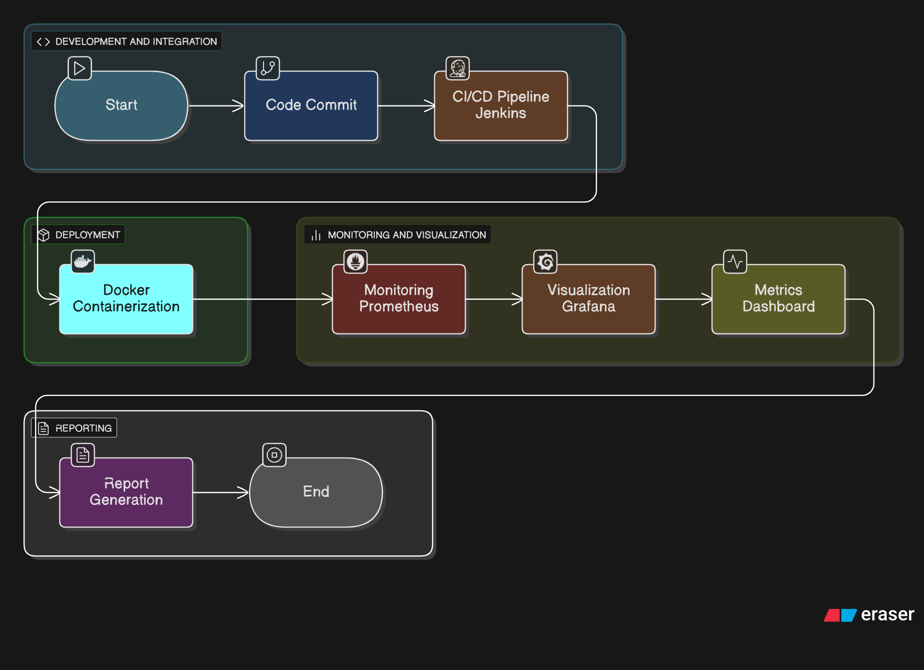
ARCHITECTURE
Jenkins Pipelines: Automate build, test, and deployment processes.
Docker: Containers run Jenkins agents and monitored services in isolated environments.
Prometheus: Collects performance and pipeline metrics from Jenkins and Docker.
Grafana: Visualizes these metrics in real-time through interactive dashboards.
Developer

Slide 5
IMPLEMENTATION
Jenkins Pipelines:
Created two pipelines – Python Pipeline (for application testing and validation) and Build-Metrics Pipeline
Jenkins automatically triggered builds on every code change from the GitHub repository.
Post-build actions pushed status data for monitoring and visualization.
Docker Integration:
Application was containerized using Docker to maintain environment consistency across builds.
Jenkins pipelines used Docker images during the build and test phases to ensure reproducibility.
Prometheus Setup:
Configured Prometheus to scrape metrics from Jenkins and Docker containers.
Used Jenkins Prometheus plugin for collecting job-level metrics such as build duration, success rate, and failure count.
Grafana Integration:
Grafana connected with Prometheus to create real-time dashboards.
Visualized build trends, job performance, and container health metrics.
Provided continuous insights into DevSecOps pipeline health and performance.

Slide 6
TECHNOLOGY STACK
Jenkins – for ci/cd automation and pipeline orchestration.
Docker – to containerize applications and ensure environment consistency.
Prometheus – for collecting and storing performance and build metrics.
Grafana – for real-time visualization and dashboard generation.
Github – for source code management and version control.
Python – used for sample application and script-based testing.

Slide 7
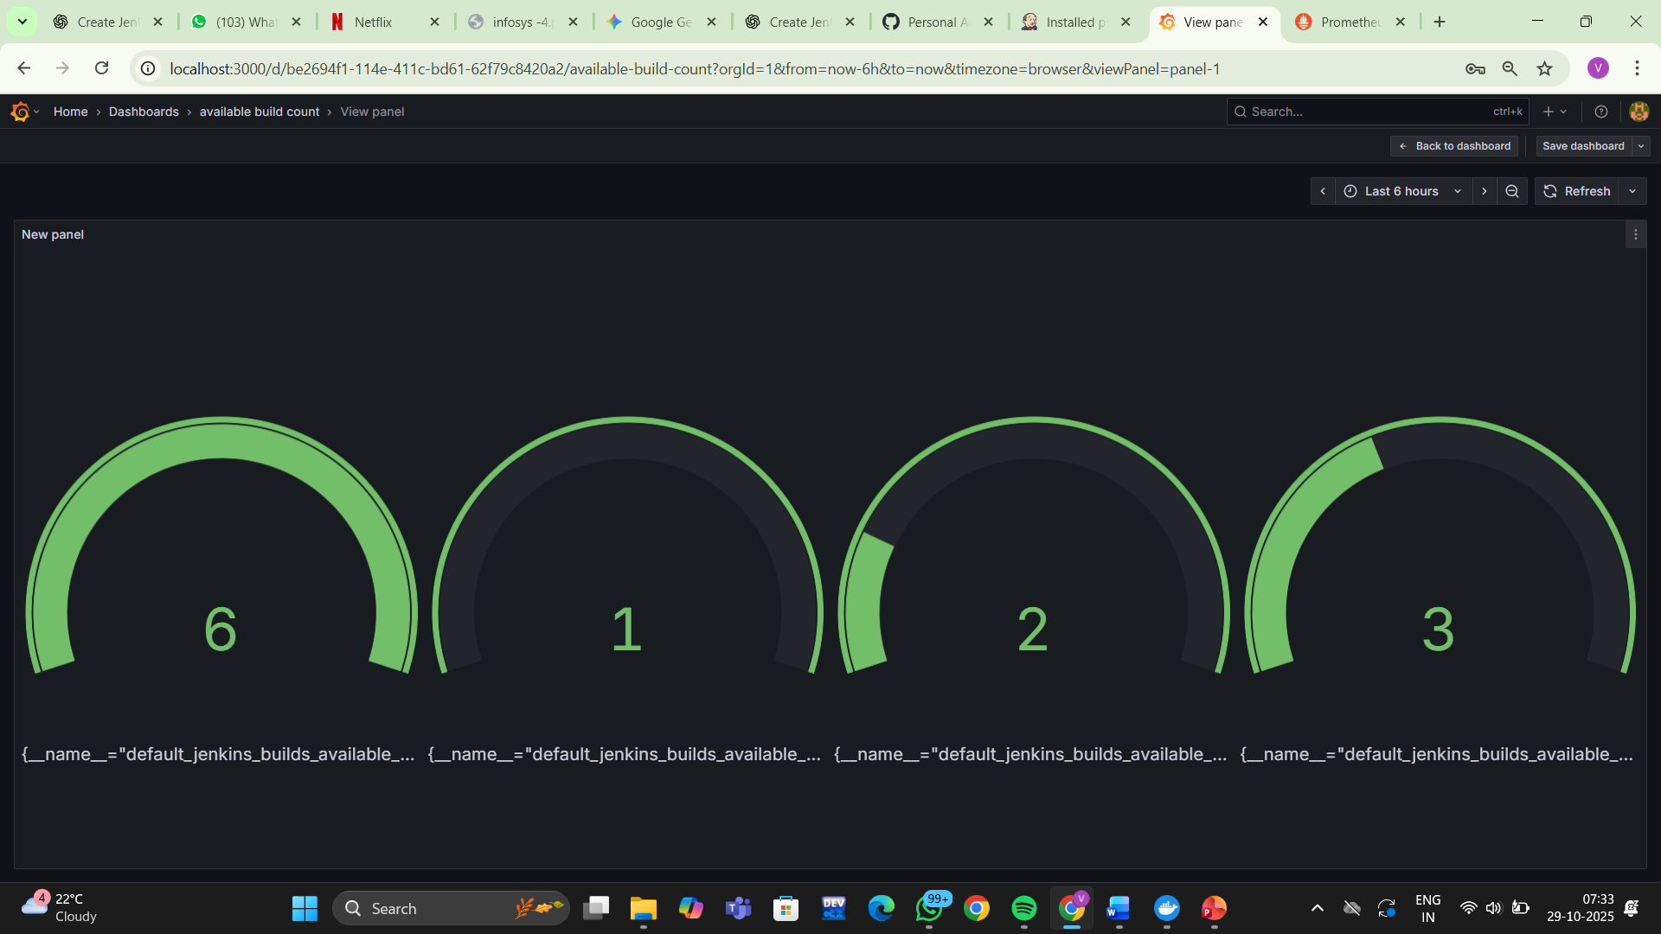
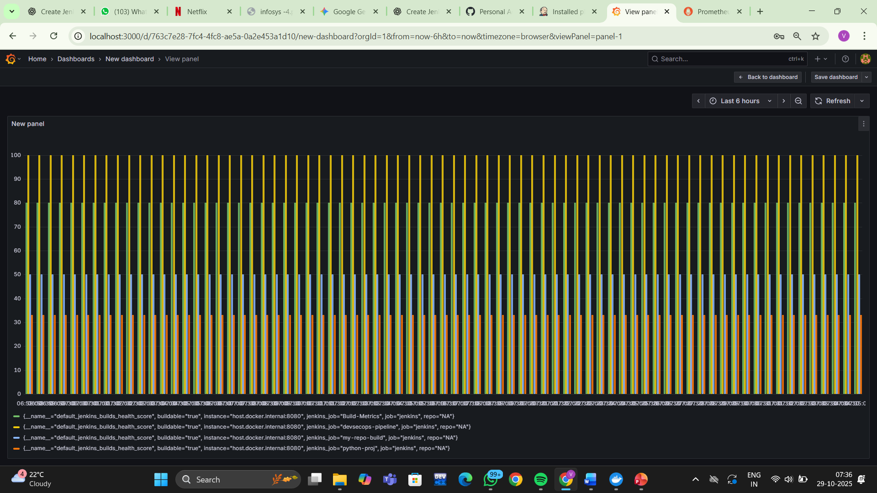
Output

Slide 8
THANK YOU!!

